Slide 1
Digital Portfolio
STUDENT NAME: KRISHNARAJ.D
REGISTER NO AND NMID: 24AID29,asbrubb24aid29
DEPARTMENT: AI & DS
COLLEGE: COLLEGE/ UNIVERSITY: VET INSTITUTE OF ARTS AND SCIENCE

Slide 2
PROJECT TITLE: DIGITAL PORTFOLIO
1.SimpleResponsiveWebsite
2. Quiz App
3. Personal Blog Design

Slide 3


AGENDA
Problem Statement
Project Overview
End Users
Tools and Technologies
Portfolio design and Layout
Features and Functionality
Results and Screenshots
Conclusion
Github Link
3/21/2024 Annual Review

Slide 4

PROBLEM STATEMENT
Many users struggle to find simple, interactive web apps for learning and personal expression that are easy to access on any device. 👉 **Goal**: Build a responsive website with an interactive JavaScript quiz app and a personal blog designed in CSS for better user experience on desktops and mobiles.

Slide 5

PROJECT OVERVIEW
Developed a simple website that works smoothly on desktops, tablets, and mobiles.
Integrated a JavaScript-based Quiz App to help users test their knowledge in various topics.
Created a personal blog section with CSS for easy customization and clean design.
Focused on responsiveness, user interactivity, and simple navigation.

Slide 6

WHO ARE THE END USERS?
Students looking for practice quizzes
Bloggers who want a simple platform for sharing posts.
Learners interested in simple, responsive websites for study purposes.

Slide 7

TOOLS AND TECHNIQUES
* **HTML** – Structure of website * **CSS** – Styling and responsiveness (Flexbox, Media Queries) * **JavaScript** – Quiz App functionality (questions, answers, scoring) * **VS Code** – Code editor * **Google Chrome** – Testing & debugging ---

Slide 8
POTFOLIO DESIGN AND LAYOUT
Clean, minimalistic layout * Responsive navigation bar * Mobile-friendly design (hamburger menu) * Simple color scheme for better readability * Separate sections for Home, Quiz App, and Personal Blog ---
8

Slide 9
FEATURES AND FUNCTIONALITY
✔ Responsive Design: Works on desktop and mobile devices
✔ Interactive Quiz App: – Multiple choice questions – Shows score at the end – User-friendly interface
✔ Personal Blog: – Easy to add posts – Simple CSS styling for clean layout
✔ Simple navigation bar for easy section switching

Slide 10
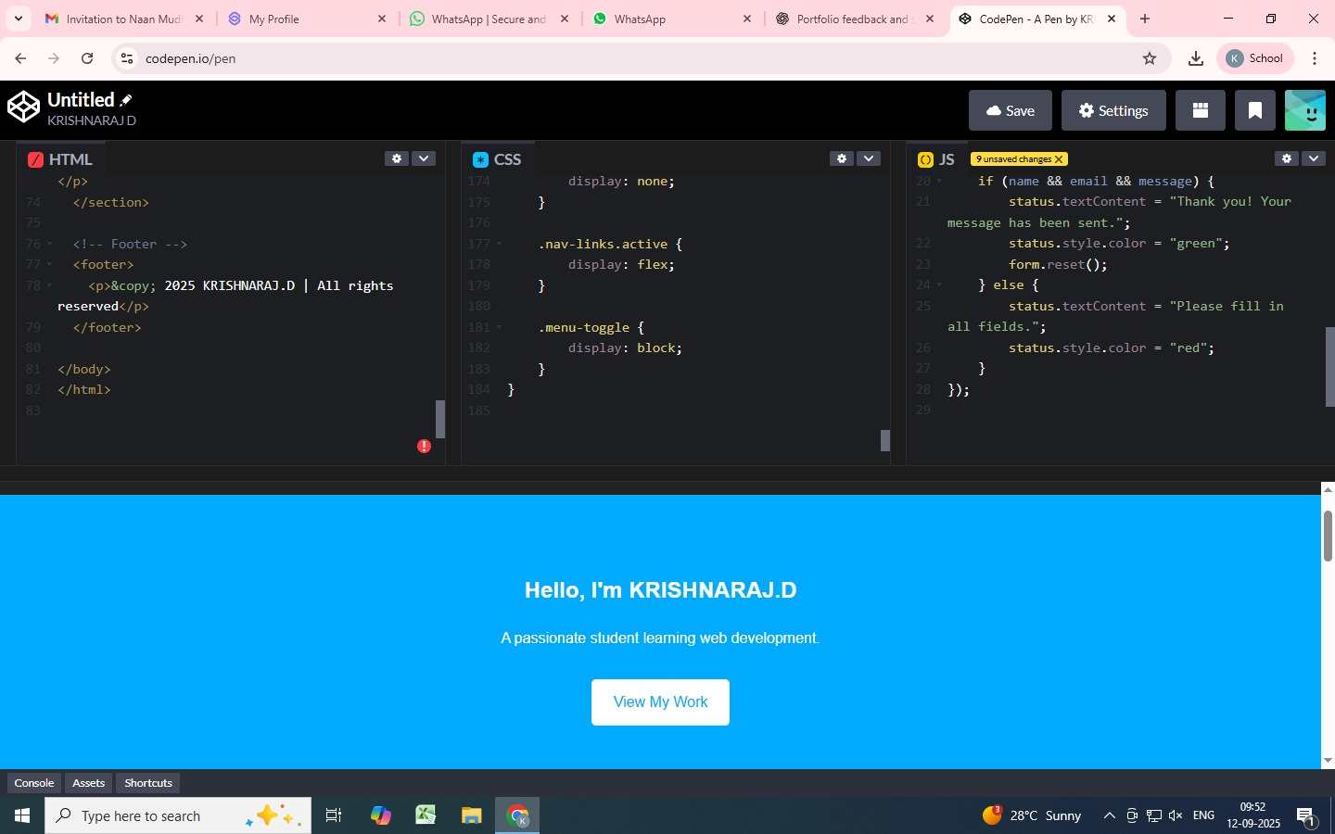
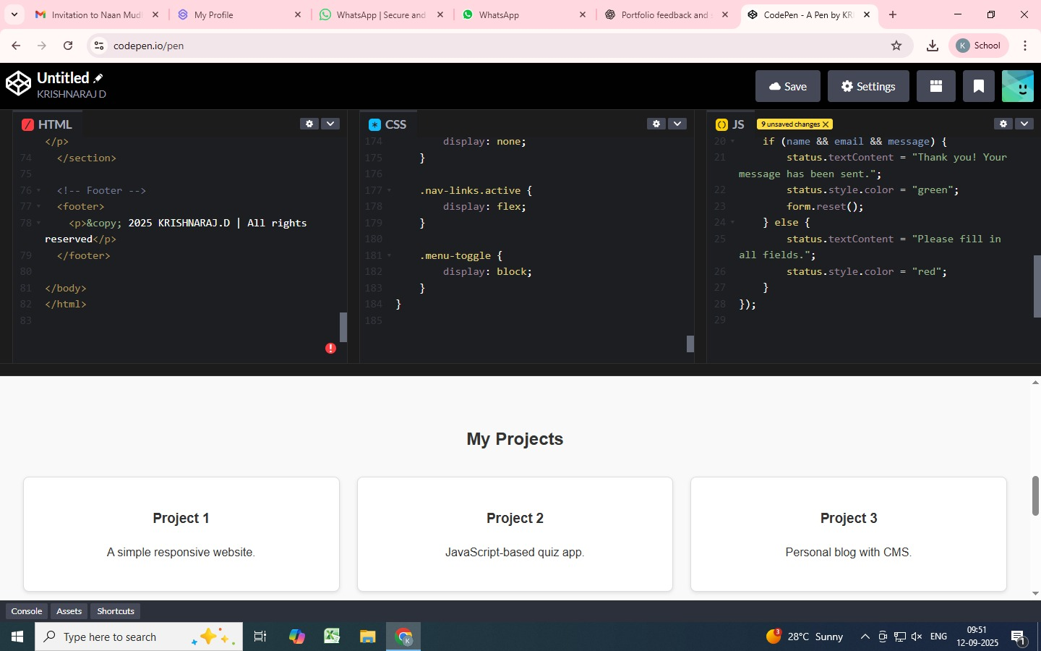
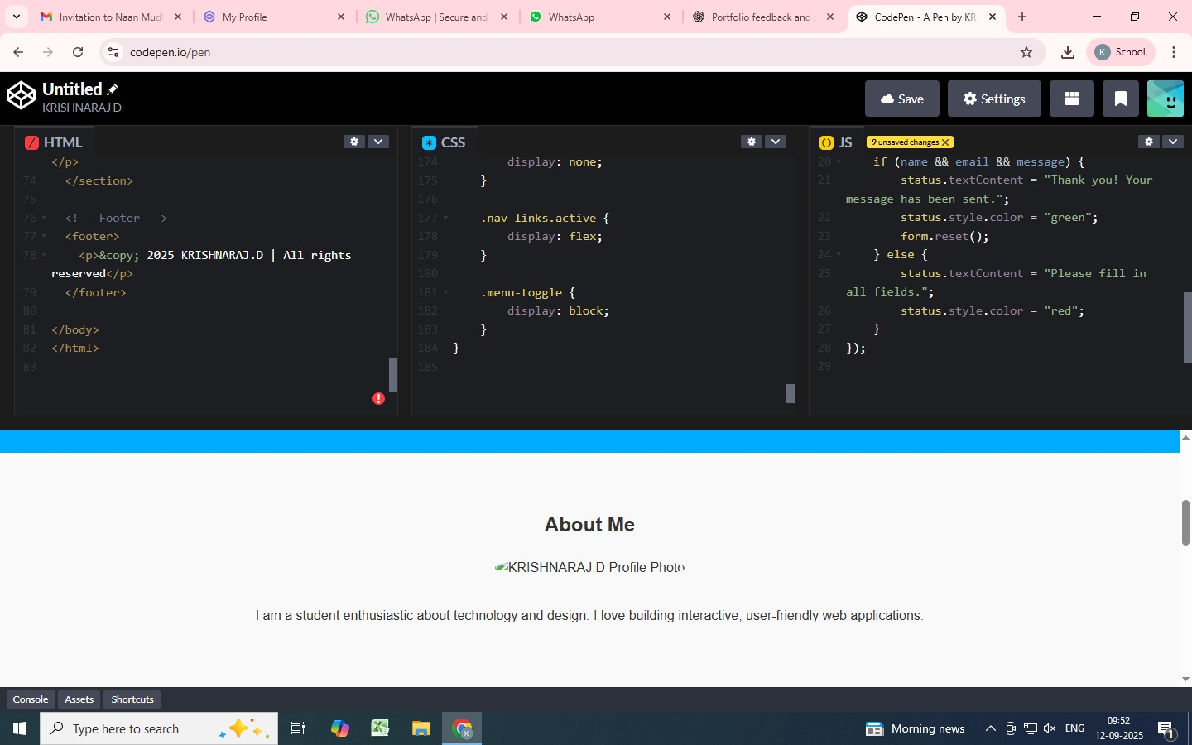
RESULTS AND SCREENSHOTS
3/21/2024 Annual Review
10

Slide 11
CONCLUSION
The Digital Portfolio project demonstrates the effective application of front-end web development skills to create a visually appealing, user-friendly, and responsive personal website. Through the use of modern technologies such as HTML, CSS, JavaScript, and responsive design principles, this portfolio provides a platform to showcase skills, projects, achievements, and contact information in a professional and accessible manner. It serves not only as a personal branding tool but also as a testament to the developer’s proficiency in front-end development. This project highlights the importance of UI/UX considerations and lays a strong foundation for further growth in both web development and digital presence.
11

Slide 12
GIT HUB LINK:
https://github.com/krishnarajd24aid-spec

