Slide 1

Collections

Slide 2

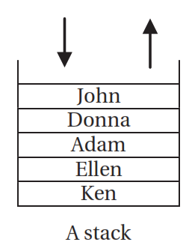
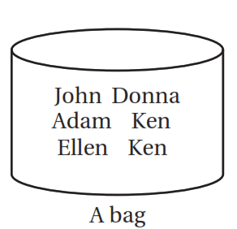
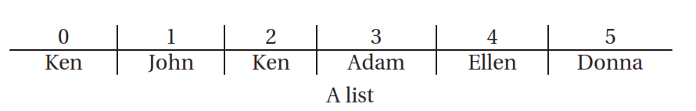
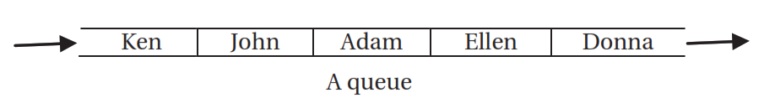
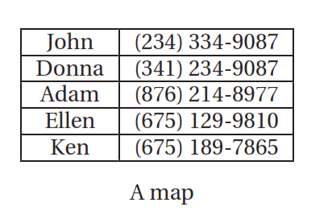
What is a Collection!!
A collection is an object that contains a group of objects.
Each object in a collection is called an element of the collection.
The designers of the Java language realized the need to manage different kinds of collections and incorporated a framework in the Java library, which is called the Collections framework.
Five types of collections
Notes:
You may observe that some collections enforce that an element must be added in a certain way to the collection and it must exit (be removed) the collection in a certain way. For example, in a queue, elements enter from one end and exit from the other end; in a stack, elements enter and exit from the same end.

Slide 3

Architecture of the Collection Framework
The Collections framework consists of three main components:
Interfaces
represent specific types of collections in the framework. There is one interface defined for every type of collection;
List<E> interface represents a list
Set<E> interface represents a set
Map<K,V> interface represents a map
Implementation classes
The Collections framework provides implementations of collection interfaces, which are called implementation classes.
Algorithm classes
Sometimes you need to perform different actions on a collection, such as searching through a collection, converting a collection of one type to another type, copying elements from one collection to another, sorting elements of a collection in a specific order, etc. The algorithm classes let you apply these kinds of algorithms to your collections.

Slide 4

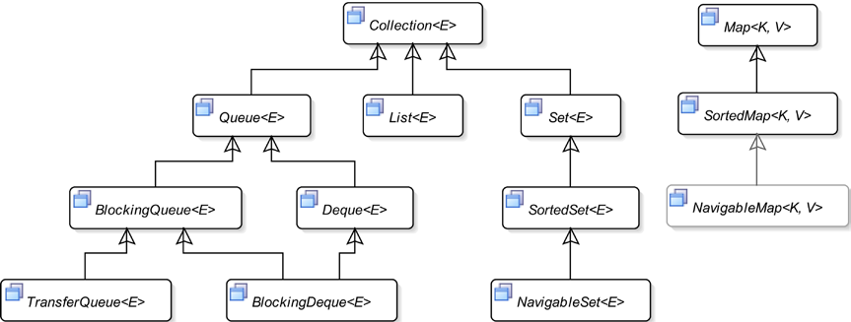
Interfaces that define the Collection

Slide 5

The Collection<E> Interface
Collections framework does not provide an implementation for the Collection interface. This is the most generic type of collection.
You can use it as an argument type in methods, where you do not care about the collection type of the argument, provided it isn’t a map.
It declares methods that are inherited by other types of collection interfaces.
Basic operations
int size()
boolean isEmpty()
boolean contains(Object o)
boolean add(E o)
boolean remove(Object o)
Iterator<E> iterator()
Bulk operations
boolean addAll(Collection<? extends E> c) void clear()
boolean containsAll(Collection<?> c)
boolean removeAll(Collection<?> c)
boolean retainAll(Collection<?> c))
Aggregate operations
default Stream<E> stream()
default Stream<E> parallelStream()
Array operations
Object[] toArray()
<T> T[] toArray(T[] a)
Comparison operations
boolean equals(Object o)
int hashCode()

Slide 6
Traversing Elements in Collections
Different types of collections store their elements differently.
Some collections impose ordering on their elements and some do not.
The Collections framework provides the following ways to traverse a collection:
Using an Iterator
Using a for-each loop
Using the forEach() method

Slide 7
Traversing Elements in Collections
Using an Iterator
The Iterator<E> interface contains the following methods:
boolean hasNext()
E next()
default void remove()
default void forEachRemaining(Consumer<? super E> action)
If the collection is modified, except using the remove() method, after the iterator is obtained, the attempt to access the next element will throw a ConcurrentModificationException
* An Iterator is a one-time object. You cannot reset an iterator. it cannot be reused to iterate over the elements of the collection. if you need to iterate over the elements of the same collection again, you need to obtain a new Iterator calling the iterator() method of the collection.

Slide 8
Traversing Elements in Collections
Using a for-each Loop
You can use the for-each loop to iterate over elements of a collection that hides the logic to set up an iterator for a collection.
Collection<T> yourCollection = /* get a collection */;
for(T element : yourCollection) {
/* The body of the for-each loop is executed once for each element in yourCollection.
Each time the body code is executed, the element variable holds the reference of the
current element in the collection.
*/
}
Behind the scenes, it gets the iterator for your collection and calls the hasNext() and next() methods for you.
* You can use the for-each loop to iterate over any collection whose implementation class implements
the Iterable interface. The Collection interface inherits from the Iterable interface, so, you can use the for-each loop with all types of collections that implement the Collection interface.
Notes:
The for-each loop is not a replacement for using an iterator. You cannot use the for-each loop everywhere you can use an iterator. For example, you cannot use the for-each loop to remove elements from the collection. The following snippet of code throws a ConcurrentModificationException exception:
List<String> names = get a list;
for(String name : names) {
// Throws a ConcurrentModificationException
names.remove(name);
}
Another limitation of the for-each loop is that you must traverse from the first element to the last element of the collection. It provides no way to start from the middle of the collection. The for-each loop provides no way to visit the previously visited elements, which is allowed by the iterator of some collection types such as lists.

Slide 9
Traversing Elements in Collections
Using the forEach() Method
The Iterable<T> interface contains a new forEach(Consumer<? super T> action) method that you can
use in all collection types that inherit from the Collection interface.
List<String> names = new ArrayList<>();
// Print all elements of the names list
names.forEach(System.out::println);
Using an Iterator is the fundamental way of iterating over elements of a collection.
It has existed since the beginning of the Java programming language.
All other ways, such as the for-each loop, the forEach() method, and the forEachRemaining() method, are syntactic sugar for the Iterator.
Internally, they all use an Iterator.

Slide 10
Different Types of Collections
Working with Sets
A set is mathematical concept that represents a collection of unique objects. In mathematics, the ordering of
elements in a set is irrelevant.
The Collections framework offers three types of sets:
Mathematical set
Sorted set
Navigable set

Slide 11
Different Types of Collections
Working with Sets
Mathematical Set
The Set<E> interface models a set in mathematics. In mathematics, a set is a collection of unique elements.
That is, a set cannot contain duplicate elements.
Java allows at most one null element in a Set because one null element is still distinguishable from all other non-null elements and thus, it is unique.
The ordering of the elements in a mathematical set is not important. Java follows the same rule; it does not guarantee the ordering of the elements in a Set. You can add elements to a Set in one order, and when
you retrieve them, they may be supplied back in a different order.
The only guarantee is that when looping through all elements of a Set, you get each element in the Set once.
The Collections framework provides the HashSet<E> class as an implementation for the Set<E> interface.

Slide 12
Different Types of Collections
Working with Sets
// Create a set
Set<String> s1 = new HashSet<>();
// Add a few elements
s1.add("John");
s1.add("Donna");
Java 9 added a static factory method named of() in the Set interface. The method is overloaded.
// Create an immutable Set of three names
Set.of("John", "Donna", "Ken");
// Create an empty immutable Set
Set.of();
// Create a Set and print its elements using the forEach method
Set<String> names = Set.of(new String[] {"John", "Donna", "Ken"});
names.forEach(System.out::println);

Slide 13
Different Types of Collections
Working with Sets
LinkedHashSet<E> - another implementation class for the Set<E> interface.
The class adds one feature over the HashSet implementation. The implementation guarantees that the iterator of a Set will return the elements in the same order the elements were inserted.
You can perform union, intersection, and difference (or minus) operations on mathematical sets. You
can perform the same operations on sets in Java.
The union of two sets s1 and s2 contains elements from both sets with no duplicates - s1.addAll(s2)
The intersection of two sets s1 and s2 contains elements that are common to both sets - s1.retainAll(s2)
The difference of two sets, is a set that contains all elements of s1 that are not in s2 - s1.removeAll(s2)
Set s1 is a subset of set s2 if set s2 contains all elements that are also present in set s1 - s2.containsAll(s1)

Slide 14
Different Types of Collections
Working with Sets
Sorted Set
A sorted set is a set that imposes ordering on its elements. . A SortedSet must know how to sort its elements as they are added.
The sorted set relies on two things to sort its elements:
If its elements implement the Comparable interface, it will use the compareTo() method of elements to sort them.
You can supply a Comparator to use a custom sorting. (If a Comparator is specified, the Comparator is used for sorting irrespective of the elements implementing the Comparable interface).
The TreeSet<E> class is one of the implementation classes for the SortedSet interface.

Slide 15
Different Types of Collections
Working with Sets
Sorted Set
The SortedSet interface inherits all methods of the Set interface; it also adds some more.
subSet(E fromElement, E toElement)
first()
last()
headSet(E toElement)
tailSet(E fromElement)
* If a SortedSet uses natural order (uses the Comparable interface’s compareTo() method), adding a null element will throw a NullPointerException.
* If you use a Comparator to apply the ordering, it is up to you to allow a null element in the SortedSet.

Slide 16
Different Types of Collections
Working with Sets
Navigable Set
An instance of the NavigableSet<E> interface represents a navigable set. The NavigableSet interface inherits from the SortedSet interface and defines some additional methods to extend the functionality provided by the SortedSet.
descendingSet() - returns another view of the same NavigableSet in the reverse order.
lower() – returns the greatest element in the NavigableSet that is less than the specified element.
floor() - returns the greatest element that is less than or equal to the specified element.
higher() - returns the least element that is greater than the specified element.
ceiling() - returns the least element that is greater than or equal to a specified element.
pollFirst() - retrieve and remove the first element.
pollLast() - retrieve and remove the last element.

Slide 17
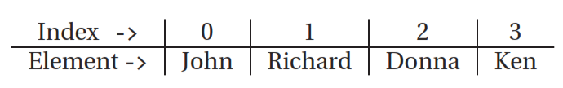
Different Types of Collections
Working with Lists
A list is an ordered collection of objects. A list is also known as a sequence.
An instance of the List<E> interface represents a list in the Collections framework.
A list can have duplicate elements.
You can also store multiple null values in a list.
It allows you to add an element to the end of the List or at any position identified by an integer called the index. The index of an element in a List is zero-based.
add(int index, E element), addAll(int index, Collection<? extends E> c), get(int index), remove(int index)
set(int index, E element) methods to add, get, remove, and replace its elements using indexes.
indexOf(Object o) or lastIndexOf(Object o) - search for the position of an element in the List
Notes:
The indexOf() method searches for the specified object in the List from the beginning and returns the index of the first occurrence of the object. The lastIndexOf() method does the same, starting from the end of the list. Both methods return -1 if the List does not contain the specified object.

Slide 18
Different Types of Collections
Working with Lists
subList(int fromIndex, int toIndex) gives you a sub-list (another view) of the original list.
It provides a specialized iterator for its elements, which is an instance of the ListIterator<E> interface. This iterator lets you iterate over its elements in both directions (forward and backward) at the same time.
The two of many implementation classes for the List interface:
• ArrayList<E> - backed by a array
• LinkedList<E> - backed by a linked list
An ArrayList performs better if you access (get and set) the elements of the list frequently.
Accessing elements in an ArrayList is faster because accessing an element from an array is always fast.
Adding or removing elements from an ArrayList performs slower, unless done from the end, because an ArrayList has to perform an array copy internally to keep the elements in sequence.
The LinkedList performs better compared to ArrayList for adding and removing elements from the middle of the list. However, it is slower for accessing elements of the list, unless at the head of the list.

Slide 19

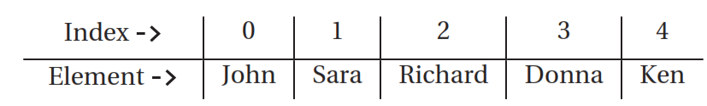

Different Types of Collections
Working with Lists
/ Create a list of strings
List<String> nameList = new ArrayList<>();
nameList.add("John"); // Adds John at the index 0
nameList.add("Richard"); // Adds Richard at the index 1
// Add an element at index 1
nameList.add(1, "Sara");
List does not allow inserting an element at any arbitrary index by using the add(int index, E element) method. If the List is empty, you can use only 0 as the index to add the first element to the list.
If you have five elements in a List, index from 0 to 4 will insert an element between existing elements. Index of 5 will append the element to the end of the List. This implies that a List must grow sequentially.
Java 9 added a static factory method named of() in the List interface. List.of("John", "Donna", "Ken");
The static of() method of the List interface creates an immutable List.

Slide 20
Different Types of Collections
Working with Lists
The ListIterator interface inherits from the Iterator interface;
It adds a few more methods to give access to elements in the list from the current position in the backward direction.
// Get a full list iterator
ListIterator<String> fullIterator = list.listIterator();
// Get a list iterator, which will start at index 5 in the forward direction.
ListIterator<String> partialIterator = list.listIterator(5);
The hasPrevious() method of the ListIterator returns true if there is an element before the current position. To get the previous element, use its previous() method.
A ListIterator lets you look ahead or look back in a List. Call to the next() method moves it one index forward and the call to the previous() method moves it one index backward.

Slide 21
Different Types of Collections
Working with Maps
It contains key-value mappings.
The first column contains keys; the second column contains the values associated with the keys.
Sometimes a map is also known as a dictionary.
Think of Map as a collection in which each element represents a key-value pair as <key, value>.
The key and the value must be reference types. You cannot use primitive types (int, double, etc.) for either keys
or values in a map.
A map is represented by an instance of the Map<K,V> interface.
The Map interface is not inherited from the Collection interface.

Slide 22
Different Types of Collections
Working with Maps
A Map does not allow any duplicate keys. Each key is mapped to exactly one value. In other words, each key in a Map has exactly one value. Values do not have to be unique.
That is, two keys may map to the same value.
A Map allows for at most one null value as its key and multiple null values as its values.
The methods in the Map interface may be classified in the following four categories:
• Methods for basic operations
• Methods for bulk operations
• Methods for view operations
• Methods for comparison operations

Slide 23
Different Types of Collections
Working with Maps
Basic operations
• int size()
• boolean isEmpty()
• boolean containsKey(Object key)
• boolean containsValue(Object value)
• V get(Object key)
• V getOrDefault(Object key, V defaultValue)
• V put(K key, V value)
• V putIfAbsent(K key, V value)
• V remove(Object key)
• boolean remove(Object key, Object value)
• boolean replace(K key, V oldValue, V newValue)
View operations
• Set<K> keySet()
• Collection<V> values()
• Set<Map.Entry<K,V>> entrySet()
* Note that all keys and all <key, value> pairs are always unique in a Map and that is the reason why you get their Set views. Since a Map may contain duplicate values, you get a Collection view of its values.
Comparison operations
• boolean equals(Object o)
• int hashCode()
Bulk operations
• void clear()
• void putAll(Map<? extends K, ? extends V> m)
• void replaceAll(BiFunction<? super K,? super V,? extends V> function)

Slide 24
Different Types of Collections
Working with Maps
The HashMap<K,V> and LinkedHashMap<K,V> are two of the available implementation classes for the Map<K,V> interface.
The HashMap allows one null value as a key and multiple null values as the values.
The LinkedHashMap is another implementation class for the Map interface. It stores entries in the Map
using a doubly linked list. It defines the iteration ordering as the insertion order of the entries. If you want to
iterate over entries in a Map in its insertion order, you need to use LinkedHashMap instead of HashMap.
The keySet(), values(), and entrySet() methods of a map return a Set of keys, a Collection of values, and a Set of entries.
Each key-value pair in a map is called an entry. An entry is represented by an instance of the Map.Entry<K,V> interface. Map.Entry<K,V> is a nested static interface of the Map<K,V> interface. It has three commonly used methods called getKey(), getValue(), and setValue().
Java 8 added a forEach(BiConsumer<? super K,? super V> action) method to the Map<K,V> interface that lets you iterate over all entries in the map in a cleaner way.

Slide 25
Different Types of Collections
Working with Maps
Java 9 added an overloaded of() static factory method to the Map<K,V> interface that provides a
simple and compact way to create immutable maps.
There are 11 versions of the of() method that let you create an immutable Map of zero to ten key-value entries.
// An empty, immutable Map
Map<Integer, String> emptyMap = Map.of();
// A singleton, unmodifiable Map
Map<String, String> singletonMap = Map.of("Ken", "(205)678-9823");
// A immutable Map with two entries
Map<Integer, String> luckyNumbers = Map.of(1, "One", 2, "Two");

Slide 26
Different Types of Collections
Working with Maps
To create an immutable Map with an arbitrary number of entries, Java 9 provided a static method named
ofEntries() in the Map interface.
<K,V> Map<K,V> ofEntries(Map.Entry<? extends K,? extends V>... entries)
To use the ofEntries() method, you need to box each map entry in a Map.Entry instance. Java 9 provides a convenience entry() static method in the Map interface to create instances of Map.Entry.
<K,V> Map.Entry<K,V> entry(K k, V v)
import java.util.Map;
import static java.util.Map.entry;
// Use the Map.ofEntries() and Map.entry() methods to create an immutable Map
Map<Integer, String> numberToWord = Map.ofEntries(entry(1, "One"),
entry(2, "Two"),
entry(3, "Three"));
The returned maps from the of() and ofEntries() methods do not allow null in keys or values.

Slide 27
Different Types of Collections
Working with Maps
Sorted Maps
A sorted map stores entries in a map in an ordered way. It sorts the map entries on keys based on either
natural sort order or a custom sort order.
The natural sort order is defined by the Comparable interface of the keys. If the keys do not implement the Comparable interface, you must use a Comparator to sort the entries.
If the keys implement the Comparable interface and you use a Comparator, the Comparator is used to sort the
keys.
An instance of the SortedMap<K,V> interface represented a sorted map. The SortedMap<K,V> interface
inherits from the Map<K,V> interface. A SortedMap is to a Map what a SortedSet is to a Set.
The TreeMap<K,V> class is the implementation class for the SortedMap<K.V> interface.

Slide 28
Different Types of Collections
Working with Maps
The SortedMap interface contains methods that let you take advantage of the sorted keys in the map.
Comparator<? super K> comparator()
K firstKey()
SortedMap<K, V> headMap(K toKey)
K lastKey()
SortedMap<K, V> subMap(K fromKey, K toKey)
SortedMap<K, V> tailMap(K fromKey)
If you want to use a Comparator to sort the entries based keys in a SortedMap, you need use the constructor of the TreeMap class that takes a Comparator as an argument.
Comparator<String> keyComparator = Comparator.comparing(String::length) .thenComparing(String::compareToIgnoreCase);
SortedMap<String, String> sMap = new TreeMap<>(keyComparator);

Slide 29
Different Types of Collections
Working with Maps
Navigable Maps
A navigable map is represented by an instance of the NavigableMap<K,V> interface. It extends the
SortedMap<K,V> interface.
It adds some useful features like getting the closest match for a key, getting a view of the map in reverse order, etc.
The TreeMap<K,V> class is the implementation class for the NavigableMap<K,V> interface.

Slide 30
Different Types of Collections
Working with Maps
Concurrent Maps
Sometimes you need to perform multiple operations on a map atomically when the map is used by multiple
threads concurrently.
For example, you may want to put a new key-value pair in a map only if the key does not already exist in the map
// Need to lock the entire map
synchronized(map) {
if (map.containsKey(key)) {
// Key is already in the map
} else {
map.put(key, value); // Add the new key-value
}
Locking the map was necessary because you needed to perform two things atomically:
testing for a key’s existence
putting the key-value if the test fails.

Slide 31
Different Types of Collections
Working with Maps
Concurrent Maps
A ConcurrentMap enables you to perform concurrent operations, without resorting to locking the map.
The ConcurrentHashMap<K,V> class is an implementation class for the ConcurrentMap<K,V> interface.
Both of them are in the java.util.concurrent package.
An instance of the ConcurrentNavigableMap<K,V> interface represents a concurrent and navigable map. The interface inherits from the ConcurrentMap<K,V> and NavigableMap<K,V> interfaces.
The ConcurrentSkipListMap<K,V> is the implementation class for the ConcurrentNavigableMap<K,V> interface

Slide 32

Different Types of Collections
Working with Queues
A queue is a collection based on the notion of a real-world queue. A queue is a collection of objects on which
some kind of processing is applied one element at a time.
A queue has two ends, known as the head and tail. In a simple queue, objects are added to the tail and removed from the head; the object added first will be removed first.
Queues can be categorized based on the way they allow insertion and removal of their elements.
simple queue: allows insertion at the tail and removal from the head.
priority queue: associates a priority with every element, element with the highest priority to be removed
delay queue: associates a delay with every element, removal of the element only when its delay has elapsed.
doubly ended queue: allows for insertion and removal of its elements from the head as well as the tail.
blocking queue: blocks the thread that adds elements when it is full, blocks the thread removing elements from it when it is empty.
transfer queue: a special type of blocking queue where a handoff of an object occurs between two threads (a producer and a consumer).
blocking doubly ended queue: a combination of a doubly ended queue and a blocking queue.

Slide 33

Different Types of Collections
Working with Queues
Simple Queues
Simple queues are represented by an instance of the Queue<E> interface. The LinkedList<E> and PriorityQueue<E> are two implementation classes for the Queue<E> interface.
How many elements can a queue hold? When the length of a queue is unlimited, it is called an unbounded queue. When the length of the queue is predefined, it is called a bounded queue.
Which element of the queue comes out next? A queue always has an entry point and an exit point. The exit point is called the head and the entry point is called the tail. The head and the tail may be the same. If the head and the tail of a queue are the same, it is called a Last In, First Out (LIFO) queue. A LIFO queue is also known as a stack.
The head and the tail of a queue may be different. If a queue follows a rule that the element entering the queue first will leave the queue first (first come, first served rule), it is called a First In, First Out (FIFO) queue.
Java also has a kind of queue called a priority queue. In priority queue, you define the priority using a Comparator or implement the Comparable interface in the elements’ class.

Slide 34
Different Types of Collections
Working with Queues
Simple Queues
A queue lets you perform three basic operations:
• Add an element to its tail
• Remove an element from its head
• Peek the element at its head
The Queue interface defines two methods for each of the three operations. One method throws an exception if the operation is not possible; the other method returns a value (false or null) to indicate the failure
Category
Method
Description
boolean add(E e)
boolean offer(E e)
Adds element to the queue if it is possible and returns true. Otherwise, throws an IllegalStateException.
Adding an element to queue
Adds element to the queue without throwing Exception.
E remove()
E poll()
Retrieves and removes the head of the queue. It throws an exception if the queue is empty.
Removing an element from the queue
Same as remove(). However, it returns null if the queue is empty instead of throwing an exception.
Peeking at the head of the queue
E element()
E peek()
Retrieves the head of the queue without removing it from the queue. It throws an exception if the queue is empty.
Same as element(), However, it returns null if the queue is empty instead of throwing an exception.

Slide 35
Different Types of Collections
Working with Queues
Priority Queues
A priory queue is a queue in which each element has an associated priority. The element with the highest
priority is removed next from the queue.
Java provides PriorityQueue<E> as an implementation class for an unbounded priority queue.
You can use natural order of the elements of the queue as its priority. In this case, the elements of the queue must implement the Comparable interface.
You can also supply a Comparator, which will determine the priority order of the elements. When you add a new element to a priority queue, it is positioned in the queue based on its priority. How the priority is decided in the queue is up to you to implement.

Slide 36
Different Types of Collections
Working with Queues
Double Ended Queues

Slide 37
Applying Algorithms to Collections
Shuffling, Reversing, Swapping, and Rotating a List
The concept of shuffling elements of a List is the same as shuffling a deck of cards.
• void shuffle(List<?> list)
• void shuffle(List<?> list, Random rnd)
Reversing is the algorithm that puts the elements of a List in the reverse order.
void reverse(List<?> list)
Swapping lets you swap the position of two elements in a List.
void swap(List<?> list, int i, int j)
Rotating involves moving all elements of a List forward or backward by a distance. [a, b, c, d]. Visualize that the List is a circular list and its first element is next to its last element. Rotate this List by a distance of 1, the resulting List becomes [d, a, b, c].
void rotate(List<?> list, int i)

Slide 38
Applying Algorithms to Collections
Sorting a List
Two static methods in the Collections class to sort the elements of a List.
<T extends Comparable<? super T>> void sort(List<T> list)
<T> void sort(List<T> list, Comparator<? super T> c)
■ Tip Java 8 added a default method named sort(Comparator<? super E> c) in the List<E> interface. It allows you to sort a List without using the Collections class.
Sorting is guaranteed to give n*log(n) performance

Slide 39
Applying Algorithms to Collections
Searching a List
You can use one of the following two static binarySearch() methods in the Collections class to search for a
specified object in a List.
• <T> int binarySearch(List<? extends Comparable<? super T>> list, T key)
• <T> int binarySearch(List<? extends T> list, T key, Comparator<? super T> c)
A List must be sorted in ascending order using the natural order or the Comparator before you use the
binarySearch() method on the List.
If the List is not sorted, the result of the binarySearch() method is not defined.
If the object is found in the List, the method returns the index of the object in the List.
Otherwise, it returns (-(insertion index)-1), where the insertion index is the index in the List where this object would have been placed, if it were present.
If the List supports random access, the search runs in log(n) time. If the List does not support random access, the search runs in n*log(n) time.

Slide 40
Thank you
Insert the title of your subtitle Here

