Slide 1
Sports Store Management System

Slide 2
Group Members
Yuvrajsinh Chudasama :- 92400527132
Krishna Ramanuj :- 92400527125
Tirthkumar Patel :- 92400527100

Slide 3
Problem Statement
Manual inventory management
Difficulty tracking stock levels
Slow and error-prone billing process
Lack of customer records
Time-consuming report generation
Need for digital automation

Slide 4
Proposed Solution
Manage sports equipment and accessories
Inventory management
Sales & Billing
Customer Management
Secure Admin Login
Report Generation

Slide 5
Objectives
Automate shop operations
Reduce manual paperwork
Improve billing accuracy
Maintain inventory records
Generate sales reports
Enhance user experience

Slide 6
Server Requirements & Technology Stack
Frontend
HTML5
CSS3
Bootstrap 5
JavaScript
Backend
PHP 8.x

Slide 7
Server Requirements & Technology Stack
Database
MySQL
phpMyAdmin
Development Tools
Laragon
Visual Studio Code

Slide 8
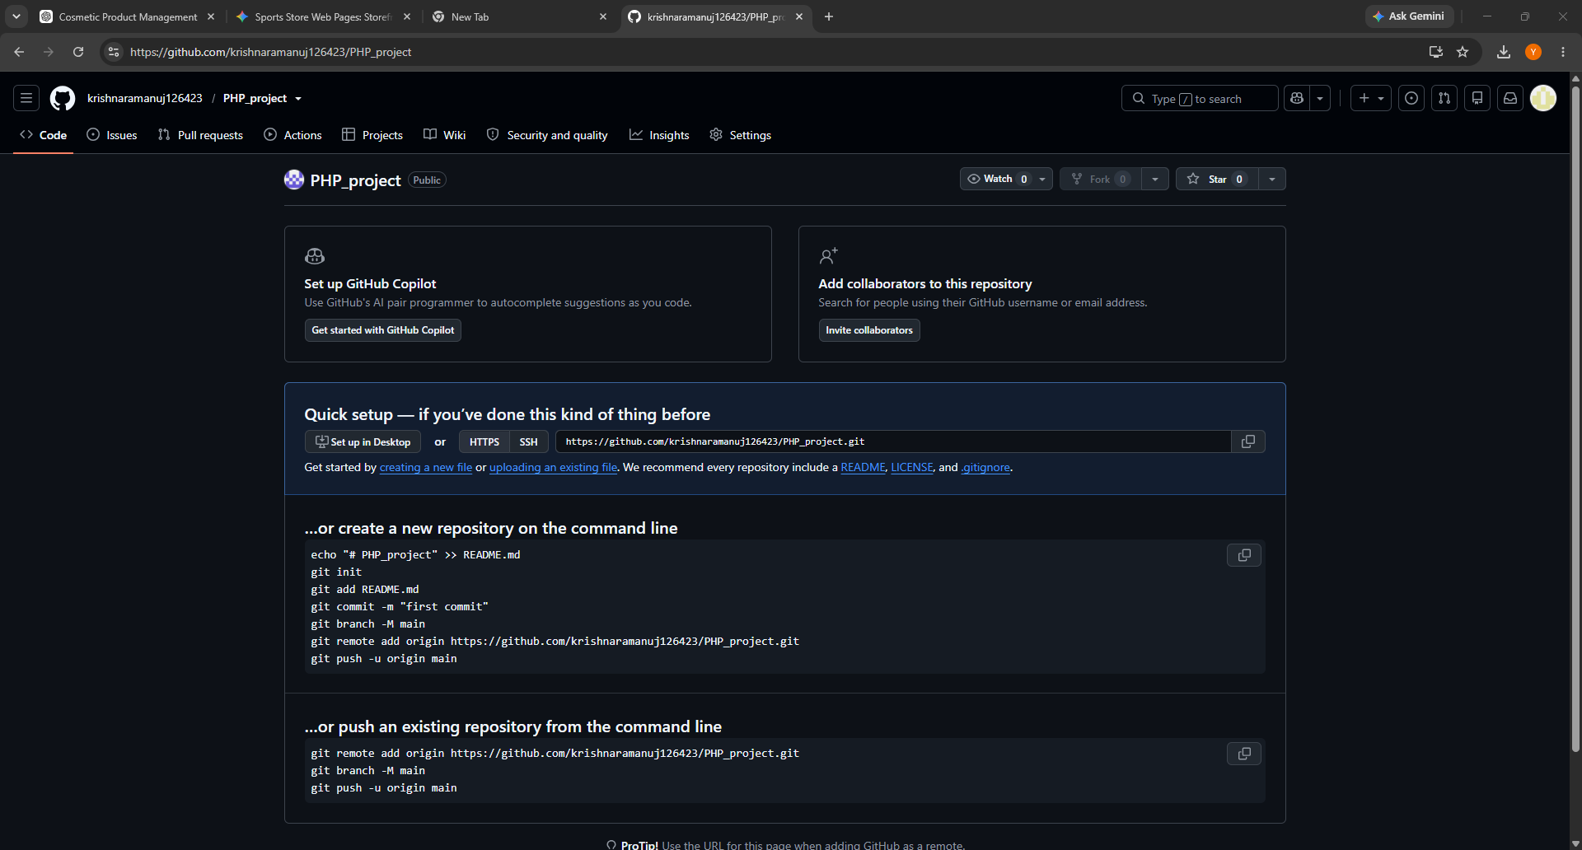
Github :-
Repository Link :-
https://github.com/krishnaramanuj126423/PHP_project

Slide 9
Tables
Table | Purpose
Admin | Stores administrator details
Customer | Stores customer information
Category | Product categories
Product | Sports products
Orders | Customer orders
Order Details | Ordered products

Slide 10
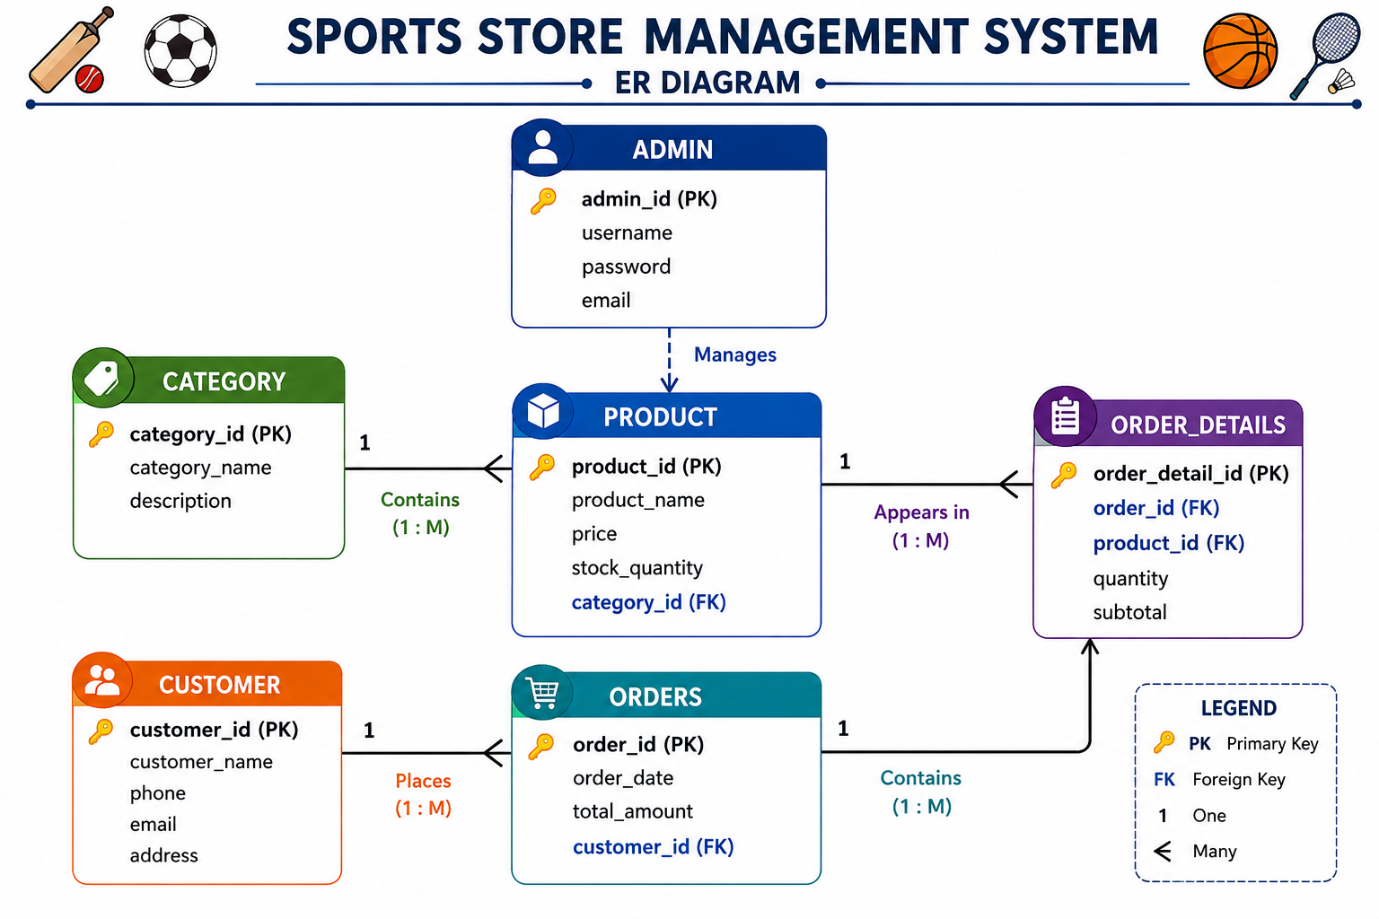
ER Diagram
The diagrams are created with the help from AI.

Slide 11
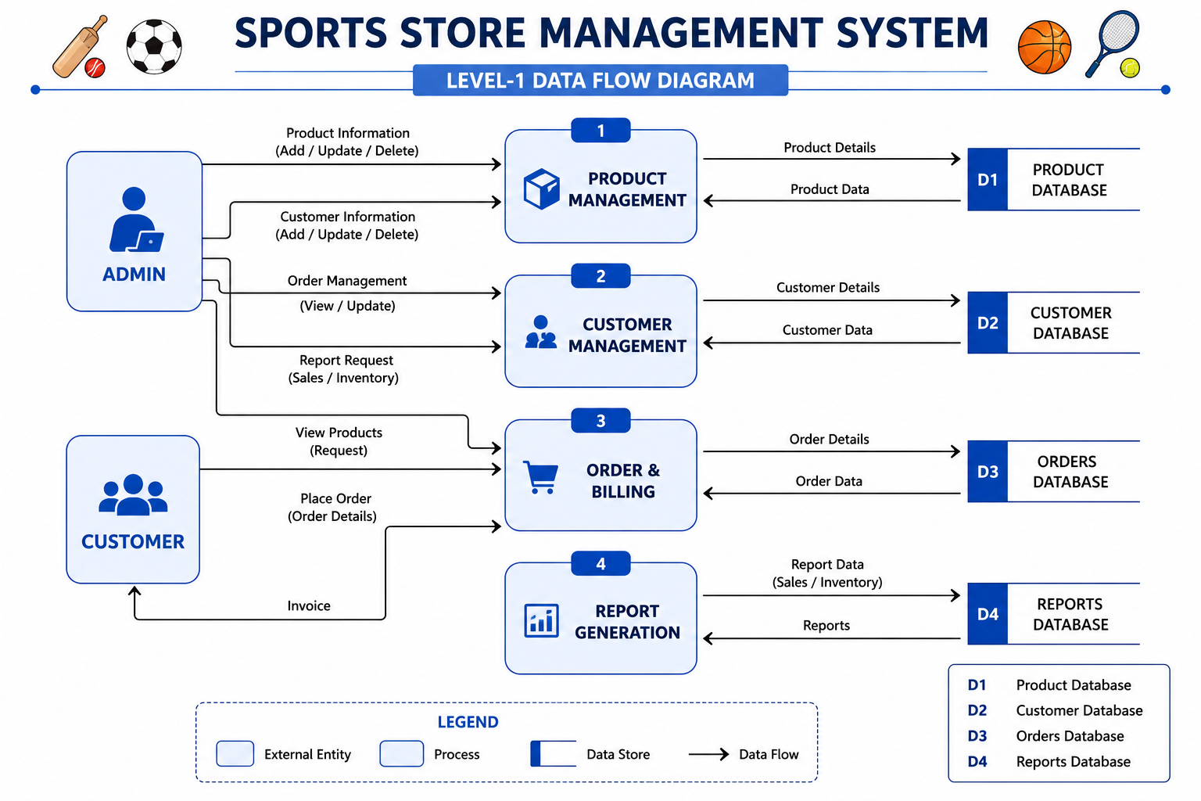
DFD Diagram – Level 1
The diagrams are created with the help from AI.

Slide 12
Challenges Learning
Database Design
Session Management
Billing Logic
Responsive UI
PHP & MySQL Integration
Full-stack Web Development
Database Management
Bootstrap Framework
SQL Queries
Authentication System
Problem Solving Skills

Slide 13
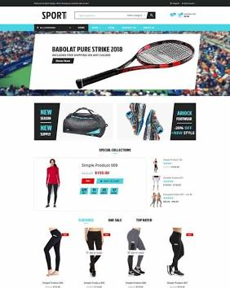
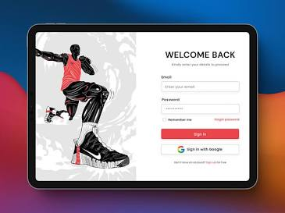
References
These are for the reference purpose only from different website.

Slide 14
Thank you!!

