Slide 1
INSIGHTVISTA 2026
RETAIL SALES
ANALYTICS
Subject:- Data Analytics and Visualization(1IT508)
GroupName:- ByteViz
PEN:- 240840116017
240840116024
240840116054
240840116116
240840116139

Slide 2
1. Problem & Objective
THE BUSINESS QUESTION
• Compare revenue and quantity across product categories.
• Understand monthly sales and transaction patterns.
• Explore customer age and gender distribution.
• Build an interactive dashboard to support quick decisions.
What patterns in retail transactions can help a business understand sales performance and customer behaviour?
OBJECTIVE
Turn raw sales records into a clear, evidence-based story for retail decision-making.

Slide 3
2. Understanding the Dataset
TRANSACTIONS
CUSTOMERS
TOTAL SALES
UNITS SOLD
1,000
1,000
456,000
2,514
Unique transaction IDs
Unique customer IDs
Dataset currency not specified
Sum of quantity
KEY FIELDS
Transaction ID
Date
Customer ID
Transaction-level identifier
Time-based comparisons
Customer count
Gender & Age
Product Category
Quantity, Price per Unit, Total Amount
Customer profile
Category comparison
Volume and revenue measures

Slide 4
3. Data Preparation & Analysis Approach
DATA QUALITY CHECKS
ROWS CHECKED
MISSING VALUES
DUPLICATE ROWS
DATE RANGE
1,000
0
0
Jan 2023 – Jan 2024
Across all 9 columns
ANALYTICAL STEPS
• Reviewed the dataset structure, field types, and summary statistics.
• Checked missing values and duplicate records; none were found.
• Converted Date to a date type for month-based grouping in analysis.
• Compared totals by category, month, gender, and customer age.

Slide 5
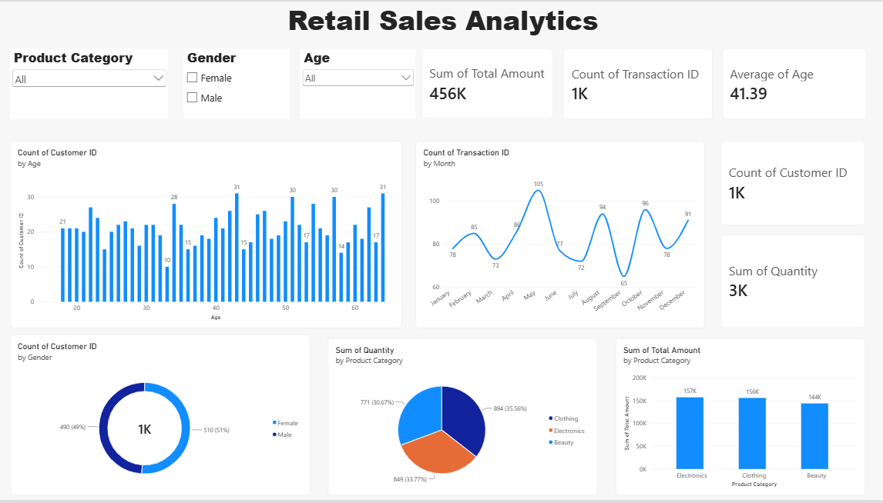
Final Dashboard

Slide 6
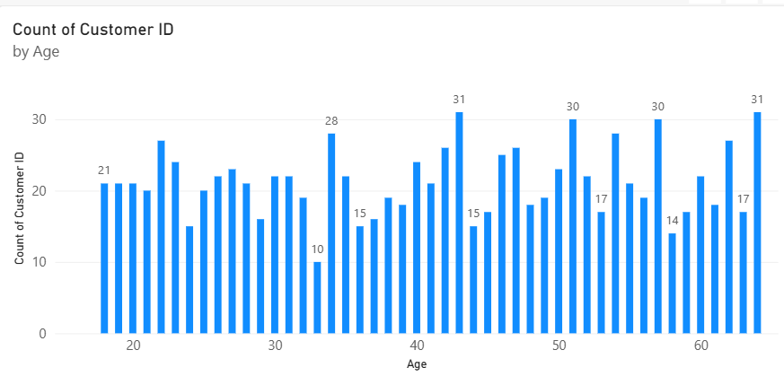
4. Power BI Dashboard
Bar Chart
Key findings
Customer records are spread across ages of approximately 18–64.
The number of customer records varies by age, with several ages reaching around 30–31 records.
There is no single age group that overwhelmingly dominates the chart.
Business insight: The business appears to serve customers across a broad adult age range. It could explore age-based promotions, but more analysis is needed to determine which age groups spend the most.
Interactive slicers: Gender • Age • Product Category

Slide 7
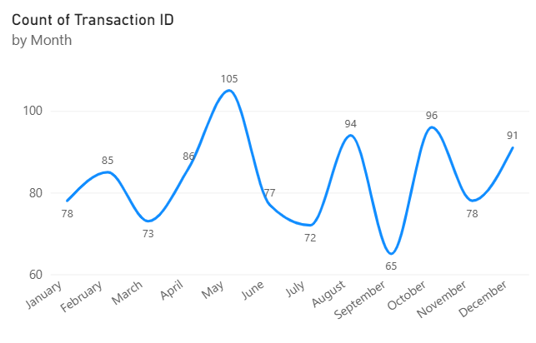
Line Chart
Key findings
May has the highest transaction count, at approximately 105.
September has the lowest transaction count, at approximately 65.
Transaction activity fluctuates across the year rather than remaining constant.
August and October also show relatively high activity, at approximately 94 and 96 transactions.
Business insight: May appears to be a strong month for transaction activity, while September may require further investigation. Comparing these patterns with promotions, holidays, and stock availability could help explain the differences.

Slide 8
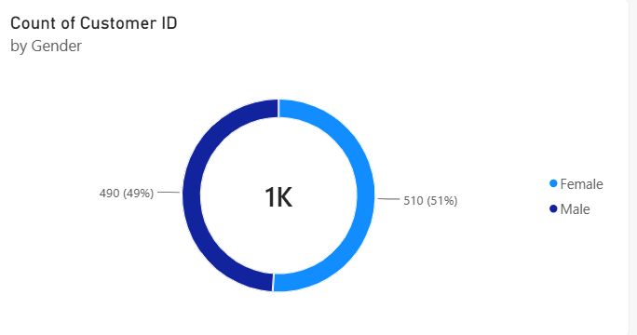
Donut Chart
Key findings
Female records account for 51% of the total.
Male records account for 49%.
The difference is only 20 records, indicating a nearly balanced distribution.
Business insight: The customer records do not show a strong gender imbalance. The business could consider marketing strategies that appeal to both groups instead of focusing heavily on one gender.

Slide 9
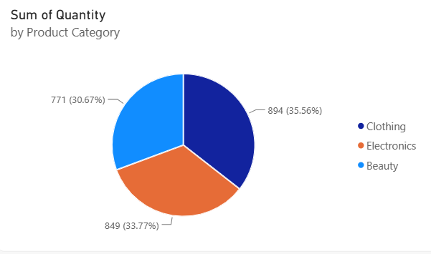
Pie Chart
Key findings
Clothing has the highest quantity sold, with 894 units.
Electronics follows with 849 units.
Beauty has the lowest quantity sold, with 771 units.
Clothing accounts for approximately 35.56% of the total quantity.
Business insight: Clothing leads in sales volume, but the difference between the categories is relatively small. The business should investigate product demand and stock availability in each category.

Slide 10
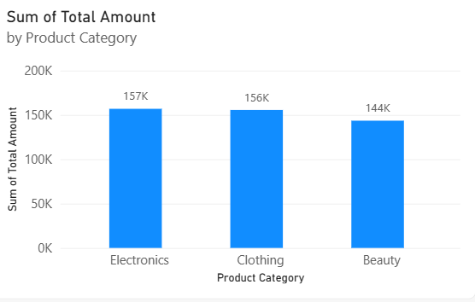
Column Chart
Key findings
Electronics generates the highest revenue, at 156,905.
Clothing follows very closely, at 155,580.
Beauty generates 143,515, the lowest of the three categories.
Electronics exceeds Clothing by only 1,325, while Beauty trails Electronics by 13,390.
Business insight: Electronics and Clothing are the strongest revenue contributors, while Beauty has an opportunity for further investigation. However, higher revenue does not automatically mean higher profit because product costs and margins are not included.

Slide 11
5. Visualization Choices — What Each Chart Answers
KPI cards
Bar chart: customer count by age
Age, customer count, quantity, sales and transaction count
Age → Count of Customer ID
Give an at-a-glance summary of overall performance.
Shows how transaction/customer records are distributed across ages.
Line chart: transactions by month
Donut chart: customers by gender
Date (month) → Count of Transaction ID
Gender → Count of Customer ID
Highlights monthly rises and falls in transaction activity.
Compares the female and male customer counts.
Pie chart: quantity by category
column chart: sales by category
Product Category → Sum of Quantity
Product Category → Sum of Total Amount
Compares units purchased across categories.
Compares revenue contribution across categories.

Slide 12
6. Key Findings from the Data
Calculated directly from the supplied 1,000-row dataset
TOTAL SALES
AVERAGE CUSTOMER AGE
FEMALE CUSTOMERS
456,000
41.39 years
51%
Across all transactions
510 records
CATEGORY PERFORMANCE
Electronics
156,905
849 units
Clothing
155,580
894 units
Beauty
143,515
771 units
MONTHLY SALES
Highest: May (53,150) • Lowest: Sep (23,620)

Slide 13
7. Insights — So What Does It Mean?
01
Category revenue is close
Electronics (156,905) narrowly leads Clothing (155,580); Beauty records 143,515. No single category dominates revenue.
02
Volume leader differs slightly
Clothing has the highest quantity (894 units), followed by Electronics (849) and Beauty (771).
03
Sales vary across months
May is the strongest month by revenue, while Sep is the weakest. Investigate promotions, seasonality, and stock availability.
04
Customer mix is balanced
Female records are 51% and male records 49%; the difference is small, so avoid assuming a strong gender skew.

Slide 14
8. Recommendations & Next Steps
Protect category balance
Investigate monthly peaks and dips
Maintain availability across all three categories; review category-level margins before shifting budget.
Compare promotions, holidays, inventory, and marketing activity with monthly sales to explain variation.
Improve dashboard exploration
Extend the analysis
Use slicers to compare categories and customer groups; add a date-range slicer for faster period comparisons.
If available, add profit, discount, product-level, store/region, and repeat-customer fields for deeper business decisions.

Slide 15
CONCLUSION
A clearer view of retail performance
The dataset contains 1,000 transactions and 456,000 in recorded sales. Electronics leads revenue, Clothing leads quantity, and monthly sales vary considerably.
The Power BI dashboard combines summary KPIs, category comparisons, customer demographics and monthly transaction trends in one interactive view.
WHAT? Show the pattern WHY? Explain the context SO WHAT? State the insight NOW WHAT? Recommend an action
Thank you

