Slide 1
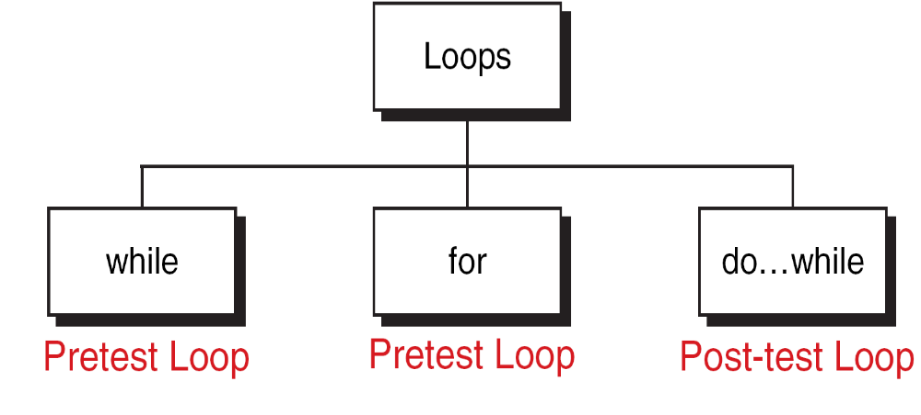
C Loop Constructs

Slide 2
while
The "while" loop is a generalized looping structure that employs a variable
or expression for testing the condition.
It is a repetition statement that allows an action to be repeated while some
conditions remain true.
The body of while statement can be a single statement or compound
statements.
It doesn’t perform even a single operation if condition fails.

Slide 3
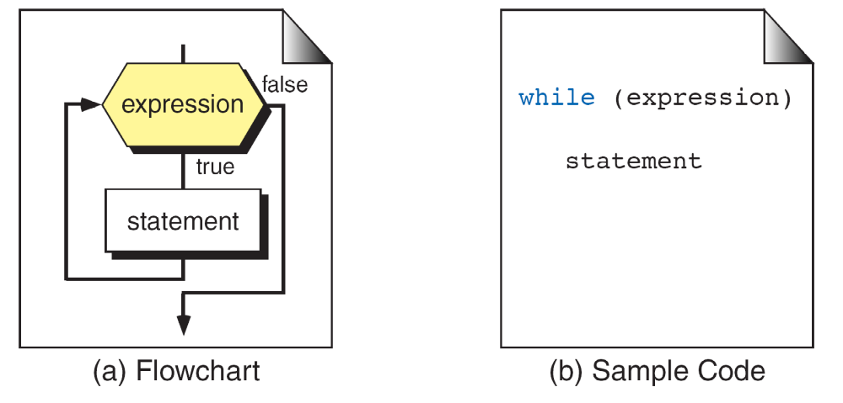
The while Statement

Slide 4
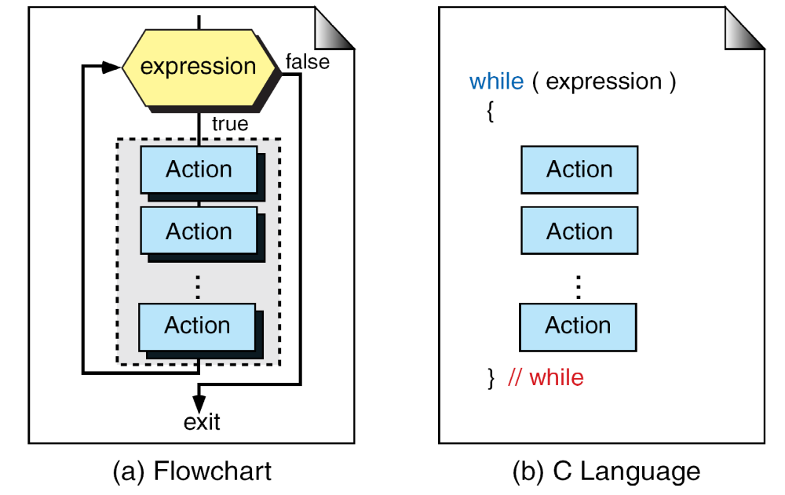
Compound while Statement

Slide 5
Example 1: To print 1 to 10 natural numbers
#include<stdio.h>
main()
{
int i;
i=1;
while (i<=10)
{
printf(“%d\n”,i);
i++;//i=i+1
}
}

Slide 6
Example 2: To print the reverse of the given number.
void main()
{
int n, rem, rev = 0;
printf("\n Enter a positive number: ");
scanf("%d",&n);
while(n != 0)
{
rem = n%10;
rev = rev*10+rem;
n = n/10;
}
printf("The reverese of %d is %d",n,rev);
}

Slide 7
do while
The “do while" loop is a repetition statement that allows an action to be
done at least once and then condition is tested.
On reaching do statement, the program proceeds to evaluate the body of
the loop first.
At the end of the loop, condition statement is evaluated.
If the condition is true, it evaluates the body of the loop once again.
This process continues up to the condition becomes false.

Slide 8
do…while Statement

Slide 9
Example 4: To print multiplication table for 5.
#include <stdio.h>
void main()
{
int i = 1, n=5;
do
{
printf(“ %d * %d = %d “, n, i, n*i);
i = i + 1;
} while ( i<= 5);
}

Slide 10
for
A for loop is used when a loop is to be executed a known number
of times.
We can do the same thing with a while loop, but the for loop is
easier to read and more natural for counting loops.
General form of the for is:
for( initialization; test-condition; updation)
{
Body of the loop
}

Slide 11
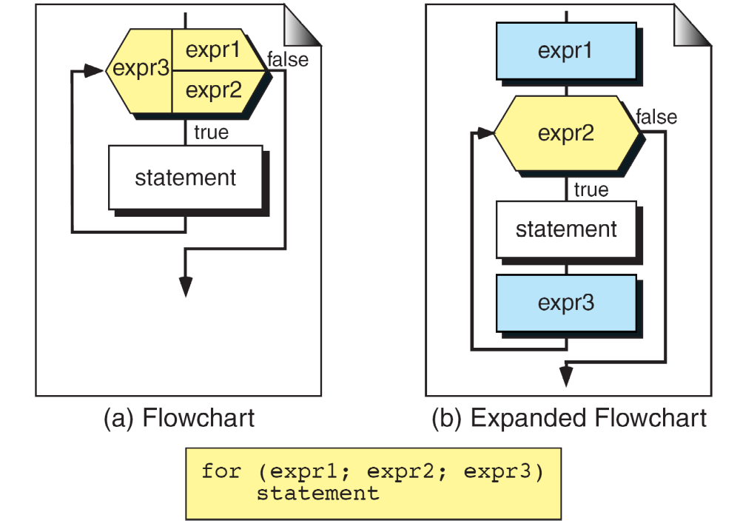
for Statement

Slide 12
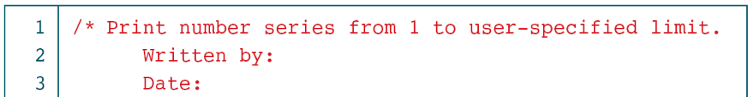
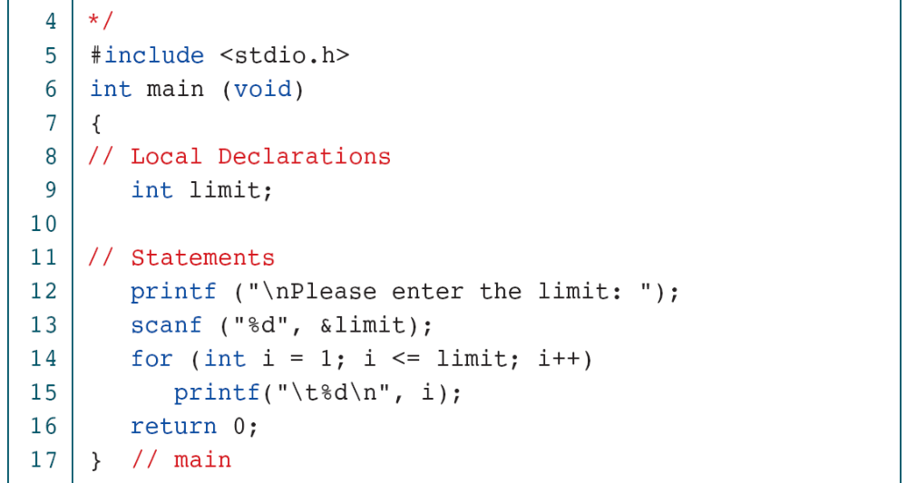
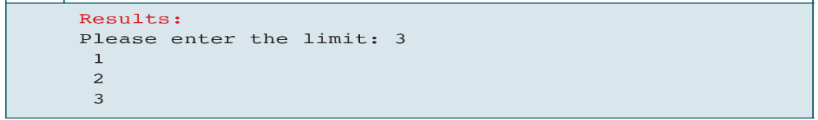

Slide 13
Nested Loops in C
Syntax:
for (initialization; condition; update)
{
for(initialization; condition; update)
{
// inner loop statements.
}
// outer loop statements.
}

Slide 14
#include <stdio.h>
int main()
{
int n;// variable declaration
printf("Enter the value of n :");
// Displaying the n tables.
for(int i=1;i<=n;i++) // outer loop
{
for(int j=1;j<=10;j++) // inner loop
{
printf("%d\t",(i*j)); // printing the value.
}
printf("\n");
}

Slide 15
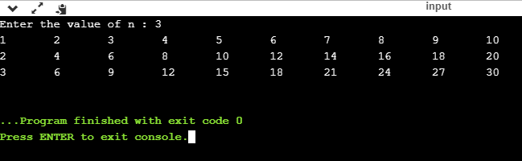

Slide 16
We can write the for loop in the following ways:
Option 1:
for (k= 1; k< = 10 ;)
{
printf(“%d”, k);
k = k + 1;
}
Here the increment is done within the body of the for loop and not in
the for statement. Note that the semicolon after the condition is
necessary.
Option 2:
int k = 1;
for (; k< = 10; k++);
{
printf(“%d”, k);
}
Here the initialization is done in the declaration statement itself, but
still the semicolon before the condition is necessary.

Slide 17
Option 3: The infinite loop
One of the most interesting uses of the for loop is the creation of the infinite loop. Since none of the three expressions that form the for loop are required, it is possible to make an endless loop by leaving the conditional expression empty.
For example: for (; ;)
printf(“The loop will run forever\n”);
Actually the for (; ;) construct does not necessarily create an infinite loop because C’s break statement, when encountered anywhere inside the body of a loop, causes immediate termination of the loop.

Slide 18
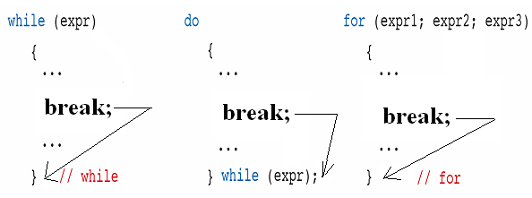
break
When a break statement is enclosed inside a block or loop, the loop is
immediately exited and program continues with the next statement
immediately following the loop.
When loop are nested break only exit from the inner loop containing it.
The format of the break statement is:

Slide 19
Example 6: Program to demonstrate break statement.
include<stdio.h>
void main()
{
int i;
for(i=0;i<5;i++)
{
if(i==3)
break;
printf("%d\n",i);
}
}
Output:
0
1
2

Slide 20
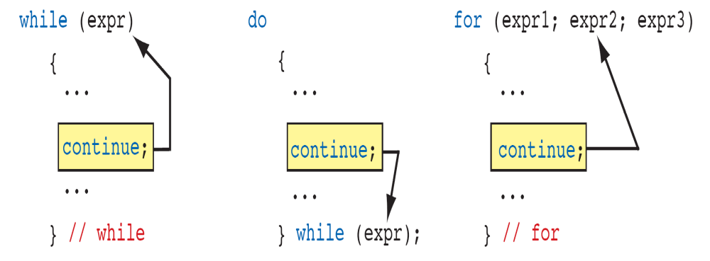
continue
When a continue statement is enclosed inside a block or loop, the loop is
to be continued with the next iteration.
The continue statement tells the compiler, skip the following statements
and continue with the next iteration.
The format of the continue statement is:

Slide 21
Example 5: Program to demonstrate continue statement.
#include<stdio.h>
main()
{
int i;
for(i=1;i<=5;i++)
{
if(i = = 3)
continue;
printf(" %d\n",i);
}
}
Output:
0
1
2
4
5

Slide 22
goto Statement:
The goto statement allows us to transfer control of the program to the specified label.
Syntax of goto Statement
goto sum;
... .. ...
... .. ...
sum:
statements;

Slide 23
#include <stdio.h>
int main()
{
int num,i=1;
printf("Enter the number whose table you want to print?");
scanf("%d",&num);
table:
printf("%d x %d = %d\n",num,i,num*i);
i++;
if(i<=10)
goto table;
}

