Slide 1
Comments
To make the program more readable use the comments.
They may used to make the program easier to understand.
Two types of comments
1. Block comment
2. Line comment.

Slide 2
Block Comment
/* Write a program to add two integer numbers */
#include<stdio.h>
int main()
{
int a=10,b=20,c;
c=a+b;
printf(“Sum of a and b=%d”,c);
return 0;
}
Any characters between /* and */ are ignored by the compiler.
Comments may appear anywhere in a program.
/* and */ is used to comment the multiple lines of code which is ignored by the compiler.
Nested block comments are invalid like /* /* */

Slide 3
Line Comment
To comment a single line use two slashes //
/* Write a program to add two integer numbers */
#include<stdio.h> // It includes input, output header file
main()
{
int a=10,b=20,c; // Variables declaration & initialization
c=a+b; // Adding two numbers
printf(“Sum of a and b=%d”,c);
return 0;
}

Slide 4
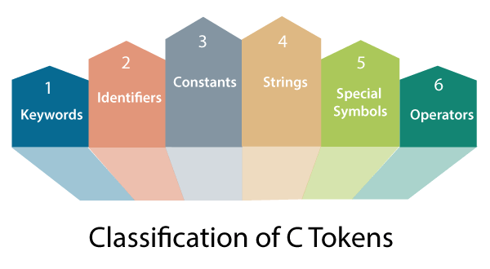
C Tokens:
In a passage of text, individual words and punctuation marks are called as tokens.
The compiler splits the program into individual units, are known as C tokens. C has six types of tokens.

Slide 5
Identifiers
Identifiers are names given to various programming elements such as variables, constants, and functions.
It should start with an alphabet or underscore, followed by the combinations of alphabets and digits.
No special character is allowed except underscore.
An Identifier can be of arbitrarily long. Only first thirty-one (31) characters are significant.
The following are the rules for writing identifiers in C:
First character must be alphabetic character or underscore.
Must consist only of alphabetic characters, digits, or underscore.
Should not contain any special character, or white spaces.
Should not be C keywords.
Case matters (that is, upper and lowercase letters). Thus, the names count and Count refer to two different identifiers.

Slide 6
Identifier | Legality
Percent | Legal
y2x5_fg7h3 | Legal
annual profit | Illegal: Contains White space
_1990_tax | Legal but not advised
savings#account | Illegal: Contains the illegal character #
double | Illegal: It is s a C keyword
9winter | Illegal: First character is a digit
Examples of legal and illegal C identifiers

Slide 7
Variables
Variable is a valid identifier which is used to store the value in the memory location, that value varies during the program execution.
Types of variables:
Global Variables
Local Variables
Global Variable: The variables which are declared at the starting of the program are called as global variable. They are visible to all the parts of the program.
Local Variable: The variables which are declared in a function are called local variables to that function. These variables visible only within the function.
Syntax:Datatype var name;(Declaration)
Eg:int a;
Initialization:datatype varname=value;
int a=10;

Slide 8
Variables (contd…)
When you want to process some information, you can save the values temporarily in variables.
#include<stdio.h>
main()
{
int a=10,b=20,c;
c=a+b;
printf(“sum of a and b=%d\n”,c);
return 0;
}
Note : Variables must be declared before they are used, usually at the beginning of the function.

Slide 9
Variables (contd…)
There are some restrictions on the variable names (same as
identifiers):
First character must be alphabetic character or underscore.
Must consist only of alphabetic characters, digits, or underscore.
Should not contain any special character, or white spaces.
Should not be C keywords.
Case matters (that is, upper and lowercase letters). Thus, the names count and Count refer to two different identifiers.

Slide 10
The following list contains some examples of legal and illegal C variable names:
Variable Name | Legality
Percent | Legal
y2x5_fg7h | Legal
annual_profit | Legal
_1990_tax | Legal but not advised
savings#account | Illegal: Contains the illegal character #
double | Illegal: It is a C keyword
9winter | Illegal: First character is a digit

Slide 11
Constants
Constants are data values that cannot be changed during the program execution.
Like variables, constants have a type.
Types of constants:
Boolean constants: A Boolean data type can take only two values true and false.
Character constants
Single character constants
string constants.
Numeric constants.
integer constant 1.Decimal Integer( Ex:3) 2.Octal Integer(Ex:05) 3.Hexa Decimal Integer (Ex 0X9)
real constants. Ex:3.5

Slide 12
Single character constants
A single character constants are enclosed in single quotes.
Example: ‘1’ ‘X’ ‘%’ ‘ ‘
Character constants have integer values called ASCII values.
char ch=‘A’;
printf(“%d”,ch); Output: 65
similarly printf(“%c”,65) Output: A
string Constants
String is a collection of characters or sequence of characters enclosed in double quotes.
The characters may be letters, numbers, special characters and blank space.
Example: “sree” “2019” “A”.

Slide 13
Numeric Constants
Integer constant: It is a sequence of digits that consists numbers from
0 to 9.
Example: 23 -678 0 +78
Rules:
Integer constant have at least one digit.
No decimal points.
No commas or blanks are allowed.
The allowable range for integer constant is -32768 to 32767.
1.Decimal Integer( Ex:3)
2.Octal Integer(Ex:05)
3.Hexa Decimal Integer (Ex 0X9)

Slide 14
Backslash \escape characters
Constant | Meaning
‘\b’ | Back space
‘\n’ | New line
‘\v’ | Vertical tab
‘\t’ | Horizontal tab
‘\’ | Single quote
“\” | Double quotes
‘\0’ | Null
‘\?’ | Question mark
‘\\’ | Backslash
‘\0’ | null
Backslash characters are used in output functions.
These backslash characters are preceded with the \ symbol.

Slide 15
Key Words
C word is classified as either keywords or identifiers.
Keywords have fixed meanings, these meanings cannot be changed.
Keywords must be in lowercase.

Slide 16
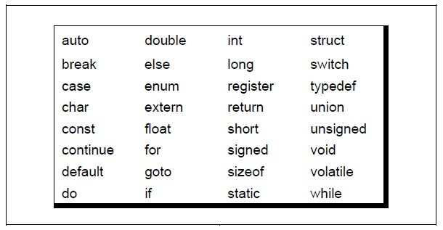

Slide 17
Strings
Strigs in c are always represented as an array of characters having null character '\0' at the end of the string. This null character denotes the end of the string.Strings in C are enclosed within double quotes, while characters are enclosed within single characters.
char a[10] = "latha"; // The compiler allocates the 10 bytes to the 'a' array.
char a[] = “latha reddy"; // The compiler allocates the memory at the run time.
char a[10] = {‘p,‘p',‘s','a','\0'}; // String is represented in the form of characters.

Slide 18
Data types in C
Data types are used to indicate the type of value represented or stored in a variable, the number of bytes to be reserved in memory, the range of values that can be represented in memory, and the type of operation that can be performed on a particular data value.
ANSI C supports 3 categories of data types:
Built-in data types
Derived data types
User Defined data types

Slide 19
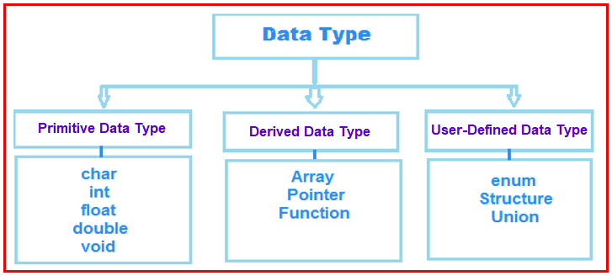
Data types in C (contd…)

Slide 20
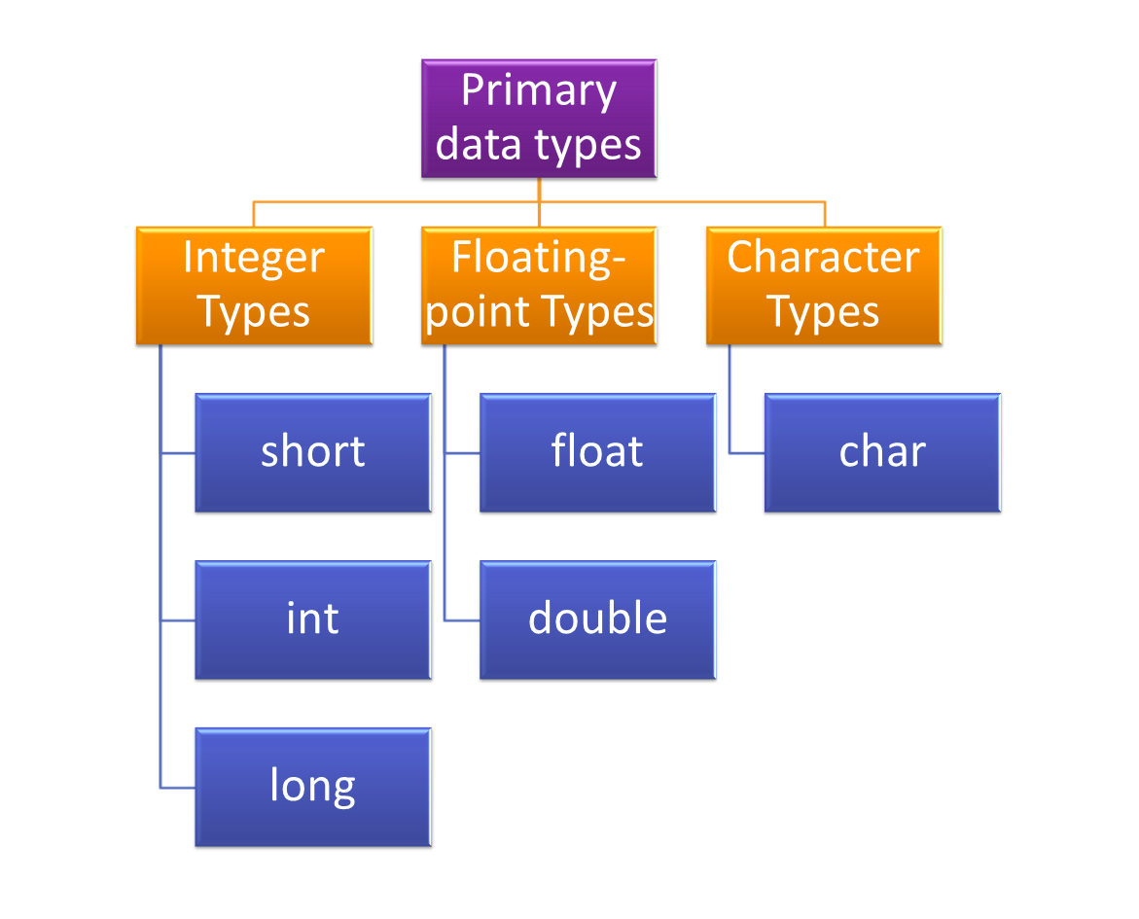

Slide 21
Built-in data types:
Built-in data types are also known as primitive data types. C uses the
following primitive data types.
int integer quantity (size :2bytes)
char character (stores a single character)(size:1 byte)
float floating point number(size:4 bytes)
double floating point number(size: 8bytes)
Float max 6digits after the decimal point
Double 16 digits after the decimal point
FORMAT SPECIFIERS:
%d :int
%f:float
%c:char
%lf:double
%s:string
%p:pointers
Integral Data Type:
Boolean : It uses a keyword known as bool. It can represent only two values true or false.

Slide 22
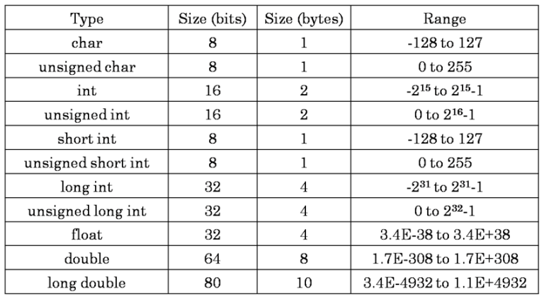

Slide 23
sizeof(DataType) Operator
To get the exact size of a type or a variable on a particular platform, you can use the sizeof operator.
To get the exact size of a type or a variable on a particular platform, you can use the sizeof operator.
// Run on 64 bit Machine
#include <stdio.h>
int main() {
int a = 16;
printf("Size of variable a : %d\n",sizeof(a));
printf("Size of int data type : %d\n",sizeof(int));
printf("Size of char data type : %d\n",sizeof(char));
printf("Size of float data type : %d\n",sizeof(float));
printf("Size of double data type : %dn",sizeof(double));
return 0;
}

Slide 24
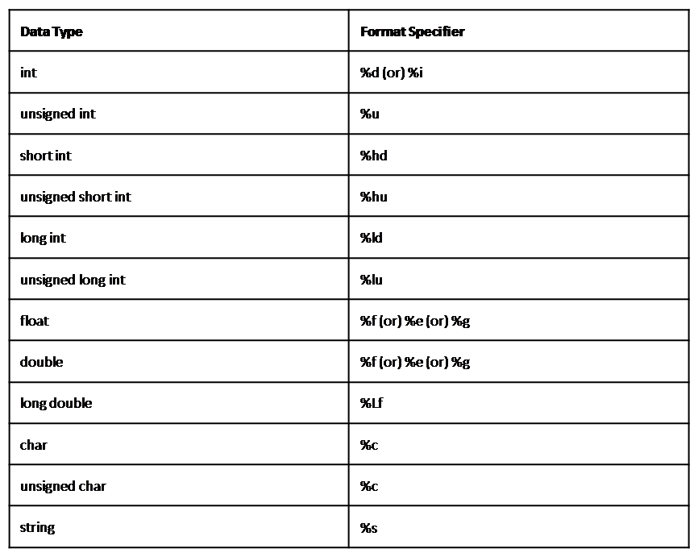

Slide 25
C Input and Output
Input means to provide the program with some data to be used in the program and Output means to display data on the screen or write the data to a printer or a file.
The functions used for standard input and output are present in the stdio.h header file. Hence to use the functions we need to include the stdio.h header file in our program, as shown below.
#include <stdio.h>
Following are the functions used for standard input and output:
printf() function - Show Output
scanf() function - Take Input
getchar() and putchar() function
gets() and puts() function

Slide 26
printf() function - Show Output
The printf() function is the most used function in the C language. This function is defined in the stdio.h header file and is used to show output on the console (standard output).
printf() Example - Print a statement
printf("format string",argument_list);
The format string can be %d (integer), %c (character), %s (string), %f (float) etc.
Let's print a simple sentence using the printf() function.
#include <stdio.h>
int main() {
int a=10;
printf( "a vlaue is %d",a);
return 0;
}

Slide 27
scanf() function
The scanf() function is used for input. It reads the input data from the console.
scanf("format string",argument_list);
//sum of two numbers
#include<stdio.h>
int main()
{
int a, b, sum;
printf("Enter two no:\n ");
scanf("%d %d", &a, &b);
sum = a + b;
printf("Sum %d", sum);
return 0;
}

Slide 28
Types of Operators
C operators can be classified into a number of categories.
They include:
Arithmetic Operators
Relational Operators
Logical Operators
Assignment Operator
Increment and Decrement Operators
Conditional Operators
Bitwise Operators
Special Operators

Slide 29
Arithmetic Operators
C Operation | Binary Operator | C Expression
Addition | + | a + b
Subtraction | - | a - b
Multiplication | * | a * b
Division(second operand must be nonzero) | / | a / b
Modulus | % | a % b

Slide 30
Syntax: operand1 arithmetic_operator operand2
Examples:
10 + 10 = 20 (addition on integer numbers)
10.0 + 10.0 = 20.0 (addition on real numbers)
10 + 10.0 = 20.0 (mixed mode)
14 / 3 = 4 (ignores fractional part)

Slide 31
Relational Operators
C operation | Relational Operator | C expression
greater than | > | x > y
less than | < | x < y
greater than or equal to | >= | x >= y
less than or equal to | <= | x <= y
Equality | == | x == y
not equal | != | x != y

Slide 32
Relational operators are used to compare the relationship between two operands.
Syntax: exp1 relational_operator exp2
The value of a relational expression is either one or zero.
It is one if the specified relation is true and zero if the relation is false.
Relational operators are used by if , while and for statements.

Slide 33
Logical Operators
Logical operators used to test more than one condition and make decision. Yields a value either one or zero.
Syntax: operand1 logical_operator operand2 or
logical_operator operand
Example: (x<y) && (x= = 8)
Operator | Meaning
&& | Logical AND (true only if both the operands are true)
|| | Logical OR (true if either one operand is true)
! | Logical NOT (negate the operand)

Slide 34
A | B | A && B | A || B
0 | 0 | 0 | 0
0 | 1 | 0 | 1
1 | 0 | 0 | 1
1 | 1 | 1 | 1
A | ! A
0 | 1
1 | 0

Slide 35
Assignment Operators
Assignment operators are used to assign the result of an expression to a variable.
Assignment Operator is =
Syntax: variable = expression;
Types of assignment:
Single Assignment Ex: a = 10;
Multiple Assignment Ex: a=b=c=0;
Compound Assignment Ex: c = a + b;

Slide 36
Operator | Example | Equivalent Statement
+= | c += 7 | c = c + 7
-= | c -= 8 | c = c – 8
*= | c *= 10 | c = c * 10
/= | c /= 5 | c = c / 5
%= | c %= 5 | c = c % 5

Slide 37
Increment and Decrement Operators
We can add or subtract 1 to or from variables by using increment (++) and decrement (--) operators.
The operator ++ adds 1 to the operand and the operator – – subtracts 1.
They can apply in two ways: postfix and prefix.
Syntax: increment or decrement_operator operand
operand increment or decrement_operator
Prefix form: Variable is changed before expression is evaluated
Postfix form: Variable is changed after expression is evaluated.

Slide 38
Operator | Example | Meaning | Equivalent Statements
++ | i++ | postfix | i=i+1; i+=1;
++ | ++i | prefix | i=i+1; i+=1;
-- | i-- | postfix | i=i-1; i -=1;
-- | --i | prefix | i=i-1; i-=1;

Slide 39
Conditional (ternary)Operators ( ?: )
C’s only conditional (or ternary) operator requires three operands.
Syntax: conditional_expression? expression1: expression2;
The conditional_expression is any expression that results in a true
(nonzero) or false (zero).
If the result is true then expression1 executes, otherwise expression2 executes.
Example: a=1;
b=2;
x = (a<b)?a:b;
This is like
if(a<b)
x=a;
else
x=b;

Slide 40
Bitwise Operators
C has a special operator known as Bitwise operator for manipulation of data at bit level.
Bitwise operator may not be applied for float and double.
Manipulates the data which is in binary form.
Syntax: operand1 bitwise_operator operand2

Slide 41
Bitwise Operators | Meaning
& | Bitwise AND
| | Bitwise OR
^ | Exclusive OR
<< | Shift left
>> | Shift right
~ | One’s compliment

Slide 42
Examples:
& Bitwise AND 0110 & 0011
=0010
| Bitwise OR 0110 | 0011
=0111
^ Bitwise XOR 0110 ^ 0011
=0101
<< Left shift 01101110 << 2
=10111000
>> Right shift 01101110 >> 3
= 00001101
~ One's complement ~0011
=1100
Don't confuse bitwise &(and) , |(or)
with logical &&(and), ||(or)
A | B | A&B | A|B | A^B
0 | 0 | 0 | 0 | 0
0 | 1 | 0 | 1 | 1
1 | 0 | 0 | 1 | 1
1 | 1 | 1 | 1 | 0

Slide 43
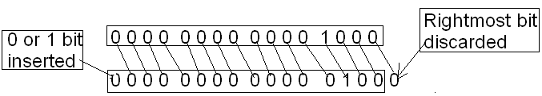
>> is a binary operator that requires two integral operands. the first one is value to be shifted, the second one specifies number of bits to be shifted.
The general form is as follows:
variable >> expression;
When bits are shifted right, the bits at the rightmost end are deleted.
Shift right operator divides by a power of 2. I.e. a>>n results in a/2^{n}, where n is number of bits to be shifted.
Example: a=8;
b=a>>1;
8>>1
// assigns 4 after shift right operation

Slide 44
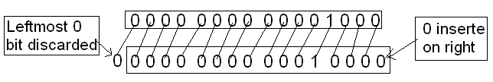
<< is a binary operator that requires two integral operands. the first one is value to be shifted, the second one specifies number of bits to be shifted.
The general form is as follows:
variable << expression;
When bits are shifted left, the bits at the leftmost end are deleted.
Example: a=8;
b=a<<1; // assigns 16 after left shift operation
Shift left operator multiply by a power of 2, a<<n results in a*2^{n}, where n is number of bits to be shifted.
1

Slide 45
Special Operators
C supports the following special category of operators.
& Address operator
* Indirection operator(value at)
, Comma operator
sizeof() Size of operator
. and → Member selection Operators

Slide 46
comma operator :
It doesn’t operate on data but allows more than one expression to appear on the same line.
Example: int i = 10, j = 20;
printf (%d %.2f %c”, a,f,c);
j = (i = 12, i + 8); //i is assigned 12 added to 8 produces 20
sizeof Operator :
It is a unary operator (operates on a single value).
Produces a result that represent the size in bytes.
Syntax: sizeof(datatype);
Example: int a = 5;
sizeof (a); //produces 2
sizeof(char); // produces 1
sizeof(int); // produces 2

Slide 47
Precedence and Association rules among operators
Precedence is used to determine the order in which different operators in a complex expression are evaluated.
Associativity is used to determine the order in which operators with the same precedence are valuated in a complex expression.
Every operator has a precedence.
The operators which has higher precedence in the expression is
evaluated first.
Example: a=8+4*2;
a=? (16)

Slide 48
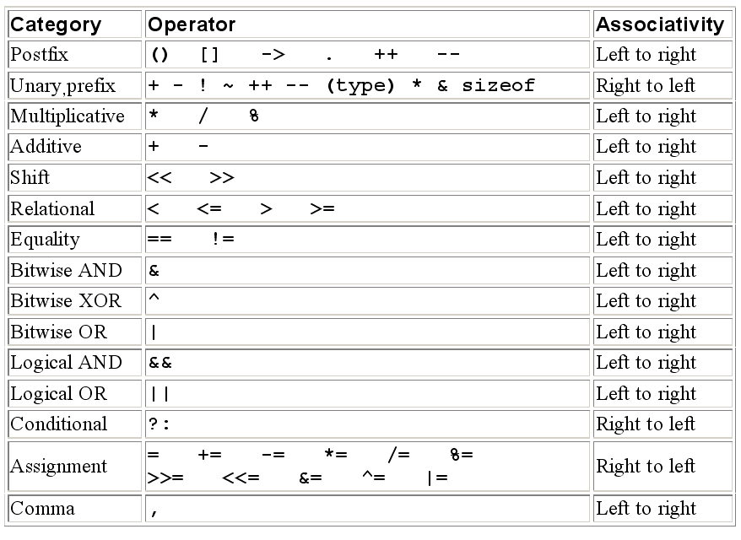
Precedence and Associativity of Operators in C (from higher to lower)

Slide 49
Example program to illustrate operator precedence

Slide 50
Example program to illustrate operator precedence (contd…)

Slide 52
Left-to-Right Associativity

Slide 53
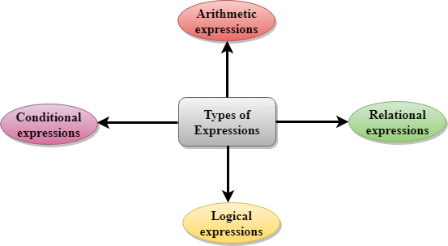
Expressions:

Slide 54
An expression is a sequence of operands and operators that reduces to a single value.
Expressions can be simple or complex.
An operator is a syntactical token that requires an action be taken.
An operand is an object on which an operation is performed; it receives an operator’s action.

Slide 55
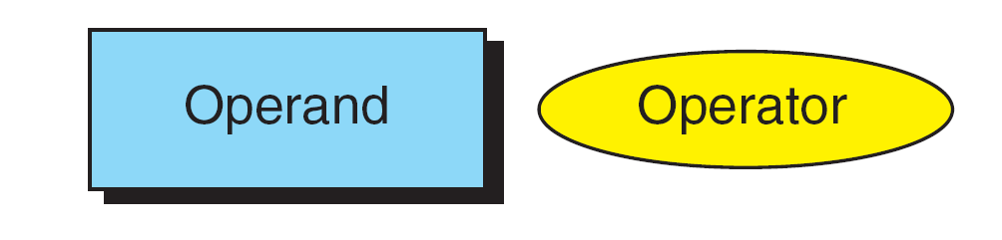
Post fix expression:
It is an expression which contains operand followed by one operator.
Example: a++; a- -;
The operand in a postfix expression must be a variable.
(a++) has the same effect as (a = a + 1)
If ++ is after the operand, as in a++, the increment takes place after the expression is evaluated.

Slide 56
In the following figure:
Value of the variable a is assigned to x
Value of the a is incremented by 1.
expression
Result of Postfix a++

Slide 57
Example for Post fix expression
#include<stdio.h>
void main()
{
int a=10,x;//
x=--a;
printf(“x=%d, a=%d”,x,a);
}
Output:
x=10, a=11

Slide 58
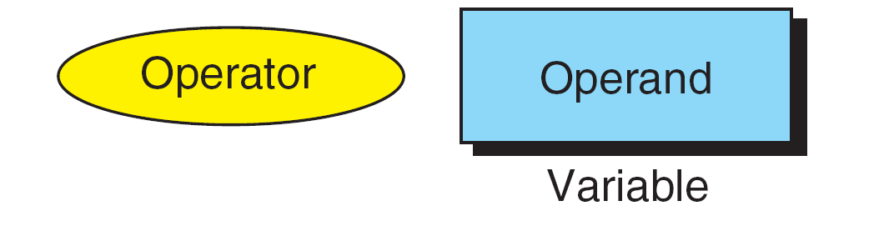
Pre fix expression:
It is an expression which contains operator followed by an operand.
Example: ++a; - -a;
The operand of a prefix expression must be a variable.
(++a) has the same effect as (a = a + 1)
If ++ is before the operand, as in ++a, the increment takes place before the expression is evaluated.
Prefix Expression

Slide 59
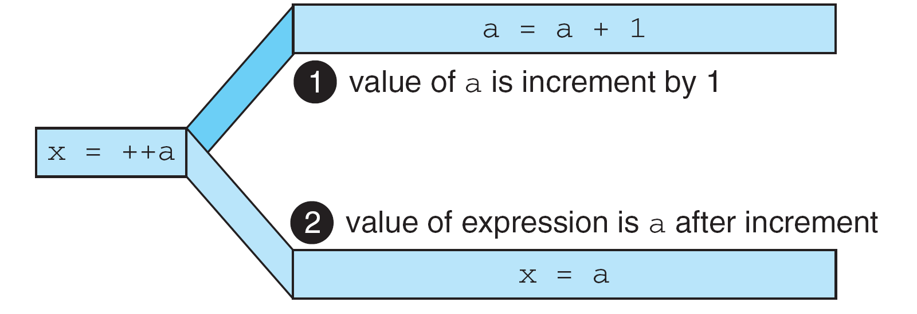
Result of prefix ++a

Slide 60
Example on pre fix expression
#include<stdio.h>
void main()
{
int a=10,x;
x=++a;
printf(“x=%d, a=%d”,x,a);
}
Output:
x=11, a=11

Slide 61
Evaluating Expressions
A side effect is an action that results from the evaluation of an expression.
For example, in an assignment, C first evaluates the expression on the right of the assignment operator and then places the value in the left variable.
Changing the value of the left variable is a side effect.

Slide 62
Arithemetic Expression:
1)6*2/( 2+1 * 2/3 +6) +8 * (8/4)=17

Slide 63
Logical expression
( x > 4 ) && ( x < 6 ) It is a test condition to check whether the x is greater than 4 and x is less than 6. The result of the condition is true only when both the conditions are true.
x > 10 || y <11 It is a test condition used to check whether x is greater than 10 or y is less than 11. The result of the test condition is true if either of the conditions holds true value.
! ( x > 10 ) && ( y = = 2 ) It is a test condition used to check whether x is not greater than 10 and y is equal to 2. The result of the condition is true if both the conditions are true.

Slide 64
#include <stdio.h>
int main()
{
int x = 4;
int y = 10;
if ( (x <10) && (y>5))
{
printf("Condition is true");
}
else
printf("Condition is false");
return 0;
}

Slide 65
Conditional Expressions
exp1 ? exp2 : exp3
#include<stdio.h>
#include<string.h>
int main()
{
int age = 25;
char status;
status = (age>22) ? 'M': 'U';
if(status == 'M')
printf("Married");
else
printf("Unmarried");
return 0;
}

Slide 66
Statements
A statement causes an action to be performed by the program.
It translates directly into one or more executable computer instructions.
Generally statement is ended with semicolon.
Most statements need a semicolon at the end; some do not.
Notes:
<number>

Slide 67
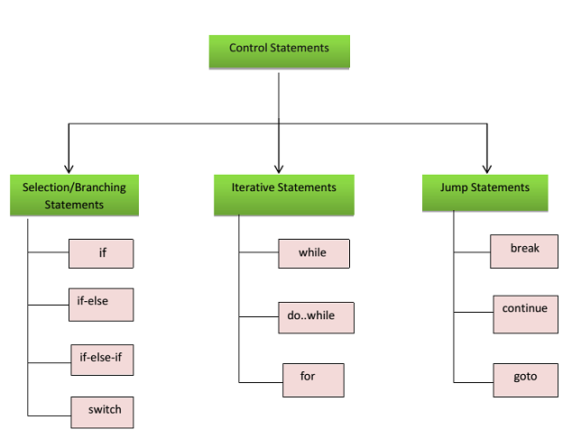

Slide 68
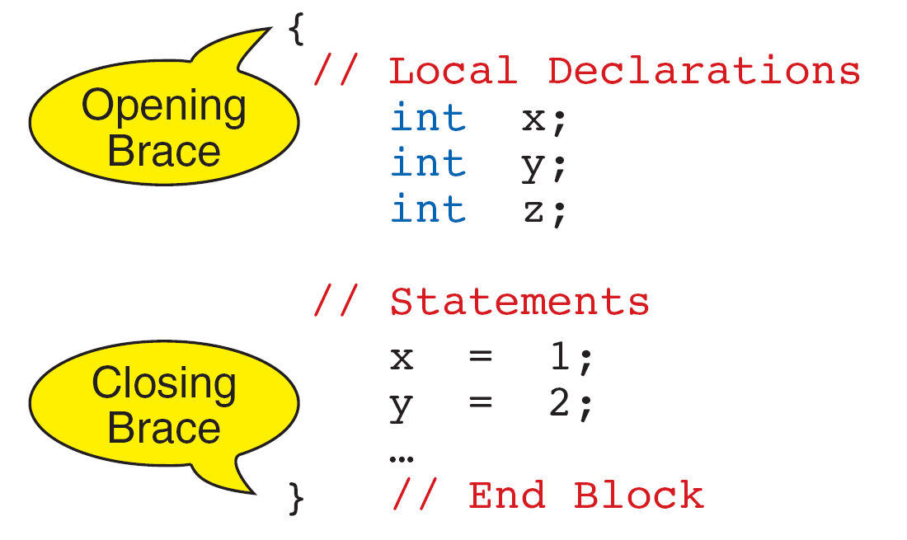
Compound statements are used to group the statements into a single executable unit.
It consists of one or more individual statements enclosed within the braces { }
Compound Statement

Slide 69
Decision Control Structures
The decision is described to the computer as a conditional statement that can be answered either true or false.
If the answer is true, one or more action statements are executed.
If the answer is false, then a different action or set of actions is executed.
Types of decision control structures:
if
if..else
nested if…else
else if ladder
switch statement
Notes:
<number>

Slide 70
Decision Control Statement: if
The general form of a simple if statement is:
if (condition)
{
statement-block;
}
Following are the properties of an if statement:
If the condition is true then the statement-block will be executed.
If the condition is false it does not do anything ( or the statement is skipped)
The condition is given in parentheses and must be evaluated as true
(nonzero value) or false (zero value).
If a compound statement is provided, it must be enclosed in opening
and closing braces.

Slide 71
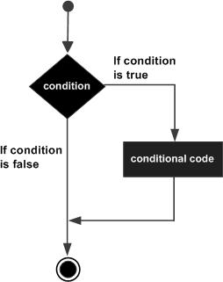
Decision Control Statement: if
Flow Chart
Example:
main()
{
int a=10,b=20;
if(a>b)
{
printf(“%d”,a);
}
printf(“%d”,b);
}

Slide 72
Decision Control Statement: if..else
;
;
if...else Logic Flow

Slide 73
Syntactical Rules for if…else Statements
The expression or condition which is followed by if statement must be enclosed in parenthesis.
No semicolon is needed for an if…else statement.
Both the true and false statements can be any statement (even another if…else).
Multiple statements under if and else should be enclosed between curly braces.
No need to enclose a single statement in curly braces.

Slide 74
Decision Control Statement: nested if…else
Nested if…else means within the if…else you can include another if…else either in
if block or else block.
Nested if…else Statements

Slide 75
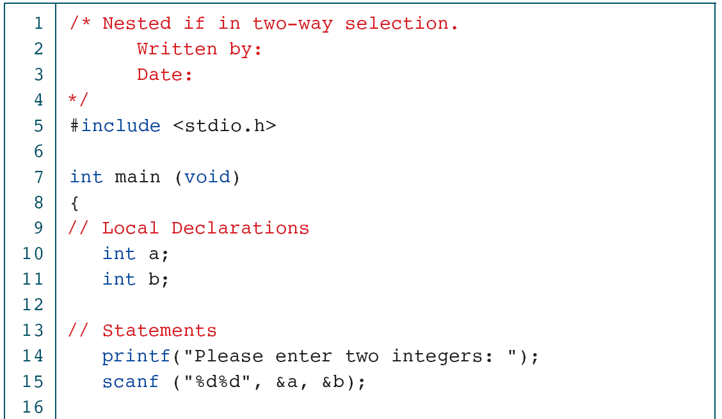
Decision Control Statement: nested if…else

Slide 76
Decision Control Statement: nested if…else

Slide 77
Decision Control Statement: else if
if (condition1)
statements1;
else if (condition2)
statements2;
else if (condition3)
statements3;
else if (condition4)
statements4;
……
else if(conditionn)
statementsn;
else
default_statement;
statement x;
The conditions are evaluated from the top to down.
As soon as a true condition is found the statement associated with it is executed
and the control is transferred to the statementx by skipping the rest of the ladder.
When all n conditions become false,final else containing default_statement
that will be executed

Slide 78
Example program for else if
main()
{
float m1,m2,m3,m4;
float perc;
printf(“enter marks\n”);
scanf(“%f%f%f%f”,&m1,&m2,&m3,&m4);
perc=(m1+m2+m3+m4)/4;
if(perc>=75)
printf(“\nDistinction”);
else if(per<75 && per>=60)
printf(“\nFirst Class”);
else if(per<60 && per>=50)
printf(“\nSecond Class”);
else if(per<50 && per>=40)
printf(“\nThird Class”);
else
printf(“\nFail”);
}//main

Slide 79
Decision Control Statement: switch
It is a multi-way conditional statement generalizing the if…else
statement.
It is a conditional control statement that allows some particular group
of statements to be chosen from several available groups.
A switch statement allows a single variable to be compared with
several possible case labels, which are represented by constant values.
If the variable matches with one of the constants, then an execution
jump is made to that point.
A case label cannot appear more than once and there can only be one
default expression.

Slide 80
Decision Control Statement: switch
Note: switch statement does not allow less than ( < ), greater than ( > ).
ONLY the equality operator (==) is used with a switch statement.
The control variable must be integral (int or char) only.
When the switch statement is encountered, the control variable is evaluated.
Then, if that evaluated value is equal to any of the values specified in a case clause, the statements immediately following the colon (“:”) begin to run.
Default case is optional and if specified, default statements will be executed, if there is no match for the case labels.
Once the program flow enters a case label, the statements associated with case have been executed, the program flow continues with the statement for the next case. (if there is no break statement after case label.)

Slide 81
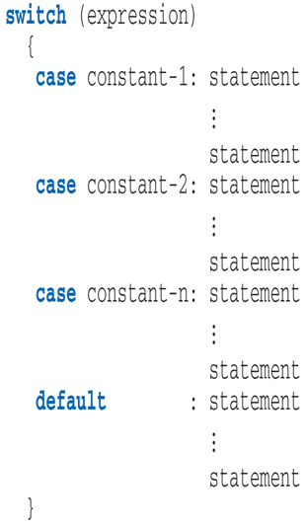
Decision Control Statement: switch
General format of switch:

Slide 82
Decision Control Statement: switch
The following results are possible, depending on the value of printFlag.
If printFlag is 1, then all three printf statements are executed.
If printFlag is 2, then the first print statement is skipped and the last two are executed.
Finally, if printFlag is neither 1 nor 2, then only the statement defined by the default is executed.

Slide 83
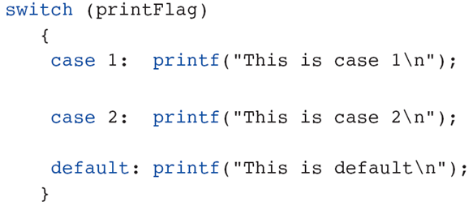
Decision Control Statement: switch
Example1 for switch statement:

Slide 84
Decision Control Statement: switch
If you want to execute only one case-label, C provides break statement.
It causes the program to jump out of the switch statement, that is go to the closing braces (}) and continues the remaining code of the program.
If we add break to the last statement of the case, the general form of switch case is as follows:

Slide 85
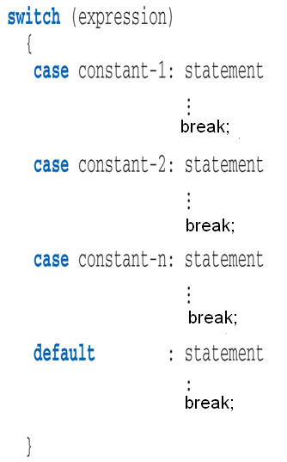
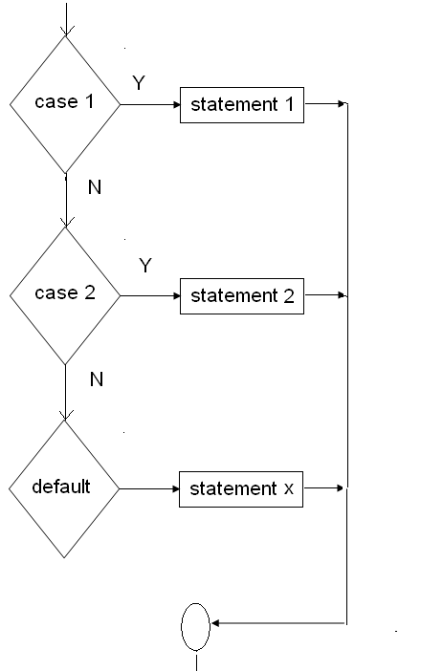
Decision Control Statement: switch
General format of switch:

Slide 86
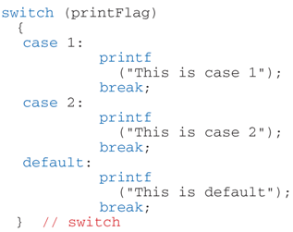
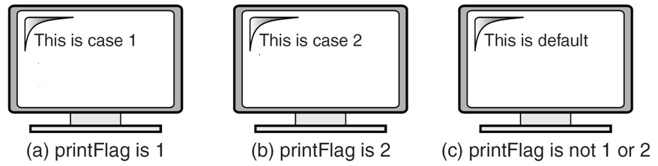
Decision Control Statement: switch
Example2 for switch statement:

