Slide 1
Fraud Call Detection in Mobile Banking App
Enhancing Security in Banking Communication

Slide 2
Introduction
- Overview of the fraud call detection feature
- Importance of securing banking communication

Slide 3
Feature Overview
- Utilizes CallKit for fraud call detection
- Allows users to verify if a caller is genuinely from the bank
- Provides real-time push notifications for verification

Slide 4
How It Works
1. User receives a call from someone claiming to be from the bank.
2. If unsure, the user enables the 'Detect Fraud' toggle in the app.
3. During or after the call, a push notification prompts verification.
4. Clicking 'Verify Banker' triggers backend validation.
5. Backend checks the number against the bank’s database.
6. Verification result is sent as a push notification to the user.

Slide 5
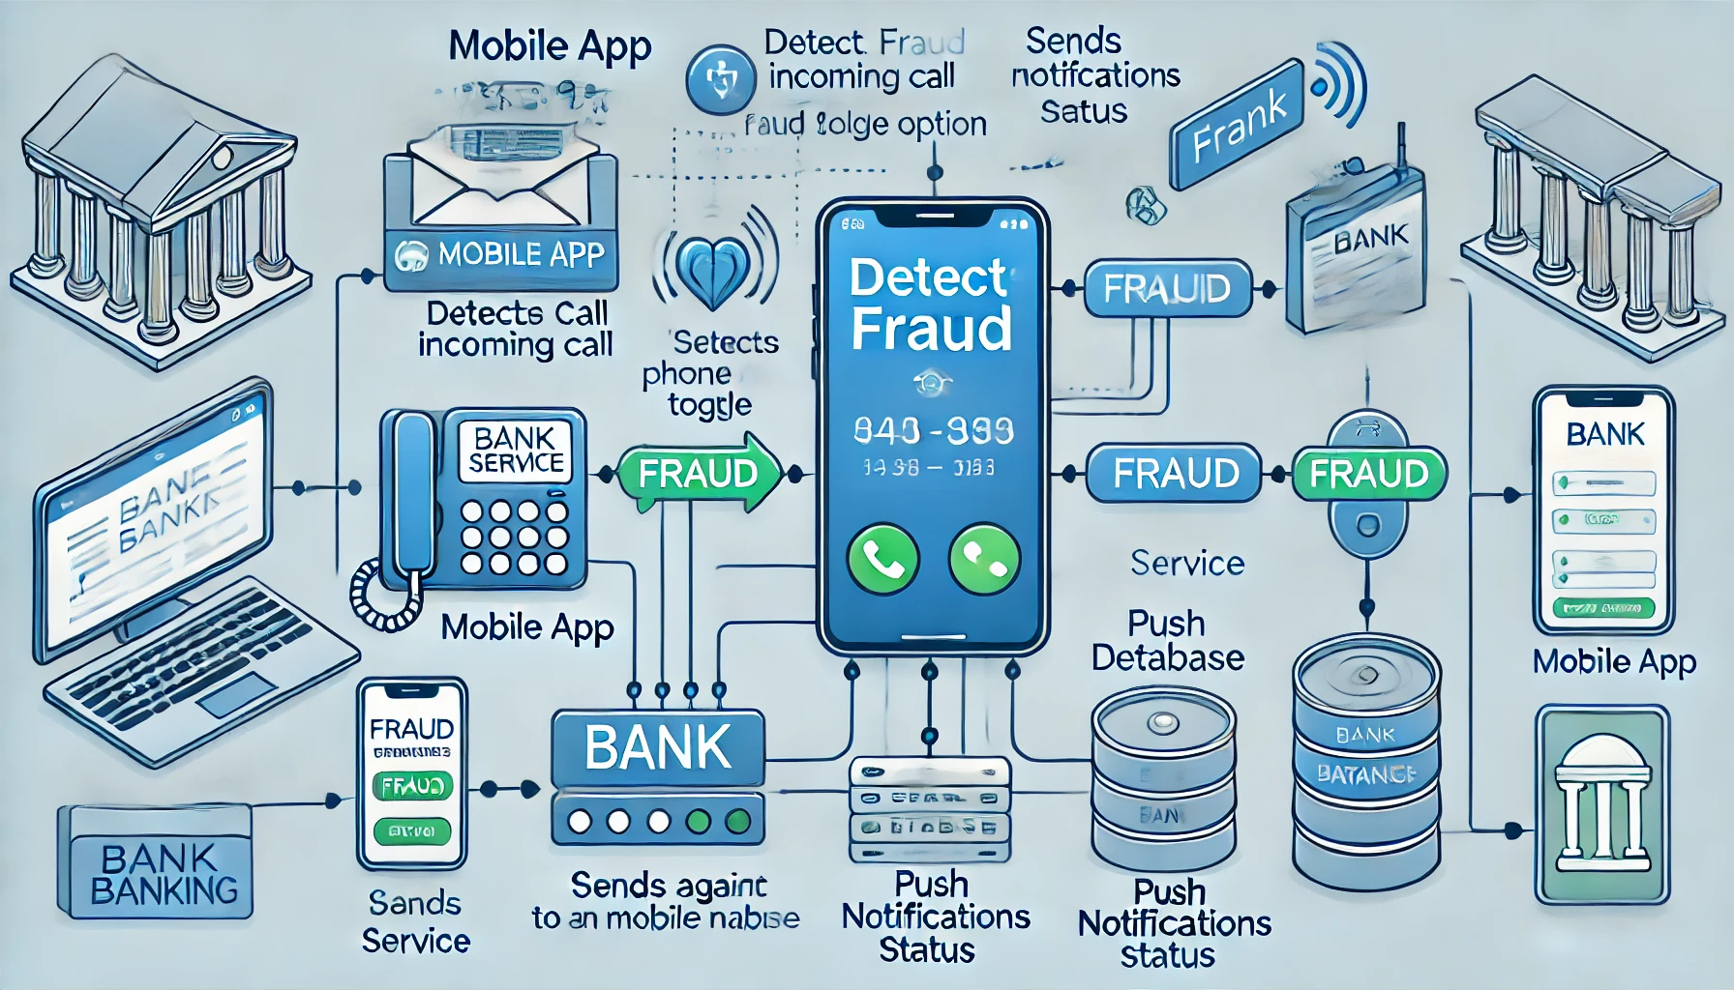
Architecture Diagram

Slide 6
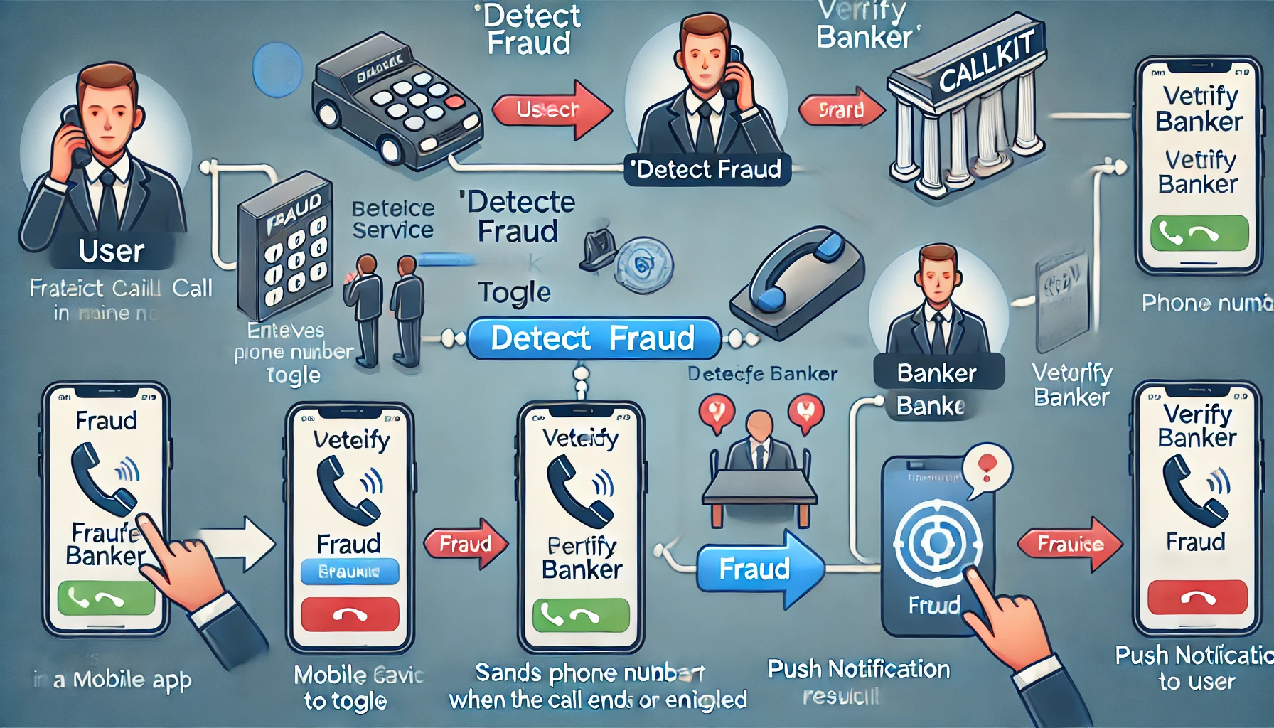
Sequence Flow

Slide 7
Benefits
- Helps customers avoid banking fraud.
- Enables real-time verification without manual intervention.
- Ensures trusted communication between banks and customers.

Slide 8
Conclusion
- Summary of the feature’s impact.
- Future enhancements (e.g., AI-based fraud detection).

Slide 9
Q&A
- Open for questions and discussions.

