Slide 1
Concurrency and Mutual exclusion
Eighth Edition
By William Stallings
Notes:
“Operating Systems: Internal and Design Principles”, 8/e, by William Stallings, Chapter 3 “Process Description and Control”.

Slide 2
Atomic operations
http://www.developerfusion.com/article/138018/memory-ordering-for-atomic-operations-in-c0x/
In concurrent programming, an operation (or set of operations) is atomic, linearizable, indivisible or uninterruptible if it appears to the rest of the system to occur instantaneously.
Atomicity is a guarantee of isolation from concurrent processes.
Is it necessary for Mutual Exclusion?
Is it necessary to implement Semaphores?
Notes:
Before defining the term process , it is useful to summarize some of the concepts
introduced in Chapters 1 and 2 :
1. A computer platform consists of a collection of hardware resources, such as
the processor, main memory, I/O modules, timers, disk drives, and so on.
2. Computer applications are developed to perform some task. Typically, they
accept input from the outside world, perform some processing, and generate
output.
3. It is inefficient for applications to be written directly for a given hardware
platform. The principal reasons for this are as follows:
a. Numerous applications can be developed for the same platform. Thus, it
makes sense to develop common routines for accessing the computer’s
resources.
b. The processor itself provides only limited support for multiprogramming.
Software is needed to manage the sharing of the processor and other
resources by multiple applications at the same time.
c. When multiple applications are active at the same time, it is necessary to
protect the data, I/O use, and other resource use of each application from
the others.
4. The OS was developed to provide a convenient, feature-rich, secure, and consistent
interface for applications to use. The OS is a layer of software between
the applications and the computer hardware ( Figure 2.1 ) that supports applications
and utilities.
5. We can think of the OS as providing a uniform, abstract representation of
resources that can be requested and accessed by applications. Resources
include main memory, network interfaces, file systems, and so on. Once the
OS has created these resource abstractions for applications to use, it must
also manage their use. For example, an OS may permit resource sharing and
resource protection.

Slide 3
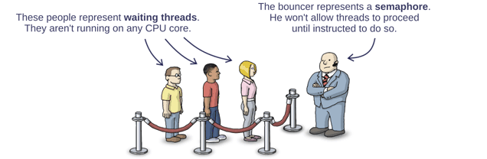
semaphores
A Semaphore Is Like a Bouncer
Any running thread can call signal at any time, and when it does, the bouncer releases exactly one waiting thread from the queue. (Not necessarily in the same order they arrived.)
http://preshing.com/20150316/semaphores-are-surprisingly-versatile/
Notes:
Before defining the term process , it is useful to summarize some of the concepts
introduced in Chapters 1 and 2 :
1. A computer platform consists of a collection of hardware resources, such as
the processor, main memory, I/O modules, timers, disk drives, and so on.
2. Computer applications are developed to perform some task. Typically, they
accept input from the outside world, perform some processing, and generate
output.
3. It is inefficient for applications to be written directly for a given hardware
platform. The principal reasons for this are as follows:
a. Numerous applications can be developed for the same platform. Thus, it
makes sense to develop common routines for accessing the computer’s
resources.
b. The processor itself provides only limited support for multiprogramming.
Software is needed to manage the sharing of the processor and other
resources by multiple applications at the same time.
c. When multiple applications are active at the same time, it is necessary to
protect the data, I/O use, and other resource use of each application from
the others.
4. The OS was developed to provide a convenient, feature-rich, secure, and consistent
interface for applications to use. The OS is a layer of software between
the applications and the computer hardware ( Figure 2.1 ) that supports applications
and utilities.
5. We can think of the OS as providing a uniform, abstract representation of
resources that can be requested and accessed by applications. Resources
include main memory, network interfaces, file systems, and so on. Once the
OS has created these resource abstractions for applications to use, it must
also manage their use. For example, an OS may permit resource sharing and
resource protection.

Slide 4
semaphores
Each thread decides for itself when to join the queue.
Dijkstra called this the P operation. P originally stood for some funny-sounding Dutch word, but in a modern semaphore implementation, you’re more likely to see this operation called wait.
Basically, when a thread calls the semaphore’s wait operation, it enters the lineup.
The bouncer, himself, only needs to understand a single instruction. Originally, Dijkstra called this the V operation. Nowadays, the operation goes by various names, such as post, release or signal.
Any running thread can call signal at any time, and when it does, the bouncer releases exactly one waiting thread from the queue. (Not necessarily in the same order they arrived.)
Now, what happens if some thread calls signal before there are any threads waiting in line? No problem: As soon as the next thread arrives in the lineup, the bouncer will let it pass directly through

Slide 5

semaphores
If signal is called, say, 3 times on an empty lineup, the bouncer will let the next 3 threads to arrive pass directly through.
Of course, the bouncer needs to keep track of this number, which is why all semaphores maintain an integer counter. signal increments the counter, and wait decrements it.
Notes:
Before defining the term process , it is useful to summarize some of the concepts
introduced in Chapters 1 and 2 :
1. A computer platform consists of a collection of hardware resources, such as
the processor, main memory, I/O modules, timers, disk drives, and so on.
2. Computer applications are developed to perform some task. Typically, they
accept input from the outside world, perform some processing, and generate
output.
3. It is inefficient for applications to be written directly for a given hardware
platform. The principal reasons for this are as follows:
a. Numerous applications can be developed for the same platform. Thus, it
makes sense to develop common routines for accessing the computer’s
resources.
b. The processor itself provides only limited support for multiprogramming.
Software is needed to manage the sharing of the processor and other
resources by multiple applications at the same time.
c. When multiple applications are active at the same time, it is necessary to
protect the data, I/O use, and other resource use of each application from
the others.
4. The OS was developed to provide a convenient, feature-rich, secure, and consistent
interface for applications to use. The OS is a layer of software between
the applications and the computer hardware ( Figure 2.1 ) that supports applications
and utilities.
5. We can think of the OS as providing a uniform, abstract representation of
resources that can be requested and accessed by applications. Resources
include main memory, network interfaces, file systems, and so on. Once the
OS has created these resource abstractions for applications to use, it must
also manage their use. For example, an OS may permit resource sharing and
resource protection.

Slide 6
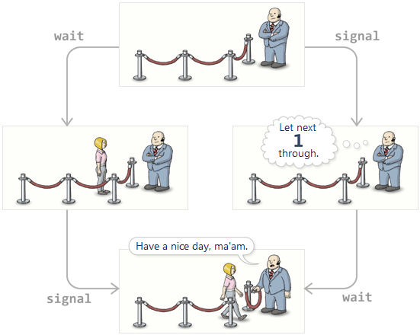
semaphores
The beauty of this strategy is that if wait is called some number of times, and signal is called some number of times, the outcome is always the same: The bouncer will always release the same number of threads, and there will always be the same number of threads left waiting in line, regardless of the order in which those wait and signal calls occurred.

Slide 7
semaphores
Semaphore
Binary Semaphore
Counting Semaphore
General Semaphore
Weak Semaphore
Strong Semaphore

Slide 8
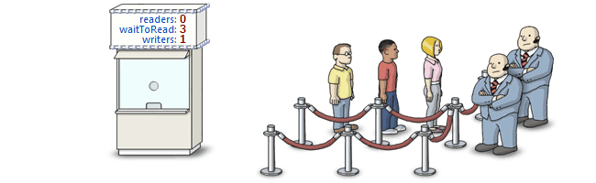
concurrency terms
Condition Variable
Monitor
Mutex
Spin Lock (busy wait)
Event Flag
Mailbox / Messages
Atomic Operation

Slide 9
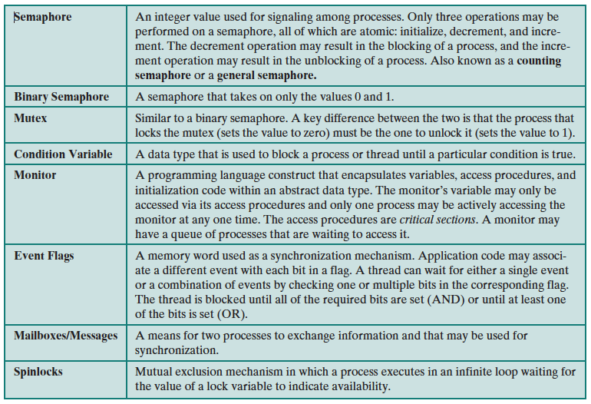
concurrency terms

Slide 10
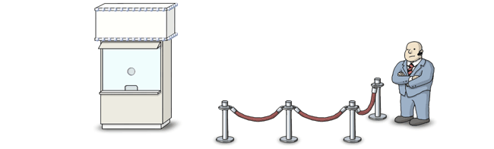
mutex
^{atomic operation}
^{critical section}

Slide 11
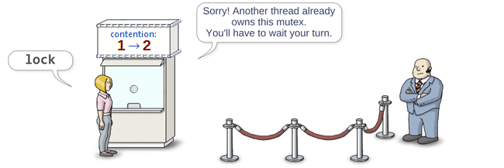
mutex
^{atomic operation}
^{critical section}
Notes:
Before defining the term process , it is useful to summarize some of the concepts
introduced in Chapters 1 and 2 :
1. A computer platform consists of a collection of hardware resources, such as
the processor, main memory, I/O modules, timers, disk drives, and so on.
2. Computer applications are developed to perform some task. Typically, they
accept input from the outside world, perform some processing, and generate
output.
3. It is inefficient for applications to be written directly for a given hardware
platform. The principal reasons for this are as follows:
a. Numerous applications can be developed for the same platform. Thus, it
makes sense to develop common routines for accessing the computer’s
resources.
b. The processor itself provides only limited support for multiprogramming.
Software is needed to manage the sharing of the processor and other
resources by multiple applications at the same time.
c. When multiple applications are active at the same time, it is necessary to
protect the data, I/O use, and other resource use of each application from
the others.
4. The OS was developed to provide a convenient, feature-rich, secure, and consistent
interface for applications to use. The OS is a layer of software between
the applications and the computer hardware ( Figure 2.1 ) that supports applications
and utilities.
5. We can think of the OS as providing a uniform, abstract representation of
resources that can be requested and accessed by applications. Resources
include main memory, network interfaces, file systems, and so on. Once the
OS has created these resource abstractions for applications to use, it must
also manage their use. For example, an OS may permit resource sharing and
resource protection.

Slide 12
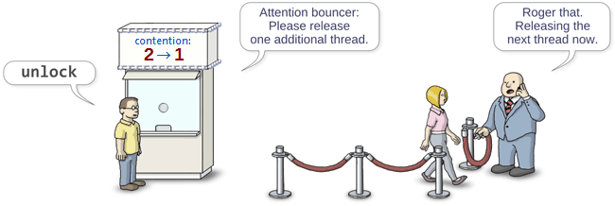
mutex
^{atomic operation}
^{critical section}
Notes:
Before defining the term process , it is useful to summarize some of the concepts
introduced in Chapters 1 and 2 :
1. A computer platform consists of a collection of hardware resources, such as
the processor, main memory, I/O modules, timers, disk drives, and so on.
2. Computer applications are developed to perform some task. Typically, they
accept input from the outside world, perform some processing, and generate
output.
3. It is inefficient for applications to be written directly for a given hardware
platform. The principal reasons for this are as follows:
a. Numerous applications can be developed for the same platform. Thus, it
makes sense to develop common routines for accessing the computer’s
resources.
b. The processor itself provides only limited support for multiprogramming.
Software is needed to manage the sharing of the processor and other
resources by multiple applications at the same time.
c. When multiple applications are active at the same time, it is necessary to
protect the data, I/O use, and other resource use of each application from
the others.
4. The OS was developed to provide a convenient, feature-rich, secure, and consistent
interface for applications to use. The OS is a layer of software between
the applications and the computer hardware ( Figure 2.1 ) that supports applications
and utilities.
5. We can think of the OS as providing a uniform, abstract representation of
resources that can be requested and accessed by applications. Resources
include main memory, network interfaces, file systems, and so on. Once the
OS has created these resource abstractions for applications to use, it must
also manage their use. For example, an OS may permit resource sharing and
resource protection.

Slide 13
Deadlock
Mutual Exclusion Condition
The resources involved are non-shareable.
Hold and Wait Condition
Requesting process hold already, resources while waiting for requested resources.
No-Preemptive Condition
Resources already allocated to a process cannot be preempted.
Circular Wait Condition
The processes in the system form a circular list or chain where each process in the list is waiting for a resource held by the next process in the list.

Slide 14
Readers writers
http://cs.nyu.edu/~lerner/spring12/Read04-ReadersWriters.pdf
This deals with the situation in which many threads try to access the same shared resource at one time.
Some threads may read and some may write, with the constraint that no process may access the share for either reading or writing, while another process is in the act of writing to it.
It is allowed for two or more readers to access the share at the same time.

Slide 15
Producer consumer
The problem describes two processes, the producer and the consumer, who share a common, fixed-size buffer used as a queue.
The producer's job is to generate a piece of data, put it into the buffer and start again.
At the same time, the consumer is consuming the data (i.e., removing it from the buffer) one piece at a time.
The problem is to make sure that the producer won't try to add data into the buffer if it's full and that the consumer won't try to remove data from an empty buffer.

