Slide 1






INTERNSHIP RECOMMENDATION ENGINE
FOR PM INTERNSHIP SCHEME
By,
2303717673721020-Krishna Sanjay J
2303717673721022-Madhan G

Slide 2
INTRODUCTION
Our project is to finding the right internship under the PM Internship Scheme which is challenging due to large volumes of opportunities. This project builds a Machine Learning and rule-based Recommendation Engine that matches students with suitable internships based on their skills, qualifications, and preferences. Using models like Random Forest and XGBoost, it provides accurate and personalized recommendations.

Slide 3
PROBLEM STATEMENT
The PM Internship Scheme provides students with a wide range of internship opportunities across government departments and partner organizations.
However, with numerous internships available, candidates often face difficulty in identifying positions that best match their skills, education, interests, and career aspirations.
Traditional approaches rely on manual search or basic filtering, which is time-consuming, inefficient, and may not capture true candidate-internship compatibility.

Slide 4
OBJECTIVE
The goal of this project, “Internship Recommendation Engine for PM Internship Scheme”, is to develop an intelligent system that automatically predicts the suitability of a candidate for different internships under the scheme.
By analyzing candidate profiles (skills, educational background, preferred locations, and sectors) and internship requirements, the system will provide personalized, ranked internship recommendations

Slide 5
METHODOLOGY
Data Collection: Internship-related data such as company name, role, stipend, location, and required skills were gathered and organized into a dataset.
Data Preprocessing: Missing values were handled, categorical features were encoded, and numerical features were scaled for uniformity.
Feature Engineering: New attributes like skill count, degree eligibility, stipend tier, and company size were created to enhance model accuracy.
Model Training: Multiple machine learning models — including Logistic Regression, Decision Tree, Random Forest, XGBoost, and LightGBM — were trained and tested.
Ensemble Learning: A Stacking Classifier combining the strengths of different models was used to improve performance and accuracy.
Recommendation Generation: Based on user inputs such as skills, degree, location, and stipend preference, the trained model ranks and recommends the most suitable internships.

Slide 6
TECHNOLOGY STACK USED
Language: Python
Frontend: Streamlit (Interactive Web App)
Libraries: Pandas, NumPy, Matplotlib, Seaborn
Machine Learning: Scikit-learn, XGBoost, LightGBM
Model Storage: Pickle (for saving trained models & encoders)
Feature Extraction: TF-IDF Vectorizer
Tools & Environment: Jupyter Notebook, VS Code
Dataset: company.csv (Internship data for training & analysis)

Slide 7
MODEL IMPLEMENTATION
Data Loading: Imported internship dataset with company, role, stipend, skills, location, and degrees.
Preprocessing: Handled missing values, encoded categorical features, normalized numerical data, extracted skills via TF-IDF.
Feature Engineering: Added skill/degree count, stipend tier, role popularity, company size, remote & top company flags.
Model Training: Trained Logistic Regression, Decision Tree, Random Forest, XGBoost, LightGBM; final model via Stacking Ensemble.
Evaluation: Accuracy, Confusion Matrix, Classification Report.
Recommendation: Suggests top internships based on user profile and match score.

Slide 8
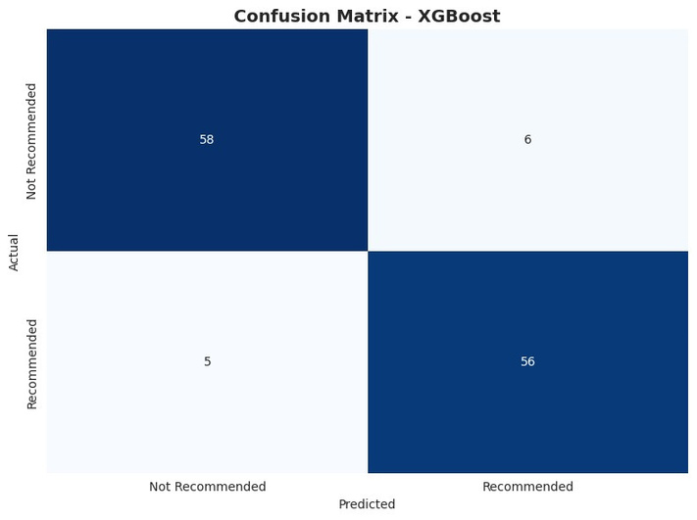
RESULT & EVALUATION
Model evaluation
DETAILED EVALUATION: XGBoost
Model Accuracy Rank
XGBoost 0.912 1
LightGBM 0.896 2
Decision Tree 0.856 3
Random Forest 0.816 4

Slide 9
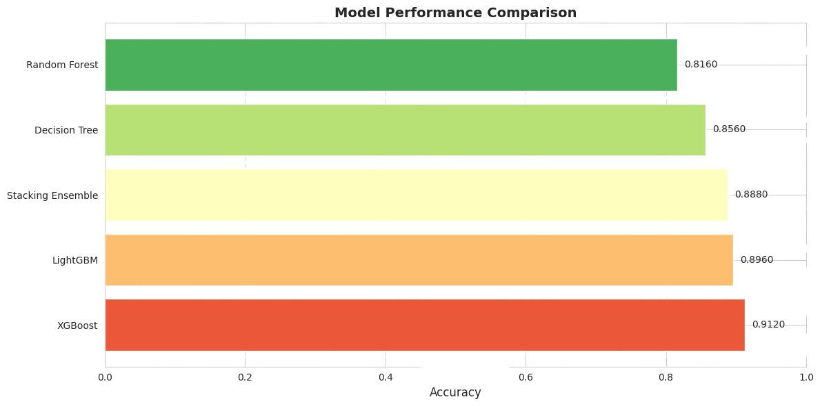
RESULT & EVALUATION

Slide 10
CONCLUSION
Successfully developed an internship recommendation system tailored to user skills, degree, location, and preferences.
Feature engineering and text-based skill analysis significantly improved recommendation accuracy.
The stacking ensemble model provided the best performance among all models tested.
Users can get personalized internship suggestions, making the search process faster and more efficient.
Future improvements could include real-time data updates, company reviews, and advanced skill matching.

Slide 11
THANK
YOU

