Slide 1
“Pahilo Mart”
A Grocery E-sell System
Presented by:
Purna Bahadur Lungelli
Shree krishna Sapkota
Bishal kharel

Slide 2
Topics To Be Discussed
Introduction
Background Study
Statement of problems
Objectives
Methodology
Implementation and tools to be used
Time Plan
Resources

Slide 3
Introduction
Website for Finding Grocery Online
Types of Users:
Buyer
Seller
Reduce the problem of going to market and crowdy places
Cash On delivery is preferred

Slide 4
Background
It is fastest growing service right now
People are getting busier in day to day life so to reduce their time on buying grocery
Focuses On quality of products
Focuses on time management

Slide 5
Statement Of problem
To provide products of customer's choice
To reduce time for user to go shopping
To provide the products to user as cheap as possible

Slide 6
Objectives
To provide unique customer experience
To establish better business relationships
To improve customer loyalty
To sell more products
To reduce management costs
To boost the efficiency of services

Slide 7
Methodology
Requirement Collection
By conducting the interview (open ended).
Required Categorization on basis of module

Slide 8
Tools and technology
Front-end Development
HTML
CSS
JavaScript
Bootstrap
Back-end Development
PHP
Database (My-SQL)

Slide 9
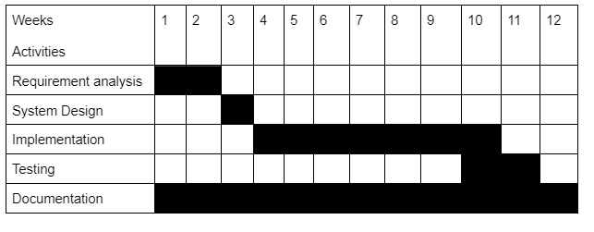
Time Plan

Slide 10
References
S. E. Ullah, T. Alauddin and H. U. Zaman, "Developing an E-commerce website," 2016 International Conference on Microelectronics, Computing and Communications (MicroCom), 2016, pp. 1-4, doi: 10.1109/MicroCom.2016.7522526.
DOI “https://ieeexplore.ieee.org/abstract/document/7522526”

Slide 11
Thank you!!!

