Slide 1

Ice Analyzers
Climate Crisis Hackathon 2021
Krishna, Samantha, Thomas, Guang

Slide 2
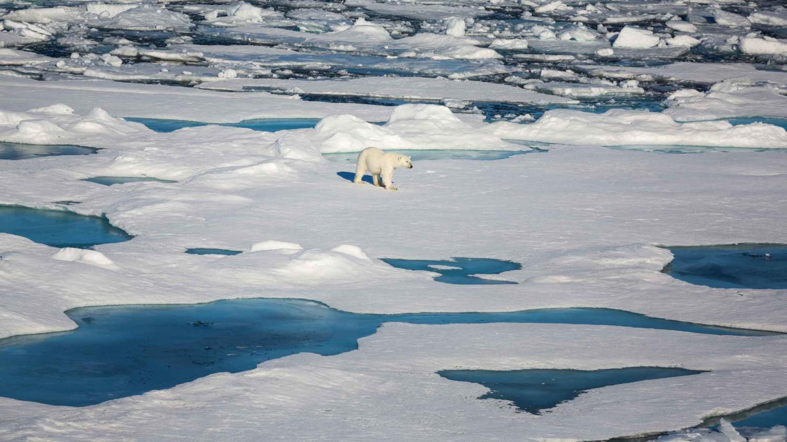
Motivation
We estimate the velocity of the sea ice in order to gain insights into the dynamical response of the Arctic Ocean in the midst of climate change.
Notes:
Can book with Elham for explaining models

Slide 3
Sea Ice Challenge
Goal: predict drifting ice velocity on buoys
Challenge goal: reproduce u_buoy and v_buoy components of sea ice drift velocity
Model prediction:
Y: sea ice velocity of drifting buoys
X: factors such as wind, sea ice thickness, distance to coast

Slide 4
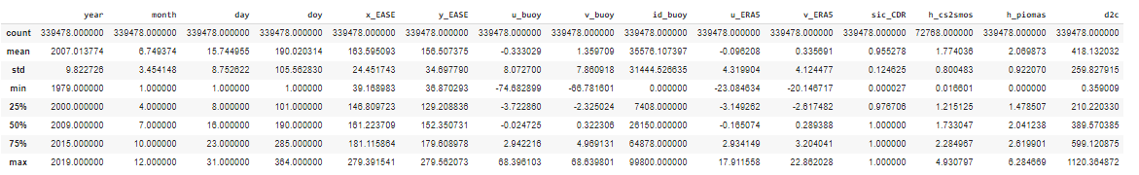
Data Exploration - Table

Slide 5
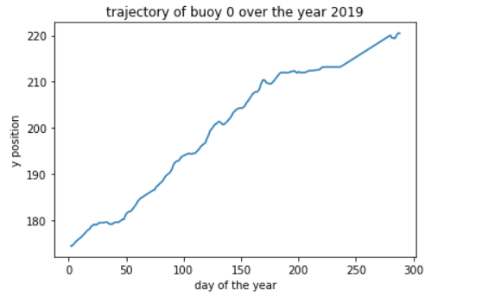
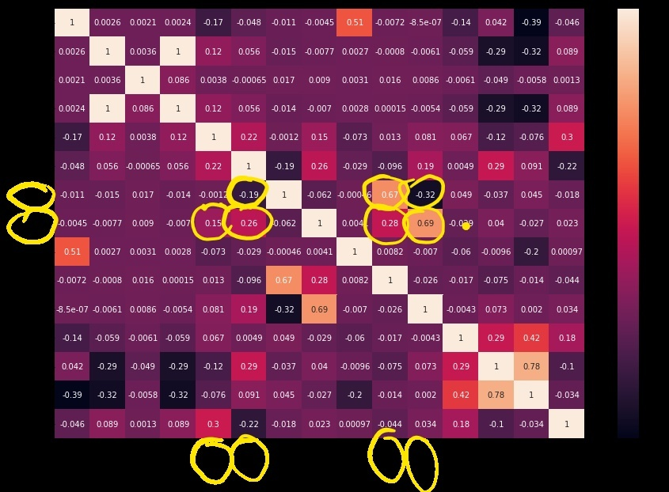
Data Exploration - Heatmap

Slide 6
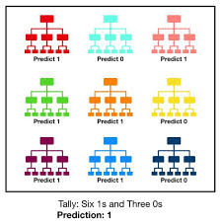
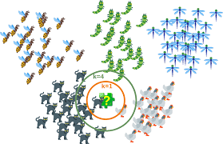
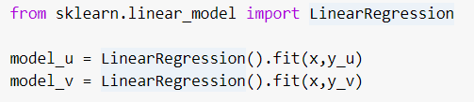

Models Building and Training
KNN (k-Nearest Neighbours)
Random Forest
Linear Regression

Slide 7
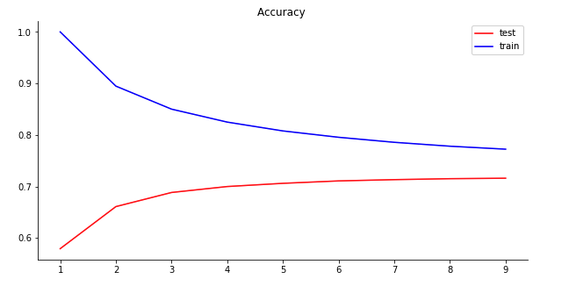
Model: k-Nearest Neighbours

Slide 8


Conclusion:
Data Visualizations:
Predictions vs. Actuals
Evaluate Accuracy
Potential better results with CNN (filters, #layers,tuning)
Notes:
Can book with Elham for explaining models

