Slide 1






SMART INDIA HACKATHON 2026
TITLE PAGE
  Problem Statement ID: SIH26264
  Problem Statement Title: Integrated Dashboard for Monitoring and Tracking Institution-Related Complaint Cases Across AICTE Bureaus/Cells
  Theme: Smart Automation
  PS Category: Software
  Team ID: SIH26-DU-T07
  Team Name: AstraX

Slide 2



















UNICOMPLY
ONE VIEW OF EVERY INSTITUTION COMPLAINT
PROPOSED SOLUTION
KEY INNOVATIONS AND UNIQUENESS
Complaint Intake and Tracking:
One register for cases from CPGRAMS, email, letters and Regional Offices, each with a 21-day SLA clock.
Registry-Anchored Matching: Exact ID first, then fuzzy; another district blocks the link.
Reasons and an Offline Mode: Every flag lists its reasons in words. A TF-IDF fallback runs with no network and no model download.
Institution Resolution:
Turns a misspelt name such as “agrsen” into the right Permanent ID from a registry of 3,751 institutions.
ACTIONABLE INTELLIGENCE
Tiered Alerts: Probable goes to heads and senior officers, Possible to heads.
SLA Alerts: Warning on day 17 of 21, a breach alert after, and a 7-day idle reminder.
Overlap Detection:
Finds open cases on the same institution, university or trust in different units and lists the reasons.
ADDRESSING THE PROBLEM
No Blind Spots: The same college can face a fee case in PGRC and a show-cause notice from RB. Unicomply puts both on one screen.
Officer Decision and Alerts:
Heads confirm or dismiss each overlap and name a coordinator; alerts go to the units involved.
Joined-Up Action: Heads see who else is acting, so two units do not repeat the work or issue conflicting decisions.

Slide 3




































































Technical Approach
01 DATA SOURCES
02 INGESTION
03 ENRICH AND FEATURES
04 CLASSIFY
05 SCORE AND ALERT
06 STORE AND SERVE
Public registry, synthetic cases
Intake and text clean-up
Find the institution, pair the cases
Decide, then learn from it
Alerts and overlap status
Storage and the screens
Complaint channels
1
Register the case
3
Resolve the institution
6
Decide and learn
7
Raise the alerts
SQLite
Seven intake routes
cases/router.py · workflow.py
resolve.py · index.py
engine/service.py
alerts/service.py
demo database, 14 tables
  Seven channels, from CPGRAMS and email to inspections
  1,500 cases, all fabricated
  Typos, short forms, missing districts
  Ground truth kept for scoring
  Seed 26264, reproducible
  One form, validated before it is sent
  Routed to the category's bureau by default
  case_ref per bureau and year; SLA due date set
  Case and overlap check in one transaction
  Block by state, then exact ID, name or alias match
  Score the rest: fuzzy 0.45, semantic 0.25, acronym 0.15, location 0.15
  A different district vetoes the link
  Auto-link at 0.50 if 0.05 ahead of the runner-up
  Otherwise: review queue, or no match
  A reviewer's pick is saved as an alias
  The same spelling then resolves on its own
  Probable: critical alert to heads and senior officers
  Possible: warning to the involved heads
  SLA warning on day 17 of 21, breach after
  One alert per person, case and day
  A dismissed pair never alerts again
  case
  case_action
  institution
  trust
  overlap_group
  overlap_pair
  overlap_link
  match_review
Production path: PostgreSQL with pgvector
4
Score each pair
2
Normalize the text
overlap.py · index.py
8
Serve the app
  Candidates: open cases in a 180-day window
  Text 0.60, category 0.25, time 0.15 (60-day decay)
  Level: institution 1.0, parent 0.8, trust 0.6
  Reasons written for every pair
Overlap lifecycle
main.py · pages/
AICTE registry
normalize.py · abbreviations.json
  REST /api/v1 with a {success, data, error} envelope
  Every case query is scoped by role and bureau
  Today queue, case split view, overlap lanes
  Evidence table and resolution line
  Ctrl K finds a case or institution
Approved list, 2024-25
  Case, punctuation and filler words removed
  Short forms expanded: ENGG to ENGINEERING
  Acronym built for every registry name
  District and Permanent ID read from the text
How it was tuned
overlaps/service.py
  3,751 institutions in six states
  46 trusts and 70 universities
  Real names and Permanent IDs
  open → confirmed or dismissed → resolved
  Confirming names a coordinator; dismissing needs a remark
  Resolves itself when every case is disposed
tune.py · eval.py
5
Cluster and tier
  Synthetic data, seed 26264
  Tuned on the dev split only
  Test split: F1 0.919, precision 0.998, recall 0.852
overlap.py
  Complete linkage by issue, no chaining
  Probable from 0.50, Possible from 0.45
Tech Stack
by layer; the bar on each step shows its layer
Current System Metrics demo data, 20 Nov 2026
Known Limitations from the test split
Frontend
React 19
TypeScript
Ant Design
TanStack Query
Vite
Recharts
3,751
AICTE institutions in the registry
Overlap recall is 0.72, not 0.90.
Misses start at names that never resolved.
Backend
Python 3.11
FastAPI
Pydantic
SQLModel
REST + JSON envelope
1,500
cases in the demo world
Matching engine
RapidFuzz
scikit-learn
Sentence-Transformers
NumPy
TF-IDF fallback
Acronym-only names resolve at 0.52.
Names like VVIET have little else to match on.
39
open overlaps, 25 Probable
Data
SQLite
JSON seed files
PostgreSQL + pgvector (production path)
22
uncertain matches to review
Wrong state means no link.
The state blocks the search: 0 of 14 linked.
Quality
pytest
Vitest
mypy --strict
tsc strict
The cases are fabricated.
Institutions are real; cases are not.
604
backend tests passing

Slide 4












Feasibility and Viability
0.1 s
3,751
0.998
23 / 32
39
604
Analysis of the feasibility of the idea
measured on the running prototype
Intake time
Institutions
Link precision
Pairs found
Open overlaps
Backend tests
Median of 10 intakes into a 1,500-case database. Laptop, offline mode.
AICTE-approved institutions in six states, with Permanent IDs and trusts.
655 of 656 automatic links were right on the test split. Recall is 0.852.
Planted pairs found, test split. With the right institution given: 32 of 32.
Demo data: 25 Probable, 14 Possible. Each waits for a head.
Passing on main, plus 369 frontend tests. It runs in a browser; nothing to install.
INTAKE
REGISTRY
RESOLUTION
OVERLAP
ALERT
OFFICER
Potential challenges and risks
where each stage could break
Names arrive misspelt or shortened, often with no state or ID.
The public list has no state column; states came from its row blocks.
Acronyms resolve at 0.52; a wrong state blocks the link.
Misses start at names that never resolved, not at scoring.
Flags are noisy: 23 of 70 flagged pairs were planted overlaps.
Officers have set routines and may not take up a new tool.
Strategies for overcoming these challenges
the fix for that stage
Expand short forms, correct spelling against the registry, and send doubtful names to a review queue.
Get the full master list from AICTE and sync it nightly by Permanent ID, then cover every state.
Review choices become aliases. Next: look beyond the stated state and keep a register of acronyms.
Fix resolution first. Probable precision is already 15 of 15, so hold the thresholds and re-run the eval after each change.
Tier and deduplicate alerts. A head confirms or dismisses, and a dismissed pair stays out.
Start with one bureau. Today shows each person’s own queue, and Ctrl K jumps to any case.
Viability
why it keeps running
No paid services: the registry is AICTE’s public list, and matching runs on a laptop with no network.
Small to run: one FastAPI service, one SQLite file and one React app; PostgreSQL is the production path.
Ready for real data: connectors post to the same intake API, and CPGRAMS numbers stay as the external reference.

Slide 5
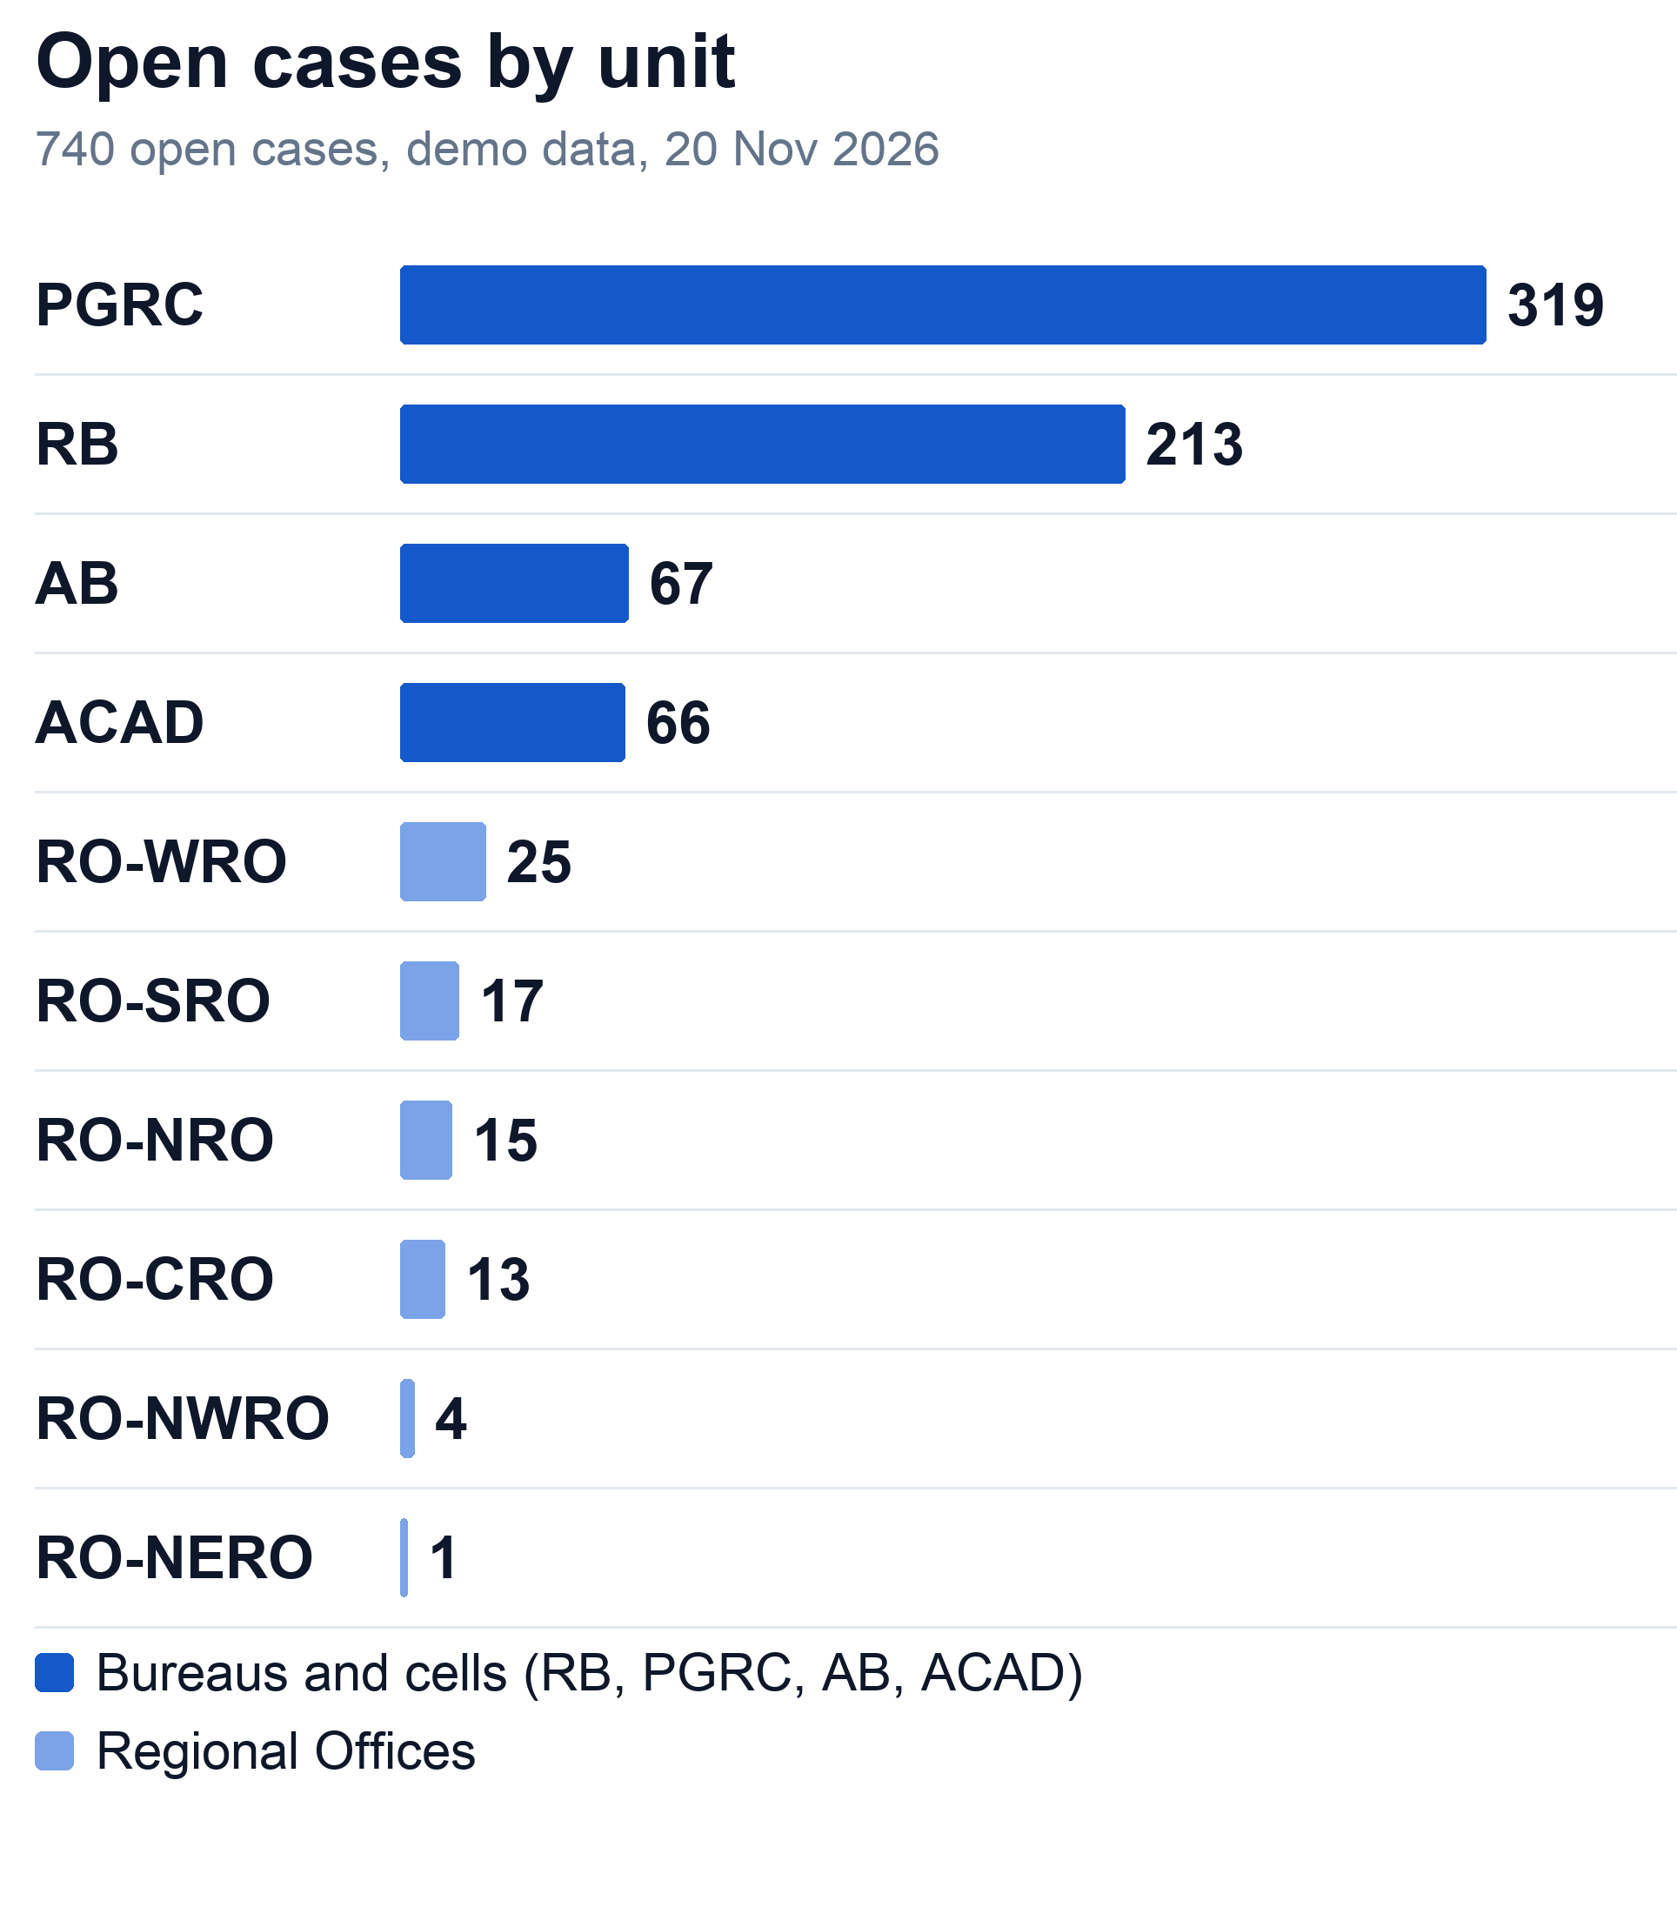









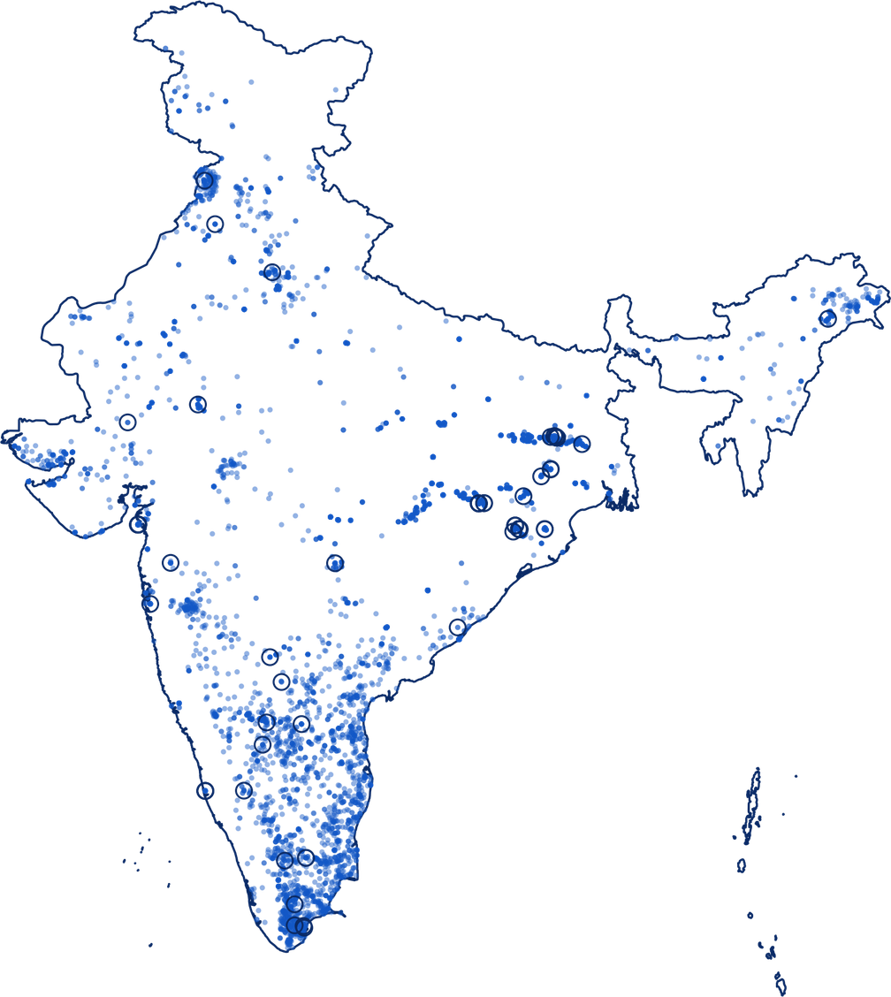





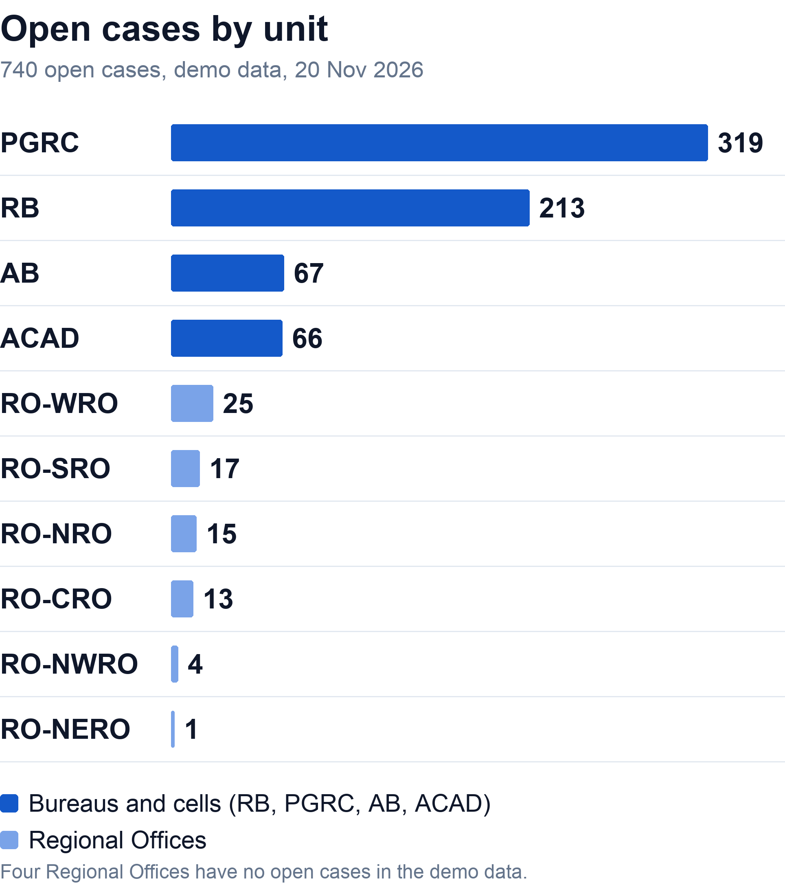
Impacts and Benefits
POTENTIAL IMPACT ON THE TARGET AUDIENCE
Senior management
All 14 units
1,500 cases across 14 AICTE units in the demo data; 3,751 real institutions in the registry
630
open cases past the 21-day limit
39 open overlaps: 25 Probable, 14 Possible
Of 1,500 cases, 740 are pending. Every KPI opens the list behind it.
Intake operators
Intake desk and match review
22
uncertain matches in the review queue
Bureau heads
PGRC, RB, AB and ACAD
The engine shows ranked candidates with reasons. The pick is saved, so the same spelling resolves next time.
39
overlaps waiting for a decision
Each lists its cases and reasons. Confirming names a coordinator and alerts the other heads.
Institutions
AICTE-approved, six states
3,751
institutions with Permanent IDs
Regional Offices
One office per region
Each institution page lists its cases across every bureau, so one college gets one coordinated response.
10
Regional Offices in the system
Each sees the cases of institutions in its region. Other units’ cases show as summary cards.
BENEFITS OF THE SOLUTION
Social
Economic
Environmental
Governance
Students and parents get one answer from AICTE, not two that contradict. The 21-day clock and the day-17 warning keep cases from sitting unseen.
Built on open tools and AICTE’s public list, with no licences or hardware to buy. Heads start from one ranked queue instead of several registers.
No new hardware. If two units learn of each other’s case early, one site visit can replace two. We have not measured this.
Every flag lists its reasons. A head confirms or dismisses, and each action is logged. Unmatched names stay unlinked.

Slide 6








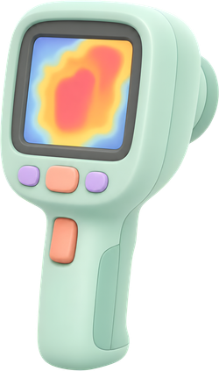





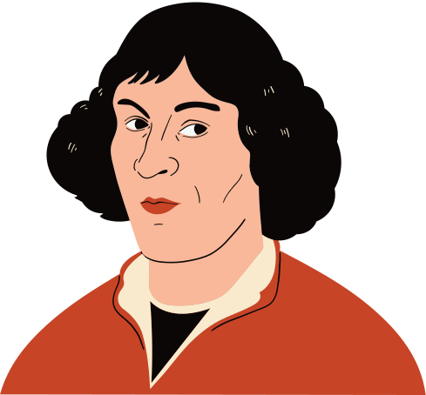
Research and References
Research and Related Work
References
Kang et al., 2026
Registry-anchored name matching
doi.org/10.6087/kcse.396
Registry-anchored matching
Exact match, then fuzzy, with a location check: precision 0.97 (Kang et al., 2026)
Sentence embeddings
Sentence-BERT makes similarity search practical (Reimers and Gurevych, 2019)
Reimers and Gurevych, 2019
Sentence-BERT, EMNLP-IJCNLP
aclanthology.org/D19-1410
Complete-linkage clustering
Stops unrelated records chaining into one group (Mamun et al., 2016)
CPGRAMS guidelines
DARPG memo, 23 Aug 2024: 21 days
pgportal.gov.in
Synthetic test data
Synthetic data with replicated errors estimated linkage quality well (Lam et al., 2024)
Unicomply
Source code and documentation
github.com/krishnasharma1493/Unicomply

