Slide 1






SMART INDIA HACKATHON 2026
TITLE PAGE
  Problem Statement ID: SIH162
  Problem Statement Title: AI-Based Detection and Classification of Industrial Fires and Persistent Thermal Sources Using NASA FIRMS, OSM & Satellite Data
  Theme: Miscellaneous
  PS Category: Software
  Team ID: SIH26-DU-T07
  Team Name: AstraX

Slide 2










IGNISSENSE
AI & SATELLITE-POWERED INDUSTRIAL FIRE INTELLIGENCE PLATFORM
PROPOSED SOLUTION
KEY INNOVATIONS AND UNIQUENESS
Satellite Data Ingestion:
Automatically takes in estimated real-time NASA satellite fire data (Brightness Temperature and Fire Radiative Power)
Class ML & Explainable AI: Categorises risks and elaborates on alerts with SHAP insights
Dual-Layer Logic & Interoperability: Minimises count of false alarms with persistence baselines; exports GeoJSON/CSV for QGIS and state systems.
Geospatial Context Fusion:
Maps real-time fire warnings to nearby industrial infrastructure using MongoDB spatial indexing + geospatial queries
ACTIONABLE INTELLIGENCE
Risk Based Prioritization: Ranks fire alerts using thermal intensity, proximity
Automated Response Alerts: Triggers prioritized notifis with location, risk level, etc
AI False Alarm Filtering:
Apply XGBoost algorithm to distinguish chimney fires from true incidents, based on thermal oddity patterns
ADDRESSING THE PROBLEM
Zero-Lag & Zero CapEx: Identifies satellite heat signatures within minutes, safeguarding industrial corridors without the use of expensive ground sensors.
Incident Command Dashboard:
Visualize high-risk areas in real-time with single-click GeoJSON export for emergency response teams
Context-Aware Triage & Scale: Computes hazard proximity to critical architecture for prioritized dispatch—scalable nationwide.

Slide 3



























Technical Approach
01 DATA SOURCES
02 INGESTION
03 ENRICH AND FEATURES
04 CLASSIFY
05 SCORE AND ALERT
06 STORE AND SERVE
Free, public, updated by others
Backend · Node.js, Express 5, TS · :5001
Backend · MongoDB 2dsphere queries
Inference · Python, XGBoost 3.4 · :8000
Backend · rules in TypeScript
Atlas · React 19 · :5173
NASA FIRMS
1
Pull satellite data
3
Spatial enrichment
6
Classify
7
Score and raise alerts
MongoDB Atlas
Area API, near-real-time
firms.client.ts · scheduler.ts
enrichment.service.ts · taxonomy.ts
service.py · feature_frame.py
classification.service.ts
geospatial store
  VIIRS_SNPP_NRT, VIIRS_NOAA20_NRT, VIIRS_NOAA21_NRT (375 m)
  MODIS_NRT on Terra, Aqua (1 km)
  CSV over HTTPS with a MAP_KEY
  Last 2 days per poll (API allows 1–5)
  India rectangle 68–97.5°E, 6.5–37.5°N
  4 FIRMS products, fetched one after another
  Every 5 min; runs never overlap; catch-up after a restart
  4 requests per cycle; limit is 5,000 per 10 min
  One IngestionLog row per product
  Nearest OSM feature within 25 km ($nearSphere, 2dsphere); closest category wins
  9 categories: industrial, oil & gas, mining, power, forest, agriculture, urban, water, other
  Land cover inferred from that category
  POST /predict on a stdlib HTTP server
  HTTP 400 if a required feature is missing
  Empty history → 0; days_since stays NaN; same code as train.py
  XGBoost XGB-FIRMS-v2.0.0-INDIA returns the class and all 6 probabilities
  Service down: no prediction, row tagged -OFFLINE (153 so far)
  Persistence and anomaly scores (0–1), rule-based
  Alert when anomaly ≥ 0.65 and the facility is ≤ 1.5 km
  Critical at anomaly ≥ 0.80
  Explanation text built from the features
  hotspots
  classifications
  alerts
  osmfeatures
  osmtiles
  facilities
  ingestionlogs
  geocodecaches
2dsphere on hotspots and osmfeatures; unique dedup index
4
Build feature vector
2
Clean and deduplicate
feature.extractor.ts · featureContract.ts
8
Serve the map
  14 values per detection
  Radiometry: FRP, TI4, TI5, ΔT, confidence, day/night
  Context: facility distance and type, land cover
  History: 3 km / 72 h cluster, 1.5 km recurrence, mean FRP, z-score, days since last
  New detections classified 15 at a time
Alert lifecycle
app.ts · MapView.tsx
OpenStreetMap
ingestion.service.ts · indiaBoundary.ts
  REST /api/v1 with a {success, data, error} envelope; Helmet; 500 req / 15 min
  MapLibre GL map with layers and filters
  Unclassified shown as hollow rings
  Search coordinates, places, facilities
  Detail panel: facility, district, FRP history
  TanStack Query refresh every 15–60 s
Geofabrik India extract
  VIIRS I-4/I-5 and MODIS 21/31 mapped to one schema
  Malformed rows dropped
  Point-in-polygon test against India's boundary
  Unique index on location, time, satellite, sensor
  457,869 repeat rows rejected so far
How it was trained
alert.model.ts · AlertsPage
  341,086 features across India
  Industry, power, oil & gas, mining
  Same tag filter as the Overpass extractor
  open → acknowledged → resolved, set by an officer
  Sort by latest, severity or anomaly; filter by severity
  74 alerts so far: 34 critical, 37 high, 3 medium
build_labels.py · train.py
5
Completeness check
  FIRMS archive 2022–24, independent labels
  0.5° blocks; train 2023, test 2024
  Macro-F1 0.55 on held-out 2024 regions (distance rule 0.41)
classification.service.ts
  10 of the 14 must resolve; the 4 history features may be empty
  If not: stored as unclassified, no model call (229 so far)
Thermal-Event Classes training label rule
Feature Set one schema, 14 features
Current System Metrics live database, 26 Sep 2026
Known Limitations from model metadata
Industrial Fire
Static source, no flare or mine
Required 10 must be present
Optional 4 can be absent
12,966
satellite detections
Labels are rule-based.
From FIRMS type, flare sites, mine maps and WorldCover, not field visits.
Gas Flare
Static source ≤ 1 km from a flare site
  frp
  brightness
  brightness_ti5
  temp_delta_ti4_ti5
  confidence
  is_night
  facility_distance_m
  facility_type_encoded
  landcover_encoded
  nearby_cluster_count_3km
  historical_recurrence_1_5km
  historical_mean_frp
  frp_z_score
  days_since_last_detection
12,569
classified by the model
Wildfire
Vegetation fire, ≥ 60% tree/grass
No facility within 25 km, no class.
Remote wildfires are under-represented in training and on the map.
Agricultural Burning
Vegetation fire, ≥ 60% cropland
341,086
OSM features indexed
A Vitest test parses classes.py and fails if the TypeScript and Python feature lists drift apart.
73
open alerts
Gas flare F1 is 0.24.
India has only about 156 known flare sites to learn from.
Mining Thermal Activity
Static source inside a mining polygon
Every sensor run is logged
with status and counts (1,662 runs so far).
Other / Uncertain
Volcano, offshore, mixed cover
457,869
repeat rows rejected

Slide 4








Feasibility and Viability
4
4 / 5,000
341,086
0.55
71
0
Analysis of the feasibility of the idea
measured on the running prototype
Satellites
FIRMS requests
Facilities mapped
Macro-F1
Alerts raised
Installs needed
VIIRS on S-NPP, NOAA-20 and NOAA-21, plus MODIS, give several passes over India every day.
4 requests per 5-minute cycle against 5,000 allowed per 10 minutes. An average run takes 42 s.
Industrial, power, oil & gas and mining sites from OpenStreetMap, at no cost.
On 2024 regions never seen in training, against 0.41 for a distance rule. Trains on a CPU.
Each near a mapped plant, with its reasons, facility distance and class probabilities.
The dashboard runs in a browser. 77 automated tests pass across the backend.
SATELLITE PASS
INGESTION
ENRICHMENT
MODEL
ALERT
OFFICER
Potential challenges and risks
where each stage could break
Clouds and smoke hide fires, and 375 m pixels can miss small burns.
FIRMS serves only the last 5 days, so a longer outage loses data. It happened on 25–28 Aug.
No mapped facility within 25 km means no class. 219 detections so far.
Labels come from public datasets by rule, not field checks. Gas flares are weakest (F1 0.24).
A wrong alert could lead to action against the wrong plant or farmer.
Officers already have routines and may not take up a new tool.
Strategies for overcoming these challenges
the fix for that stage
Merge all four sensors and judge persistence over 72 h rather than single passes. Confirm important sites with Sentinel-2 imagery.
Run on an always-on server. On restart, catch-up refills the missed window by itself. Backfill older gaps from FIRMS archive files.
Add CPCB and state industry registers to the facility layer, refresh OSM monthly, and re-run gated detections after each import.
Pilot with a State PCB so inspection results become labels, retrain each season, and use the EOG flare list as a direct lookup.
An officer acknowledges or resolves every alert. Nothing goes straight to enforcement, and unclear cases stay unclassified.
Start with one district. The alert list works like an inspection queue, and staff get hands-on training during the pilot.
Viability
why it keeps running
No paid data or hardware: FIRMS, OpenStreetMap and WorldCover are free, and nothing is installed in the field.
Small to run: three open-source services and one MongoDB database.
Already India-wide: a new state needs its facility registers, not a new model.

Slide 5
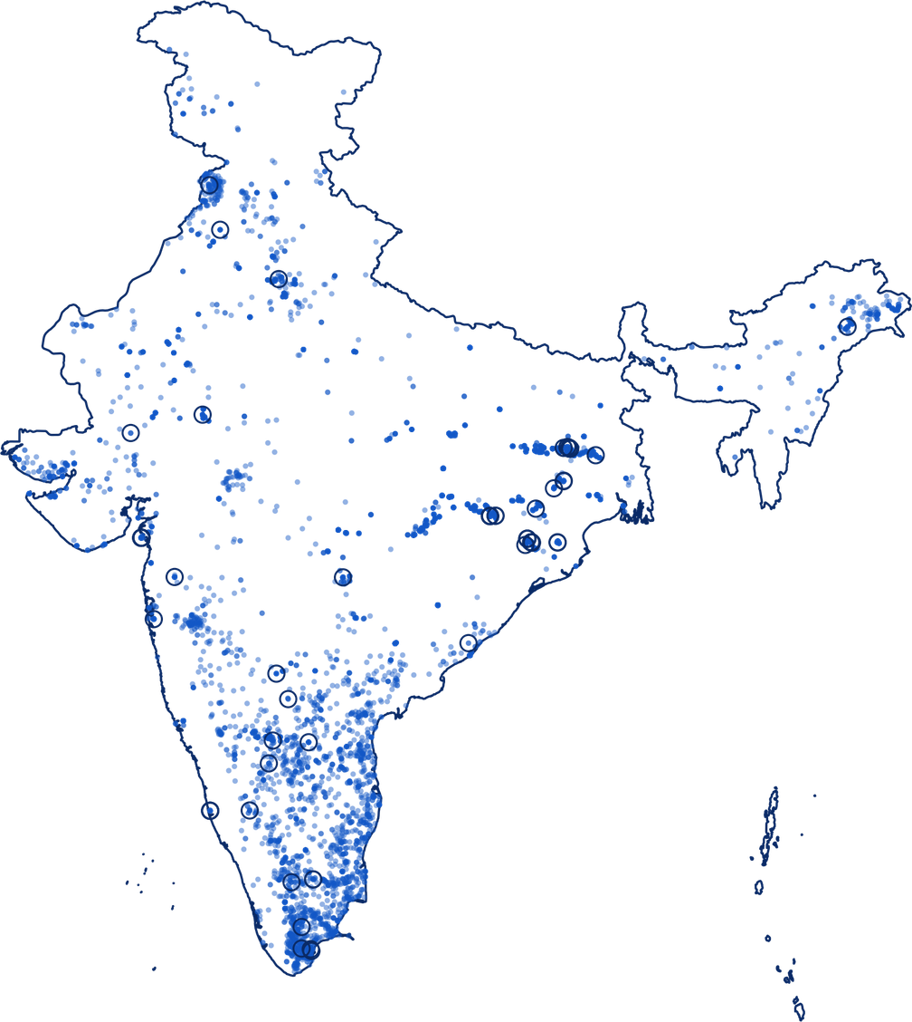









Impacts and Benefits
POTENTIAL IMPACT ON THE TARGET AUDIENCE
Agriculture and district offices
Amritsar, Punjab
12,585 FIRMS detections, 20 Aug – 23 Sep 2026, from the running system; 97.1% classified automatically
1,802
detections classed as crop burning
71 alerts: high anomaly within 1.5 km of a mapped plant
85 near Amritsar as the paddy-residue season begins. Each is tagged with its district, so action goes to the right office.
Mining regulators
Jharia coalfield, Jharkhand
1,611
mining heat detections
Oil and gas regulators
Hazira, Gujarat
691 over Jharia, where underground coal fires have burned for decades. FRP history shows which sites are getting hotter.
105
gas flares
32 around Hazira's gas processing plants. Recurrence at the same 1.5 km spot separates routine flaring from a new event.
Pollution control boards
Raigarh–Jharsuguda, Chhattisgarh and Odisha
1,180
industrial fires
Forest departments and SDMAs
Western Ghats, Kerala and Tamil Nadu
191 in this steel and aluminium belt. Near a mapped plant they become alerts with facility, distance and reasons.
1,749
wildfire detections
137 in the southern Ghats. The count of detections within 3 km in 72 h shows which fires are spreading.
BENEFITS OF THE SOLUTION
Social
Economic
Environmental
Governance
Earlier flags give district health officials time to issue smoke advisories, even where there is no ground air-quality monitor. Alerts name the district and state in plain words.
Built only on free data: NASA FIRMS, OpenStreetMap, ESA WorldCover. No sensors to buy or install. Field teams start from a ranked alert list, not a raw map.
Action goes to the actual source: crop, forest, flare, mine or plant. Repeat detections at one spot expose chronic emitters, not just one-off fires.
Every alert shows its reasons and class probabilities. 219 detections with no mapped facility were left unclassified rather than guessed. MIT-licensed and open to audit.

Slide 6
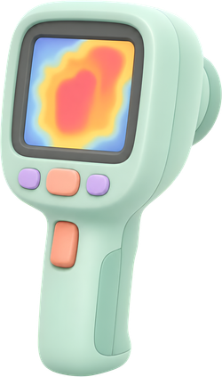



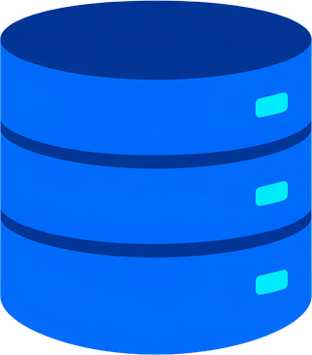


Research and References
Research and Related Work
References
NASA FIRMS
Fire information for resource management system
https://firms.modaps.eosdis.nasa.gov/
Thermal anomaly detection
Uses satellite-based thermal data to detect active fire events and thermal anomalies
Geospatial context
Provides geospatial context such as locations of industrial facilities, roads and infrastructure
OpenStreetMap
Open data for geospatial information
https://www.openstreetmap.org/#map=2/-41.2/-6.6
Land Cover & Historical Data
Helps identifying land use patterns and analyse past thermal behaviour
MongoDB Atlas
Cloud database for geospatial data
https://www.mongodb.com/products/platform/atlas-database
XGBoost & Explainable AI
Effective for multi-class classification and provides feature importance for transparency
Copernicus EMS
Disaster mapping & emergency response
copernicus.eu/en/copernicus-services

Slide 7
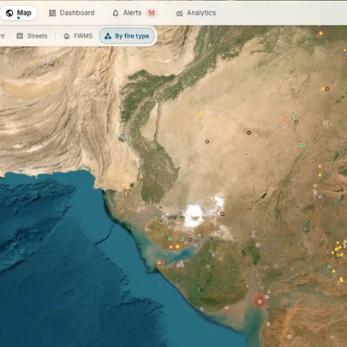
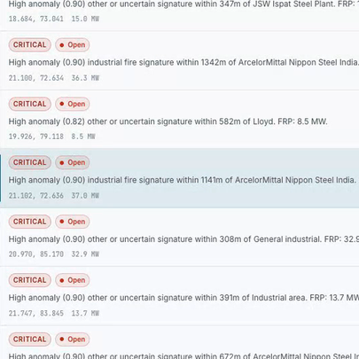
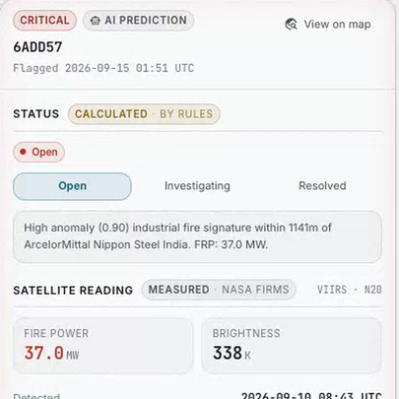
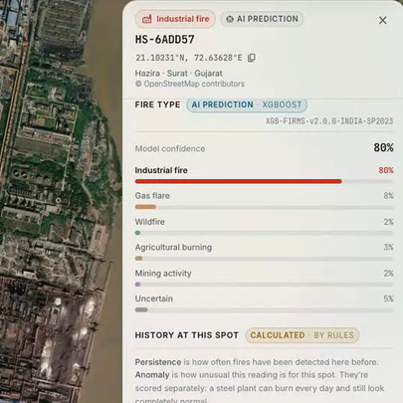
User Flow
Github Repo Link
USER
GOAL
STARTS AT
SUCCESS
Fire monitoring officer
Check a flagged fire, record a decision
Open-alert count on the map
Alert marked Investigating or Resolved
1
3
YES
Investigating
2
START
05
NO
Opens the app
Fire?
Resolved
NOT SURE
Leave open
01 Live map
02 Alert list
03 Alert detail
04 Detection on map
05 Decide
DOES
Sees the open-alert count on the Alerts tab
Filters to critical alerts and picks the ArcelorMittal one
Reads why it was flagged, then taps View on map
Checks fire type, the nearest site and past fires here
Sets the status back on the alert. The open count drops.
ASKS
"Anything new since I last looked?"
"Which one needs me first?"
"Why did this get flagged?"
"Is this really a factory fire?"
"Send a team, or close it?"
Not sure: the alert stays open, the next satellite pass adds history to the spot, and the officer checks again
start or end
screen
decision
1
where the officer clicks
BEHIND THE SCREENS
New NASA FIRMS detections every 5 minutes. XGBoost names the fire type, and a fixed rule raises the alert: anomaly ≥ 0.65 with a mapped site within 1.5 km.

