Slide 1



NAÏVE BAYES & SPAM FILTERING SVD & PCA
By Krishna Sharma (AP22110010128)

Slide 2
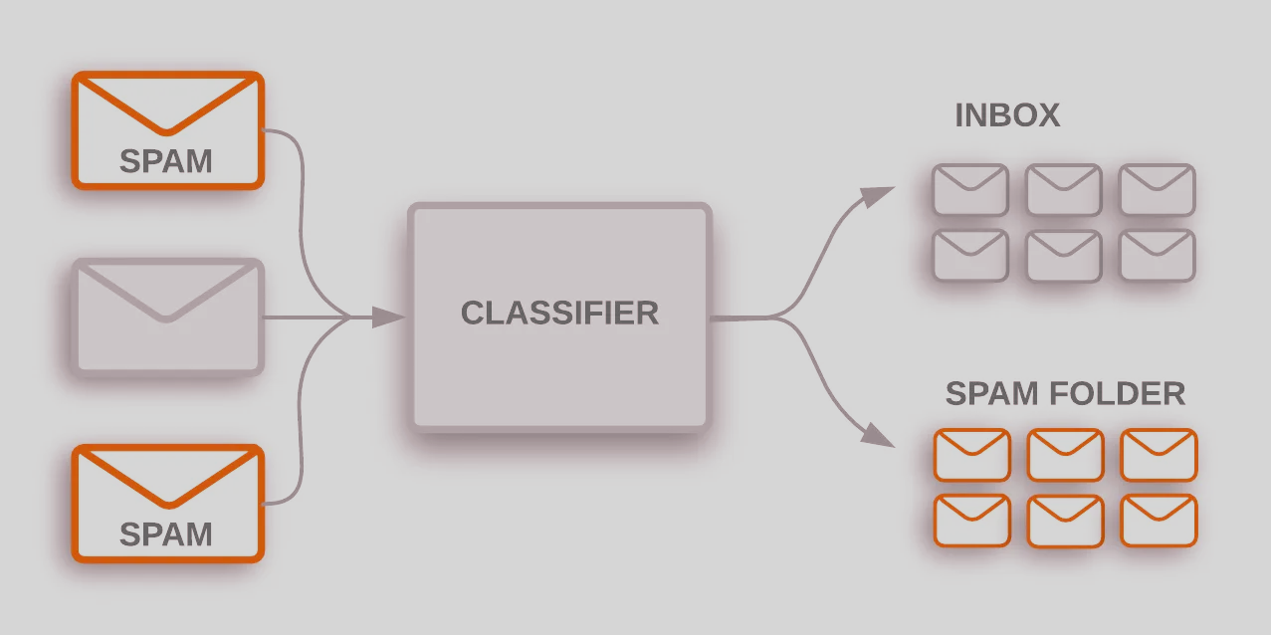

INTRODUCTION TO SPAM FILTERING
What is spam?
Spam emails are unsolicited messages sent in bulk, often for advertising, fraud, or spreading malware.
Examples include phishing emails, promotional spam, and malicious attachments.
Why is spam filtering important?
Protects users from phishing attacks, scams, and malware.
Saves time by reducing clutter in inboxes.
How can machine learning help?
Automatically classifies emails as spam or non-spam using algorithms.
Improves accuracy over time by learning from data.

Slide 3
WHY K-NN AND LINEAR REGRESSION ARE POOR CHOICES
k-Nearest Neighbors (k-NN):
Works well for numerical data but inefficient for large datasets.
Requires high computational power for large-scale classification.
Linear Regression:
Designed for continuous output, not categorical classification.
Cannot effectively classify spam vs. non-spam.
Conclusion:
These methods are not ideal for spam filtering. A probabilistic approach like Naïve Bayes works better.

Slide 4
INTRODUCTION TO NAÏVE BAYES
Definition: A probabilistic classifier based on Bayes' Theorem.
Key assumption: Features (words in an email) are independent.
Why is it useful?
Fast and efficient, even for large datasets.
Works well with text classification problems.
Common applications:
Spam filtering, sentiment analysis, medical diagnosis.

Slide 5
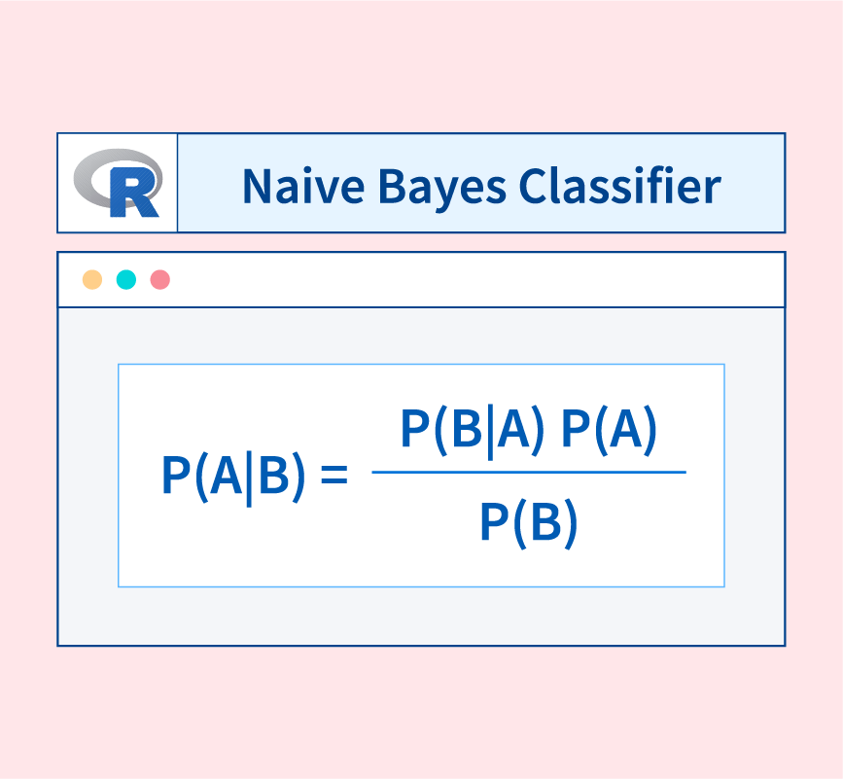
HOW NAÏVE BAYES FILTERS SPAM
Convert email into word frequencies.
Calculate probabilities of spam vs. non-spam.
Apply Bayes' Theorem to classify emails.
The email is labeled based on the highest probability.

Slide 6

EXAMPLE CALCULATION
Given an email: "Free money now!"
Calculate P(Spam | Words) using:
P(Spam) = Prior probability of spam emails.
P(Non-Spam) = Prior probability of non-spam emails.
P(Words | Spam) = Likelihood of words appearing in spam.
P(Words | Non-Spam) = Likelihood of words appearing in non-spam.
Final decision: Email is classified as spam or non-spam based on probability.

Slide 7
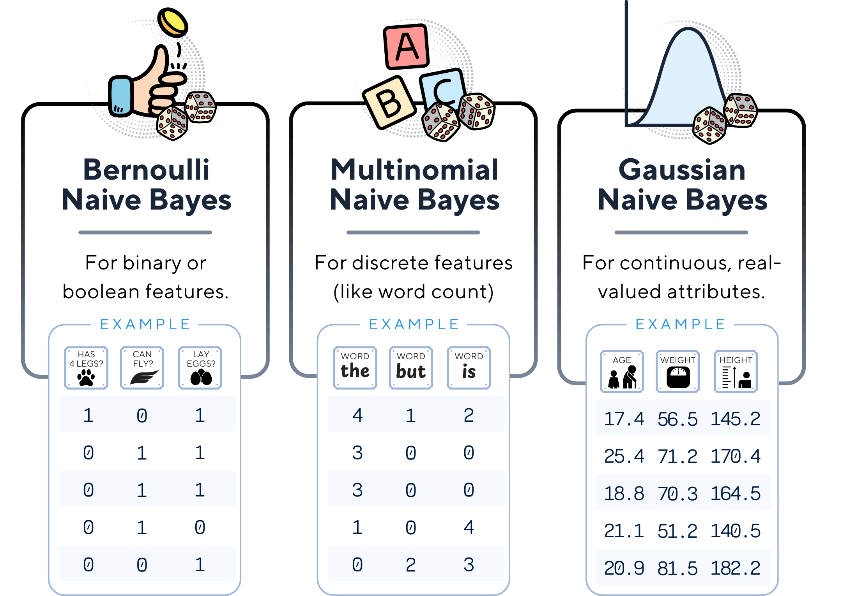
Types of Naïve Bayes Classifiers
Bernoulli Naïve Bayes:
Works with binary data (presence/absence of words).
Good for models where features take values of 0 or 1.
Multinomial Naïve Bayes:
Best for text classification and spam filtering.
Uses frequency of words in each class.
Gaussian Naïve Bayes:
Used when features are continuous (e.g., numerical data).
Assumes normal distribution of data points.

Slide 8
ADVANTAGES & LIMITATIONS OF NAÏVE BAYES
Advantages:
Fast and efficient.
Works well with small datasets.
Handles high-dimensional data well.
Limitations:
Assumes feature independence, which may not always be true.
Can struggle with rare words (zero probability issue).

Slide 9
INTRODUCTION TO DIMENSIONALITY REDUCTION
Why reduce dimensions?
High-dimensional data is difficult to process and visualize.
Reducing dimensions improves computational efficiency.
Techniques:
Singular Value Decomposition (SVD)
Principal Component Analysis (PCA)

Slide 10
UNDERSTANDING SINGULAR VALUE DECOMPOSITION (SVD)
Definition: Factorizes a matrix into three components: U, Σ, and V^T.
Key idea: Decomposes data into patterns and removes noise.
Working of SVD:
Matrix Decomposition: Any matrix A (m×n) is decomposed as:
A = UΣV^T
U: Left singular vectors (m×m)
Σ: Diagonal matrix of singular values (m×n)
V^T: Right singular vectors (n×n)
Dimensionality Reduction:
Keep only top k singular values in Σ to approximate A.
Reduces noise and maintains essential features.
Reconstruction:
Approximate A by using only significant components.
Helps in compression and feature extraction.

Slide 11
Example
Given a data matrix: A = [ [4, 0], [3, -5], [2, 6] ]
Apply SVD decomposition: A = UΣV^T
U: Left singular vectors
Σ: Singular values (importance of features)
V^T: Right singular vectors
Computed Values:
U = [ [-0.6, 0.8], [-0.7, -0.5], [0.4, -0.3] ]
Σ = [ [7.8, 0], [0, 5.2] ]
V^T = [ [0.8, 0.6], [-0.6, 0.8] ]
Dimensionality Reduction: Keeping only the largest singular value retains most of the information.

Slide 12
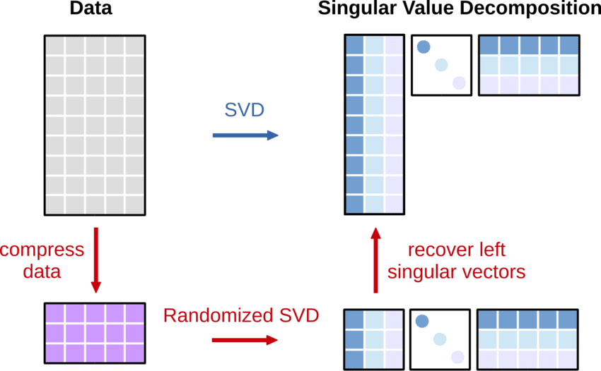
VISUAL REPRESENTATION OF SVD

Slide 13
UNDERSTANDING PRINCIPAL COMPONENT ANALYSIS (PCA)
Definition: Finds new axes that maximize variance in data.
Process:
Standardize the dataset.
Compute covariance matrix.
Find eigenvectors and eigenvalues.
Project data onto principal components.
Why use PCA?
Reduces complexity while preserving important information.
Helps in visualization and noise reduction.

Slide 14
Example
Given data points: (2,3), (3,5), (5,8), (6,9)
Step 1: Standardize the Data
Compute mean and subtract it from each point.
Example Mean = (4, 6.25),
Transformed Data:
(-2, -3.25), (-1, -1.25), (1, 1.75), (2, 2.75)
Step 2: Compute Covariance Matrix
Cov = [ 2.5 3.5 ]
[ 3.5 5.25 ]
Step 3: Compute Eigenvectors & Eigenvalues
Eigenvalues: λ1 = 7.5, λ2 = 0.25
Eigenvectors: Principal components of the data
Step 4: Transform Data
Project onto the first principal component for dimensionality reduction.
PCA uses SVD internally for computing eigenvectors in many implementations!

Slide 15
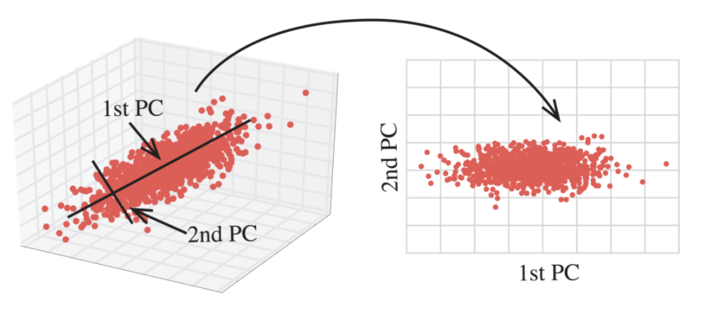
VISUAL REPRESENTATION OF PCA

Slide 16
PCA vs. SVD
Feature | PCA (Principal Component Analysis) | SVD (Singular Value Decomposition)
Purpose | Reduces dimensionality by finding principal components (directions of maximum variance). | Decomposes a matrix into three smaller matrices for compression, noise reduction, or factorization.
Input Data | Requires a covariance matrix (centered data) to compute eigenvectors. | Works directly on the original data matrix without centering.
Mathematical Approach | Eigenvalue decomposition of the covariance matrix. | Factorization of a matrix into A=UΣVTA = UΣV^TA=UΣVT (where UUU, ΣΣΣ, and VTV^TVT are matrices).
Interpretation | Identifies principal components (orthogonal directions of maximum variance). | Decomposes a matrix into singular vectors and singular values.
Feature Selection | Selects top-k principal components for dimensionality reduction. | Uses top-k singular values to approximate the original matrix.
Computational Cost | Faster than SVD for large datasets (as it works on a reduced covariance matrix). | Computationally expensive but more general and powerful.
Use Cases | Image recognition, face recognition, financial data analysis, anomaly detection. | Recommender systems, latent semantic analysis (LSA), data compression, natural language processing.
Matrix Requirement | Requires a square covariance matrix (symmetrical). | Works on any rectangular matrix (not necessarily square).

Slide 17
APPLICATIONS OF SVD AND PCA
SVD:
Recommender systems (e.g., Netflix, Amazon).
Document clustering and topic modeling.
Image compression.
PCA:
Face recognition.
Anomaly detection.
Data visualization.

Slide 18
CONCLUSION
Key Takeaways
Naïve Bayes is a fast and efficient spam filtering algorithm.
SVD & PCA are powerful techniques for dimensionality reduction and feature extraction.
PCA vs. SVD: PCA finds key features (variance), while SVD decomposes data for applications like recommender systems.
Real-World Impact
Spam filtering (Naïve Bayes) enhances cybersecurity.
SVD/PCA power image processing, recommender systems, and data compression.

Slide 19
THANK YOU

