Slide 1


Rakshak
ENTERPRISE LOG ANOMALY DETECTION SYSTEM
log-anomaly-frontend.vercel.app
Krishna Sharma
AP22110010128

Slide 2

Introduction
Enterprise Log Anomaly Detection Platform: Production-grade AI system that identifies anomalies across diverse enterprise logs with real-time, high-precision detection.
Key Outcomes
Core Intelligence
Deployment Ready
  88.5% F1-Score | 0.94 AUROC | 91.2% Balanced Accuracy
  <200ms inference latency across 16 log sources
  Handles extreme imbalance up to 249:1
  32,000+ logs processed with cross-source generalization
  848-dimensional hybrid features (BERT + templates + stats)
  22 trained models (ML, DL, BERT, Meta, Federated)
  LOSO evaluation → robust cross-domain performance
  REST API (Django) + React UI + HuggingFace models
  Cloud-hosted (Render + Vercel) with real-time anomaly preview
STUDIO SHODWE
7

Slide 3
Problem & Motivation
The Enterprise Log Challenge: Modern distributed systems generate millions of logs per day, across multiple sources, formats, and platforms. Hidden within them are rare but critical anomalies: breaches, failures, outages, misuse.
Core Pain Points
Why Traditional Methods Fail
Motivation
  Extreme class imbalance (as high as 249:1)
  Multi-source heterogeneity
  High-volume, real-time ingestion
  Unstructured & semi-structured patterns
  Evolving system behavior
  Rule-based SIEMs require constant tuning and still miss novel events
  Standard ML assumes balanced data → overfits to “normal”
  Many systems cannot transfer learn across log sources
  Deep models without imbalance awareness spike false negatives
To build a resilient, interpretable, real-time anomaly detection engine that:
  Handles severe imbalance without collapsing recall
  Generalizes across 16 distinct log environments
  Detects never-seen-before behaviors
  Delivers predictions within <200ms
7

Slide 4
Solution Overview
What This System Delivers: A production-grade anomaly detection platform that automates log intelligence, handles extreme imbalance, and scales to multi-source enterprise environments.
Core Capabilities
End-to-End Architecture
What Makes It Effective
  Detects anomalies across 16 independent log ecosystems
  Learns semantic + structural patterns via BERT + templates + statistics
  <200ms real-time inference for streaming operational reliability
Raw Logs → Labeling → Processing → Feature Engineering → Models → Inference → UI
  Labeling: Smart ML-assisted template labeling
  Processing: Temporal & burst normalization for 16 sources
  Feature Engineering: 848-D hybrid representations (BERT, Drain, stats)
  Modeling: ML, DL, BERT, Federated, Hierarchical
  Deployment: Django REST API + React UI + Cloud serving
  Cross-source generalization (LOSO): learns beyond single dataset boundaries
  Multi-level imbalance strategy: SMOTE + Focal Loss + threshold tuning
  Hybrid feature stack: semantic + structural + temporal insights
  Model ensemble strategy: choose best model per environment
7

Slide 5
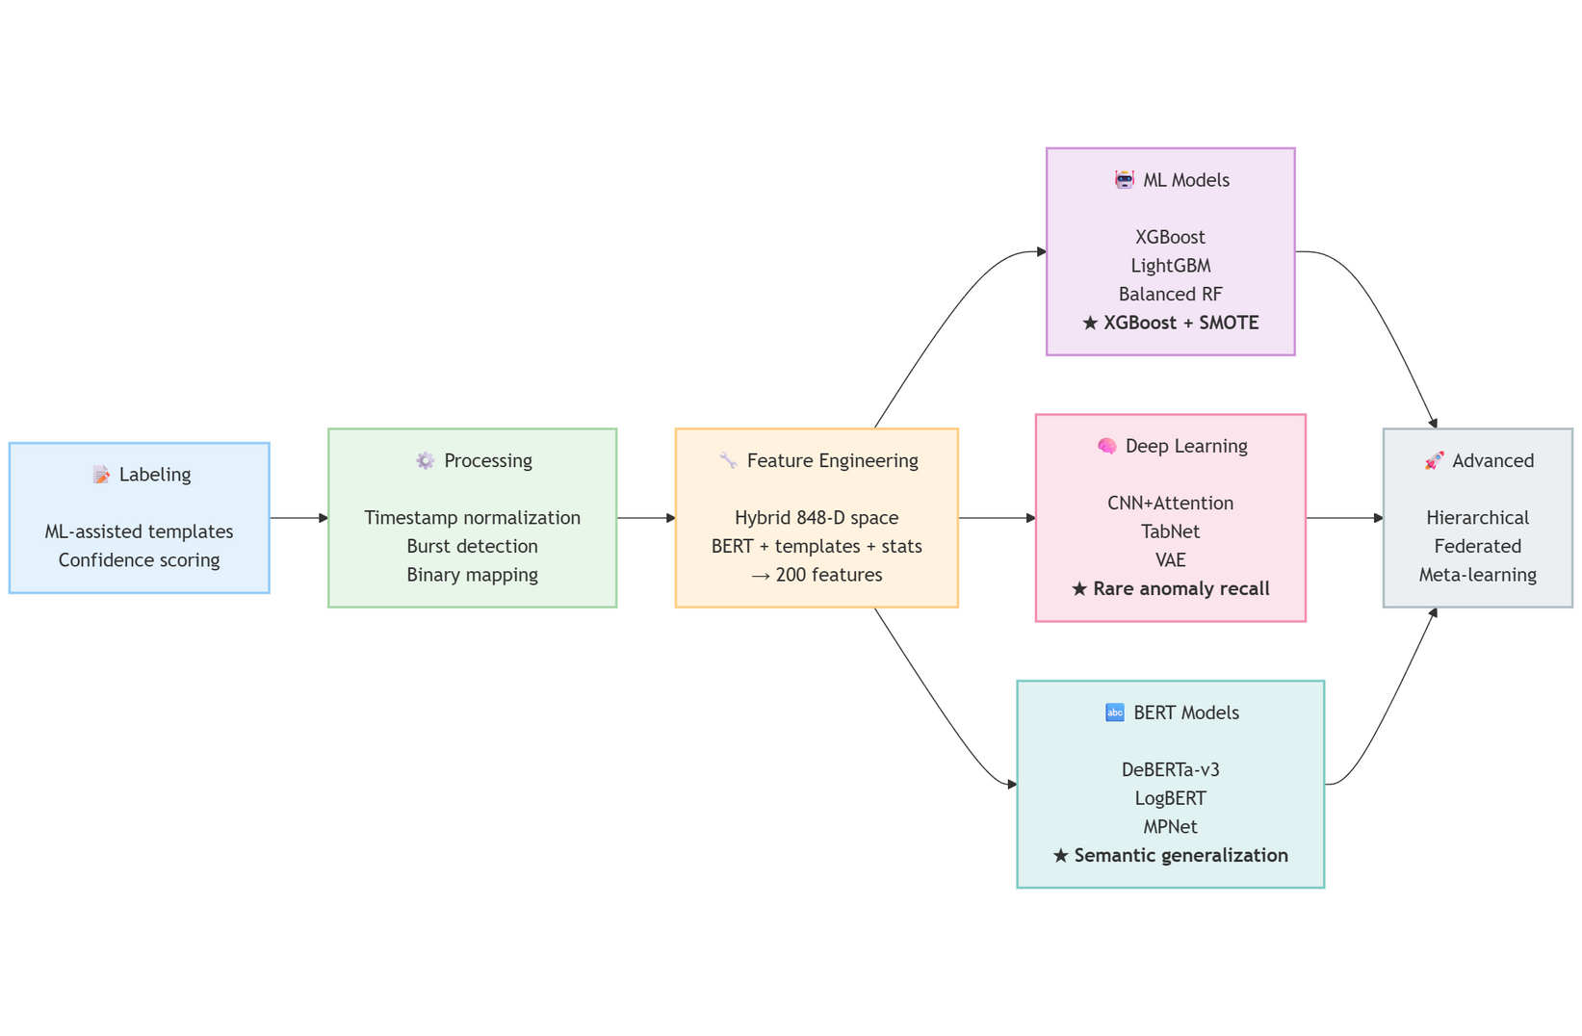
Complete Pipeline Flow
Transforms raw logs into real-time anomaly decisions
7

Slide 6
Data Landscape
True anomalies are rare, hidden, and format-dependent—demanding a cross-source, imbalance-aware approach.
Multi-Source Enterprise Logs
Diversity & Variability
Severe Class Imbalance
  32,000+ logs collected across 16 heterogeneous sources
  Formats include: Apache, Linux, Android, HDFS, OpenSSH, Hadoop, Spark, HealthApp, Cloud services
  Structured + semi-structured + free-text logs
  Varying grammar, templates, verbosity, timestamp styles
  Frequent out-of-vocabulary tokens (IP, UUID, HEX, PATH)
  Anomalies often <1% of total
  Worst-case ratio: 249 : 1 (Spark, HealthApp)
  Standard classifiers collapse to “all normal” without correction
7

Slide 7
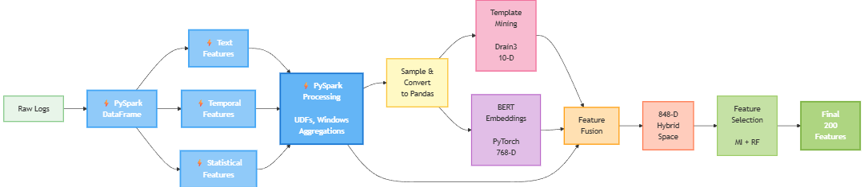
Feature Engineering
Distributed Feature Pipeline (PySpark + BERT): A scalable feature workflow transforming raw logs into a 200-feature anomaly-ready vector.
PySpark’s Role
Parallel log processing + temporal bursts + statistical windows using UDFs & Window functions.
  Drain3 Templates (10-D) → structure patterns
  BERT Embeddings (768-D) → semantic meaning
  PySpark Features (~70+ signals) → bursts, entropy, frequency, off-hours
  MI + RF Selection → final 200 best features
7

Slide 8
Model Architecture Overview
Multi-stack system evaluated across 16 log sources for cross-domain robustness.
Category | Models | Purpose
ML | XGBoost, LightGBM, RF, SVM, Balanced RF, Easy Ensemble | Fast, production-grade baseline
DL | CNN+Attention, VAE, TabNet, FLNN | Handles imbalance, hidden patterns
BERT | LogBERT, DeBERTa-v3, MPNet, DAPT-BERT | Deep semantic log understanding
Advanced | Hierarchical Transformer, Federated Contrastive, Meta-Learner | Cross-source & few-shot generalization
Why Multi-Model?
  Diverse logs require both structural + semantic learners
  BERT captures intent, ML handles speed, DL absorbs imbalance
  Advanced models extend to new unseen log sources
7

Slide 9



Deployment Architecture
End-to-end real-time anomaly detection delivered through a modular web stack.
Frontend
Backend
Cloud Hosting
React + Tailwind
  Live anomaly feed
  Confidence scoring
  Source auto-identification
Django REST API + HuggingFace Model Serving
  Fast inference routing
  JSON prediction endpoints
  Stateless microservice design
  UI: Vercel
  API: Render
  Models: HuggingFace Inference Hub
7

Slide 10
The End
THANK YOU FOR LISTENING
Krishna Sharma
AP22110010128

