Slide 1
Taylor_Swift
Born and raised in Pennsylvania, Swift moved to Nashville, Tennessee, at the age of 14 to pursue a career in country music.

Slide 2
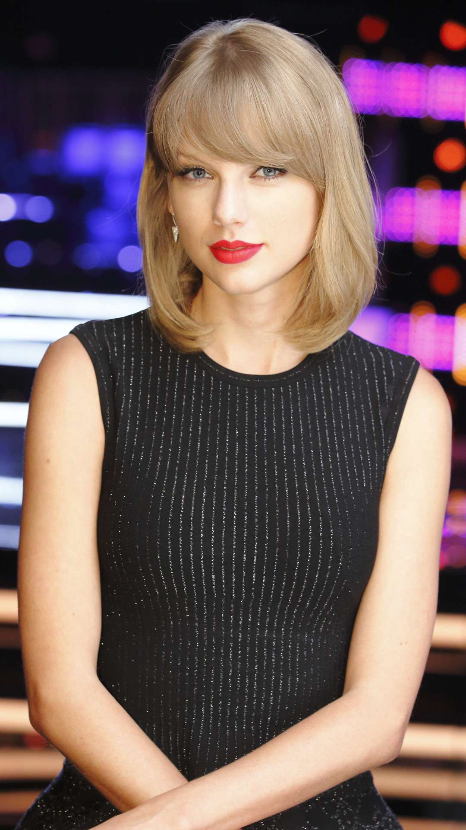

Slide 3
ABOUT

Slide 4
Born and raised in Pennsylvania, Swift moved to Nashville, Tennessee, at the age of 14 to pursue a career in country music.

Slide 5
Swift is one of the best-selling music artists of all time, having sold more than 50 million albums—including 27.8 million in the US—and 150 million single downloads.

Slide 6
Swift later shifted her focus toward country music inspired by Shania Twain's songs, which made her "want to just run around the block four times and daydream about everything".

Slide 7
In 2003, Swift and her parents started working with New York-based music manager Dan Dymtrow.

Slide 8
Borchetta has said that record industry peers disliked his signing of a 16-year-old singer-songwriter at first, but that Swift tapped into a previously unknown market—teenage girls who listen to country music.

Slide 9
Later that year, Swift both hosted and performed as the musical guest for an episode of Saturday Night Live.

Slide 10
In a June 2015 open letter, Swift criticized Apple Music for not offering royalties to artists during the streaming service's free three-month trial period and stated that she would pull 1989 from the catalog.

Slide 11
Other singles from the album include "New Year's Day" and "Delicate", the former of which was released exclusively to country radio.

Slide 12
Swift also explored the music of older country stars, including Patsy Cline, Loretta Lynn, Dolly Parton, and Tammy Wynette.

Slide 13
Swift has also been influenced by many artists outside the country genre.

Slide 14
Swift's music contains elements of pop, pop rock, and country.

Slide 15
While presenting Swift an award for her humanitarian endeavors in 2012, Michelle Obama described her as a singer who "has rocketed to the top of the music industry but still keeps her feet on the ground, someone who has shattered every expectation of what a 22-year-old can accomplish".

Slide 16
Swift's philanthropic efforts have been recognized by the Do Something Awards and the Tennessee Disaster Services.

Slide 17
Swift has sold more than 50 million albums, 150 million single downloads, and was one of the top five music artists with the highest worldwide digital sales.

Slide 18
Her 2006 self-titled debut album peaked at number five on the Billboard 200 and spent the most weeks on the chart in the 2000s.

Slide 19
The album's third single, "Our Song", made her the youngest person to single-handedly write and perform a number-one song on the Hot Country Songs chart.

Slide 20
Swift's sixth album, Reputation (2017) and its lead single "Look What You Made Me Do" topped the UK and US charts; with the former, she became the first act to have four albums sell one million copies within one week in the US.

Slide 21
Swift is one of the best-selling music artists of all time, having sold more than 50 million albums—including 27.8 million in the US—and 150 million single downloads.

Slide 22
Big Machine Records was still in its infancy during the June 2006 release of the lead single, "Tim McGraw", and Swift and her mother helped "stuff the CD singles into envelopes to send to radio".

Slide 23
Following "Tim McGraw", four more singles were released throughout 2007 and 2008: "Teardrops on My Guitar", "Our Song", "Picture to Burn" and "Should've Said No".

Slide 24
For the former, Swift became the youngest person to single-handedly write and perform a number-one song on the chart.

Slide 25
Four more singles were released throughout 2008 and 2009: "White Horse", "You Belong with Me", "Fifteen" and "Fearless".

Slide 26
"You Belong with Me" was the album's highest-charting single on the Billboard Hot 100, peaking at number two.

Slide 27
The album received promotion from Swift's first concert tour, the Fearless Tour, which grossed over $63 million.

Slide 28
Swift contributed backing vocals to John Mayer's "Half of My Heart", a single featured on his fourth album, Battle Studies (2009).

Slide 29
In August 2010, Swift released "Mine", the lead single from her third studio album, Speak Now.

Slide 30
Three of the album's singles, "Mine", "Back to December", and "Mean", peaked in the top ten in Canada.

Slide 31
In November 2011, Swift released her first live album, Speak Now World Tour: Live.

Slide 32
In August, Swift released "We Are Never Ever Getting Back Together", the lead single from her fourth studio album, Red.

Slide 33
Swift released the album's second single, "Begin Again", in October.

Slide 34
Other singles released from the album include "I Knew You Were Trouble", "22", "Everything Has Changed", "The Last Time", and "Red".

Slide 35
1989 sold 1.28 million copies in the US during the first week of release and debuted atop the Billboard 200—this made Swift the first act to have three albums sell more than one million copies in their opening release week, for which she earned a Guinness World Record.

Slide 36
The album's lead single, "Shake It Off", was released in August 2014 and debuted at number one on the Billboard Hot 100.

Slide 37
The album also generated two additional number-one singles—"Blank Space" and "Bad Blood" (featuring Kendrick Lamar)—as well as the top-ten entries "Style" and "Wildest Dreams", and other singles "Out of the Woods" and "New Romantics".

Slide 38
Two months later, Swift and British singer Zayn Malik released a single together called "I Don't Wanna Live Forever", for the soundtrack of the film Fifty Shades Darker (2017).

Slide 39
Swift thereafter cleared her social media accounts and released "Look What You Made Me Do" as the lead single from her sixth album, Reputation (stylized as reputation).

Slide 40
In October, Swift released the album's second single, "...Ready for It?

Slide 41
Two promotional singles were released from Reputation, "Gorgeous" and "Call It What You Want"; the former later became the album's fifth single, however only being released as such in Europe.

Slide 42
Other singles from the album include "New Year's Day" and "Delicate", the former of which was released exclusively to country radio.

Slide 43
The tour broke multiple venue attendance and grossing records in the United States, earning $266.1 million and selling more than two million tickets.

Slide 44
The lead single from Swift's seventh studio album, "Me!"

Slide 45
Swift has sold more than 50 million albums, 150 million single downloads, and was one of the top five music artists with the highest worldwide digital sales.

Slide 46
She is the third best-selling digital singles artist in the US with a total of 106.5 million equivalent units certified according to Recording Industry Association of America.

Slide 47
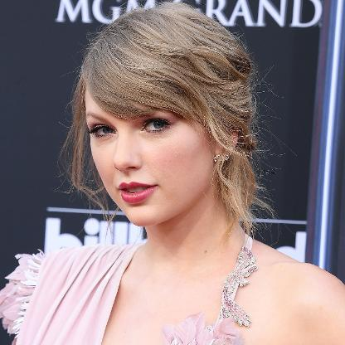

Slide 48
ADVANTAGES

Slide 49
The album won four Grammy Awards, with Swift becoming the youngest Album of the Year winner.

Slide 50
She is also the recipient of 10 Grammys, one Emmy, 23 Billboard Music Awards, and 12 Country Music Association Awards, and she holds six Guinness World Records.

Slide 51
When Swift was about 12 years old, computer repairman and local musician Ronnie Cremer taught her how to play guitar and helped with her first efforts as a songwriter, leading to her writing "Lucky You".

Slide 52
To help Swift break into country music, her father transferred to the Nashville office of Merrill Lynch when she was 14, and the family relocated to a lakefront house in Hendersonville, Tennessee.

Slide 53
She also won the Country Music Association's Horizon Award for Best New Artist, the Academy of Country Music Awards' Top New Female Vocalist, and the American Music Awards' Favorite Country Female Artist honor.

Slide 54
She was also nominated for Best New Artist at the 2008 Grammy Awards.

Slide 55
In 2009, the music video for "You Belong with Me" was named MTV Video Music Award for Best Female Video.

Slide 56
Also that year, she won five American Music Awards, including Artist of the Year and Favorite Country Album.

Slide 57
At the 52nd Grammy Awards, Fearless was named Album of the Year and Best Country Album, and "White Horse" was named Best Country Song and Best Female Country Vocal Performance.

Slide 58
Swift was the youngest artist ever to win Album of the Year.

Slide 59
Jon Caramanica of The New York Times found it "refreshing to see someone so gifted make the occasional flub" and described Swift as "the most important new pop star of the past few years".

Slide 60
Swift became the youngest ever artist to be named Entertainer of the Year by the Country Music Association.

Slide 61
It entered the United States at number three, making Swift the second female artist in the history of the Hot 100 (after Mariah Carey) to debut multiple tracks in the top five in one year; the other was "Today Was a Fairytale" at number two.

Slide 62
"Mean" won Best Country Song and Best Country Solo Performance at the 54th Annual Grammy Awards.

Slide 63
Swift won various other awards for Speak Now, including Songwriter/Artist of the Year by the Nashville Songwriters Association (2010 and 2011), Woman of the Year by Billboard (2011), and Entertainer of the Year by the Academy of Country Music (2011 and 2012) and the Country Music Association in 2011.

Slide 64
At the American Music Awards of 2011, Swift won Artist of the Year and Favorite Country Album.

Slide 65
Its single "I Knew You Were Trouble" won Best Female Video at the 2013 MTV Video Music Awards.

Slide 66
Swift was named Best Female Country Artist at the 2012 American Music Awards and Artist of the Year at the 2013 ceremony.

Slide 67
She received the Nashville Songwriters Association's Songwriter/Artist Award for the fifth and sixth consecutive years in 2012 and 2013 respectively.

Slide 68
In 2013, Swift co-wrote and co-produced "Sweeter than Fiction" with Jack Antonoff for the One Chance soundtrack, and received a Best Original Song nomination at the 71st Golden Globe Awards.

Slide 69
Outside music, Swift voiced Audrey, a tree lover, in the animated film The Lorax (2012), made a cameo in the sitcom New Girl (2013), and had a supporting role in the film adaptation of The Giver (2014).

Slide 70
The videos for "Blank Space" and "Bad Blood" won four accolades at the 2015 MTV Video Music Awards, with the latter winning for Video of the Year and Best Collaboration.

Slide 71
Swift was named Billboard's Woman of the Year in 2014, becoming the first artist to win the award twice.

Slide 72
Also that year, she received the Dick Clark Award for Excellence at the American Music Awards.

Slide 73
In 2015, "Shake It Off" was nominated for three Grammy Awards, including Record of the Year and Song of the Year and Swift won the Brit Award for International Female Solo Artist.

Slide 74
Swift was one of eight artists to receive a 50th Anniversary Milestone Award at the 2015 Academy of Country Music Awards.

Slide 75
In 2016, Swift won three Grammy Awards for 1989—Album of the Year, Best Pop Vocal Album, and Best Music Video for "Bad Blood".

Slide 76
The song earned Swift an award for Song of the Year at the 51st CMA Awards.

Slide 77
At the 2017 MTV Video Music Awards, the duo won the award for Best Collaboration for the song's music video.

Slide 78
At the American Music Awards of 2018, Swift won Tour of the Year for the tour, Artist of the Year, Favorite Pop/Rock Female Artist, and Favorite Pop/Rock Album for Reputation.

Slide 79
In November 2018, Swift signed a new multi-album deal with Big Machine's distributor Universal Music Group; in the United States, her future releases will be promoted under the Republic Records imprint.

Slide 80
Swift was drawn to the storytelling of country music, and was introduced to the genre by "the great female country artists of the '90s"—Shania Twain, Faith Hill, and the Dixie Chicks.

Slide 81
Alt-country artists such as Ryan Adams, Patty Griffin and Lori McKenna have inspired Swift.

Slide 82
McCartney, both as a Beatle and a solo artist, makes Swift feel "as if I've been let into his heart and his mind ... Any musician could only dream of a legacy like that".

Slide 83
In 2015, she was named Woman of the Year at the Elle Style Awards, and ranked first in Maxim's Hot 100 list.

Slide 84
In 2012, she pledged $4 million to fund the building of a new education center at the Country Music Hall of Fame and Museum in Nashville.

Slide 85
As a recipient of the Academy of Country Music's Entertainer of the Year in 2011, Swift donated $25,000 to St. Jude Children's Research Hospital, Tennessee.

Slide 86
Later that year, Swift made a surprise appearance at a benefit concert in New York City raising money for LGBT equality.

Slide 87
The music video for Swift's anti-bullying song "Mean" deals in part with homophobia in high schools; the video was nominated for an MTV VMA social activism award in 2011.

Slide 88
During Swift's acceptance speech for Artist of the Year at the American Music Awards of 2018, she encouraged her fans to vote in the 2018 midterm elections.

Slide 89
Swift has received many awards and honors, including 10 Grammy Awards, 23 American Music Awards (most wins by a female artist), 23 Billboard Music Awards (the most wins by an act), 12 Country Music Association Awards, 8 Academy of Country Music Awards, one Brit Award, and one Emmy Award.

Slide 90
Swift's second album, Fearless, was released in 2008.

Slide 91
Buoyed by the success of pop crossover singles "Love Story" and "You Belong with Me", Fearless became the best-selling album of 2009 in the US.

Slide 92
It debuted at number one in the United States and the single "Mean" won two Grammy Awards.

Slide 93
Her fourth album, Red (2012), yielded the successful singles "We Are Never Ever Getting Back Together" and "I Knew You Were Trouble".

Slide 94
Taylor Swift peaked at number five on the Billboard 200 albums chart in the United States and spent 157 weeks on the ranking, marking the longest stay on the chart by any release in the country in the 2000s decade.

Slide 95
All were highly successful on Billboard's Hot Country Songs chart in the United States, with "Our Song" and "Should've Said No" both reaching number one.

Slide 96
"Teardrops on My Guitar" became a moderate commercial success, reaching number thirteen on the Billboard Hot 100 songs chart in the United States.

Slide 97
Swift also released the holiday album Sounds of the Season: The Taylor Swift Holiday Collection in October 2007 and the EP Beautiful Eyes in July 2008.

Slide 98
Swift's second studio album, Fearless, was released on November 11, 2008.

Slide 99
The album debuted at number one on the Billboard 200 and was the top-selling album of 2009 in the United States.

Slide 100
It entered the United States at number three, making Swift the second female artist in the history of the Hot 100 (after Mariah Carey) to debut multiple tracks in the top five in one year; the other was "Today Was a Fairytale" at number two.

Slide 101
Speak Now, released on October 25, 2010, was a commercial success, debuting at number one on the Billboard 200, and becoming the 16th album to achieve opening week sales of one million copies.

Slide 102
"I Knew You Were Trouble" was a major commercial success, peaking at number two in the United States.

Slide 103
The album was a critical and commercial success, and debuted at number one on the Billboard 200 with first-week sales of 1.21 million copies.

Slide 104
This marked the highest opening sales in a decade in the United States, and made Swift the first female to have two million-selling album openings, a record recognized by the Guinness Book of World Records.

Slide 105
The song reached number one in Sweden and peaked at number two in the United States.

Slide 106
", which charted at number three in Australia and at number four in the United States.

Slide 107
The album was released on November 10 and sold 1.216 million copies in the United States—becoming 2017's top-selling album (pure sales only) in the country—and 2 million copies worldwide during its first week.

Slide 108
In early November, Swift released a compilation album titled reputation Stadium Tour Surprise Song Playlist for digital streaming only on all streaming platforms.

Slide 109
In November 2018, Swift signed a new multi-album deal with Big Machine's distributor Universal Music Group; in the United States, her future releases will be promoted under the Republic Records imprint.

Slide 110
In 2011, Swift used a dress rehearsal of her Speak Now tour as a benefit concert for victims of recent tornadoes in the United States, raising more than $750,000.

Slide 111
While promoting Reputation, Swift released a series of behind the scenes videos showing the album recording process through DirecTV.

Slide 112
Swift's studio albums Taylor Swift, Fearless, Speak Now, Red, and 1989 have all sold over 4 million copies in the US.

Slide 113
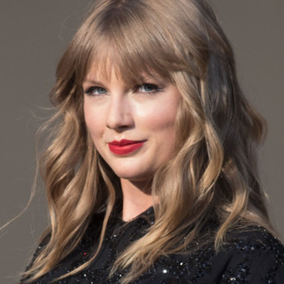

Slide 114
DISADVANTAGES

Slide 115
Swift's music to indicate country—a few banjo strums, a pair of cowboy boots worn onstage, a bedazzled guitar—but there's something in her winsome, vulnerable delivery that's unique to Nashville".

Slide 116
Its singles "Shake It Off", "Blank Space", and "Bad Blood" reached number one in the US, Australia, and Canada.

