Slide 1
Hello, World!
python-pptx is here!

Slide 2
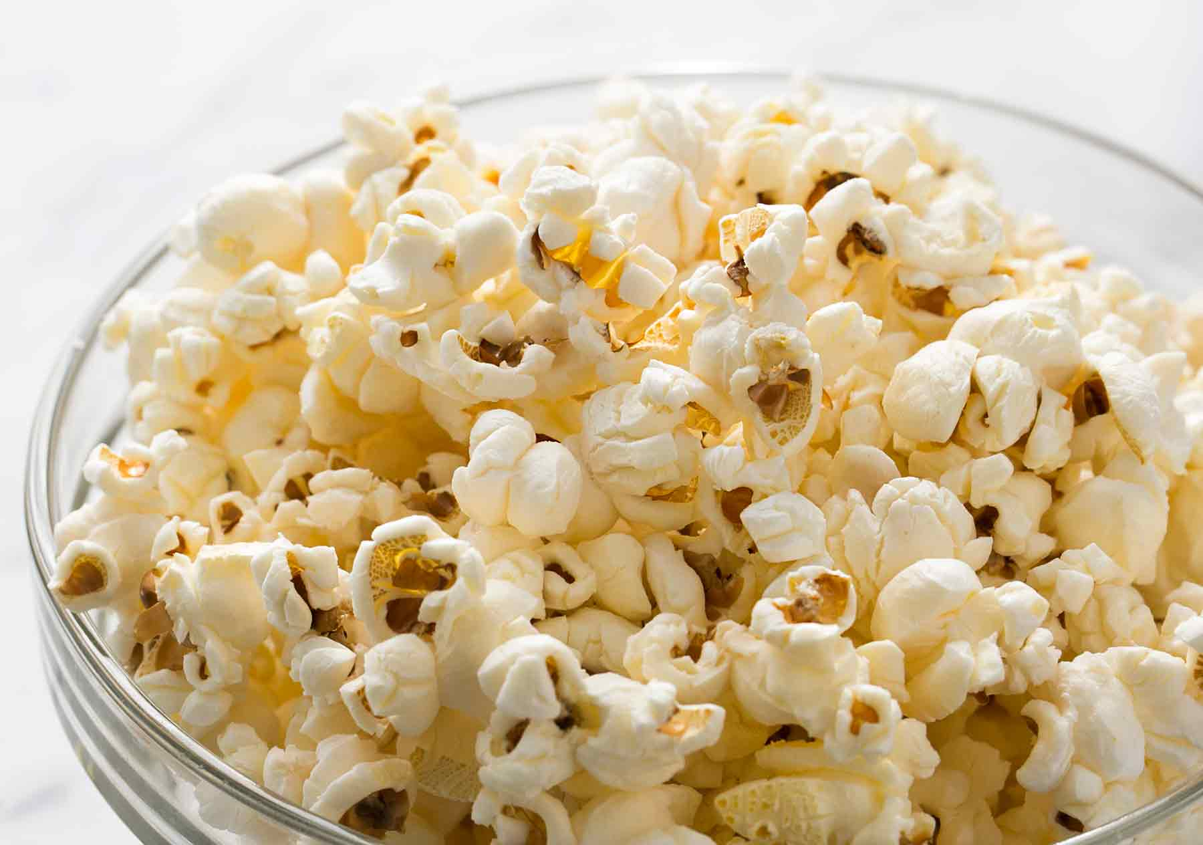

Slide 3
explain!
Popcorn (popped corn, popcorns or pop-corn) is a variety of corn kernel, which expands and puffs up when heated.

Slide 4
explain!
A popcorn kernel's strong hull contains the seed's hard, starchy endosperm with 14–20% moisture, which turns to steam as the kernel is heated.

Slide 5
explain!
Pressure from the steam continues to build until the hull ruptures, allowing the kernel to forcefully expand from 20 to 50 times its original size—and finally, cool.

Slide 6
explain!
A popcorn kernel's strong hull contains the seed's hard, starchy endosperm with 14–20% moisture, which turns to steam as the kernel is heated.

Slide 7
explain!
Popcorn is an ingredient in Cracker Jack, and in the early years of the product, it was popped by hand.

Slide 8
explain!
Cretors, a Chicago candy store owner, created a number of steam-powered machines for roasting nuts and applied the technology to the corn kernels.

Slide 9
explain!
By the turn of the century, Cretors had created and deployed street carts equipped with steam-powered popcorn makers.

Slide 10
explain!
During World War II, sugar rations diminished candy production, and Americans compensated by eating three times as much popcorn as they had before.

Slide 11
explain!
In 1981, General Mills received the first patent for a microwave popcorn bag, with popcorn consumption seeing a sharp increase by tens of thousands of pounds in the years following.

Slide 12
explain!
At least six localities (all in the Midwestern United States) claim to be the "Popcorn Capital of the World;": Ridgway, Illinois; Valparaiso, Indiana; Van Buren, Indiana; Schaller, Iowa; Marion, Ohio; and North Loup, Nebraska.

Slide 13
explain!
According to the USDA, corn used for popcorn production is specifically planted for this purpose; most is grown in Nebraska and Indiana, with increasing area in Texas.

Slide 14
explain!
Unlike most other grains, the outer hull of the popcorn kernel is both strong and impervious to moisture and the starch inside consists almost entirely of a hard type.

Slide 15
explain!
A different method of popcorn-making is be seen on the streets of some Chinese cities and Korea today.

Slide 16
explain!
The un-popped corn kernels are poured into a large cast-iron canister — sometimes called a 'popcorn hammer'— that is then sealed with a heavy lid and slowly turned over a fire in rotisserie fashion.

Slide 17
explain!
With a huge boom, all of the popcorn explodes and is poured into the sack.

Slide 18
explain!
If heated too quickly, the steam in the outer layers of the kernel can reach high pressures and rupture the hull before the starch in the center of the kernel can fully gelatinize, leading to partially popped kernels with hard centers.

Slide 19
explain!
Heating too slowly leads to entirely unpopped kernels: the tip of the kernel, where it attached to the cob, is not entirely moisture-proof, and when heated slowly, the steam can leak out of the tip fast enough to keep the pressure from rising sufficiently to break the hull and cause the pop.

Slide 20
explain!
Producers and sellers of popcorn consider two major factors in evaluating the quality of popcorn: what percentage of the kernels will pop, and how much each popped kernel expands.

Slide 21
explain!
For the consumer, larger pieces of popcorn tend to be more tender and are associated with higher quality.

Slide 22
explain!
For the grower, distributor and vendor, expansion is closely correlated with profit: vendors such as theaters buy popcorn by weight and sell it by volume.

Slide 23
explain!
For these reasons, popcorn growers and distributors dry the kernels until they reach the moisture level at which they expand the most.

Slide 24
explain!
Known in the popcorn industry as "old maids", these kernels fail to pop because they do not have enough moisture to create enough steam for an explosion.

Slide 25
explain!
The kernels from a single cob of popcorn may form both butterfly and mushroom flakes; hybrids that produce 100% butterfly flakes or 100% mushroom flakes exist, the latter developed only as recently as 1998.

Slide 26
explain!
Cinemas have come under fire due to their high markup on popcorn; Stuart Hanson, a film historian at De Montfort University in Leicester once said, "One of the great jokes in the industry is that popcorn is second only to cocaine or heroin in terms of profit."

Slide 27
explain!
This is largely because it contains high levels of the chemicals 6-acetyl-2,3,4,5-tetrahydropyridine and 2-acetyl-1-pyrroline, very powerful aroma compounds that are used by food and other industries to make products that either smell like popcorn, bread, or other foods containing the compound in nature, or for other purposes.

Slide 28
explain!
Popcorn as a breakfast cereal was consumed by Americans in the 1800s and generally consisted of popcorn with milk and a sweetener.

Slide 29
explain!
Popcorn balls (popped kernels stuck together with a sugary "glue") were hugely popular around the turn of the 20th century, but their popularity has since waned.

Slide 30
explain!
The popcorn maker is a relatively new home appliance, and its popularity is increasing because it offers the opportunity to add flavors of the consumer's own choice and to choose healthy-eating popcorn styles.

Slide 31
explain!
For the sake of flavor, however, large amounts of fat, sugar, and sodium are often added to prepared popcorn, which can quickly convert it to a very poor choice for those on restricted diets.

Slide 32
explain!
One example of this first came to public attention in the mid-1990s, when the Center for Science in the Public Interest produced a report about "Movie Popcorn", which became the subject of a widespread publicity campaign.

Slide 33
explain!
In studies conducted by the Motion Picture Association of America it was found that the average American attends six movies a year and that movie theater popcorn and other movie theater snacks are viewed as a treat, not intended to be part of a regular diet.

Slide 34
explain!
Popcorn is included on the list of foods that the American Academy of Pediatrics recommends not serving to children under four, because of the risk of choking.

Slide 35
explain!
One of these formerly common artificial-butter flavorants, diacetyl, has been implicated in causing respiratory illnesses in microwave popcorn factory workers, also known as "popcorn lung".

Slide 36
explain!
Popcorn, threaded onto a string, is used as a wall or Christmas tree decoration in some parts of North America, as well as on the Balkan peninsula.

