Slide 1
Java_(programming_language)
However, Java programs' execution speed improved significantly with the introduction of just-in-time compilation in 1997/1998 for Java 1.1, the addition of language features supporting better code analysis (such as inner classes, the StringBuilder class, optional assertions, etc.

Slide 2
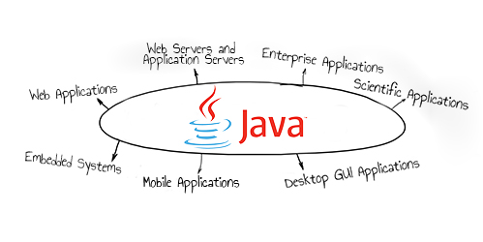

Slide 3
ABOUT

Slide 4
Java uses an automatic garbage collector to manage memory in the object lifecycle.

Slide 5
The programmer determines when objects are created, and the Java runtime is responsible for recovering the memory once objects are no longer in use.

Slide 6
Once no references to an object remain, the unreachable memory becomes eligible to be freed automatically by the garbage collector.

Slide 7
In some languages, memory for the creation of objects is implicitly allocated on the stack or explicitly allocated and deallocated from the heap.

Slide 8
All code is written inside classes, and every data item is an object, with the exception of the primitive data types, (i.e.

Slide 9
The Java source file may only contain one public class, but it can contain multiple classes with other than public access modifier and any number of public inner classes.

Slide 10
When the source file contains multiple classes, make one class "public" and name the source file with that public class name.

Slide 11
For class file generation, anonymous classes are treated as if their name were the concatenation of the name of their enclosing class, a $, and an integer.

Slide 12
The keyword public denotes that a method can be called from code in other classes, or that a class may be used by classes outside the class hierarchy.

Slide 13
The keyword static in front of a method indicates a static method, which is associated only with the class and not with any specific instance of that class.

Slide 14
Only static methods can be invoked without a reference to an object.

Slide 15
Static methods cannot access any class members that are not also static.

Slide 16
Methods that are not designated static are instance methods and require a specific instance of a class to operate.

Slide 17
Java classes that run in managed environments such as applets and Enterprise JavaBeans do not use or need a main() method.

Slide 18
A Java program may contain multiple classes that have main methods, which means that the VM needs to be explicitly told which class to launch from.

Slide 19
The main method must accept an array of String objects.

Slide 20
The Java launcher launches Java by loading a given class (specified on the command line or as an attribute in a JAR) and starting its public static void main(String) method.

Slide 21
The out object is an instance of the PrintStream class and provides many methods for printing data to standard out, including println(String) which also appends a new line to the passed string.

Slide 22
For container classes, for example, this is a problem because there is no easy way to create a container that accepts only specific types of objects.

Slide 23
Oracle Corporation is the current owner of the official implementation of the Java SE platform, following their acquisition of Sun Microsystems on January 27, 2010.

Slide 24
The Oracle implementation is packaged into two different distributions: The Java Runtime Environment (JRE) which contains the parts of the Java SE platform required to run Java programs and is intended for end users, and the Java Development Kit (JDK), which is intended for software developers and includes development tools such as the Java compiler, Javadoc, Jar, and a debugger.

Slide 25
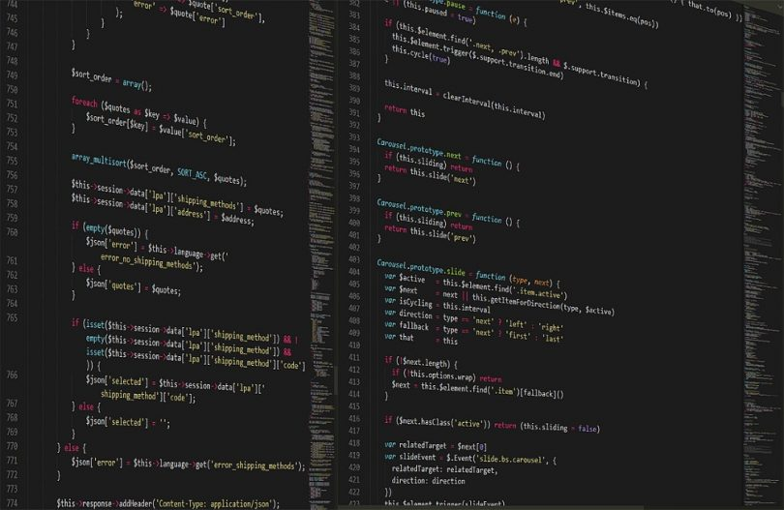

Slide 26
ADVANTAGES

Slide 27
However, Java programs' execution speed improved significantly with the introduction of just-in-time compilation in 1997/1998 for Java 1.1, the addition of language features supporting better code analysis (such as inner classes, the StringBuilder class, optional assertions, etc.

Slide 28
This allows the garbage collector to relocate referenced objects and ensures type safety and security.

Slide 29
As in C++ and some other object-oriented languages, variables of Java's primitive data types are either stored directly in fields (for objects) or on the stack (for methods) rather than on the heap, as is commonly true for non-primitive data types (but see escape analysis).

Slide 30
The effect of this alternate declaration is semantically identical (to the args parameter which is still an array of String objects), but it allows an alternative syntax for creating and passing the array.

Slide 31
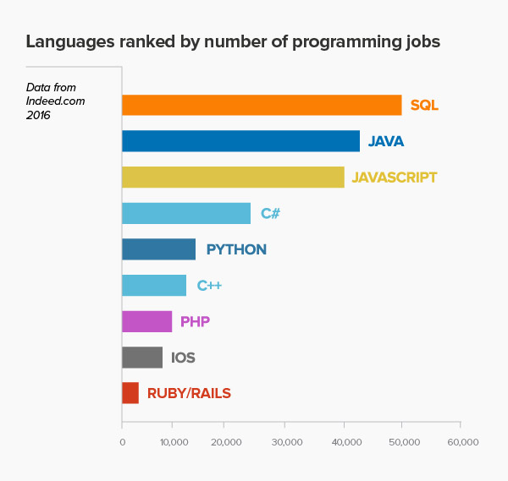

Slide 32
DISADVANTAGES

Slide 33
Something similar to a memory leak may still occur if a programmer's code holds a reference to an object that is no longer needed, typically when objects that are no longer needed are stored in containers that are still in use.

Slide 34
Paradoxically, the presence of a garbage collector has faded the necessity of having an explicit destructor method in the classes, thus rendering the management of these other resources more difficult.

Slide 35
Since Java 5, the main method can also use variable arguments, in the form of public static void main(String... args), allowing the main method to be invoked with an arbitrary number of String arguments.

Slide 36
The String args parameter is an array of String objects containing any arguments passed to the class.

