Slide 1
Java
However, Java programs' execution speed improved significantly with the introduction of just-in-time compilation in 1997/1998 for Java 1.1, the addition of language features supporting better code analysis (such as inner classes, the StringBuilder class, optional assertions, etc.

Slide 2
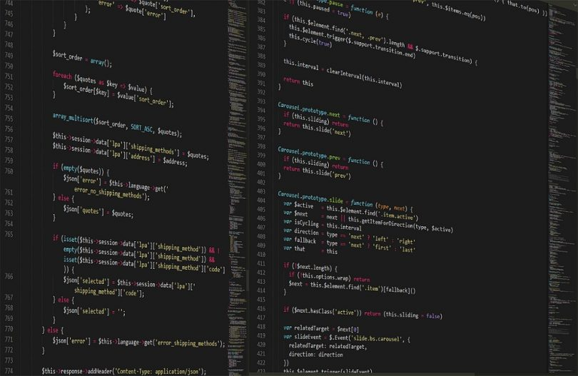

Slide 3
ABOUT

Slide 4
Java uses an automatic garbage collector to manage memory in the object lifecycle.

Slide 5
The programmer determines when objects are created, and the Java runtime is responsible for recovering the memory once objects are no longer in use.

Slide 6
Once no references to an object remain, the unreachable memory becomes eligible to be freed automatically by the garbage collector.

Slide 7
All code is written inside classes, and every data item is an object, with the exception of the primitive data types, (i.e.

Slide 8
program can be written in Java as: Source files must be named after the public class they contain, appending the suffix .java, for example, HelloWorldApp.java.

Slide 9
It must first be compiled into bytecode, using a Java compiler, producing a file named HelloWorldApp.class.

Slide 10
The keyword public denotes that a method can be called from code in other classes, or that a class may be used by classes outside the class hierarchy.

Slide 11
For container classes, for example, this is a problem because there is no easy way to create a container that accepts only specific types of objects.

Slide 12
Generics allow compile-time type checking without having to create many container classes, each containing almost identical code.

Slide 13
Java is a general-purpose computer-programming language that is concurrent, class-based, object-oriented, and specifically designed to have as few implementation dependencies as possible.

Slide 14
Java was originally developed by a Canadian James Gosling at Sun Microsystems (which has since been acquired by Oracle) and released in 1995 as a core component of Sun Microsystems' Java platform.

Slide 15
The original and reference implementation Java compilers, virtual machines, and class libraries were originally released by Sun under proprietary licenses.

Slide 16
As of May 2007, in compliance with the specifications of the Java Community Process, Sun had relicensed most of its Java technologies under the GNU General Public License.

Slide 17
Meanwhile, others have developed alternative implementations of these Sun technologies, such as the GNU Compiler for Java (bytecode compiler), GNU Classpath (standard libraries), and IcedTea-Web (browser plugin for applets).

Slide 18
Java 8 will be supported with public updates for personal use up to at least December 2020.

Slide 19
Sun Microsystems released the first public implementation as Java 1.0 in 1996.

Slide 20
At one time, Sun made most of its Java implementations available without charge, despite their proprietary software status.

Slide 21
Major release versions of Java, along with their release dates: Sun has defined and supports four editions of Java targeting different application environments and segmented many of its APIs so that they belong to one of the platforms.

Slide 22
The platforms are: The classes in the Java APIs are organized into separate groups called packages.

Slide 23
End users commonly use a Java Runtime Environment (JRE) installed on their own machine for standalone Java applications, or in a web browser for Java applets.

Slide 24
Java itself is platform-independent and is adapted to the particular platform it is to run on by a Java virtual machine for it, which translates the Java bytecode into the platform's machine language.

Slide 25
The programmer determines when objects are created, and the Java runtime is responsible for recovering the memory once objects are no longer in use.

Slide 26
program can be written in Java as: Source files must be named after the public class they contain, appending the suffix .java, for example, HelloWorldApp.java.

Slide 27
The Java source file may only contain one public class, but it can contain multiple classes with other than public access modifier and any number of public inner classes.

Slide 28
A class that is not declared public may be stored in any .java file.

Slide 29
The keyword public denotes that a method can be called from code in other classes, or that a class may be used by classes outside the class hierarchy.

Slide 30
The method name "main" is not a keyword in the Java language.

Slide 31
Java classes that run in managed environments such as applets and Enterprise JavaBeans do not use or need a main() method.

Slide 32
A Java program may contain multiple classes that have main methods, which means that the VM needs to be explicitly told which class to launch from.

Slide 33
The Java launcher launches Java by loading a given class (specified on the command line or as an attribute in a JAR) and starting its public static void main(String) method.

Slide 34
Printing is part of a Java standard library: The System class defines a public static field called out.

Slide 35
Swing is a graphical user interface library for the Java SE platform.

Slide 36
If Java prevented all runtime type errors (ClassCastException's) from occurring, it would be type safe.

Slide 37
Oracle Corporation is the current owner of the official implementation of the Java SE platform, following their acquisition of Sun Microsystems on January 27, 2010.

Slide 38
This implementation is based on the original implementation of Java by Sun.

Slide 39
Because Java lacks any formal standardization recognized by Ecma International, ISO/IEC, ANSI, or other third-party standards organization, the Oracle implementation is the de facto standard.

Slide 40
The Oracle implementation is packaged into two different distributions: The Java Runtime Environment (JRE) which contains the parts of the Java SE platform required to run Java programs and is intended for end users, and the Java Development Kit (JDK), which is intended for software developers and includes development tools such as the Java compiler, Javadoc, Jar, and a debugger.

Slide 41
The implementation started when Sun began releasing the Java source code under the GPL.

Slide 42
Historically, Sun's trademark license for usage of the Java brand insists that all implementations be "compatible".

Slide 43
Platform-independent Java is essential to Java EE, and an even more rigorous validation is required to certify an implementation.

Slide 44
The Java programming language requires the presence of a software platform in order for compiled programs to be executed.

Slide 45
Oracle supplies the Java platform for use with Java.

Slide 46
Although Android, built on the Linux kernel, is written largely in C, the Android SDK uses the Java language as the basis for Android applications.

Slide 47
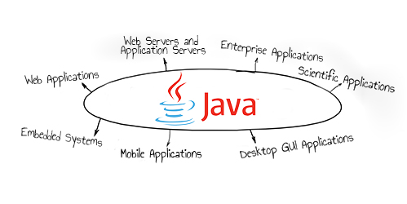

Slide 48
ADVANTAGES

Slide 49
However, Java programs' execution speed improved significantly with the introduction of just-in-time compilation in 1997/1998 for Java 1.1, the addition of language features supporting better code analysis (such as inner classes, the StringBuilder class, optional assertions, etc.

Slide 50
This allows the garbage collector to relocate referenced objects and ensures type safety and security.

Slide 51
It is intended to let application developers "write once, run anywhere" (WORA), meaning that compiled Java code can run on all platforms that support Java without the need for recompilation.

Slide 52
As of 2016, Java was one of the most popular programming languages in use, particularly for client-server web applications, with a reported 9 million developers.

Slide 53
Oracle released the last public update for the legacy Java 8 LTS, which is free for commercial use, in January 2019.

Slide 54
On November 13, 2006, Sun released much of its Java virtual machine (JVM) as free and open-source software, (FOSS), under the terms of the GNU General Public License (GPL).

Slide 55
One design goal of Java is portability, which means that programs written for the Java platform must run similarly on any combination of hardware and operating system with adequate run time support.

Slide 56
However, Java programs' execution speed improved significantly with the introduction of just-in-time compilation in 1997/1998 for Java 1.1, the addition of language features supporting better code analysis (such as inner classes, the StringBuilder class, optional assertions, etc.

Slide 57
Some platforms offer direct hardware support for Java; there are micro controllers that can run Java bytecode in hardware instead of a software Java virtual machine, and some ARM-based processors could have hardware support for executing Java bytecode through their Jazelle option, though support has mostly been dropped in current implementations of ARM.

Slide 58
As in C++ and some other object-oriented languages, variables of Java's primitive data types are either stored directly in fields (for objects) or on the stack (for methods) rather than on the heap, as is commonly true for non-primitive data types (but see escape analysis).

Slide 59
Java reuses some popular aspects of C++ (such as the printf method).

Slide 60
The Javadoc style of commenting allows the user to run the Javadoc executable to create documentation for the program and can be read by some integrated development environments (IDEs) such as Eclipse to allow developers to access documentation within the IDE.

Slide 61
JavaFX is a software platform for creating and delivering desktop applications, as well as rich Internet applications (RIAs) that can run across a wide variety of devices.

Slide 62
The class library contains features such as: Javadoc is a comprehensive documentation system, created by Sun Microsystems, used by many Java developers.

Slide 63
The bytecode language supported by the Android SDK is incompatible with Java bytecode and runs on its own virtual machine, optimized for low-memory devices such as smartphones and tablet computers.

Slide 64
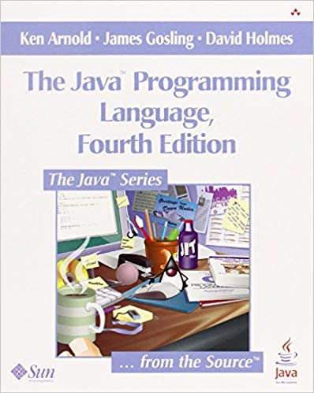

Slide 65
DISADVANTAGES

Slide 66
Something similar to a memory leak may still occur if a programmer's code holds a reference to an object that is no longer needed, typically when objects that are no longer needed are stored in containers that are still in use.

Slide 67
Paradoxically, the presence of a garbage collector has faded the necessity of having an explicit destructor method in the classes, thus rendering the management of these other resources more difficult!

Slide 68
Since Java 5, the main method can also use variable arguments, in the form of public static void main(String... args), allowing the main method to be invoked with an arbitrary number of String arguments.

Slide 69
Where prior implementations of these looks and feels may have been considered lacking, Swing in Java SE 6 addresses this problem by using more native GUI widget drawing routines of the underlying platforms.

Slide 70
This resulted in a legal dispute with Microsoft after Sun claimed that the Microsoft implementation did not support RMI or JNI and had added platform-specific features of their own.

