Slide 1
Selena_Gomez
Gomez's acting credits include starring roles in the films Another Cinderella Story (2008), Princess Protection Program (2009), Wizards of Waverly Place: The Movie (2009), Ramona and Beezus (2010), Monte Carlo (2011), Spring Breakers (2012), Getaway (2013) and The Fundamentals of Caring (2016).

Slide 2
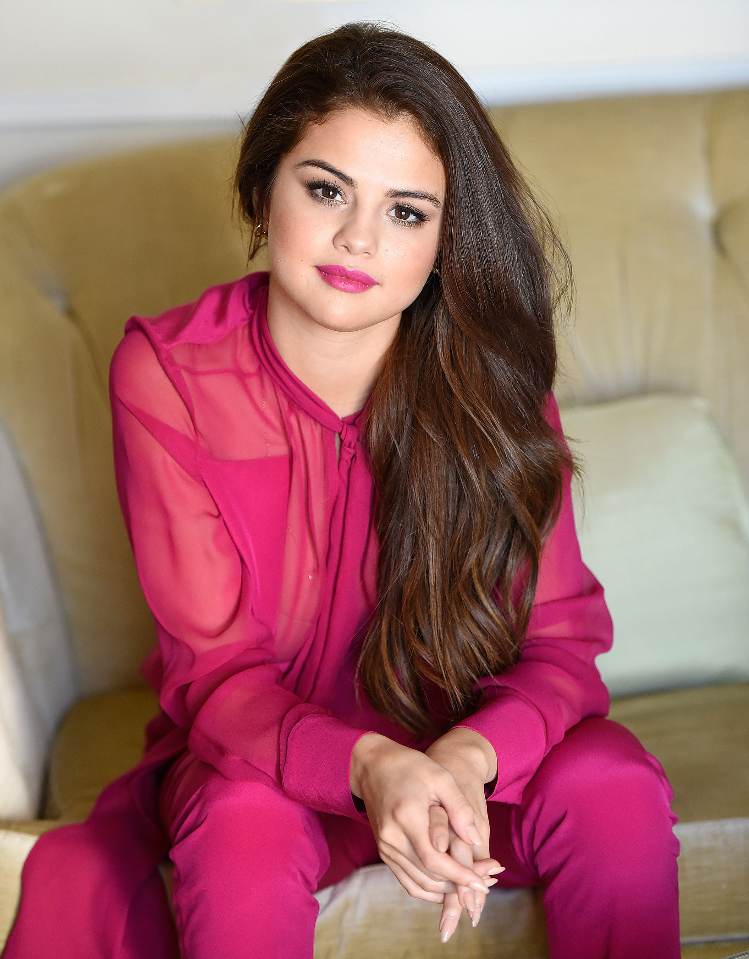

Slide 3
ABOUT

Slide 4
Both Gomez and Lovato were later selected to appear on the series in 2002, with Gomez portraying the character of Gianna.

Slide 5
" Gomez appeared in thirteen episodes of the show between 2002 and 2004, though the show's producers released her as she was getting "too old" for the series.

Slide 6
While working on the series, Gomez had a cameo role in the film Spy Kids 3-D: Game Over (2003) and the made-for-television film Walker, Texas Ranger: Trial by Fire (2005).

Slide 7
Gomez made a guest appearance in a 2006 episode of the Disney series The Suite Life of Zack & Cody.

Slide 8
During this time, Gomez filmed pilot episodes for two potential Disney Channel series; the first, titled Arwin!, a spin-off of the Suite Life series, while the second titled Stevie Sanchez was a spin-off of the series Lizzie McGuire.

Slide 9
Gomez recorded the theme song for the series, titled "Everything is Not What It Seems".

Slide 10
Gomez later appeared in the music video for the song "Burnin' Up", which the Jonas Brothers had recorded and released, and later, she also appeared in an episode of the reality series Jonas Brothers: Living the Dream.

Slide 11
She contributed a cover of the song "Cruella de Vil" to the compilation album DisneyMania 6, and later recorded the original song "Fly to Your Heart" for the soundtrack of the animated film Tinker Bell.

Slide 12
She had a leading role as an aspiring dancer Mary Santiago in the direct-to-video film Another Cinderella Story, a sequel to A Cinderella Story, starring Hilary Duff and Chad Michael Murray and the second installment of A Cinderella Story series.

Slide 13
Gomez recorded three songs for the soundtrack, and released one of them, "Tell Me Something I Don't Know", as a promotional single.

Slide 14
She later announced a film adaptation of the novel Thirteen Reasons Why, in which she was to play a young girl who commits suicide; ultimately, neither film was made, though Gomez would later executive produce a television adaptation of Thirteen Reasons Why.

Slide 15
She later made a guest appearance on the Disney series Sonny With a Chance, starring Lovato.

Slide 16
Gomez, along with Lovato, starred in the Disney Channel film Princess Protection Program, which aired in June 2009.

Slide 17
For the film, Gomez and Lovato recorded the song "One and the Same", which was later released as a promotional single.

Slide 18
On August 28, 2009, Gomez starred in Wizards of Waverly Place: The Movie, a television film based on the series.

Slide 19
In 2010, Gomez starred as one of the two female leads in Ramona and Beezus, a film adaption of the children's novel series by Beverly Cleary.

Slide 20
Gomez appeared in a cameo role in the film The Muppets and appeared in the Disney shows So Random!

Slide 21
Gomez hoped to focus on her film career outside Disney and starred in the animated film Hotel Transylvania (2012).

Slide 22
Gomez had a role in the controversial exploitation film Spring Breakers (2013), starring James Franco.

Slide 23
She later appeared in the film Rudderless (2014), the directorial debut of William H.

Slide 24
She reprised the role of Mavis in Hotel Transylvania 2, which was released on September 25; the film was met with a positive critical and commercial reception upon its release.

Slide 25
Gomez had a cameo role in the film The Big Short, which was released on December 11 by Paramount Pictures.

Slide 26
Gomez and Kygo confirmed the single titled "It Ain't Me" via their social media accounts a week later, which was released on February 16.

Slide 27
In August 2017, Gomez was cast in A Rainy Day in New York, a film directed by Woody Allen for Amazon Studios.

Slide 28
On October 19, 2017, Gomez and EDM producer Marshmello announced that they would be collaborating on a new track titled "Wolves," which was released on October 25.

Slide 29
Gomez was featured on the Benny Blanco song "I Can't Get Enough", alongside Tainy and J Balvin, which was released in February 2019.

Slide 30
Gomez also appeared in ads for Coca-Cola's "Share a Coke" campaign, and she appeared in advertisements for the campaign and lyrics from two of her songs will be featured on packages of Coca-Cola products nationwide.

Slide 31
Gomez later stated in 2017 that she did not like the term "religion" and that sometimes it "freaks me out", adding "I don't know if it's necessarily that I believe in religion, as much as I believe in faith and a relationship with God.

Slide 32
The Weeknd released My Dear Melancholy, in March 2018, which—according to media outlets—referenced Gomez in several songs.

Slide 33
As a solo artist, Gomez has released the two number-one albums Stars Dance (2013) and Revival (2015).

Slide 34
In 2017, Billboard reported that Gomez has sold over 7 million albums and 22 million singles worldwide.

Slide 35
Gomez recorded three songs for the soundtrack, and released one of them, "Tell Me Something I Don't Know", as a promotional single.

Slide 36
For the film, Gomez and Lovato recorded the song "One and the Same", which was later released as a promotional single.

Slide 37
Selena Gomez & the Scene released their second studio album A Year Without Rain that same year, which debuted on the US Billboard 200 at number 4 with sales of a little over 66,000.

Slide 38
Selena Gomez & the Scene released their third and final studio album that same year.

Slide 39
The album received mixed reviews, with the album's second single receiving a 4x Platinum certification from the RIAA.

Slide 40
Gomez released "Come & Get It" as the lead single from the album.

Slide 41
The single became Gomez's first top ten entry on the Billboard Hot 100.

Slide 42
Another single from the album, "Slow Down", peaked at number 27 in the Billboard charts.

Slide 43
It became her first album to debut at number one on the US Billboard 200 chart, where it sold 97,000 copies in its first week.

Slide 44
The album remained in the top ten in its second week, though declined down the chart in the following weeks.

Slide 45
Gomez surprise released her new single "The Heart Wants What It Wants" (2014) on November 6, and confirmed after months of speculation that she would be releasing a compilation album as a means of finishing out her contract with Hollywood Records.

Slide 46
Gomez released her first solo compilation album, For You (2014), on November 24.

Slide 47
While working on her second studio album, Gomez collaborated with Zedd for his single "I Want You to Know" (2015), released as the lead single from his second album on February 23.

Slide 48
The single became Gomez's fourth top twenty entry on the Billboard Hot 100, and received a platinum certification from the Recording Industry Association of America (RIAA).

Slide 49
The song sold 179,000 copies in its first week of release alone, and went on to become her first top five single on the Billboard Hot 100 in the United States.

Slide 50
Gomez released her second studio album, Revival (2015), on October 9, 2015.

Slide 51
"Hands to Myself" was the album's third single, which became her third consecutive number one on the Mainstream Top 40 chart.

Slide 52
This made Gomez one of only six female artists to have three singles from the same album top the chart.

Slide 53
Gomez has begun working on her third studio album while touring, and added a new song titled "Feel Me" to the setlist of her Revival Tour.

Slide 54
Gomez and Kygo confirmed the single titled "It Ain't Me" via their social media accounts a week later, which was released on February 16.

Slide 55
The song reached the top 10 of the Billboard Hot 100 chart.

Slide 56
A second music video was released on YouTube the next month which also teased the follow-up single "Fetish", released on July 13, 2017.

Slide 57
On May 10, 2018, Gomez released a new single from the 13 Reasons Why Season 2 Soundtrack, titled "Back To You".

Slide 58
In 2013, she released her second fragrance, Vivamore by Selena Gomez.

Slide 59
It debuted on the Billboard Hot 100 at No.

Slide 60
Gomez has released two studio albums, one EP, and one compilation album in her solo career.

Slide 61
Gomez also the lead singer of the former band Selena Gomez & the Scene, releasing three studio albums and one remix album.

Slide 62
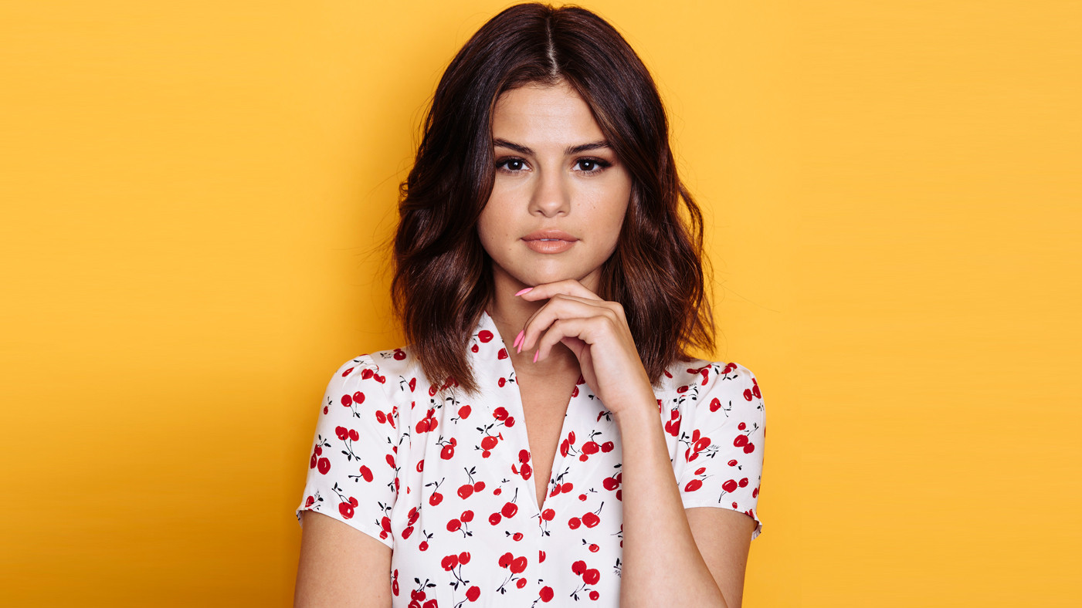

Slide 63
ADVANTAGES

Slide 64
Gomez's acting credits include starring roles in the films Another Cinderella Story (2008), Princess Protection Program (2009), Wizards of Waverly Place: The Movie (2009), Ramona and Beezus (2010), Monte Carlo (2011), Spring Breakers (2012), Getaway (2013) and The Fundamentals of Caring (2016).

Slide 65
Gomez was given a recurring role on the popular Disney Channel series Hannah Montana in 2007, portraying pop star Mikayla.

Slide 66
She later auditioned for a role in the Disney series Wizards of Waverly Place, ultimately winning the lead role of Alex Russo.

Slide 67
While working on the second season of Wizards of Waverly Place, Gomez appeared on the Disney Channel special Studio DC: Almost Live alongside various other Disney stars.

Slide 68
Later that year, Gomez had the supporting role of Helga in the animated film Horton Hears a Who!

Slide 69
Gomez continued to have mainstream success throughout the following year, appearing as Alex Russo in a crossover episode of the Disney series The Suite Life on Deck.

Slide 70
The film saw Gomez in a more mature role than her previous works, and reportedly led to Gomez having a "bit of a meltdown on set.

Slide 71
Gomez had a supporting role in the comedy film Neighbors 2: Sorority Rising; she portrayed the president of a Phi Lambda sorority.

Slide 72
From 2009 to 2012, Gomez was involved in "Disney's Friends for Change", an organization which promoted "environmentally-friendly behavior", and she appeared in its public service announcements.

Slide 73
With her former band Selena Gomez & the Scene, she attained the top-ten albums Kiss & Tell (2009), A Year Without Rain (2010) and When the Sun Goes Down (2011) on the US Billboard 200.

Slide 74
She has also earned seven top-ten entries on the US Billboard Hot 100: "Come & Get It", "The Heart Wants What It Wants", "Good for You" with ASAP Rocky, "Same Old Love", "Hands to Myself", "We Don't Talk Anymore" and "It Ain't Me" with Kygo.

Slide 75
While working on the second season of Wizards of Waverly Place, Gomez appeared on the Disney Channel special Studio DC: Almost Live alongside various other Disney stars.

Slide 76
" The group released their debut studio album in August 2009, which debuted at number nine on the Billboard 200 albums chart in the United States, with first-week sales of 66,000 copies.

Slide 77
The single went on to become her second top ten hit on the Billboard Hot 100 chart, and sold over one million copies in the United States.

Slide 78
Gomez released "Good for You" (2015) as the lead single from her second studio album on June 22, 2015; the single features rapper ASAP Rocky.

Slide 79
"Same Old Love" (2015) was released as the album's second single, and went on to top the Mainstream Top 40 chart.

Slide 80
The single peaked at number five on the Billboard Hot 100, tying with "Good for You" as her highest charting effort.

Slide 81
Gomez and Canadian singer Tory Lanez were featured on "Trust Nobody", the second single from Norwegian DJ Cashmere Cat debut studio album 9.

Slide 82
She has a limited-edition collection of handbags called the "Selena Grace" that she designed in collaboration with luxury brand Coach, Inc. On March 29, 2018, Gomez released photos from her partnership with Coach on her Instagram account.

Slide 83
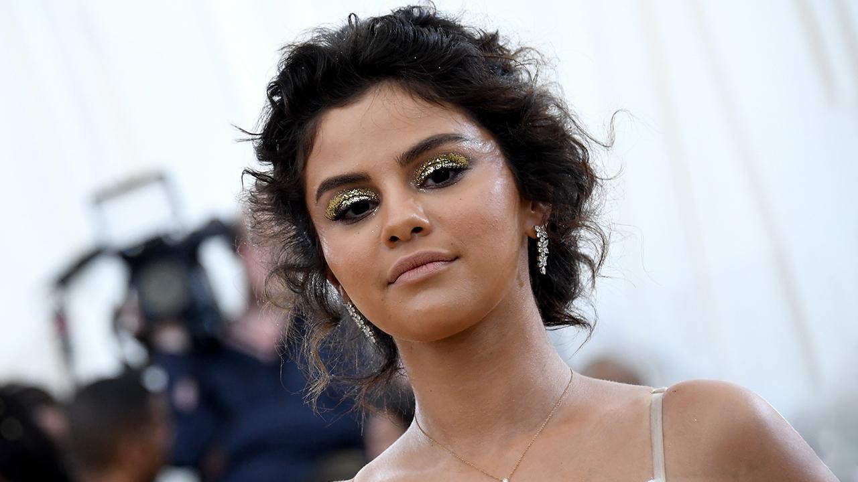

Slide 84
DISADVANTAGES

Slide 85
Gomez appeared in the film Behaving Badly (2014) with Dylan McDermott and Nat Wolff.

Slide 86
The project, filmed prior to Gomez's stint in rehab, was released in August 2014 to a generally negative critical and commercial reception.

