Slide 1
Java_(programming_language)
Java uses an automatic garbage collector to manage memory in the object lifecycle.

Slide 2
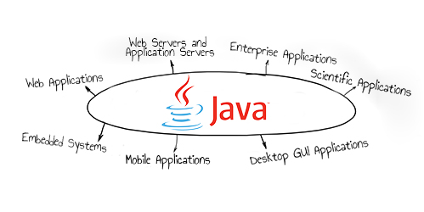

Slide 3
ABOUT

Slide 4
Java uses an automatic garbage collector to manage memory in the object lifecycle.

Slide 5
Once no references to an object remain, the unreachable memory becomes eligible to be freed automatically by the garbage collector.

Slide 6
In some languages, memory for the creation of objects is implicitly allocated on the stack or explicitly allocated and deallocated from the heap.

Slide 7
This allows the garbage collector to relocate referenced objects and ensures type safety and security.

Slide 8
program can be written in Java as: Source files must be named after the public class they contain, appending the suffix .java, for example, HelloWorldApp.java.

Slide 9
When the source file contains multiple classes, make one class "public" and name the source file with that public class name.

Slide 10
A class that is not declared public may be stored in any .java file.

Slide 11
The effect of this alternate declaration is semantically identical (to the args parameter which is still an array of String objects), but it allows an alternative syntax for creating and passing the array.

Slide 12
The String args parameter is an array of String objects containing any arguments passed to the class.

Slide 13
It is intended to let application developers "write once, run anywhere" (WORA), meaning that compiled Java code can run on all platforms that support Java without the need for recompilation.

Slide 14
Following Oracle Corporation's acquisition of Sun Micro-systems in 2009–10, Oracle has described itself as the "steward of Java technology with a relentless commitment to fostering a community of participation and transparency".

Slide 15
This did not prevent Oracle from filing a lawsuit against Google shortly after that for using Java inside the Android SDK (see Google section below).

Slide 16
In January 2016, Oracle announced that Java run-time environments based on JDK 9 will discontinue the browser plugin.

Slide 17
Java bytecode instructions are analogous to machine code, but they are intended to be executed by a virtual machine (VM) written specifically for the host hardware.

Slide 18
Oracle Corporation is the current owner of the official implementation of the Java SE platform, following their acquisition of Sun Microsystems on January 27, 2010.

Slide 19
The Oracle implementation is packaged into two different distributions: The Java Runtime Environment (JRE) which contains the parts of the Java SE platform required to run Java programs and is intended for end users, and the Java Development Kit (JDK), which is intended for software developers and includes development tools such as the Java compiler, Javadoc, Jar, and a debugger.

Slide 20
The implementation started when Sun began releasing the Java source code under the GPL.

Slide 21
Historically, Sun's trademark license for usage of the Java brand insists that all implementations be "compatible".

Slide 22
The Java programming language requires the presence of a software platform in order for compiled programs to be executed.

Slide 23
Oracle supplies the Java platform for use with Java.

Slide 24
The Java language is a key pillar in Android, an open source mobile operating system.

Slide 25
Depending on the Android version, the bytecode is either interpreted by the Dalvik virtual machine or compiled into native code by the Android Runtime.

Slide 26
On 7 May 2012, a San Francisco jury found that if APIs could be copyrighted, then Google had infringed Oracle's copyrights by the use of Java in Android devices.

Slide 27
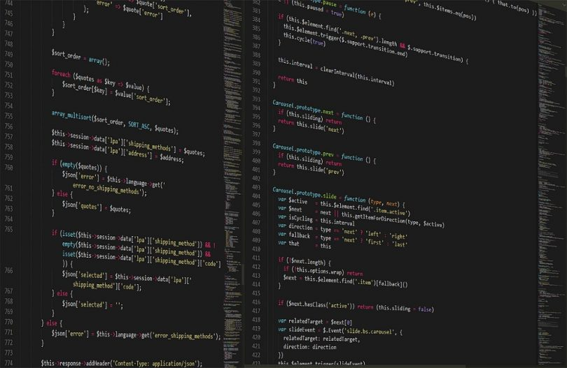

Slide 28
ADVANTAGES

Slide 29
The programmer determines when objects are created, and the Java runtime is responsible for recovering the memory once objects are no longer in use.

Slide 30
As in C++ and some other object-oriented languages, variables of Java's primitive data types are either stored directly in fields (for objects) or on the stack (for methods) rather than on the heap, as is commonly true for non-primitive data types (but see escape analysis).

Slide 31
The keyword static in front of a method indicates a static method, which is associated only with the class and not with any specific instance of that class.

Slide 32
Only static methods can be invoked without a reference to an object.

Slide 33
Static methods cannot access any class members that are not also static.

Slide 34
Methods that are not designated static are instance methods and require a specific instance of a class to operate.

Slide 35
The main method must accept an array of String objects.

Slide 36
Since Java 5, the main method can also use variable arguments, in the form of public static void main(String... args), allowing the main method to be invoked with an arbitrary number of String arguments.

Slide 37
The Java launcher launches Java by loading a given class (specified on the command line or as an attribute in a JAR) and starting its public static void main(String) method.

Slide 38
Printing is part of a Java standard library: The System class defines a public static field called out.

Slide 39
The out object is an instance of the PrintStream class and provides many methods for printing data to standard out, including println(String) which also appends a new line to the passed string.

Slide 40
Java was originally developed by James Gosling at Sun Microsystems (which has since been acquired by Oracle) and released in 1995 as a core component of Sun Microsystems' Java platform.

Slide 41
The original and reference implementation Java compilers, virtual machines, and class libraries were originally released by Sun under proprietary licenses.

Slide 42
Meanwhile, others have developed alternative implementations of these Sun technologies, such as the GNU Compiler for Java (bytecode compiler), GNU Classpath (standard libraries), and IcedTea-Web (browser plugin for applets).

Slide 43
Sun Microsystems released the first public implementation as Java 1.0 in 1996.

Slide 44
At one time, Sun made most of its Java implementations available without charge, despite their proprietary software status.

Slide 45
On November 13, 2006, Sun released much of its Java virtual machine (JVM) as free and open-source software, (FOSS), under the terms of the GNU General Public License (GPL).

Slide 46
Major release versions of Java, along with their release dates: Sun has defined and supports four editions of Java targeting different application environments and segmented many of its APIs so that they belong to one of the platforms.

Slide 47
One design goal of Java is portability, which means that programs written for the Java platform must run similarly on any combination of hardware and operating system with adequate run time support.

Slide 48
This is achieved by compiling the Java language code to an intermediate representation called Java bytecode, instead of directly to architecture-specific machine code.

Slide 49
End users commonly use a Java Runtime Environment (JRE) installed on their own machine for standalone Java applications, or in a web browser for Java applets.

Slide 50
However, the overhead of interpreting bytecode into machine instructions made interpreted programs almost always run more slowly than native executables.

Slide 51
Just-in-time (JIT) compilers that compile byte-codes to machine code during runtime were introduced from an early stage.

Slide 52
Java itself is platform-independent and is adapted to the particular platform it is to run on by a Java virtual machine for it, which translates the Java bytecode into the platform's machine language.

Slide 53
However, Java programs' execution speed improved significantly with the introduction of just-in-time compilation in 1997/1998 for Java 1.1, the addition of language features supporting better code analysis (such as inner classes, the StringBuilder class, optional assertions, etc.

Slide 54
), and optimizations in the Java virtual machine, such as HotSpot becoming the default for Sun's JVM in 2000.

Slide 55
Some platforms offer direct hardware support for Java; there are micro controllers that can run Java bytecode in hardware instead of a software Java virtual machine, and some ARM-based processors could have hardware support for executing Java bytecode through their Jazelle option, though support has mostly been dropped in current implementations of ARM.

Slide 56
Where prior implementations of these looks and feels may have been considered lacking, Swing in Java SE 6 addresses this problem by using more native GUI widget drawing routines of the underlying platforms.

Slide 57
JavaFX is a software platform for creating and delivering desktop applications, as well as rich Internet applications (RIAs) that can run across a wide variety of devices.

Slide 58
This implementation is based on the original implementation of Java by Sun.

Slide 59
This resulted in a legal dispute with Microsoft after Sun claimed that the Microsoft implementation did not support RMI or JNI and had added platform-specific features of their own.

Slide 60
Platform-independent Java is essential to Java EE, and an even more rigorous validation is required to certify an implementation.

Slide 61
Although Android, built on the Linux kernel, is written largely in C, the Android SDK uses the Java language as the basis for Android applications.

Slide 62
The bytecode language supported by the Android SDK is incompatible with Java bytecode and runs on its own virtual machine, optimized for low-memory devices such as smartphones and tablet computers.

Slide 63
Android does not provide the full Java SE standard library, although the Android SDK does include an independent implementation of a large subset of it.

Slide 64
The use of Java-related technology in Android led to a legal dispute between Oracle and Google.

Slide 65
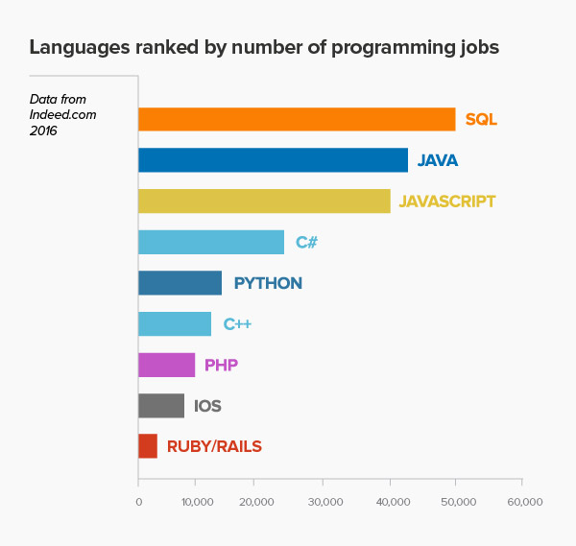

Slide 66
DISADVANTAGES

Slide 67
Something similar to a memory leak may still occur if a programmer's code holds a reference to an object that is no longer needed, typically when objects that are no longer needed are stored in containers that are still in use.

Slide 68
Paradoxically, the presence of a garbage collector has faded the necessity of having an explicit destructor method in the classes, thus rendering the management of these other resources more difficult.

Slide 69
The Java source file may only contain one public class, but it can contain multiple classes with other than public access modifier and any number of public inner classes.

Slide 70
The keyword public denotes that a method can be called from code in other classes, or that a class may be used by classes outside the class hierarchy.

Slide 71
For container classes, for example, this is a problem because there is no easy way to create a container that accepts only specific types of objects.

Slide 72
Java is a general-purpose programming language that is class-based, object-oriented, and designed to have as few implementation dependencies as possible.

Slide 73
Java applications are typically compiled to "bytecode" that can run on any Java virtual machine (JVM) regardless of the underlying computer architecture.

Slide 74
Because Java lacks any formal standardization recognized by Ecma International, ISO/IEC, ANSI, or other third-party standards organization, the Oracle implementation is the de facto standard.

