Slide 1

Title: Data Analysis of MBA Decision Dataset
Name : Krishna Soni
Course: Introduction to Analytics Project 4
Date: 02/01/2025

Slide 2
Dataset Overview: The MBA Decision Dataset includes data from individuals considering or pursuing an MBA.
Key Attributes:
Person ID: Unique identifier for each candidate.
Age: Age of candidates (in years).
Gender: Male, Female, Other.
Undergraduate Major: Major field of study.
Undergraduate GPA: GPA from undergraduate education.
Years of Work Experience: Professional experience prior to the MBA.
Annual Salary Before MBA: Salary before pursuing an MBA.
MBA Funding Source: How the MBA is funded (loans, scholarships).
Reason for MBA: Motivation for pursuing the MBA.
Importance of the Dataset:
Provides insights into demographics, motivations, and expectations of MBA candidates.
Helps prospective students and educators understand trends in MBA education.
Notes:
Now, I would like to provide an introduction to the MBA Decision Dataset that we will be analyzing.
Start with the Dataset Overview
The MBA Decision Dataset consists of comprehensive information gathered from individuals who are either contemplating or actively pursuing a Master of Business Administration (MBA). The insights gained from this dataset are essential for understanding the current landscape of MBA education.
Discuss Key Attributes
Let's take a closer look at some of the key attributes included in this dataset. First, we have the Person ID, which serves as a unique identifier for each candidate.
Next is Age, which records the candidates' ages in years. Gender is also included, with options for male, female, or other.
The dataset captures the Undergraduate Major, providing insight into the educational backgrounds of candidates.
Additionally, we’ve included Undergraduate GPA, Years of Work Experience, and the Annual Salary Before MBA to help us analyze the career trajectories of these students.
Other important attributes encompass MBA Funding Source, which indicates whether candidates are utilizing loans or scholarships, and the Reason for MBA, detailing their motivations for further education.
Highlight the Importance of the Dataset
In sum, this dataset offers valuable insights into who the MBA candidates are—covering their demographics, motivations, and expectations.
Analyzing this data allows prospective students to make informed decisions and helps education institutions tailor their offerings to meet the needs of future candidates. Understanding these factors can ultimately enhance the MBA experience for all stakeholders involved.

Slide 3
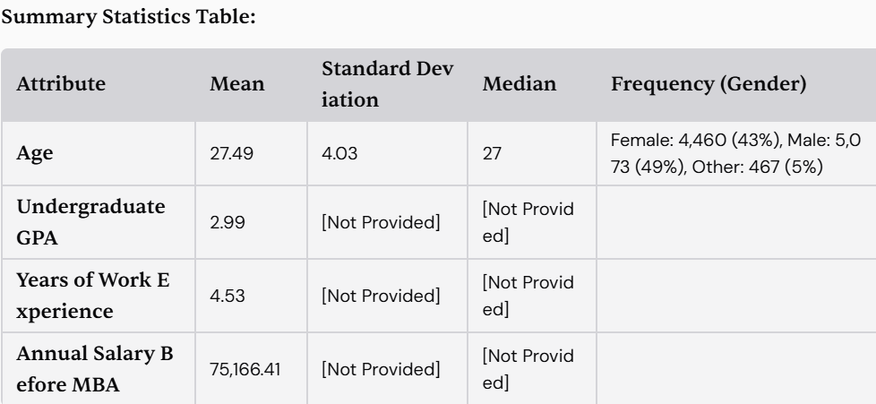
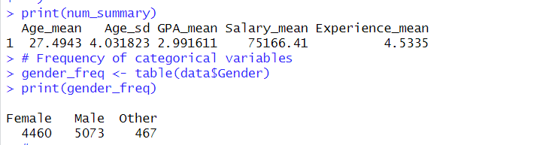
Summary Statistics of the MBA Decision Dataset
Notes:
Let’s move on to the summary statistics derived from our MBA Decision Dataset, which quantify the characteristics of our candidates.
[Discuss the Summary Statistics]
In the table displayed, we start with the Age attribute, where we observe:
The Mean Age of candidates is approximately 27.49 years, indicating that most MBA candidates tend to be relatively young, likely at the beginning of their professional careers.
The Standard Deviation is 4.03, suggesting that there is some variation in ages, but most candidates fall within a relatively close range of the mean.
The Median Age is 27, affirming that half of the candidates are younger than this age.
Next, we have the Undergraduate GPA, which presents a Mean GPA of 2.99. However, specific details regarding the standard deviation and median are not provided here. It’s important to note that the GPA scale can vary, and this average value indicates potential performance levels among candidates prior to entering the MBA program.
Looking at the Years of Work Experience, the average is 4.53 years. This underscores that candidates typically bring a foundation of professional experience, which likely enriches their MBA learning experience and peer discussions.
For the Annual Salary Before MBA, the mean salary is reported at $75,166.41, reflecting a solid professional background for many of these candidates before their MBA pursuits.
[Discuss Gender Distribution]
We also have the frequency distribution for Gender:
There are 4,460 female candidates, which constitutes approximately 43% of the dataset.
We have 5,073 male candidates, about 49%.
Candidates identifying as Other total 467, making up around 5%.
The near parity in gender distribution is encouraging as it indicates a diverse representation in MBA programs.

Slide 4
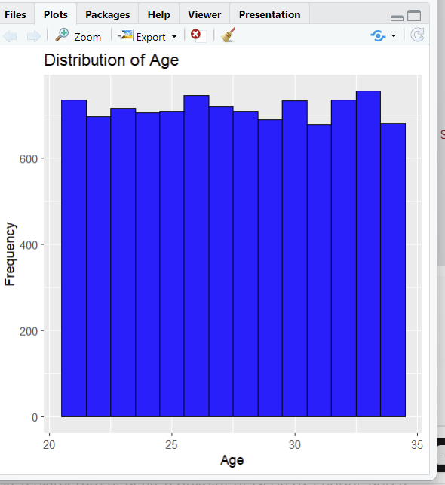
Distribution of Age
Key Observations:
The histogram shows the frequency of MBA candidates' ages.
Ages range from 20 to 35 years.
Notes:
In this slide, I will discuss the distribution of ages among our MBA candidates.
Introduce the Histogram
Here you see a histogram illustrating the Distribution of Age. This visualization categorizes candidates’ ages and shows how many individuals fall into each age range.
Discuss the Age Ranges
The x-axis represents the ages of candidates, ranging from 20 to 35 years old, while the y-axis indicates the frequency of candidates within those age ranges.
As we examine the histogram, we can observe that the majority of candidates are clustered between ages 25 and 30.
Highlight Patterns and Trends
It appears that age distribution is fairly uniform across this range, with few bars showing a significant dip—evenly distributed except for some peaks, indicating that MBA candidates tend to fall within a relatively narrow age range.
With the highest frequencies around the ages of 26 to 30, it suggests that many candidates are likely to enter the MBA programs shortly after gaining a few years of work experience.
Consider Implications
This age distribution is important for educational institutions as it highlights the typical profile of MBA candidates.
Understanding age demographics allows for tailoring programs and support services that cater specifically to the life stages and circumstances of these students.

Slide 5
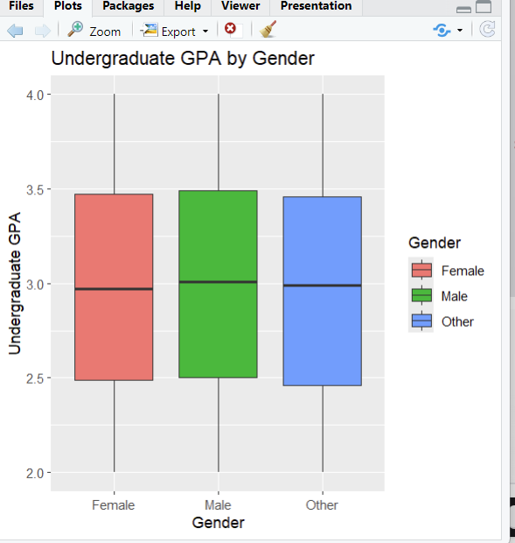
Undergraduate GPA by Gender
Notes:
In this slide, we will explore the relationship between Undergraduate GPA and Gender among MBA candidates.
Introduce the Boxplot
This boxplot visualizes the Undergraduate GPA by gender, showcasing how GPA varies across different genders: Female, Male, and Other.
The y-axis represents the Undergraduate GPA, which is commonly scored on a typical 4.0 scale, while the x-axis indicates the different genders of the candidates.
Discuss Each Boxplot Category
Looking at the box for Female candidates (red), we can see that the median GPA is approximately 3.3, with interquartile ranges extending from around 2.8 to 3.5. This suggests a relatively strong academic performance among female candidates.
For Male candidates (green), the median GPA is at about 3.0, with the interquartile range from around 2.9 to 3.6. This indicates that males have a wider range of GPAs compared to females, which is reflected in higher variability.
The box representing Other (blue) candidates shows a median GPA close to 3.1, with an interquartile range that overlaps with both male and female candidates. This suggests that gender minorities have a GPA distribution similar to male candidates but are lower than female candidates on average.
Highlight Observations
One significant observation from this data is that female candidates appear to outperform male candidates in terms of GPA on average.
The boxplots also reveal the presence of outliers, particularly among male candidates, suggesting that while many perform at or near the median, some may have achieved exceptionally high or low GPAs.
Discuss Implications
This data is critical when considering academic support resources and outreach strategies for prospective MBA students.
Institutions may want to consider tailored academic support initiatives that could help male candidates improve their GPA alongside the existing strengths of female candidates.

Slide 6
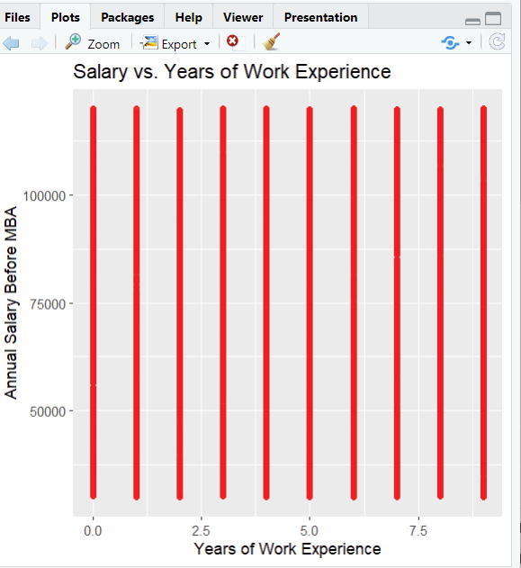
Salary vs. Years of Work Experience
Notes:
Now, we will examine the relationship between Annual Salary before entering an MBA program and the years of work experience that candidates possess.
Introduce the Visualization
The graph presented here plots Annual Salary Before MBA against Years of Work Experience.
Discuss the Axes
On the x-axis, we have Years of Work Experience, ranging typically from 0 to 8 years, while the y-axis represents the Annual Salary, indicating the monetary compensation received prior to pursuing an MBA.
Highlight Issues with Visualization
Upon observing this visualization, it appears there's an issue: the data points seem to cluster without providing any discernable trend or pattern. This could suggest a couple of things:
There might be a limited dataset, or it could be that salary is relatively independent of years of experience in this cohort.
The absence of variability in the y-values, meaning many candidates may have similar salaries despite various amounts of work experience.
Discuss Implications and Importance
Ideally, one would expect to see a positive correlation—meaning, as years of work experience increase, salaries also tend to rise.
Understanding the relationship between these two variables is essential for future students when considering the return on investment of an MBA, as it helps assess whether the additional education leads to a significant salary increase.

Slide 7
Reference:
Choudhary, A. (n.d.). MBA Decision After Bachelors Dataset. Kaggle. Retrieved [Month Day, Year], from https://www.kaggle.com/datasets/ashaychoudhary/dataset-mba-decision-after-bachelors.

