Slide 1

Prepared By:
Krishna Soni

Slide 2

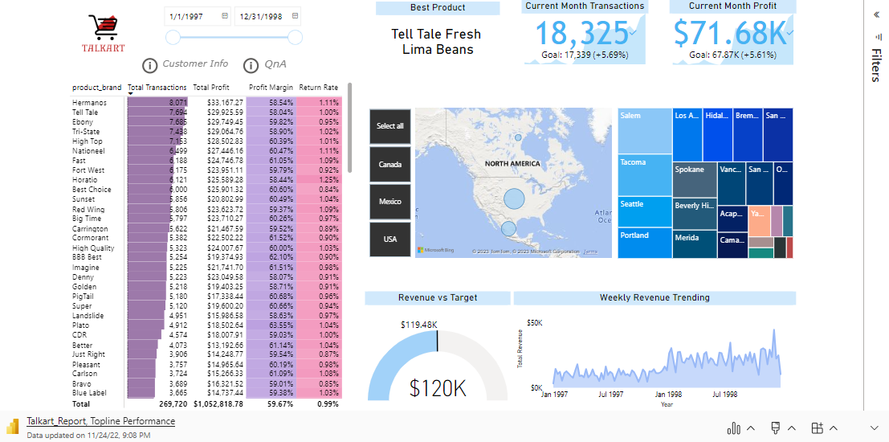
Microsoft Power BI

Slide 3
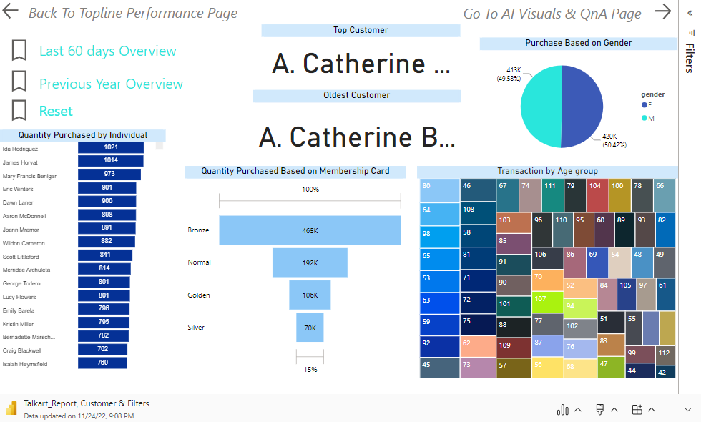

Slide 4
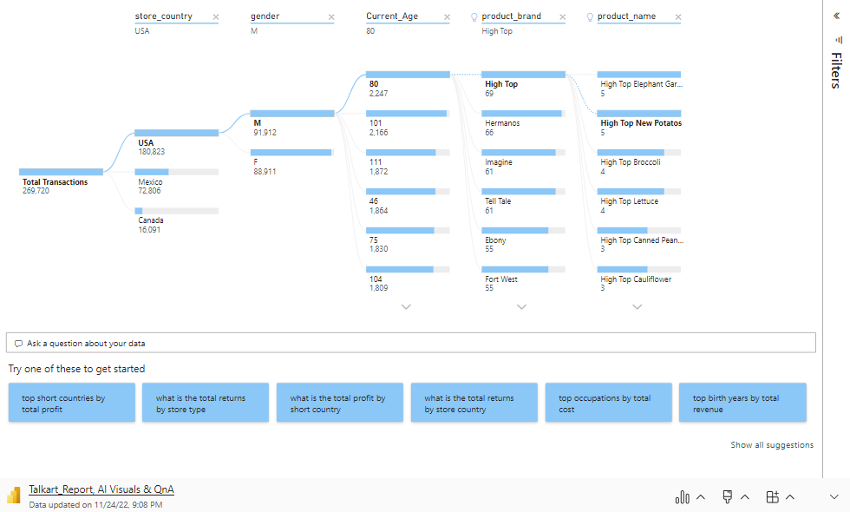

Slide 5
