Slide 1
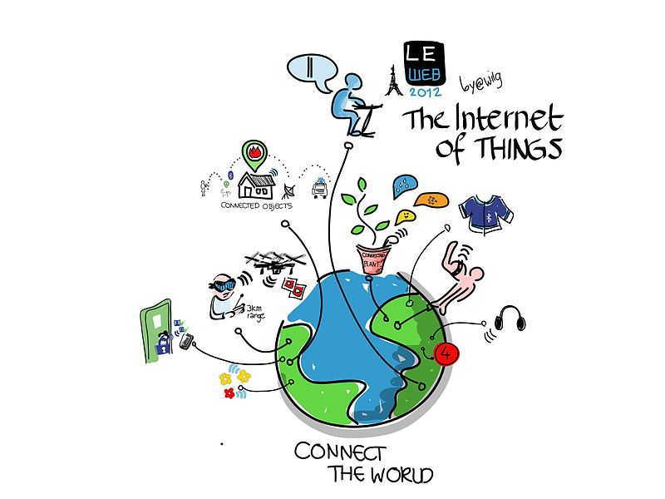

Slide 2
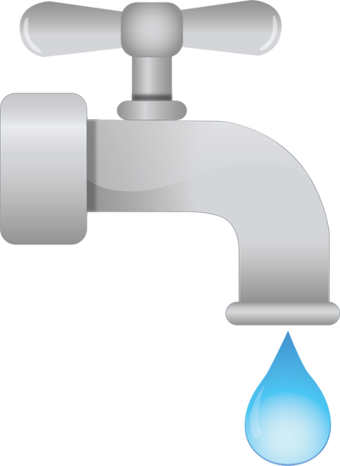
HOUSEHOLD WATER MONITORING SYSTEM
TEAM MEMBERS
KARTHI.G
KRISHNA PRIYA.S
SOWMYA.K

Slide 3

CONTENTS
ABSTRACT
INTRODUCTION
GOALS AND OBJECTIVES
SYSTEM REQUIREMENTS
SYSTEM DESIGN
MODULE DESCRIPTION
ADVANTAGES OF PROPOSED SYSTEM
CONCLUSION
REFERENCES

Slide 4
ABSTRACT
Water are wasted by many uncontrolled ways. This problem is quietly related to poor water allocation, inefficient use, and lack of adequate and integrated water management. Therefore, efficient use and water monitoring are potential constraint for home or office water management system
This system uses wireless

Slide 5

Internet of Things (IoT) is a global network of
“smart devices” that can sense and interact with their
environment using the internet for their communication and interaction with users and other systems.

Slide 6
INTRODUCTION
The IOT is proposed development of the internet in which everyday objects have internet connectivity.
Devices are integrated with the virtual world of internet and interact with it by tracking, sensing and monitoring objects and their environment.
Aims to develop a household water monitoring system in IOT environment that checks both quality and quantity of water.

Slide 7
GOALS AND OBJECTIVES
To check the quality and quantity of water.
Monitoring the water flow rate.
Uses an open source platform.
Alert the user.
When our water usage exceeds the limit.
Helps to make water consumption more visible.
Gets the real time data in a web based application.

Slide 8
SYSTEM REQUIREMENTS
Flow sensor : YFS402
Water Quality Sensors
Conductivity
Coagulation
Microcontrollers
Arduino AT MEGA 2560
Arduino Uno
NRF
GSM-SIM300
WIFI Module ESP8266
Cloud based server : PHP and MYSQL.

Slide 9
MODULE DESCRIPTION
1.User module
Consumers can check their water usage.
2.Administrator module
Register consumer
Maintain consumption details

Slide 10
SYSTEM DESIGN

Slide 11
MICROCONTROLLER
ARDUINO
ATMEGA 2560
NRF
ESP8266
FLOW
CONDUCTIVITY
QUALITY
COAGULATION
GSM
MICROCONTROLLER
ARDUINO UNO
NRF
FLOW

Slide 12
ADVANTAGES
Multipurpose
User friendly
Easy to install
Read meter consumption remotely.
Reduce the water theft.
Automate the billing system.
Leakage detection

Slide 13
CONCLUSION
Huge amount of water is wasted by uncontrolled use.
Main issue addressed in this project : to develop an efficient IOT based water monitoring system for smart homes.
Water quality information can be accessed so that users get water usage goals and forge social connections .
By using this:Water wastage is prevented and will be saved to our future generations.

Slide 14
REFERENCES
[1] International Research Journal of Engineering and Technology (IRJET) Volume: 02 Issue: 04 | July-2015
[2] Planning of water quality monitoring systems, Technical Report Series No.3
[3] Guidelines on water meters ,Report no.RDSO/WKS/2015/5 March– 2015
[4] Home automation for dummies (Google Books)

Slide 15
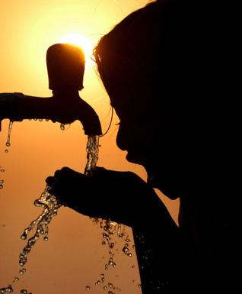

Slide 16
THANK YOU

