Slide 1
OSSP • OPERATING SYSTEMS PROJECT
INTER-PROCESS
CHAT APPLICATION
Using Inter-Process Communication (IPC)
SUBJECT
OSSP
PROJECT TEAM :
Harshitha.B — 2520080007
Krishnasree — 2520080009
Vennala — 252008018
Two independent processes. One conversation.
01 / 10

Slide 2
01 • OVERVIEW
Introduction
A simple chat application that demonstrates how independent processes exchange information.
What is IPC?
Our project idea
• Inter-Process Communication allows separate processes to exchange data.
• Each process has its own memory space, so communication needs an OS-supported mechanism.
• IPC is used in operating systems, background services, and multi-process applications.
• Create two independent chat processes: User A and User B.
• Send and receive messages in both directions through named pipes (FIFOs).
• Display messages in the terminal and handle exit and common errors safely.
CORE IDEA
Process A ⇄ IPC channel ⇄ Process B
02 / 10

Slide 3
02 • DEFINE
Problem Statement
Independent processes need a controlled way to exchange messages.
THE CHALLENGE
• Processes normally operate in separate memory spaces.
• One process cannot directly read another process’s private memory.
• Communication must account for synchronization, message ordering, and process exit.
• A simple, demonstrable communication channel is needed for two-way exchange.
PROPOSED SOLUTION
Build a two-way chat application using IPC.
Two named pipes provide separate paths for A → B and B → A.
Goal: reliable local message exchange with clean shutdown.
03 / 10

Slide 4
03 • ARCHITECTURE
System Design
Two independent processes communicate through two one-way FIFO channels.
PROCESS A
send
IPC LAYER
send
PROCESS B
User 1
Input + display
FIFO A → B
FIFO B → A
User 2
Input + display
reply
reply
OS responsibilities: pipe access • process coordination • resource cleanup
04 / 10

Slide 5
04 • BUILD
Implementation Approach
A practical sequence for building the prototype in C on Linux.
01
Create FIFOs
Create two named pipes for opposite message directions.
02
Launch processes
Run the same program as User A and User B in two terminals.
03
Send & receive
Use open(), read(), and write() to transfer messages.
04
Handle concurrency
Use a receiver thread or event-driven I/O so messages arrive while typing.
05
Validate & exit
Check input, handle unavailable peers, and close pipes cleanly.
Example exit command: /exit
05 / 10

Slide 6
05 • TECHNOLOGY
Technologies Used
A lightweight stack chosen to highlight operating-system concepts.
C
Linux / Ubuntu
POSIX FIFO APIs
CORE LANGUAGE
OPERATING SYSTEM
IPC MECHANISM
Implements process logic and IPC system calls.
Supports POSIX APIs and named pipes.
mkfifo(), open(), read(), and write().
Pthreads
GCC
VS Code + Terminal
CONCURRENCY
COMPILER
DEVELOPMENT TOOLS
Allows receiving and sending to proceed concurrently.
Builds the C program from source code.
Edit, compile, run, and test two process instances.
Why this stack? It is low-cost, easy to demonstrate, and directly connected to OS-level IPC.
06 / 10

Slide 7
06 • VALIDATION
Testing
Test normal communication as well as error and shutdown scenarios.
TEST CASE
PROCEDURE
EXPECTED BEHAVIOUR
Basic messaging
A sends a message to B
B displays the correct message
Reverse reply
B sends a response to A
A receives the reply
Multiple messages
Send several messages in sequence
Messages appear in the intended order
Peer unavailable
Start only one process
App handles waiting or open failure safely
Exit handling
Enter /exit
Process closes resources cleanly
Testing note: record actual outcomes and screenshots after running the implementation.
07 / 10

Slide 8
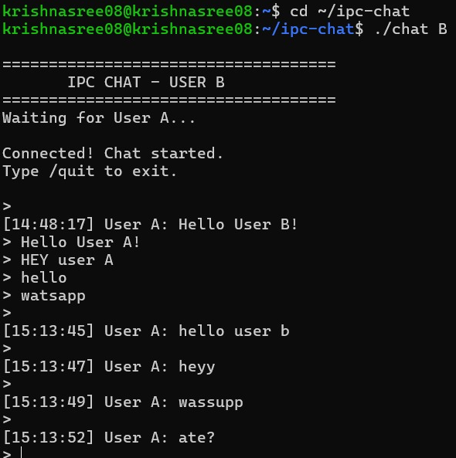
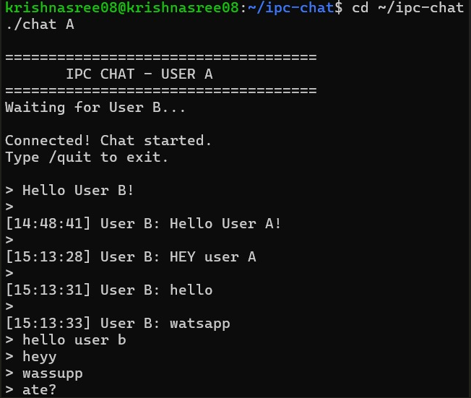
07 • OUTCOMES
Results & Demonstration
What the completed prototype should demonstrate.
Expected outcomes
• Messages travel in both directions.
• Sender and message text are displayed clearly.
• Several messages can be exchanged in one session.
• The application handles exit and common errors
Illustrative output — replace with real terminal screenshots after testing.
08 / 10

Slide 9
08 • VALUE
Impact & Conclusion
A compact project that turns an OS concept into a working demonstration.
Impact & applications
Conclusion
• Builds practical understanding of process isolation and IPC.
• Relevant to local background services and separate software modules.
• Can be extended to multiple processes, a GUI, and message history.
• Security enhancements could add authentication and encryption.
• The design uses two independent processes and two FIFO channels.
• It demonstrates message transfer, concurrency, and cleanup.
• It provides a foundation for comparing FIFOs with queues and sockets.
• The prototype is local IPC, not an internet chat service.
KEY TAKEAWAY
IPC enables independent processes to coordinate without sharing private memory directly.
09 / 10

Slide 10
THANK YOU
Inter-Process Chat Application Using IPC
OSSP • Harshitha • Krishnasree • Vennala
Questions & Discussion
10 / 10

