Slide 1
“Moneyball” in NBA to predict the performance of the players
Kirill Novik
Krishna Chaitanya Sripada
Yu-Ching Kuo

Slide 2


Moneyball
2002 Okland Athletics (Major League Baseball team)
empirical analysis of baseball data
Find out undervalued players
Break the league record with 20 straight-wins
Make to Playoffs
44 million vs. 125 million (New York Yankees)
Moneyball: The Art of Winning an Unfair Game

Slide 3

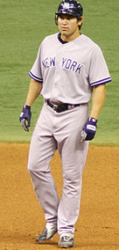



Benefits
Data
Mining
Stars
Notes:
Giambi -> MVP
Damond -> Big player
Discover potential players
Good performance
Most important -> Save Money

Slide 4
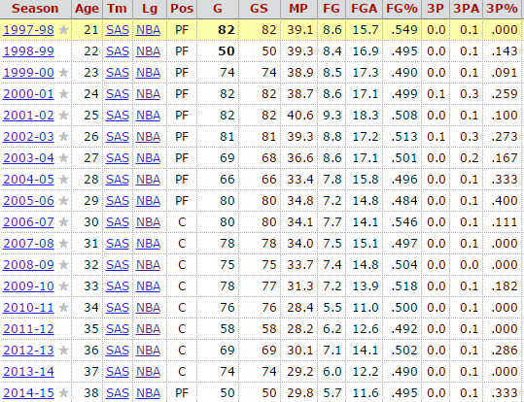
Moneyball in NBA?
Find Undervalued Players?
Avoid Overestimated Players?
Form a competitive team?
Not a team for championship but at least for playoff
Data
Mining
Statistic Data
Questions?

Slide 5
Data Base
Basketball-reference.com
Analysis based on teams
Analysis based on individual players

Slide 6
Strategy
Analyze by teams
Form a economic and competitive team!
Find key factors for a good teams
Evaluate each player with the key factors
accurate
Form an performance index for each player
Validate the index by evaluating the performance of the teams this season
not accurate

Slide 7
Principal Component Analysis
Used to reduce size of data set.
Uses a linear combination of original correlated variables to form new, uncorrelated variables called principal components.
Finding principal components helps in interpreting which attributes have the greatest contribution to each component.
First principal component has the largest variance.

Slide 8
Linear Discriminant Analysis
The basic goal is to project the dataset onto a lower dimensional space with good class separability in order to avoid overfitting and also reduce computational costs.
Closely related to PCA as they book look for linear combinations of variables that best explain the data.
LDA explicitly attempts to model the difference between the classes of data.

Slide 9
Use of PCA and LDA in NBA dataset
Dataset contains lots of attributes like Points, Rebounds, Assists etc.
Using PCA, we can reduce the dimensionality of the dataset i.e., consider fewer attributes that fully explain the data and remove other information without loss of necessary information.
LDA can be use to help classify the player’s/team’s performance as good or bad.

Slide 10
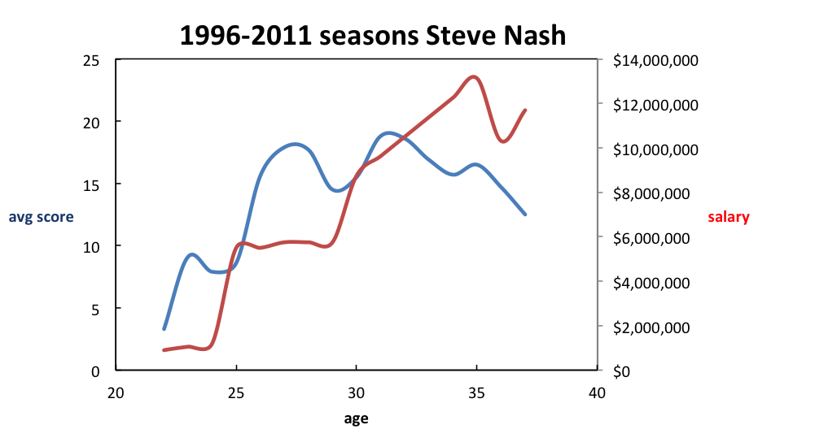
Analysis of Patterns
Using PCA and LDA, we would predict the performance of the teams in the current season.
Example: As per the dataset, his average score has been decreasing since 2005 and at the same time his age was 37 and that is likely to affect his performance. It turned out that he only played 65 out of 164 games for Lakers and was earning 9.1 million per year.

Slide 11
Challenges
The patterns for a good team?
Points, Assists , Rebounds, Turn overs per game. Or any combinations of these factors?
Find key factors for a good teams
Combine all the attributes into an index:
Points, Assists , Rebounds, Turn overs per game. Or any combinations of these factors?
Evaluate the defense?
Find a pattern or an easy way to evaluate
Evaluate potential performance in the future?
The pattern from their past performance
Form a “performance index” for each player

Slide 12


