Slide 1
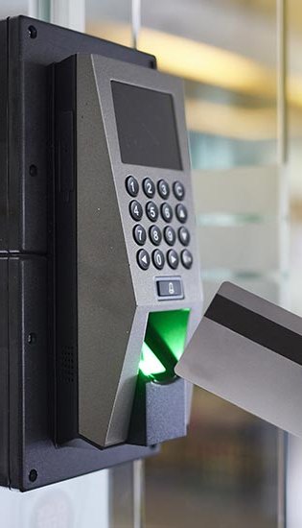
Security Access Control System
Team Members:
Sriya Garde
Krishna Suhagiya
12/10/23
1

Slide 2
Introduction
A Security Access Control System is developed using STM32 Microcontroller and RFID module.
The access control system uses RFID tags and Keypad as inputs, RFID reader to authenticate credentials, and Buzzer, OLED and Voice Recording and Playback module as outputs.
This Access control system provides institutions with the ability to enforce credentials for entry, with badges or key cards, ensuring that only authorized individuals are granted access, ability to override security with an Admin key and to add a new card to the system.

Slide 3
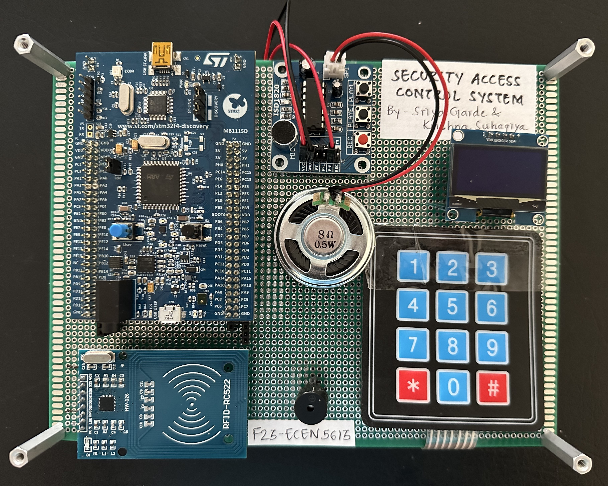
Final Project Board
STM32F411 DISCO Board
SSD1106 OLED
Active Buzzer
ISD1820 Voice Recording & Playback Module
+
8ohm, 0.5 W Speaker
MFRC522 RFID Reader Module
4X3 Matrix Keypad

Slide 4
System Specifications
MFRC522 RFID reader with working Read range up to 1m which is interfaced with STM32 using SPI Communication Protocol.
Philips Mifare 1 S50 – NFC Tags with working Read/Write range of less than 10cm.
4X3 Matrix Keypad with ‘#’ as delimiter to enter Password input.
ISD1820 Voice Recording and Playback Module with ability to record and play a single track.
SSD1106 OLED interfaced with STM32 using I2C Communication Protocol.

Slide 5
System Scenarios & Flows

Slide 6
Future Scope
Ability to create a database using Database platforms like SQL and connect it to the system to validate multiple cards for Access.
Ability to Delete cards from database,
Ability to store Valid cards data using some form of Key Encryption to protect the unique user identities.
Ability to play multiple voice recorded messages.
Limit the number of attempts to access the system.

Slide 7
THANK YOU!
Team Members:
Sriya Garde
Krishna Suhagiya
10/22/23
7

