Slide 1
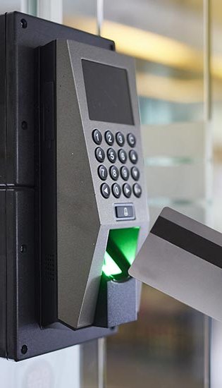
Security Access Control System
Team Members:
Sriya Garde
Krishna Suhagiya
10/22/23
1

Slide 2
Introduction
A Security Access Control System will be developed using AT89C51RC2 controller and RFID module
The access control will use RFID tags and Keypad as inputs, RFID reader to authenticate credentials and buzzer, LCD for outputs
Access control systems provide institutions with the ability to enforce credentials for entry, such as badges or key cards, ensuring that only authorized individuals are granted access to specific areas within the facility, thereby improving overall security

Slide 3
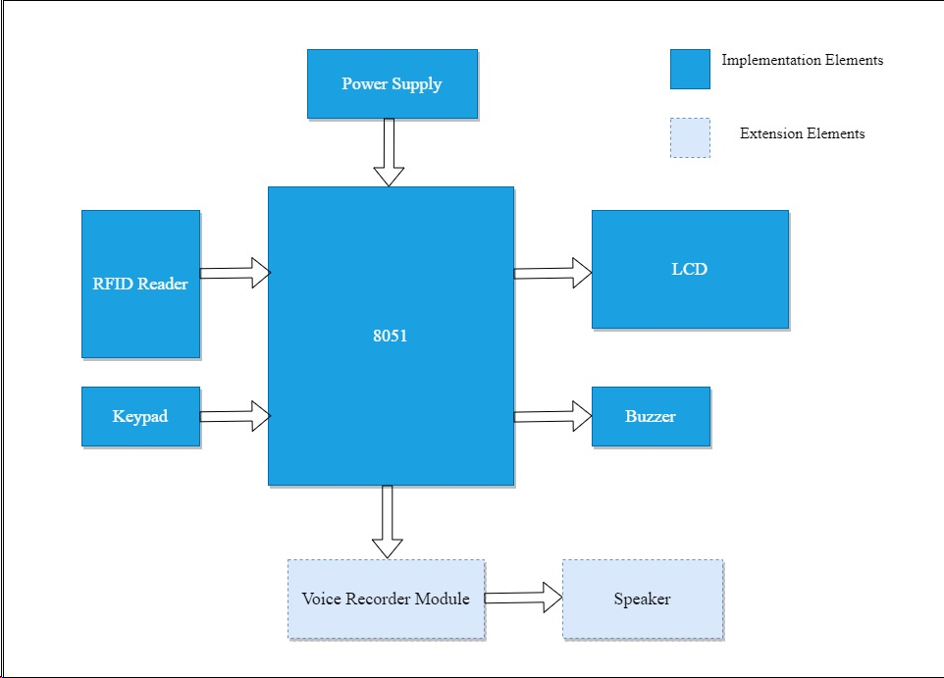
Block Diagram

Slide 4
New Hardware and Software elements of the project
Hardware Elements
Software Elements
Interfacing the RFID reader module -MFRC522 and the RFID card-reader functionality
Designing 3.3V power supply for the RFID Module
Interfacing 4x3 Matrix Keypad
Interfacing Buzzer for Audio Outputs
Extension Elements - Interfacing Voice recorder module APR33A3 and speaker to make the system inclusive
RFID Module – SPI module initialization and communication.
Database for storing RFID valid and invalid values for access control.
Matrix Keypad Initialization and functioning module.
Extension Elements – Voice Recorder APR33A3 initialization and functioning module.

Slide 5
Timeline
WEEK 1
(16-22 Oct)
Research about Project and finalize the topic.
Finalize the project elements and work on PDR.
WEEK 2
(23-29 Oct)
Order parts for the system and design the schematic.
PDR presentation.
WEEK 3 & 4
(30 Oct-12 Nov)
Design and implement Power supply for 5V and 3.3V.
Test the sensor modules and peripherals individually.
WEEK 5
(13-19 Nov)
Interface RFID sensor circuit using SPI protocol with the Microcontroller.
WEEK 6
(20-26 Nov)
Interface keypad and buzzer with Microcontroller and RFID sensor module.
WEEK 7
(27 Nov-3 Dec)
Interface buzzer and test the functioning of the entire system.
Finalize the demo.
WEEK 8
(4-10 Dec)
Prepare final project demo, report.
Extend the project with additional elements.

Slide 6
Project Deliverables & Fall-Back Plan
Deliverables
Extension
Fallback
User will be able to get entry to secure places with an access card.
Alternatively, user can also enter a security code to gain entry.
There will be an audio-visual output to indicate successful or failed access.
If we can complete all our deliverables before time, we want to make the system inclusive by adding a voice recorder and speaker module as a way of conveying an audio output with pre-recorded messages along with the visual output of LCD.
If we are unable to interface the RFID module with 8051 using SPI Communication, we will use the Raspberry Pi board for the project.
If we are unable to interface RFID sensor, we will use a proximity sensor and LCD for I/O.

Slide 7
THANK YOU!
Team Members:
Sriya Garde
Krishna Suhagiya
10/22/23
7

