Slide 1
Metadata-Driven Intelligent News Article Retrieval System
Zeroth Review: Retrieval- Augmented Answer Generation (RAG) Implementation
By:
P. Krishna Surya (22BSD7030)
Shanmuka Vardhan (22BSD7022)
Notes:
Good afternoon. Today, we are excited to present our project: a Metadata-Driven Intelligent News Article Retrieval System. This work focuses on implementing a Retrieval-Augmented Answer Generation—or RAG—system specifically tailored for news intelligence. Developed by P. Krishna Surya and Shanmuka Vardhan, our goal is to move beyond simple searches and toward true synthesis.

Slide 2
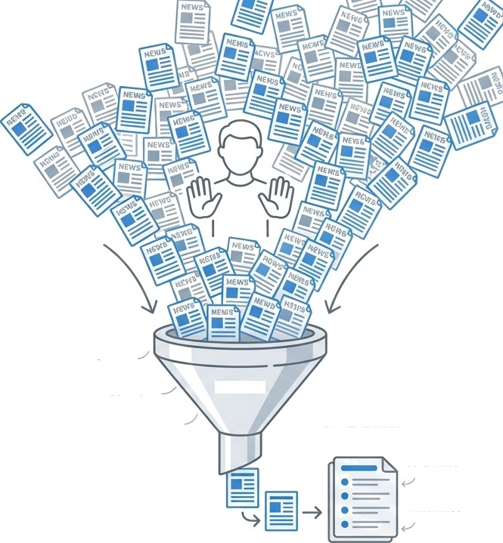
The Challenge of Digital News Overload
Digital news growth creates vast daily
article volumes across domains.
Traditional systems face key challenges:
Context Failure: Traditional systems fail to capture deep contextual relevance.
Metadata Blindness: Rich signals like source, publication date, and tags are often ignored in favour of simple keyword matching.
Lack of Synthesis: Users receive raw
lists rather than synthesized answers.
Los{
Context
Ignored Metadata
FILTER
Unsynthesized
SYNTHESIZED ANSWERS
COuTE xTUAE RELEVANCE
METADATA
AWAPENESS
Notes:
The sheer volume of digital news is overwhelming, creating vast amounts of data every single day. However, traditional retrieval systems are struggling to keep up. We’ve identified three critical failures:
Context Failure: They often miss the deep contextual relevance of a story.
Metadata Blindness: Crucial signals like publication dates, tags, and sources are often ignored in favor of simple keyword matching.
Lack of Synthesis: Users are left with raw lists of links instead of actual answers to their questions. Our system acts as a filter to turn this noise into synthesized, contextually relevant answers

Slide 3
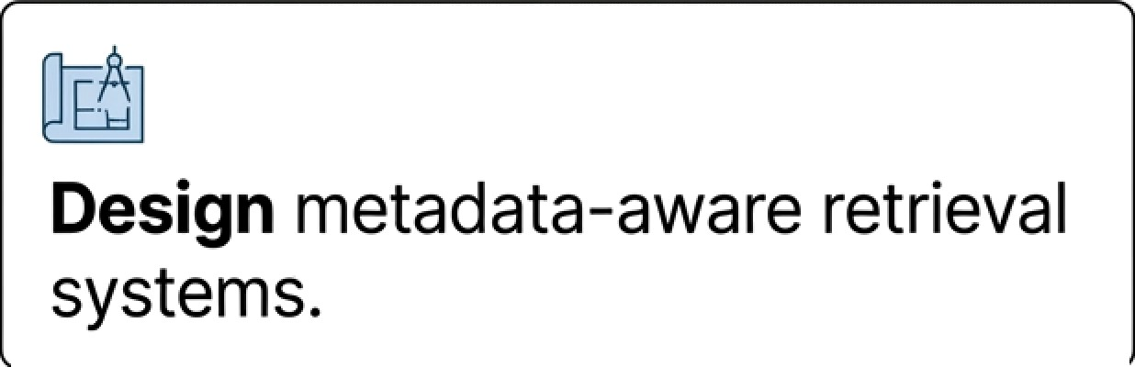
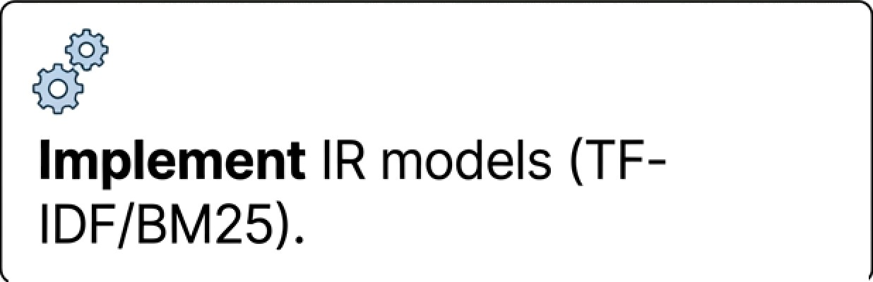



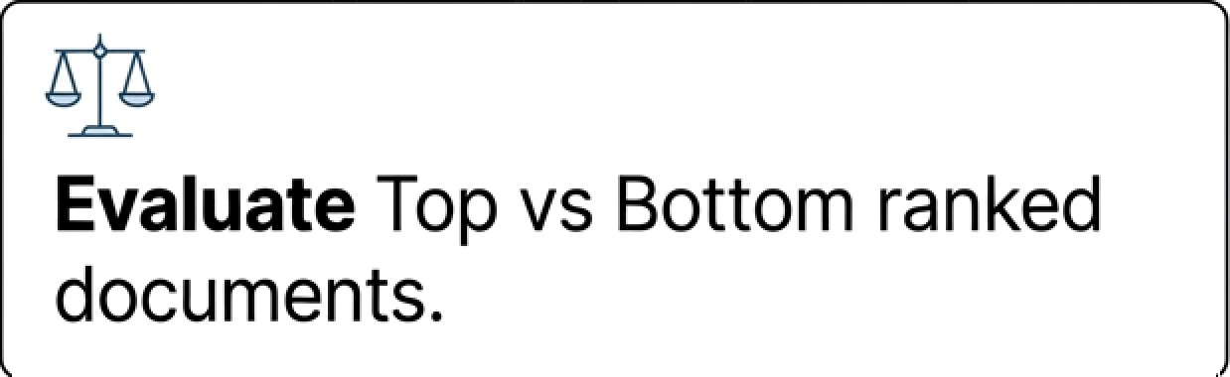
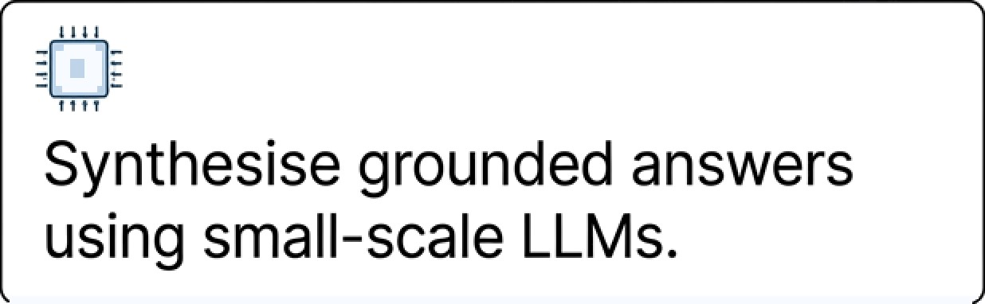
Core Project Objectives & Vision
“Primary Goal: To develop a standalone, explainable Al system for news intelligence.”
Notes:
Our primary goal is to develop a standalone, explainable AI system for news intelligence. To achieve this, our vision is built on four pillars:
Design: Creating a metadata-aware retrieval architecture.
Implementation: Using proven IR models like TF-IDF and BM25.
Synthesis: Generating grounded answers using small-scale, local LLMs.
Evaluation: Rigorously testing our results by comparing top-ranked vs. bottom-ranked documents to ensure quality."

Slide 4




Methodology: A Hybrid
Retrievial Approach
Ingest
Full text, titles,
summaries
Enrich
Extract metadata (Tags, Dates, Sources)
Process
Tokenizaflon, Normalizaton
Retrieve
Hybrid scoring: Text Similarity Metadata Weight
Notes:
We utilize a four-stage hybrid approach to manage data:
Ingest: We pull full text, titles, and summaries.
Enrich: We extract rich metadata including tags, dates, and sources.
Process: The data undergoes tokenization and normalization.
Retrieve: Finally, we use hybrid scoring, combining traditional text similarity with metadata weighting for the most accurate results."

Slide 5

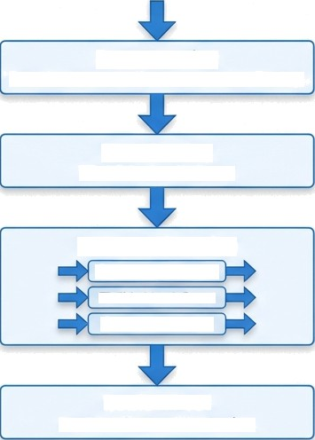
The Core Retrieval Pipeline
Raw Documents
Preprocessing
Tokenization, normalization, metadata filtering.
Base Scoring
TF-IDF Cosine Similarity.
Metadata Boosting
@ Recenc y Multiplier
Title Match Boost @ Source Authority
Retrieval Set
Top 20 vs Bottom 20 selection.
Notes:
Let’s look under the hood at the pipeline. Once raw documents enter the system, they are preprocessed through tokenization and metadata filtering. We then establish a Base Score using TF-IDF Cosine Similarity. What makes us unique is the Metadata Boosting. We apply a recency multiplier, title match boosts, and source authority weighting. This allows us to select a refined retrieval set—contrasting the top 20 against the bottom 20 documents for maximum precision

Slide 6
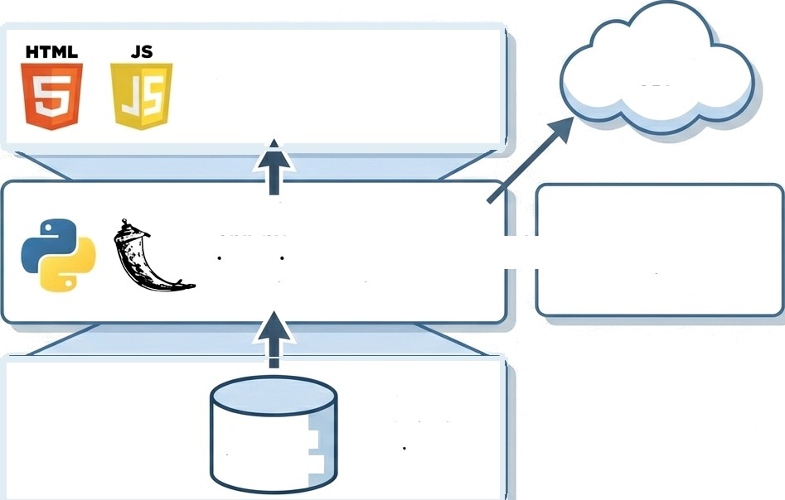
Full-Stack System Architecture
Frontend Experience ir-mode.js analytics—mode.js
Frontend Experience
The Guardian API
JetBrains Mono
aPP PY
ir engine.py
guardian service.py
Local LLM Service Ollama / LM Studio llm service.py
Backend Logic
No-install, analytical queries
Data Persistence
DuckDB
(Embedded)
Notes:
"Our architecture is designed for performance and independence:
Frontend: Built with HTML, JavaScript, and JetBrains Mono for a clean experience.
Backend: Powered by Python and Flask, utilizing our custom IR engine and Guardian service.
Data Persistence: We use DuckDB, an embedded database that allows for no-install, high-speed analytical queries.
News Source: We integrate directly with The Guardian API.
AI Layer: We run local LLM services via Ollama or LM Studio, ensuring data never has to leave the local environment."

Slide 7
The Role of RAG & Small LLMs
System Function
Exclusive Context
Retrieved documents act as the only
source of truth.
Groundedness
Ensures factual answers and removes redundancy.
Efficiency
Uses small-scale local models (Ollama/LM Studio) avoiding external API dependency.
“Retrieval is performed using classical IR techniques; the language model is used only for post-retrieval organization.”
Notes:
A key philosophy of our project is that retrieval is handled by classical IR techniques, while the language model is used only for post-retrieval organization. This provides:
Exclusive Context: The retrieved documents are the only source of truth, preventing 'hallucinations'.
Groundedness: This ensures factual answers and eliminates redundancy.
Efficiency: By using small-scale local models, we avoid expensive and privacy-risking external APIs."

Slide 8



Distinct Design Philosophy
Metadata Aware
Ranking is significantly improved via date, source, and tag weighting, not just text matching.
Offline First
Fully reproducible system using DuckDB and local language models no internet required.
Explainable (XAI)
Transparent pipeline demonstration; users can see why a document was ranked highly.
Notes:
To conclude, our system stands out through three core values:
Metadata Awareness: Our ranking is significantly smarter because it weights the 'who, when, and where' of a news story.
Offline First: Using DuckDB and local LLMs, this is a fully reproducible system that doesn't require an internet connection once data is ingested.
Explainable (XAI): We prioritize transparency. Users can actually see why a document was ranked highly, making the AI a partner rather than a black box. Thank you for your time. Are there any questions?"

