Slide 1
Review 1 Submission
Automated Data Mining
and Pattern Discovery
System
Offline-First Trend Analysis and Sentiment Mining for Unstructured News Corpora
Project Authors
P. Krishna Surya & V. Omkareshwara Reddy
March 2026

Slide 2
01 / Problem Statement
Traditional retrieval mechanisms fail to contextualise digital news overload
Context Failure
Traditional systems retrieve isolated keywords but entirely miss underlying patterns, temporal dynamics, and sentiment.
Metadata Blindness
The inability to correlate entities, publishers, and sentiments across global real-time streams.
Fragmented data points without contextual relationships

Slide 3
02 / Solution Overview
Bridging the gap between static retrieval and dynamic knowledge discovery
Core Proposition: Transforming raw, unstructured news into mathematically backed, transparent intelligence via a standalone, offline-first architecture.
Journalism Analytics
Trend analysis & insights
Brand Monitoring
Raw Unstructured
News Feeds
Reputation tracking
Offline-First
Hybrid AI
Global Economy, Tech Innovation, Political Unrest, Market Trends
Real-Time Event Tracking
Intelligence Engine & Algorithms
Live monitoring

Slide 4
03 / System Architecture
A robust five-phase engineering pipeline structures the data lifecycle
01
02
03
04
05
Ingestion
Preprocessing
Mining
Synthesis
Analytics
Transformation & Dimensionality Reduction
Intelligence Engine & Algorithms
Data Warehousing & ETL
Explainable AI & Translation
Dashboard & Insights
Collect & Store
Clean & Transform
Mine Patterns
Interpret Results
Visualize Data

Slide 5
04 / Data Foundation
Freezing the AG News corpus guarantees deterministic and verifiable research
Business
Sports
30K
30K
Working with a 120,000-article frozen subset ensures data stability throughout the research lifecycle.
Assertion: A completely static environment ensures that downstream mining algorithms produce academically verifiable results without structural drift.
World
Technology
30K
30K
Raw Data Snapshot
Title
Wall St. Bears Claw Back...
Category
Business
Source
Reuters
120,000
Date
2018-09-10
Total Articles

Slide 6
05 / Preprocessing
Semantic preprocessing strips syntactical noise to isolate core journalistic value
Raw Text
NLTK Tokenization and Normalization
Wall St. Bears Claw Back Into the Black (Reuters)...
[wall]
[st]
[bears]
[claw]
[black]
[reuters]
Takeaway
Reducing dimensionality guarantees that algorithmic pattern recognition focuses strictly on thematic terminologies, not grammatical filler.
Tokenization
Normalization
Dimensionality Reduction
Break text into units
Standardize forms
Remove noise

Slide 7
06 / Mining Engine
A modular intelligence engine overcomes the limitations of single-technique mining
Association Rule Mining
Unsupervised Clustering
Supervised Classification
(Apriori)
(K-Means / DBSCAN)
(Random Forest / SVM)
Goal
Goal
Goal
Uncovering latent relationships and co-occurring terms
Discovering novel topics without human labels
Categorising domains and learning sentiment orientation
Outcome
Outcome
Organically mapping semantic structure and filtering noise
Outcome
Detecting entity trajectories (e.g., "Economic Reform" + "Policy Shifts" at 85% confidence)
Instant automated temperature checks across high-volume streams

Slide 8
07 / Clustering
Density-based filtering autonomously separates developing stories from ephemeral noise
Executing K-Means and DBSCAN clustering identifies natural algorithmic groupings in the text vectors.
This allows the system to discover novel topics organically without relying on human-labelled constraints.
High Density
Low Density
Rapidly Developing Stories
Ephemeral Background Noise

Slide 9
08 / Predictive Analytics
Predictive mining uncovers hidden entity relationships and categorises sentiment
Predictive Association Mining
(Apriori)
Supervised Sentiment Categorization
Discovering hidden relationships between entities and detecting sudden sentiment shifts across the corpus.
(Random Forest / SVM)
Providing an instant, automated temperature check by classifying news by sentiment polarity with high mathematical accuracy.
Example Discovery
Entity A → Entity C → Entity B trajectory mapping with confidence scoring
Positive Sentiment
Negative Sentiment

Slide 10
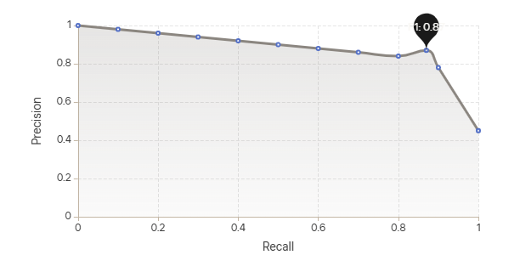
09 / Validation
Continuous mathematical validation guarantees the integrity of the underlying retrieval layer
Data Mining is only as reliable as the underlying Information Retrieval.
Proving mathematical accuracy via continuous validation metrics against real and synthetic queries ensures integrity is locked in before complex algorithmic mining occurs.
0.87
RAG
The XAI Mandate
F1-Score
Architecture
Models (via Ollama/LM Studio) are entirely isolated from external internet generation. They operate purely via a Retrieval-Augmented Generation (RAG) flow.

Slide 11
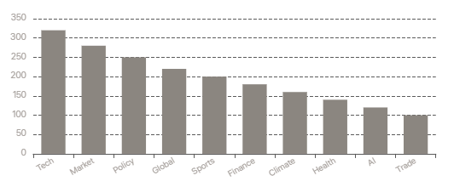
10 / User Interface
The analytics dashboard translates high-dimensional mathematical matrices into user-facing metrics
Top Keyword Frequency
Charts and topic prominence visualization
Top Keyword Frequencies
Temporal Trend Analysis
Tracking article volume over time
Rank Group Separation
Contrasting high-relevance versus low-relevance sets
Live UI Triggers
Running real-time algorithmic demonstrations on the frozen dataset
Operational Metrics
CTR
25%
Avg Time
3:45s
Lowest CTR
10 min ago
Target Time
10 min ago

Slide 12
From Noise to Knowledge
The system transforms overwhelming unstructured news data into actionable, mathematically grounded intelligence—enabling journalism analytics, brand monitoring, and real-time event tracking with complete offline reliability and transparent explainability.
Journalism
Analytics
Brand
Monitoring
Real-Time
Tracking
Project Authors
P. Krishna Surya & V. Omkareshwara Reddy
Review 1 Submission • March 2026

