Slide 1
System V vs POSIX Semaphores
Krishna Sindhuri Vemuri
G01024066

Slide 2
Inter Process Communication
exchange of information between cooperating processes
synchronization of cooperating processes
communication mechanisms
Shared memory
Pipes(named/unnamed)
Sockets
synchronization mechanisms
file locks (read-lock, write-lock)
semaphores

Slide 3
Semaphores
It is an object consisting of
a counter
a waiting list of processes
two methods
Signal
Wait
It takes the value of a non negative integer.

Slide 4
Semaphore Method wait
The wait on a semaphore “s” would have the following functionality.
function wait(Semaphore S,Int I){
while(S<=0);
S=S-I;
}

Slide 5
Semaphore Method signal
The signal on a semaphore “s” would have the following functionality.
function signal(Semaphore S,Int I){
S=S+I;
}

Slide 6
Types of semaphores
Binary Semaphores
have a value of either 0 or 1
0, the semaphore is considered unavailable (or empty)
1, the binary semaphore is considered available (or full )
it can be initialized to either available or unavailable
Counting Semaphores
Arbitrary resource count
Semaphores are said to binary or counting depending on the number of critical resources available

Slide 7
System V Semaphores
completely implemented in main memory
requires a key value to fetch the proper identifier of the desired IPC resource
A semaphore set consists of a control structure and an array of individual semaphores.
A set can contain up to 25 semaphores.
the semaphore value can be incremented / decremented with arbitrary values

Slide 8
Basic Operations
create / initialize a semaphore set with semaphores
(semget, semctl)
use the semaphore(s)
(semop, semctl)
remove the semaphore set
(semctl)

Slide 9
semget()
get an identifier for a semaphore set with semget ( )
int semget (key_t key, int nsems, int semflg)
returns the semid associated with the key
key
user defined arbitrary unique positive numerical key or IPC_PRIVATE
nsems
number of semaphores in set
semflg
access permissions and flags
IPC_CREAT and IPC_EXCL

Slide 10
semctl()
read / modify semaphore values
modify access permissions
remove a semaphore set
int semctl (int semid, int semnum, int cmd, union semun arg)
return value depends on cmd
semid
handle for semphore set (return value from semget ( ))
semnum
number of semaphore within the set

Slide 11
semctl()
cmd
command to execute
GETVAL return semaphore value
SETVAL set semaphore value
GETALL return all semaphore values
SETALL set all semaphore values
IPC_SET set permissions
IPC_RMID remove semaphore set

Slide 12
semctl()
semun
depending on cmd
union semun
{
int val; /* e.g., for SETVAL */
struct semid_ds *buf; /* e.g., for IPC_SET */
ushort *array; /* e.g., for SETALL */
};
the data structures for semaphores must be explicitly removed using the IPC_RMID cmd
A semaphore set is available until you remove it

Slide 13
semop()
all operations are performed in one step
int semop (int semid, struct sembuf *sops, size_t nsops)
struct sembuf
{
ushort sem_num; /* number of semaphore in set */
short sem_op; /* operation */
short sem_flg; /* flags */
}
allowed values for sem_flg
IPC_NOWAIT - can be used for every single operation
SEM_UNDO - undo all operations if the process terminates

Slide 14
POSIX semaphores
named semaphores
based on files in the file system
Kernel persistent
Semaphore that can be operated on by two processes that don’t share an address space
unnamed semaphores
completely implemented in main memory
correspond to Dijkstra's semaphores
Placed in a region of main memory that is shared between processes/threads

Slide 15
Named Semaphore system calls
sem_open(char* name, int flags, mode_t mode, unsigned int value)
Used to open a named semaphore
Will create the semaphore if it does not already exist
mode: specifies access permissions (should be read/write)
value: the initial value of the semaphore
sem_close(sem_t *sem)
Closes semaphore for the process that calls it
Semaphore still exists in the kernel

Slide 16
Named Semaphore system call
sem_unlink(char* name)
Name is removed immediately
Semaphore exists until all processes that have it open call sem_close
Named semaphores persist in the kernel until sem_unlink is called

Slide 17
Unnamed Semaphores system calls
sem_init(sem_t *sem, int shared, unsigned int value)
Initializes an unnamed semaphore
shared:
Zero for sharing among threads, non-zero for process sharing
If shared between processes, must allocate some memory using shm_open (shared memory open)
value: initial value of the semaphore
sem_destroy(sem_t *sem)
Destroys the semaphore pointed to by sem
Not persistent in the kernel
If other threads/processes waiting, behavior is undefined

Slide 18
Semaphore Operations
sem_post(sem_t *sem)
int sem_wait(sem_t *sem)
int sem_trywait(sem_t *sem)
int sem_timedwait(sem_t *sem, struct timespec *timeout)
int sem_getvalue(sem_t *sem, int *val)

Slide 19
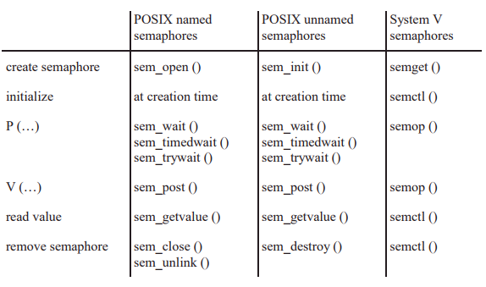
Overview

Slide 20
Comparison between System V and POSIX semaphores
System V
Heavy weight
A set of semaphores
Arbitrary value for increment/decrement
Low scalability
System-wide
More memory
POSIX
Light weight
Single semaphore
Increment/decrement by the value 1
High scalability
Process-wide
Less memory

Slide 21
References
W. Richard Stevens and Stephen A. Rago, “Advanced Programming in the UNIX environment”, Second edition
https://www.softprayog.in/programming/semaphore-basics
https://docs.oracle.com/cd/E19455-01/806-4750/6jdqdfltg/index.html

Slide 22
THANK YOU!

