Slide 1
VEGANODI
Team Details
Team ID
H26SCTO3
College
Chennai Institute of Technology
Project Title
VEGANODI-Confidence-Gated Golden-Hour Response Intelligence
Team Members
1.Monishwar B
2.Manoranjan VS
Team Lead
Krishnaswamy KV

Slide 2
Problem Statement
The Challenge
Survival after a road crash is decided in the "golden hour" — but today the clock doesn't start until a bystander notices, reacts, and calls for help.
Emergency response today is entirely human-triggered: someone has to witness the crash, judge its severity, find the right number, and describe the location — every step adds minutes.
No system currently watches, recognizes a crash the moment it happens, and starts the emergency chain on its own — ambulance, police, and hospital only learn about an incident after a human sets it in motion.
Every minute shaved off the notice-to-dispatch gap directly improves survival odds.
Objectives
01 CCTV Based Tracking: It tracks road-user interactions in real time, so risk builds on the system's radar before a human would even notice it.
02 Automated Confirmation: Confirm an actual collision automatically using multiple independent signals, gated by consensus to prevent false alarms.
03 Autonomous Dispatch: Start the emergency chain (ambulance, police, hospital pre-alerts) instantly, collapsing response time from minutes to seconds.
04 Explainable Decisions: Keep automated decisions transparent and explainable to operators, allowing response teams to trust and verify alerts at a glance.

Slide 3
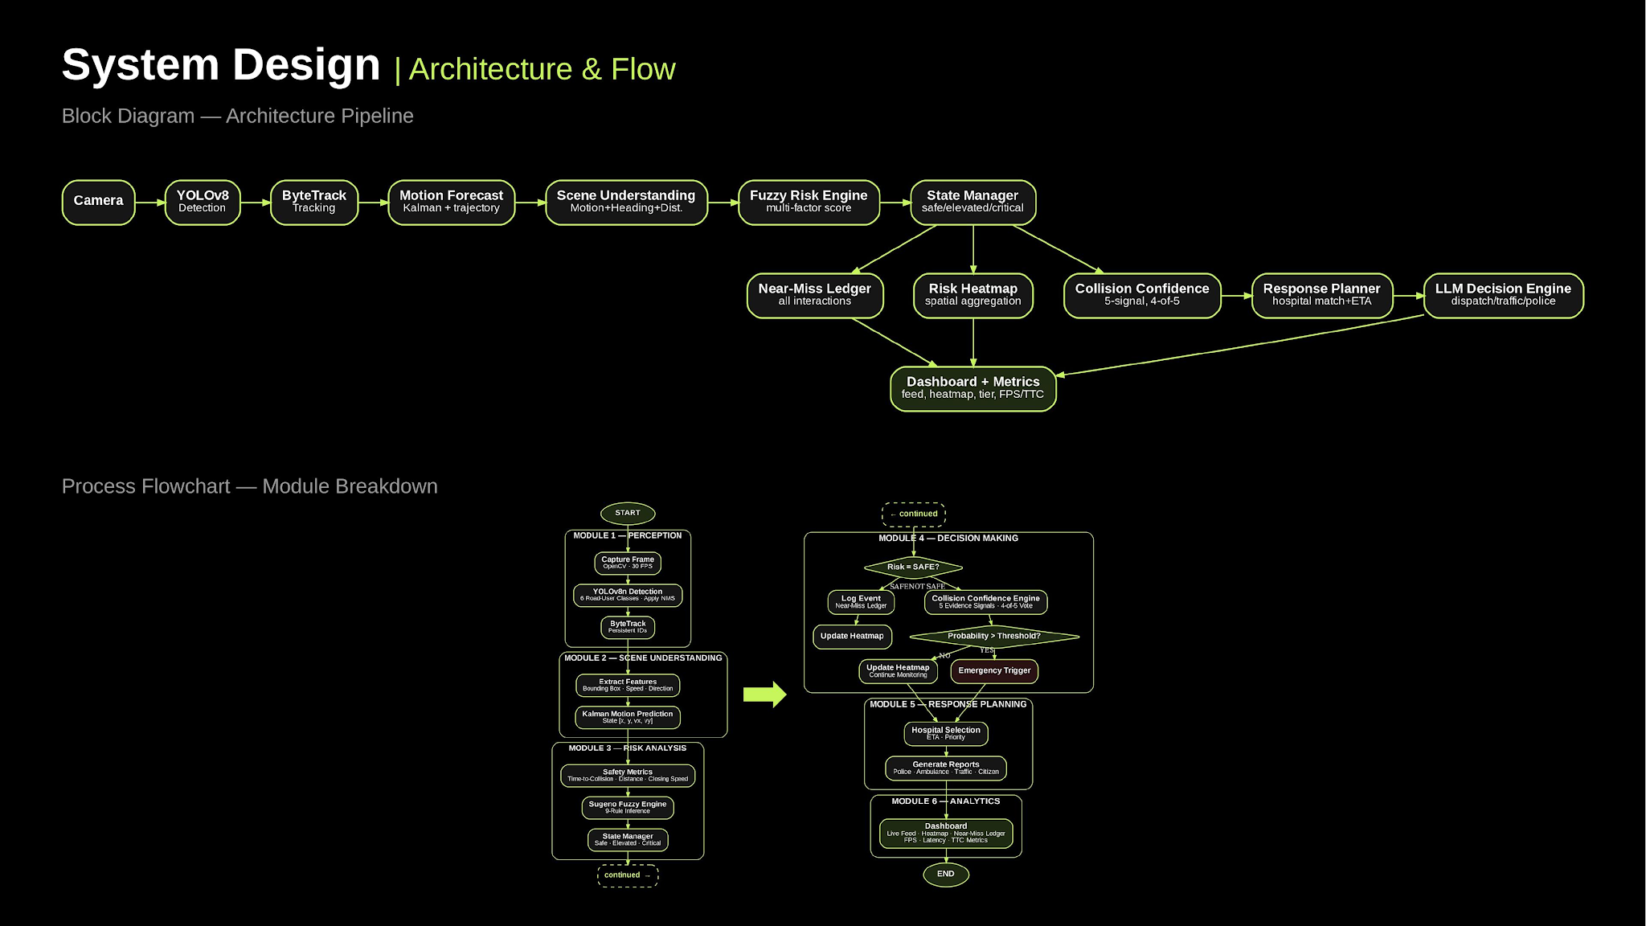

Slide 4
Algorithm Pipeline | System Architecture
STAGE
ALGORITHM
PURPOSE
Detection
YOLOv8n
Real-time road-user detection (person/vehicle classes)
Tracking
ByteTrack
Consistent ID across frames, occlusion-tolerant
State estimation
Kalman Filter [x,y,vx,vy]
Smooths noisy detections, estimates velocity & P_k
Geo-referencing
Homography / Ground-plane
Converts pixel-space to world-space distance & speed
Risk scoring
Fuzzy inference (TTC,vel,head)
Continuous risk score → SAFE/ELEVATED/CRITICAL
Temporal reasoning
Finite-state continuous model
Prevents single-frame false alarms via sequential states
Collision confirm
k-of-n consensus (≥4 of 5)
Fuses multi-signals to prevent noisy real-world dispatch
Response gen.
LLM-based structured output
Automated, context-aware emergency reporting dispatch

Slide 5
Technology Stack | System Infrastructure
Perception / CV
YOLOv8n: Real-time road-user detection (person/vehicle) and ByteTrack for tracking.
Kalman Filter: Custom/filterpy implementation for state estimation & uncertainty.
Frontend & Visualization
Command Center: React dashboard supporting multi-portal views (Police, Ambulance, Hospital).
Live Map Layer: Integrated OpenStreetMap & CartoDB for real-time spatial tracking.
Backend / Logic
Python Environment: FastAPI powering inference server, risk engine, and fuzzy logic.
Ledger Storage: CSV/JSON storage for near-miss tracking, designed to be DB-extensible.
Orchestration & Deployment
Response: LLM structured JSON generation for role-specific alerts + auto-web updates.
Connectivity: LoRa mesh concept for low-instrumentation intersections.
Edge Deployment: Single-camera commodity GPU/CPU (hardware-light design).

Slide 6
Results | Live Demo & Performance
Perception & Near-Miss Ledger
• Live perception feed: Real-time road-user detection & tracking with ID-persistent bounding boxes (cite actual FPS).
• Near-Miss Ledger: Structured TTC-scored events, ELEVATED/CRITICAL severity classification, timestamped.
End-to-End Demo Sequence
Collision Confidence & Benchmarks
• Confidence Engine: Live "N-of-5 signals confirmed" panel demonstrates the consensus gate firing in real time.
• System Benchmarks: Ready to state detection FPS, confirmation latency, and false-positive rates honestly.
[Embed / link demo video here]
Click to play real-time system reaction

Slide 7

Compare With Existing Solutions | Capability & Novelty Matrix
Capability
Derq
AMAG / Transoft
VegaNodi (Ours)
The Purpose
"Derq, AMAG, all of them, they're built for traffic engineers... They tell a city 'this junction is dangerous.
Nobody's building for the moment of the crash. So we did — the second our system confirms a collision, it doesn't wait for a human to react. The ambulance is already on standby... We're trying to buy back the minutes that save lives."
Detection & tracking
Patented, enterprise
Video analytics
Commodity, honestly labeled
Live operator confidence
Not established
Not established
"4/5 signals" panel
Multi-agency dispatch
Not established
Not established
Core Claim
Two-tier authority model
Not established
Not established
Gated action

Slide 8
Core Innovation | The Response Engine
Detection and risk-scoring are the means. The actual product is: the moment a crash is confirmed, the golden-hour clock starts running for the system instead of for a bystander.
Two-Tier Authority
Advisory Tier Continuous fuzzy risk score. Tracks every interaction, never touches the real world.
Action Tier Discrete k-of-n consensus gate (≥4 of 5 independent signals). The only path allowed to trigger a real-world response.
Instant Fan-Out
Confirm = 1 automatically triggers 4 stakeholders simultaneously:
Ambulance: Standby with location + ETA
Police: Dispatched with tactical route & priority
Hospital: Pre-alerted for trauma triage
Citizens: Warned to clear the corridor
Why It Matters
Authorizing real-world emergency action, not just a dashboard flag. Consensus gate prevents costly false positives/negatives.
The Differentiator:
An active tracking-to-dispatch loop with zero human-in-the-loop delay before first response.

Slide 9
Summary & Future Work | Project Milestones & Next Steps
Summary
• The Response Engine: VengaNodi's core contribution is an autonomous, confidence-gated tracking-to-dispatch loop starting response instantly upon crash confirmation.
• Two-Tier Authority Model: Continuous advisory fuzzy risk paired with discrete consensus-gated action ensures trustworthy autonomous dispatch.
• End-to-End Demo: Built and demoed from perception to 4-agency dispatch in just 36 hours with zero manual relay.
Future Work
Threshold Validation: Validate crash outcomes against real historical data.
Uncertainty Propagation: Wire Kalman covariance formula into TTC confidence.
Multi-Camera Fusion: Scale coverage to intersection-wide systems.
Homography Calibration: Automate per-camera manual/semi-manual setup.
Hardware Integration: Implement live signal-controller and real auto-calls.
Pilot Deployment: Measure real-world false rates and golden-hour savings.

Slide 10
Production Roadmap | Next-phase development priorities
01
Multi-Camera Fusion
Fuse overlapping camera feeds into one unified risk picture. Inference stays on-device to keep real-time alert latency intact.
02
PTZ Camera Steering
Actively pan / tilt / zoom toward a flagged risk instead of relying on a fixed field of view — turning cameras into active sensors.
03
V2X Transceivers
Broadcast risk-tier and collision-confidence data straight to equipped vehicles, and feed vehicle telemetry back into the risk engine.
04
Ambulance Routing
Make the Response Planner's ETA live — routing ambulances around congestion and high-risk zones in real time.

