Slide 1
SUMMER SCHOOL'26 · OPENAI AGENTS SDK
AI Customer Success
Manager
Six specialists · eight tools · handoffs · memory · human approval
Notes:
Open with the customer-success problem and the complete deliverable claim.
[Sources]
- https://openai.github.io/openai-agents-python/agents/
- https://openai.github.io/openai-agents-python/handoffs/
- https://openai.github.io/openai-agents-python/human_in_the_loop/
- https://openai.github.io/openai-agents-python/sessions/
- https://ai.google.dev/gemini-api/docs/models

Slide 2
Customer risk hides across disconnected signals
The business problem
Usage, tickets, sentiment, commercial data, and account notes are reviewed separately. Teams notice churn risk too late.
The decision gap
Account owners need one explainable health view, a prioritized intervention, and safe execution before the renewal window closes.
2
Notes:
Explain that the system is designed for SaaS customer-success and revenue teams.
[Sources]

Slide 3
The system turns evidence into an approved intervention
MONITOR
Collect activity, adoption, support, sentiment, and renewal signals.
REASON
Specialists diagnose risk and recommend product and recovery actions.
ACT SAFELY
A human approves every scheduling or escalation side effect.
3
Notes:
Use the three verbs to explain the product promise and safety boundary.
[Sources]
- https://openai.github.io/openai-agents-python/agents/
- https://openai.github.io/openai-agents-python/handoffs/
- https://openai.github.io/openai-agents-python/human_in_the_loop/
- https://openai.github.io/openai-agents-python/sessions/
- https://ai.google.dev/gemini-api/docs/models

Slide 4
Six specialists share one evidence layer
Customer Health
Scores risk and names drivers.
Product Expert
Recommends adoption plays.
Support Assistant
Summarizes ticket severity.
Escalation Manager
Prepares approved escalation.
Success Planner
Creates owner and due date.
Analytics
Returns the structured report.
Manager
Calls specialists as tools.
Triage
Transfers focused requests.
4
Notes:
Clarify that the six named specialists satisfy the assignment minimum; manager and triage are orchestration agents.
[Sources]
- https://openai.github.io/openai-agents-python/agents/
- https://openai.github.io/openai-agents-python/handoffs/
- https://openai.github.io/openai-agents-python/human_in_the_loop/
- https://openai.github.io/openai-agents-python/sessions/
- https://ai.google.dev/gemini-api/docs/models

Slide 5
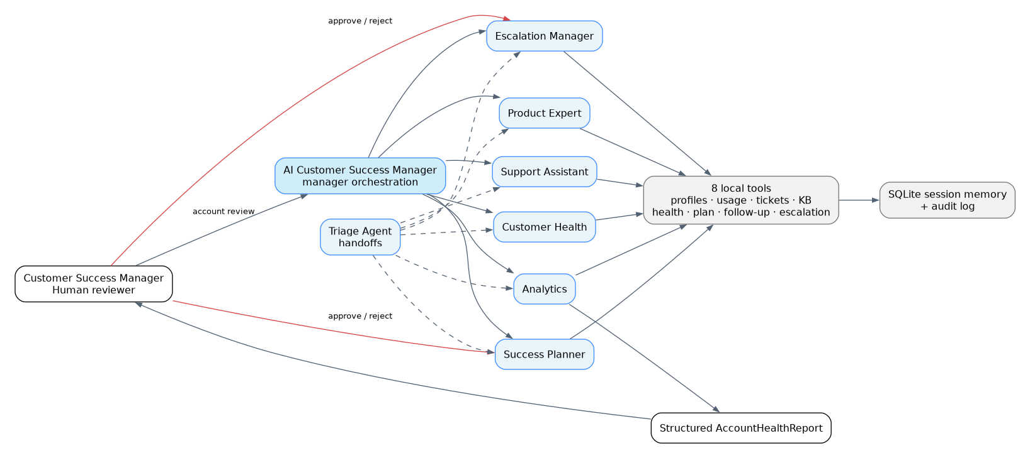
Manager tools and handoffs
Manager + handoffs
Complete reviews use agents-as-tools so the manager can combine every specialist. Focused questions use SDK handoffs so one specialist takes control.
5
Notes:
Walk left-to-right through the editable architecture source and rendered evidence image.
[Sources]

Slide 6
Eight tools ground analysis and control actions
Profile
CRM account context.
Usage
Activity and seat metrics.
Support
Tickets and NPS.
Knowledge
Product enablement guidance.
Health
Transparent 0–100 score.
Plan
Owner, actions, deadline.
Follow-up
Approval-gated scheduling.
Escalation
Approval-gated notification.
6
Notes:
Stress that the model does not invent account facts or the health score.
[Sources]
- https://openai.github.io/openai-agents-python/agents/
- https://openai.github.io/openai-agents-python/handoffs/
- https://openai.github.io/openai-agents-python/human_in_the_loop/
- https://openai.github.io/openai-agents-python/sessions/
- https://ai.google.dev/gemini-api/docs/models

Slide 7
Every run follows an auditable decision sequence
EVIDENCE
DELEGATE
DECISION
Gather
Tools return profile, usage, support, and knowledge.
Delegate
Manager tools or handoffs invoke the right specialist.
Approve
Human decision resumes RunState in the same session.
7
Notes:
Describe handoffs as SDK tools and approval as a resumable interruption.
[Sources]
- https://openai.github.io/openai-agents-python/agents/
- https://openai.github.io/openai-agents-python/handoffs/
- https://openai.github.io/openai-agents-python/human_in_the_loop/
- https://openai.github.io/openai-agents-python/sessions/
- https://ai.google.dev/gemini-api/docs/models

Slide 8
Memory preserves context; approval preserves accountability
SQLite session memory
The SDK stores each turn by session ID, enabling multi-turn account reviews without manual transcript replay.
Human-in-the-loop
Scheduling and escalation declare needs_approval=True. The CLI exposes arguments, records the choice, and resumes safely.
8
Notes:
Connect memory to continuity and approval to operational safety.
[Sources]
- https://openai.github.io/openai-agents-python/agents/
- https://openai.github.io/openai-agents-python/handoffs/
- https://openai.github.io/openai-agents-python/human_in_the_loop/
- https://openai.github.io/openai-agents-python/sessions/
- https://ai.google.dev/gemini-api/docs/models

Slide 9
The offline demo identifies a critical renewal risk
Synthetic account: Acme Retail India
Low activity, low adoption, unresolved support risk, and a renewal inside 60 days combine into one structured account report.
34 / 100
38%
42 days
Health score
Critical risk
Feature adoption
Enablement needed
Until renewal
Action this week
9
Notes:
These figures are generated from the repository's synthetic ACME-001 sample, not an external dataset.
[Sources]

Slide 10
Validation covers behavior, architecture, and packaging
TESTS
Three unit tests pass for score bounds, risk classification, and structured output.
SDK OBJECTS
Six specialists, eight tools, six handoffs, and six manager tools construct successfully.
SAFE DEMO
Offline JSON and Markdown reports run without credentials or network access.
10
Notes:
Do not claim a live Gemini call; no provider key was available during assembly.
[Sources]
- https://openai.github.io/openai-agents-python/agents/
- https://openai.github.io/openai-agents-python/handoffs/
- https://openai.github.io/openai-agents-python/human_in_the_loop/
- https://openai.github.io/openai-agents-python/sessions/
- https://ai.google.dev/gemini-api/docs/models

Slide 11
Deployment moves from reproducible demo to live operations
NOW
NEXT
SUBMIT
Validated
Offline demo, tests, diagrams, deck, and video are packaged.
Connect
Add GEMINI_API_KEY locally and run one approved live account review.
Publish
Upload the repository and paste the GitHub URL into the checklist.
11
Notes:
Close the implementation story with the two remaining student-owned external steps.
[Sources]
- https://openai.github.io/openai-agents-python/agents/
- https://openai.github.io/openai-agents-python/handoffs/
- https://openai.github.io/openai-agents-python/human_in_the_loop/
- https://openai.github.io/openai-agents-python/sessions/
- https://ai.google.dev/gemini-api/docs/models

Slide 12
DECISION
Catch churn risk early.
Act with approval.
A complete, testable Agents SDK capstone ready for a live Gemini key and GitHub upload.
Notes:
Resolve the opening problem and end on the evaluator's takeaway.
[Sources]
- https://openai.github.io/openai-agents-python/agents/
- https://openai.github.io/openai-agents-python/handoffs/
- https://openai.github.io/openai-agents-python/human_in_the_loop/
- https://openai.github.io/openai-agents-python/sessions/
- https://ai.google.dev/gemini-api/docs/models

