Slide 1

Group 7 Akhila Reddy Bharat Raju Palla Krishna Teja Samudrala Sai Revanth Reddy
BANK MARKETING CAMPAIGN

Slide 2
Contents:
Overview of Data Set
Exploratory Data Analytics
Encoding
TSNE
Random UnderSampling
Feature Selection
Model Evaluation
Bias Variance Trade off
Conclusion

Slide 3

Introduction to Dataset
The data from a Portuguese banking institution's Bank Marketing Dataset (BMD) to examine and predict the success of bank telemarketing.
There are 18 characteristics and 41,188 observations in the dataset.
We aim to identify the key factors that clients consider while deciding whether to sign up for a term deposit using a number of machine learning techniques and methods.
The Bank Marketing Dataset (BMD), the study analyzes and forecasts the success of bank telemarketing.

Slide 4

Overview of Data Set:
Bank client data – age, job, marital, education, default, housing and loan
1
Campaign information – contact, month, day_of_week and duration
2
Other attributes – campaign, pdays, previous and outcome
3
Social &Economic attributes – emp.var.rate, cons.price.idx, cons.conf.idx, euribor 3m and nr.employed
4

Slide 5
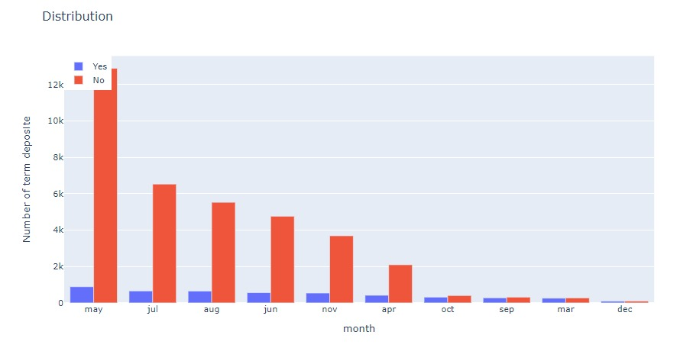
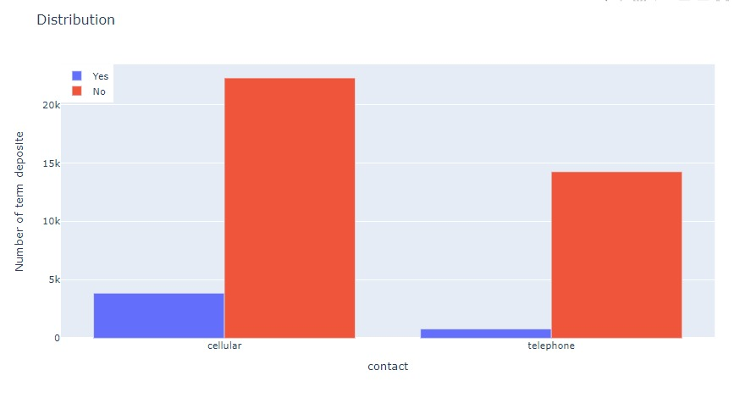
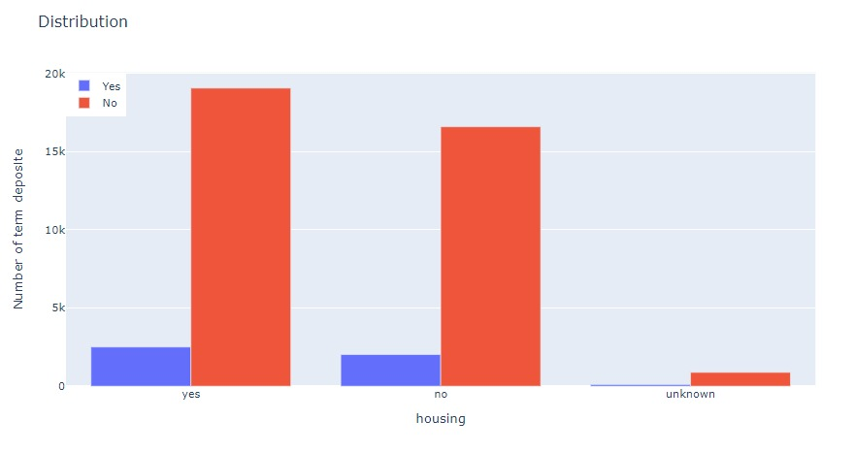
Categorical Columns:

Slide 6
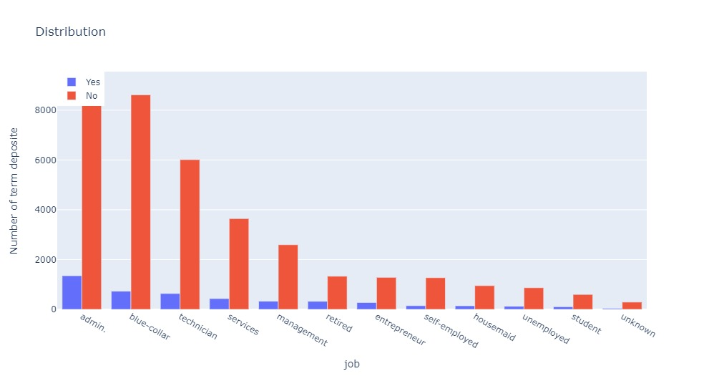
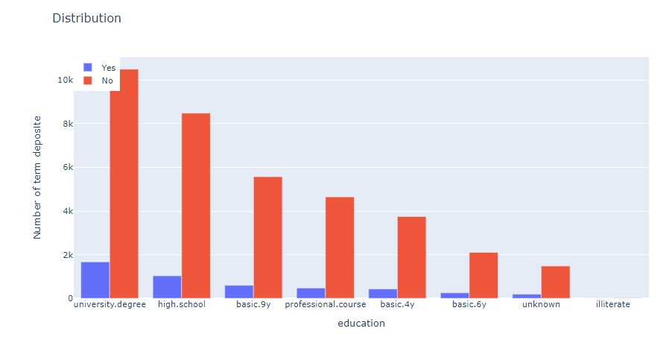

Slide 7
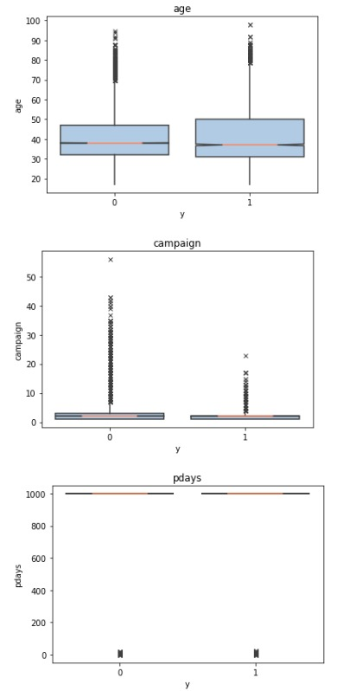
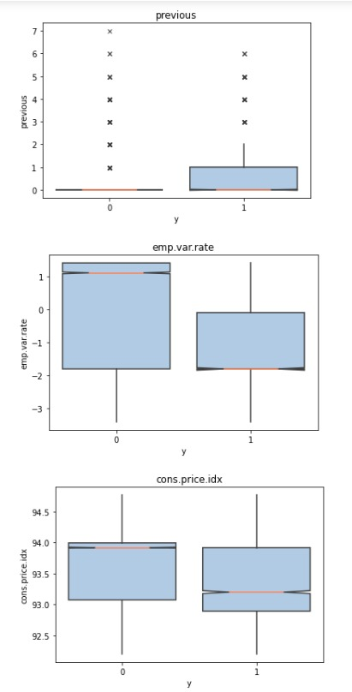
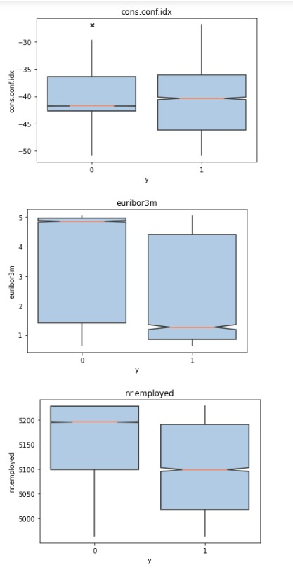
Distri Variables

Slide 8
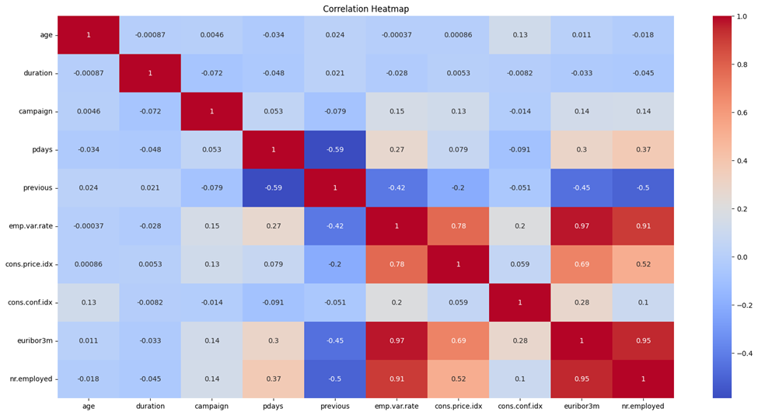
Correlation Between Columns:

Slide 9
Encoding:
Categorical column
One hot encoding
Create N-1 columns for each column
Hash mapping
Create CEIL(log(N,1.9)) columns for each column
Numerical column
PCA

Slide 10
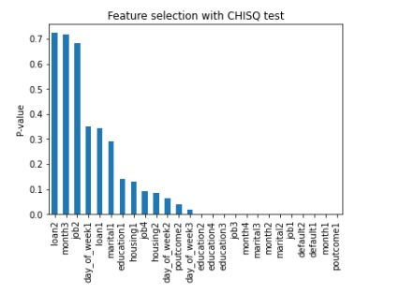
Feature Selection:
Dropping columns
Duration, emp.var.rate, cons.price.idx, euribor 3m and nr.employed
ChiSQ Test
ChiSQ test on hash mapping dataset (categorical) vs target variable

Slide 11
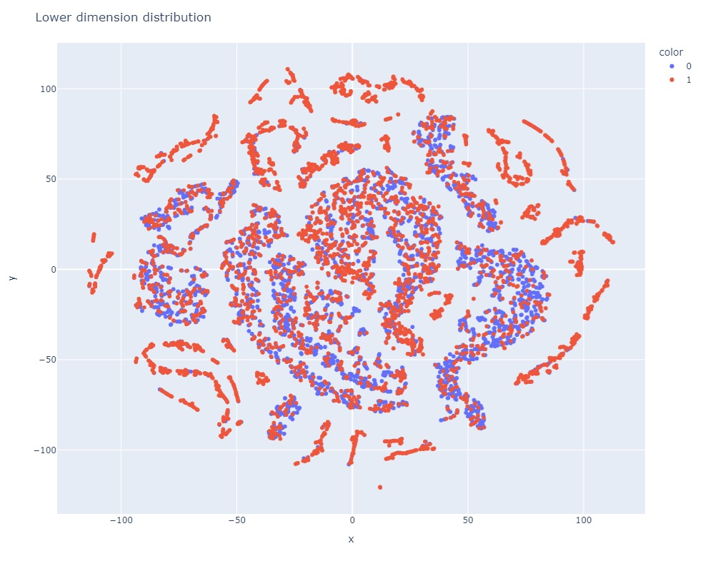
TSNE:

Slide 12
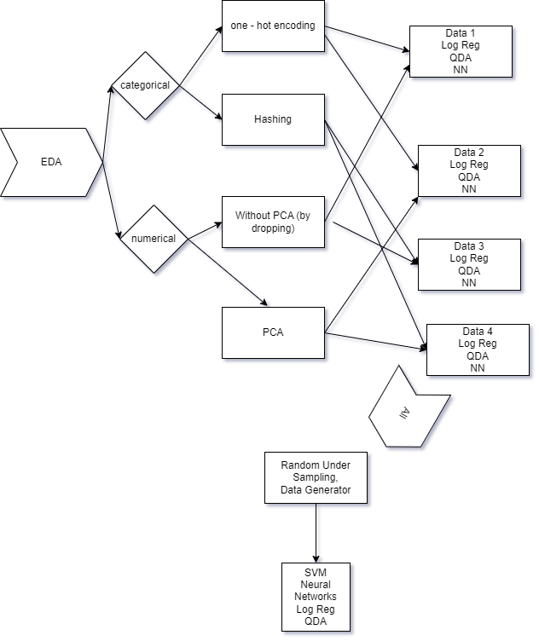
Random Undersampling:
Random undersampling is done to combat imbalance data

Slide 13
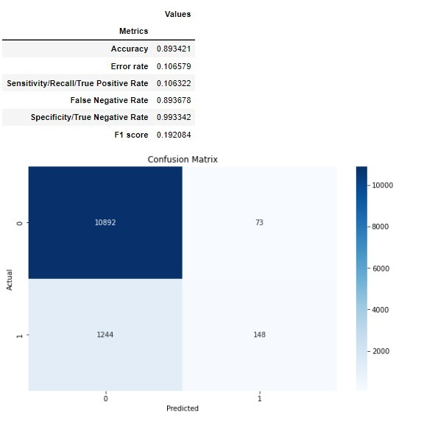
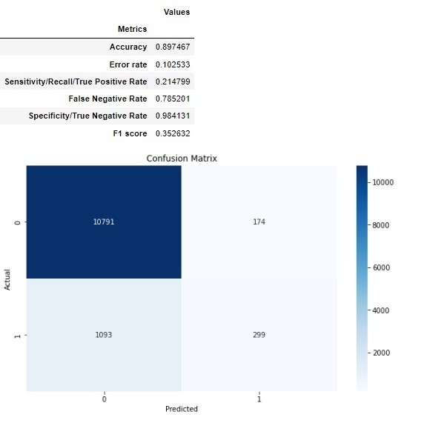
Logistic Regression:
Before PCA
Undersampling

Slide 14
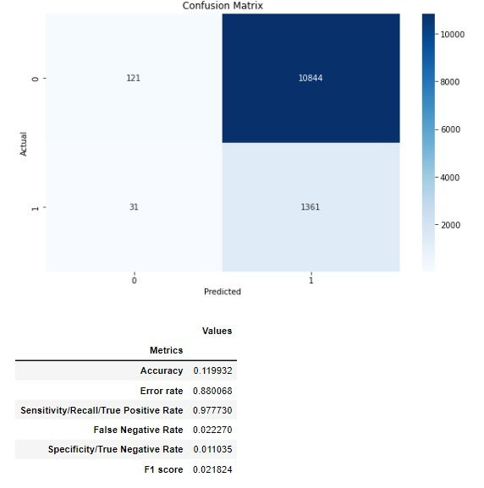
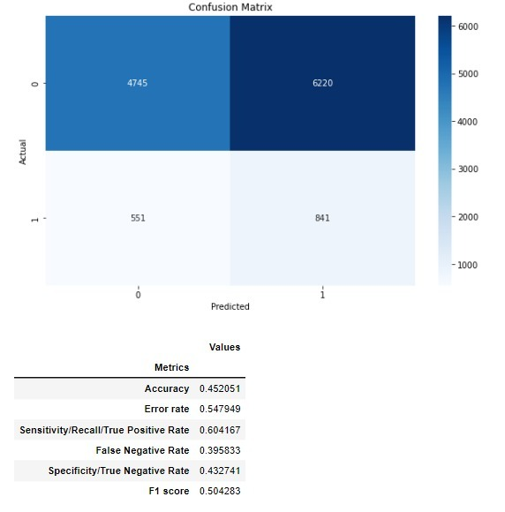
QDA:
Using ChiSq
Using One Hot Encoding

Slide 15
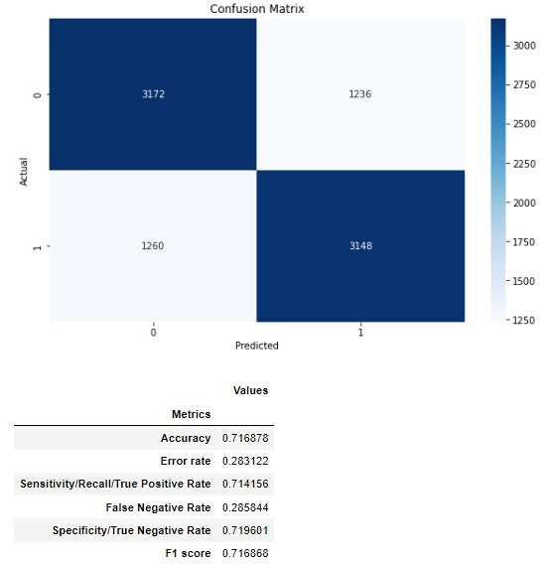
SVM:
After Hashmap

Slide 16
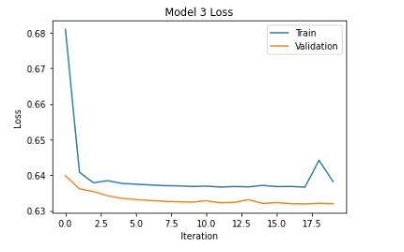
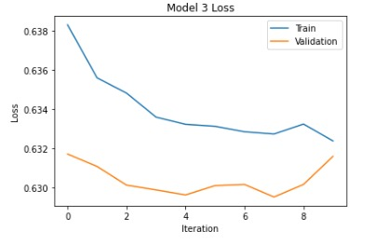
Neural Networks:
One Hot Encoder without Data Gen
Hash map with Data Generator

Slide 17
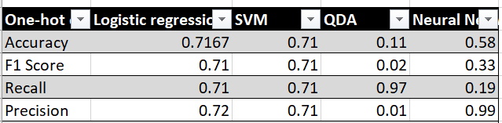
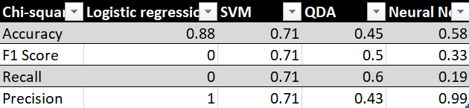
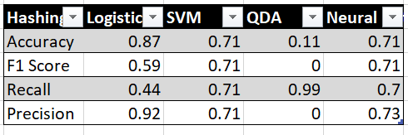
Model Performance and Evaluation:

Slide 18
Conclusion:
Neural Networks and Logistic are good fit for our dataset
SVM performs consistently.

