Slide 1
Computerization of Farmer Land Details along with beneficiary schemes
Under the Guidance of : Dr. B Jalender
PROJECT TEAM MEMBERS
A SAI KARTHIK - 21071A1202
A SURYA TEJA - 21071A1203
A KRISHNA TEJA - 21071A1204
M SAIRAJ - 21071A1239

Slide 2
AGENDA
ABSTRACT
INTRODUCTION
PROPOSED WORKPLAN
METHODOLOGY
EXPECTED OUTCOME
CONCLUSION
FUTURE SCOPE
BIBLIOGRAPHY

Slide 3
ABSTRACT
The Agricultural Land Computerization Software is a powerful tool designed to revolutionize the management of farmer land details while integrating beneficiary scheme information. It simplifies the process of recording and updating land records, offering farmers an accessible platform to manage their property. Simultaneously, it seamlessly connects with government beneficiary schemes, ensuring eligible farmers can easily access subsidies and incentives.

Slide 4
INTRODUCTION
In many countries, especially in rural and agricultural regions, the management of farmer land details and beneficiary schemes has traditionally relied on manual record-keeping systems. These systems are often inefficient, error-prone, and lack transparency, leading to various challenges for both farmers and government authorities. Due to lack of awareness and illiteracy most of the farmers are not being able to utilize and claim benefits from their lands and crop. This Software acts as interface and helps farmers and their families providing the knowledge about the benefits and scheme they could claim from the government for their respective land and the type of crop being grown. This software initially consists of a from to be filled by the farmers to provide the necessary details and based upon it the calculations are done and farmer gets a clear picture of the available beneficiary schemes that could be availed.

Slide 5
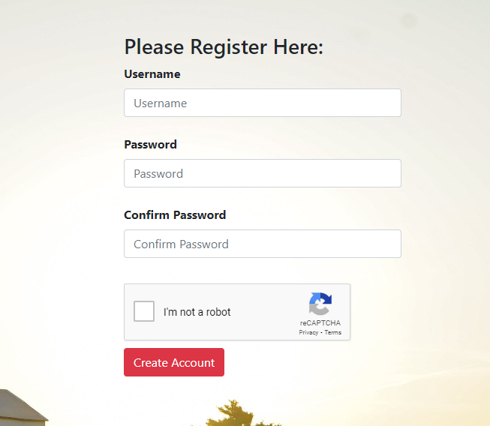
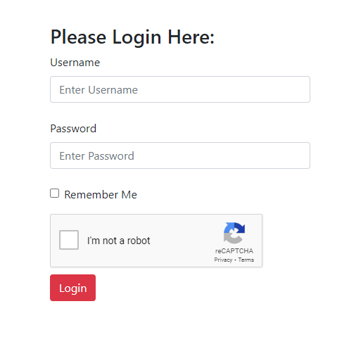
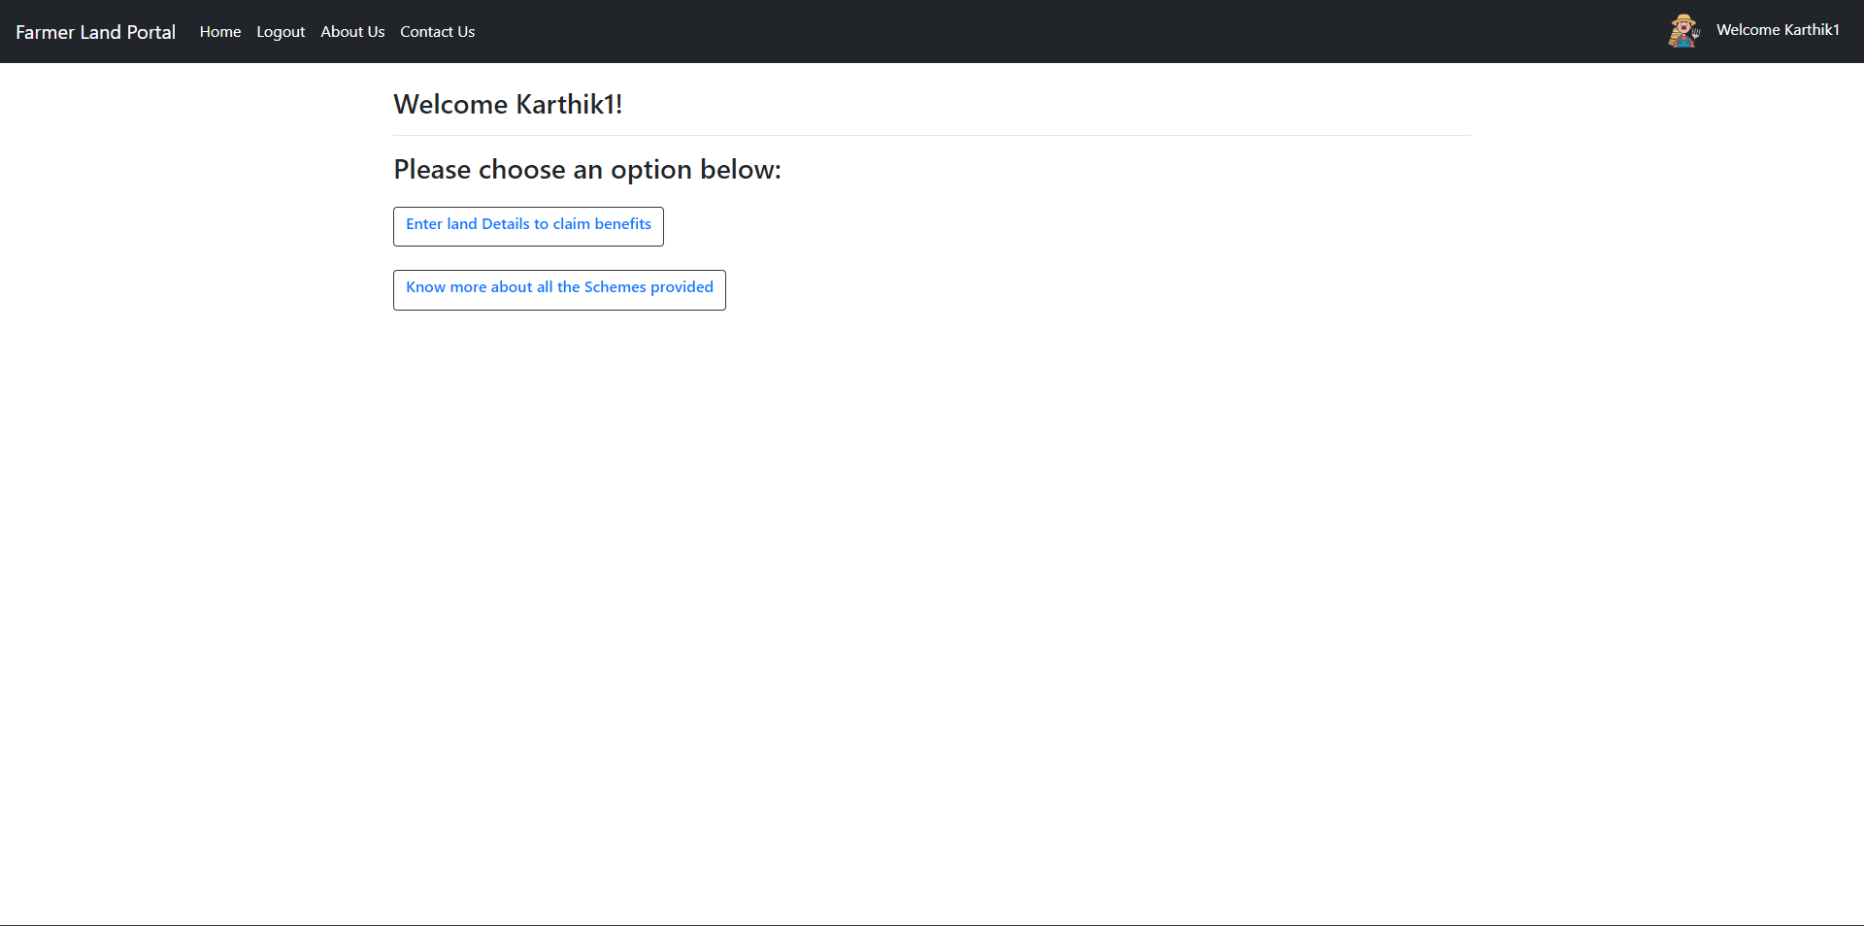
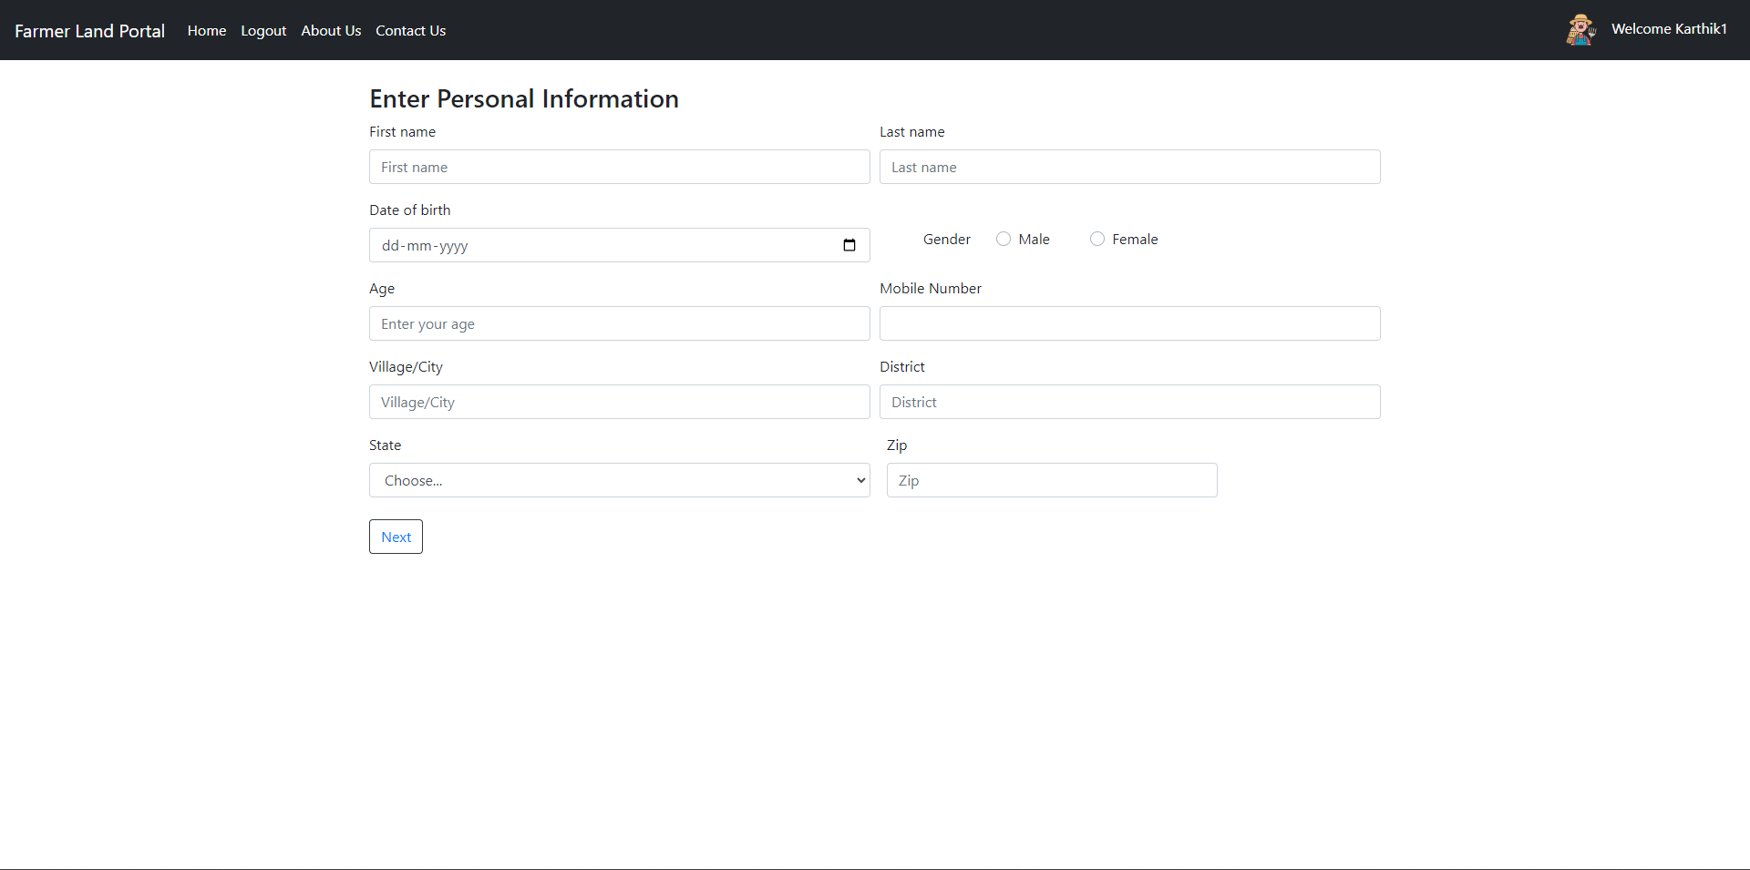
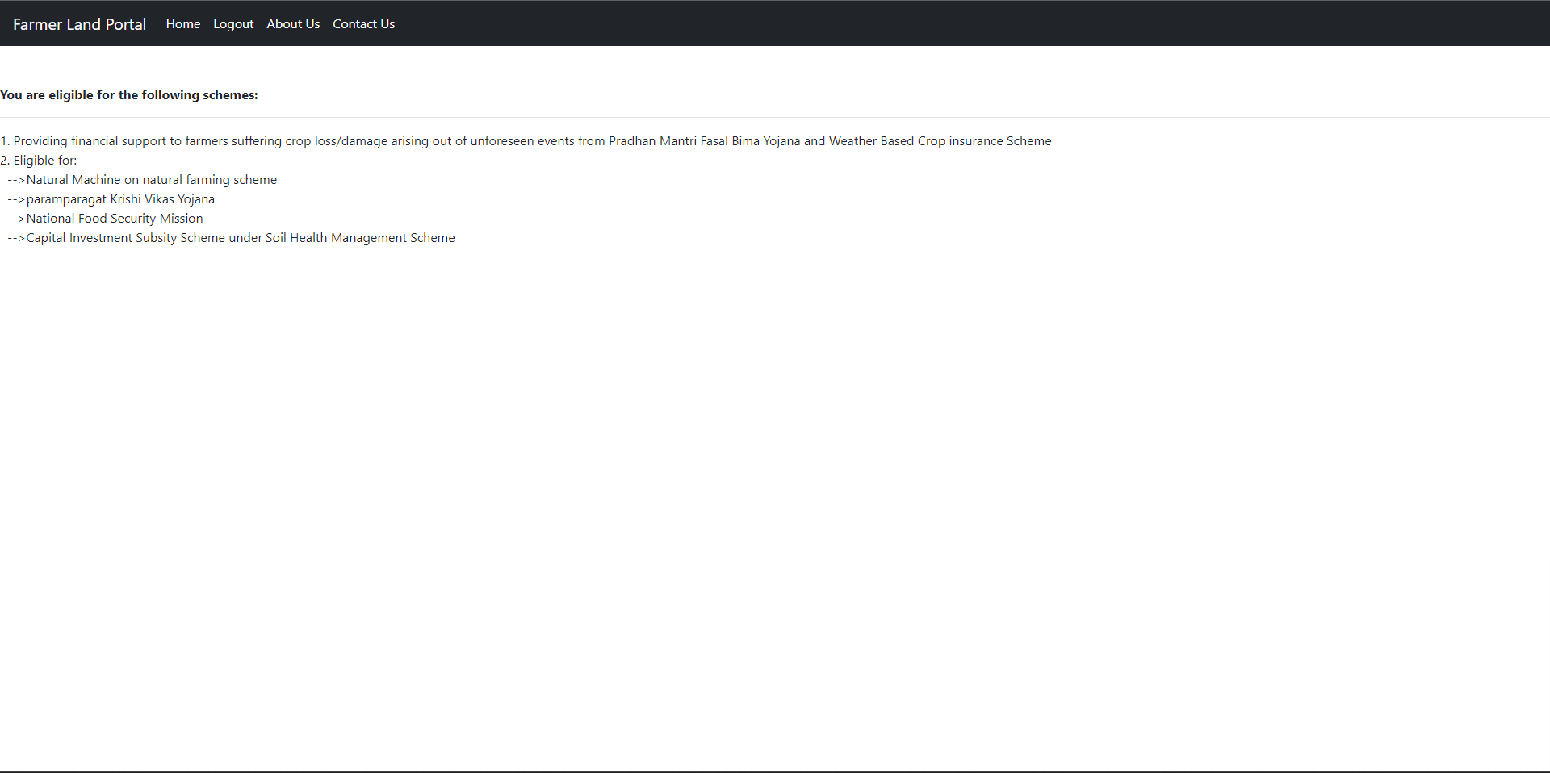
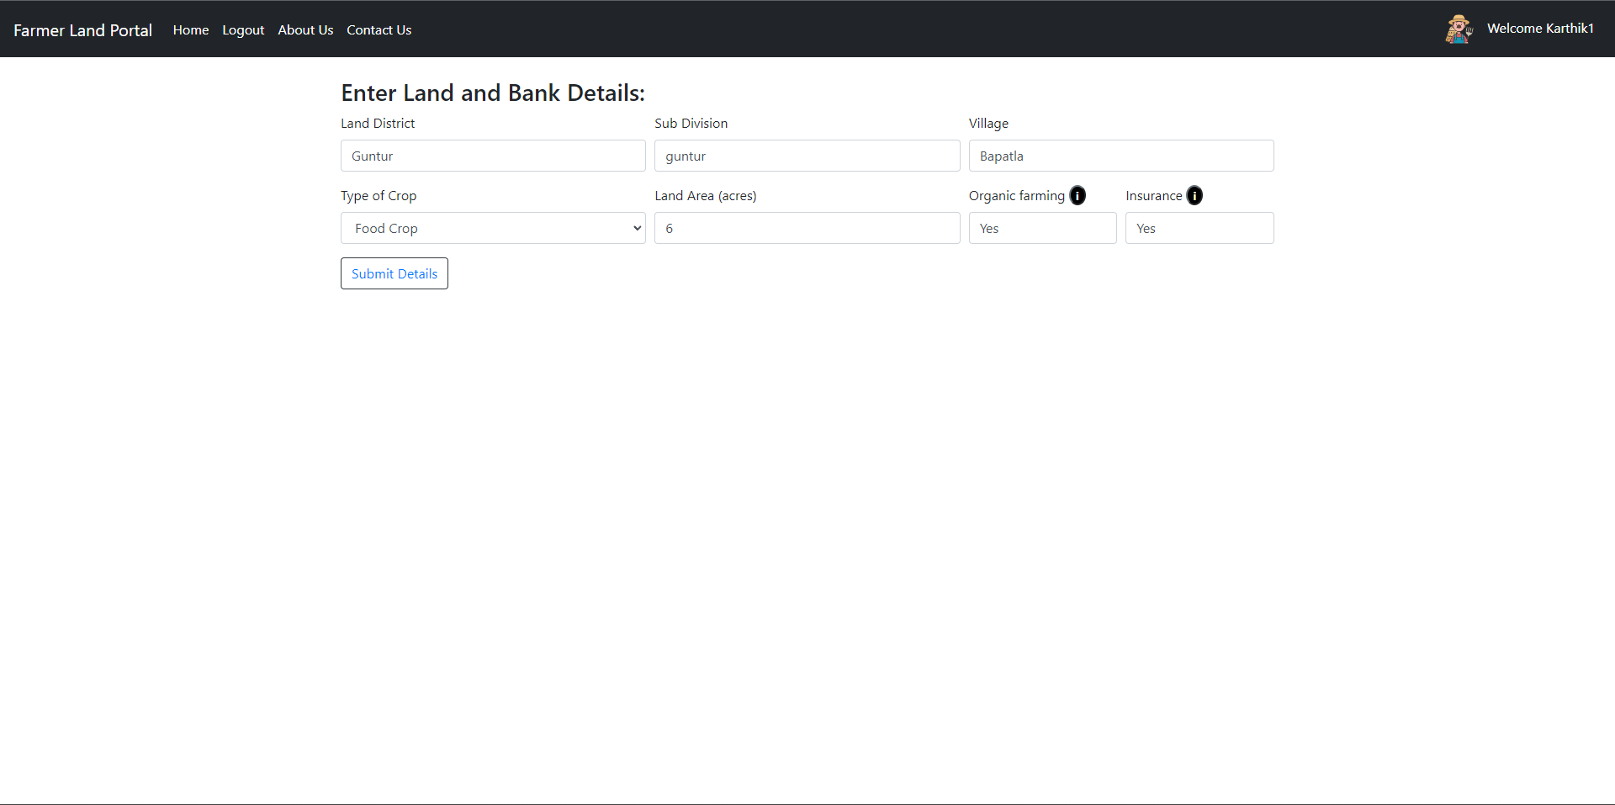
PROCESSED WORKFLOW
Login
Welcome page
Filling Details
Displaying Results

Slide 6
METHODOLOGY
Project Planning and Requirements Analysis:
● Conducted a thorough analysis of the other websites which provide benefits to farmers in letting them know about their schemes they are benefitted by.
● Defined the scope, objectives, and functionalities of the project.
System Architecture Design:
● Designed the overall architecture of the system, including the database schema, user interfaces, and interactions between different input forms.
● Selected appropriate technologies and frameworks to meet project requirements.

Slide 7
METHODOLOGY
Frontend and Backend Development:
● Implemented the frontend components for the welcome page, home page, forms page, result page, profile page and available schemes page.
● Developed the backend logic using [Backend Language/Framework], ensuring proper data flow and authentication mechanisms.
Database Design and Implementation:
● Designed a database to store information about farmers details such as username and password.
● Implemented the database using [Database Management System].

Slide 8
METHODOLOGY
User Authentication and Authorization:
● Implemented secure user authentication and authorization mechanisms for the farmer [Authentication Framework].
● Ensured that sensitive information is protected and access is granted based on user roles.

Slide 9
EXPECTED OUTCOME
The proposed outcome of the creating a website for computerization of farmer land details along with beneficiary scheme details is to have an faster and more convenient and user friendly portal where individual farmers finds it easy to register and enter their land details to proper have an information about the schemes they can be benefitted by. Not only displaying schemes we also provided respective links to each scheme so that it would be convenient for the user to easily navigate to the respective scheme site and enroll/apply for it.

Slide 10
CONCLUSION
In conclusion, The computerization of farmer land details, coupled with beneficiary scheme details, marks a significant step towards modernizing agricultural practices and promoting inclusive development. This comprehensive system offers numerous advantages that contribute to the overall growth and welfare of the farming community. This digital transformation not only benefits individual farmers but also contributes to the overall growth and resilience of the agricultural sector, aligning with the broader goals of sustainable development.

Slide 11
FUTURE WORK
Extending the project to support many languages.
Building more user friendly interfaces.
Time to time updates of any new introduced schemes.
Delivering error free mechanism.

Slide 12
BIBLIOGRAPHY
Information regarding multiple schemes details for farmer
---https://vikaspedia.in/schemesall/schemes-for-farmers
Farmer welfare websites
---https://agriwelfare.gov.in/en/Major
---https://farmer.gov.in/

Slide 13
THANK YOU

