Slide 1


Slide 2
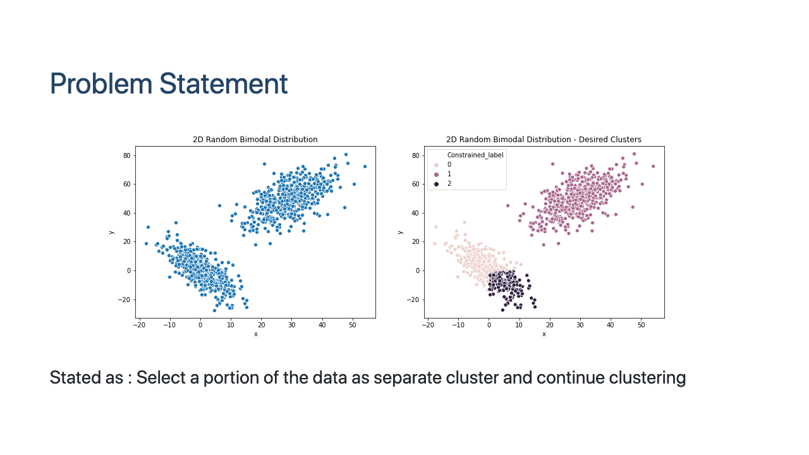
Notes:
Image from output of the data

Slide 3
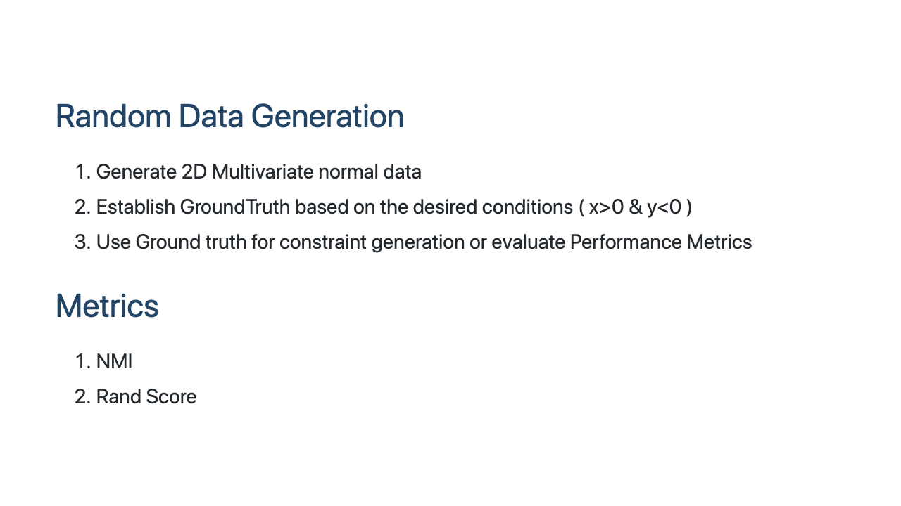

Slide 4
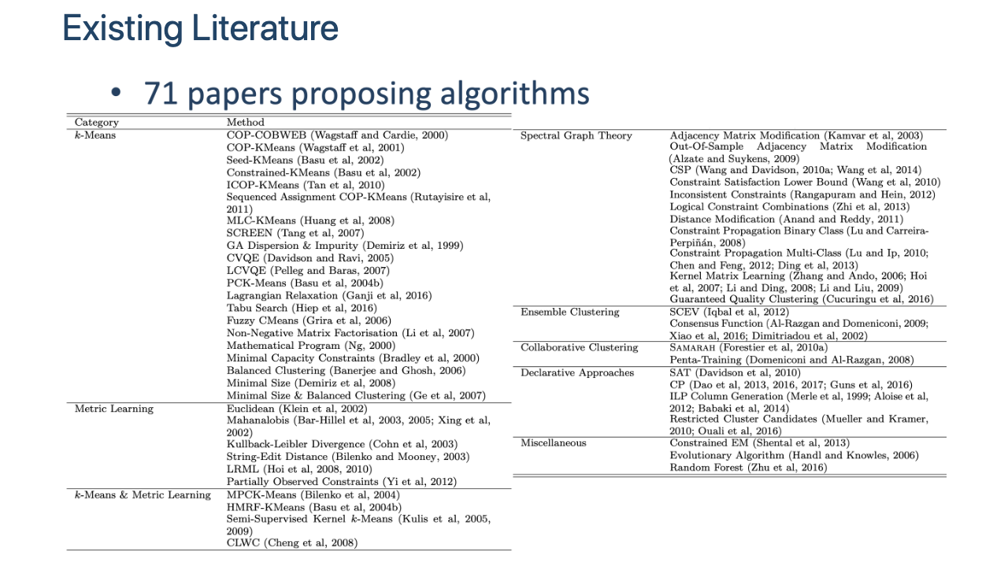
Notes:
Multiple papers suggesting the implementations being done in the past and fwe Dee plearning pulciations are present too

Slide 5
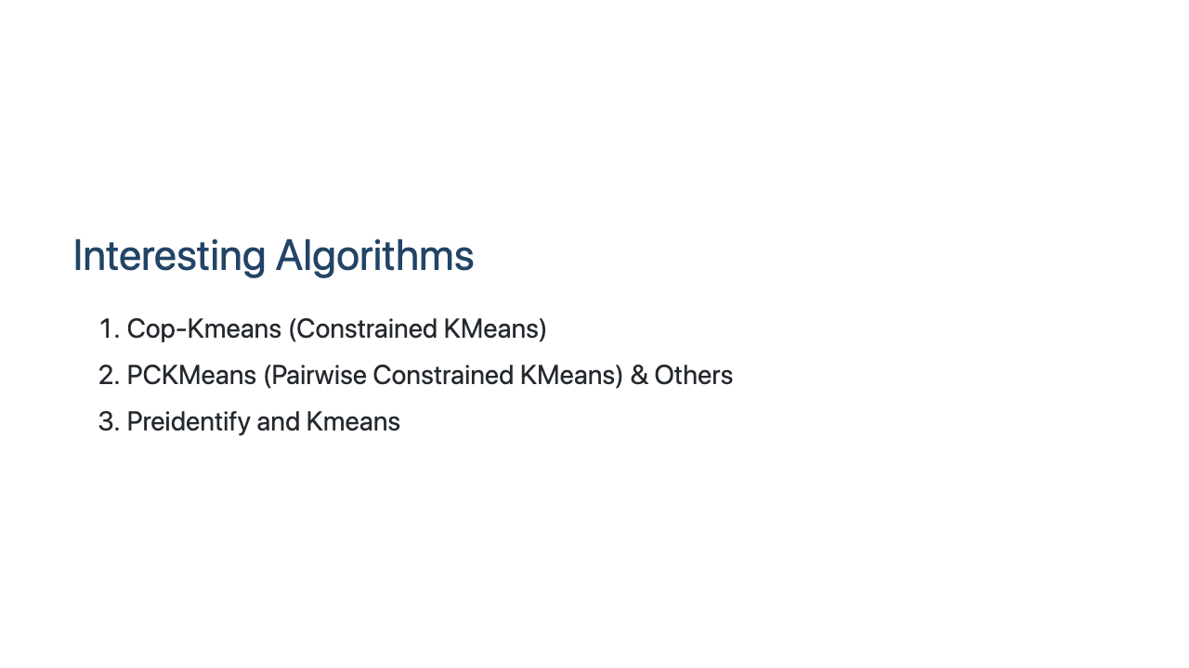

Slide 6
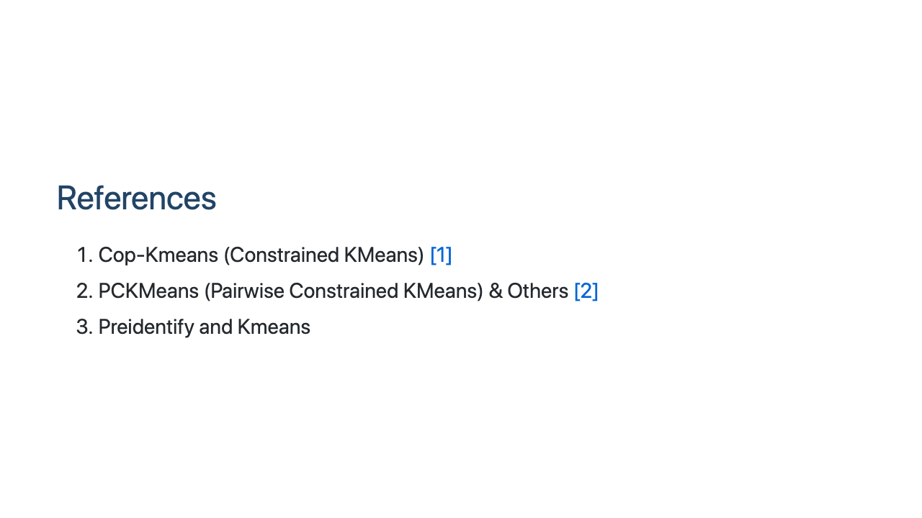

Slide 7
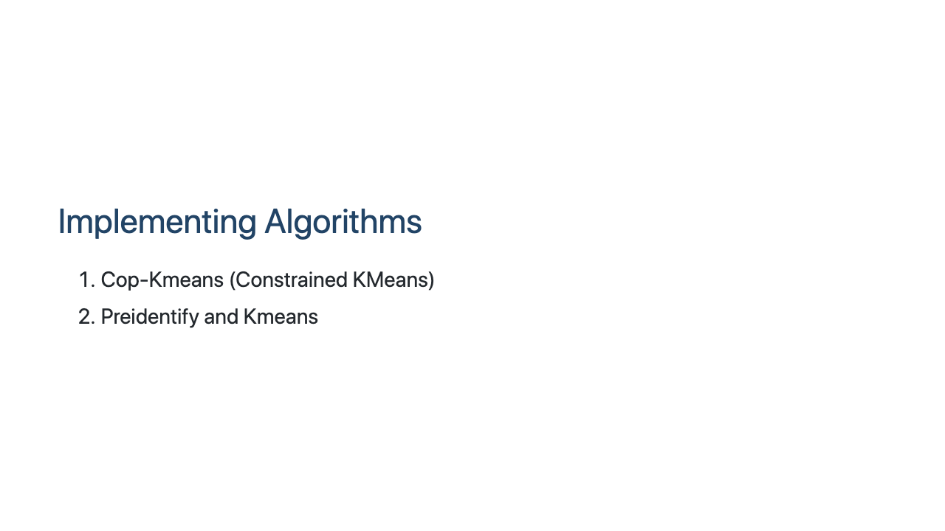

Slide 8
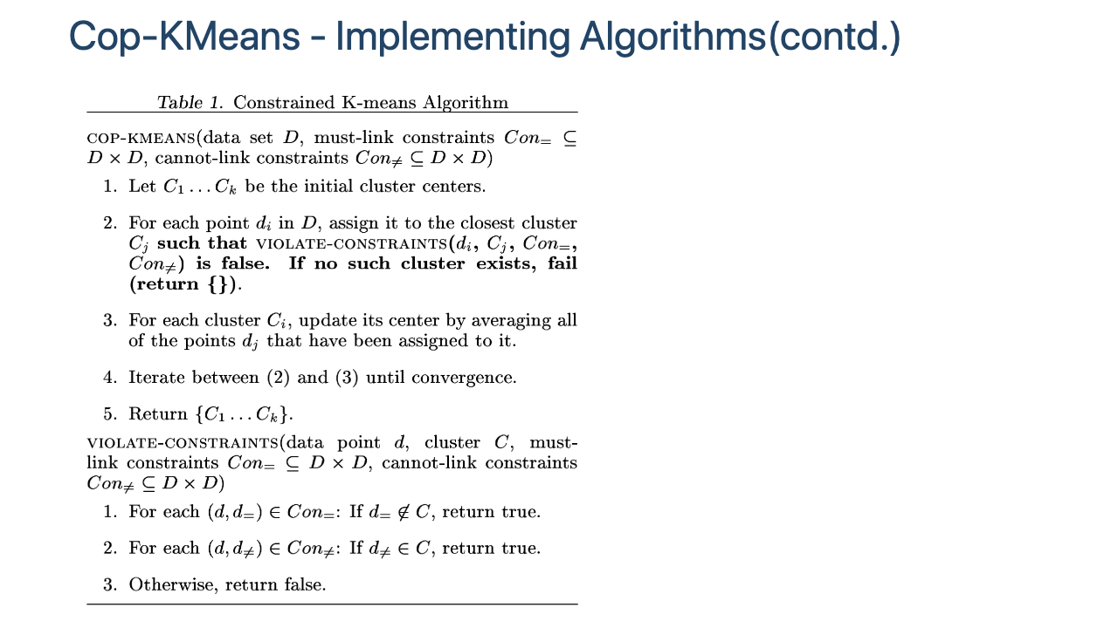
Notes:
<img src="./CopKMeans_Algo.png" width="200" height = "400"></img>

Slide 9
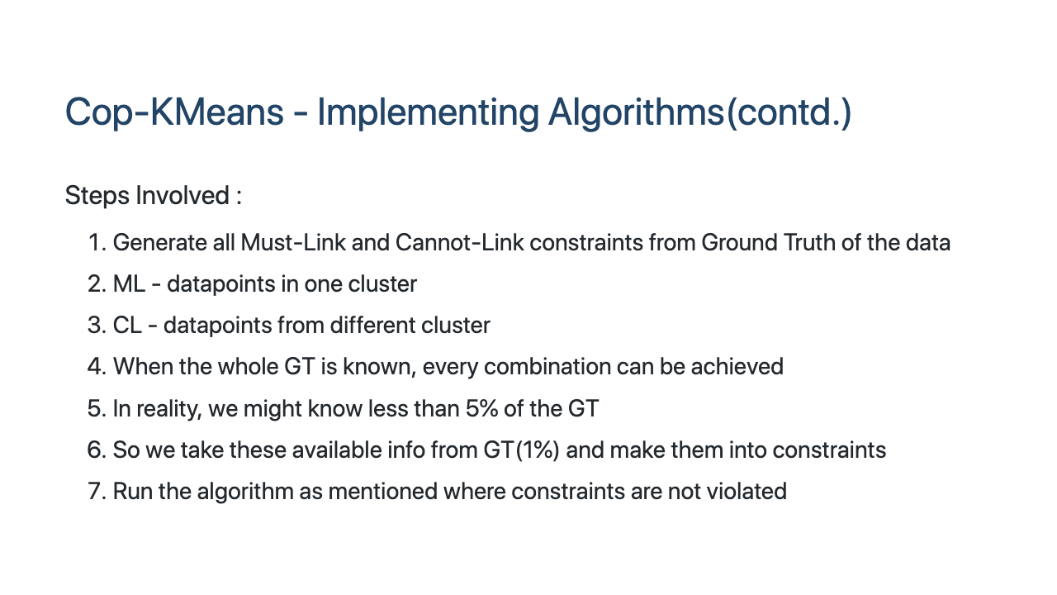

Slide 10
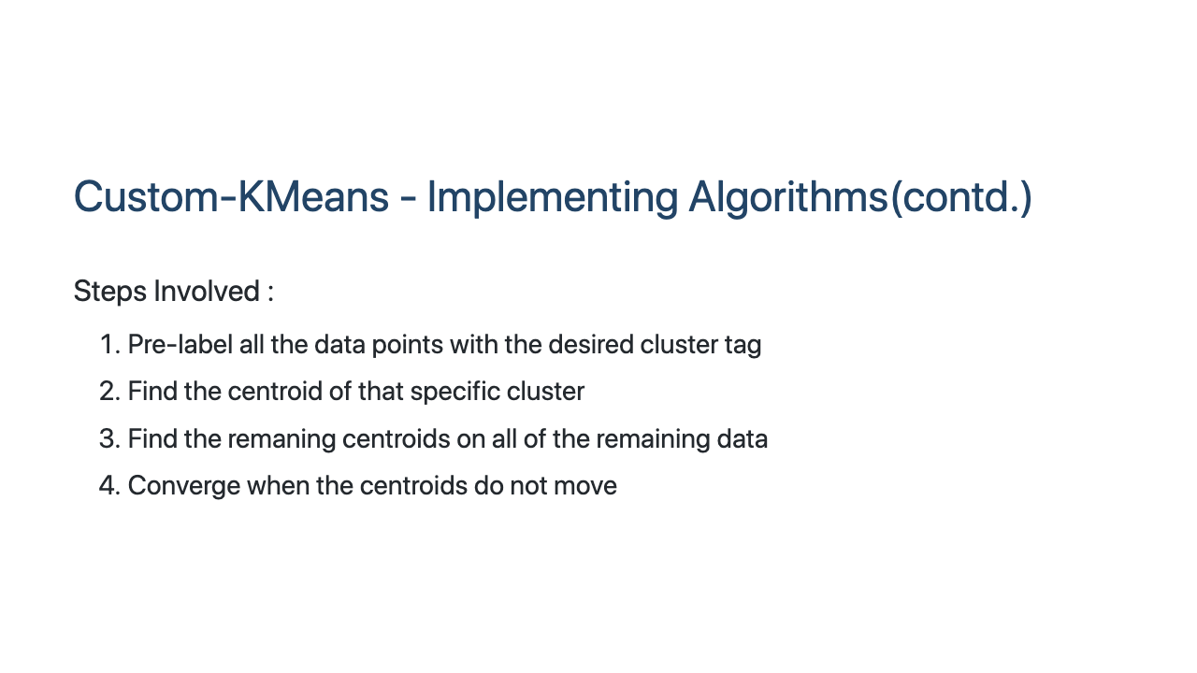

Slide 11
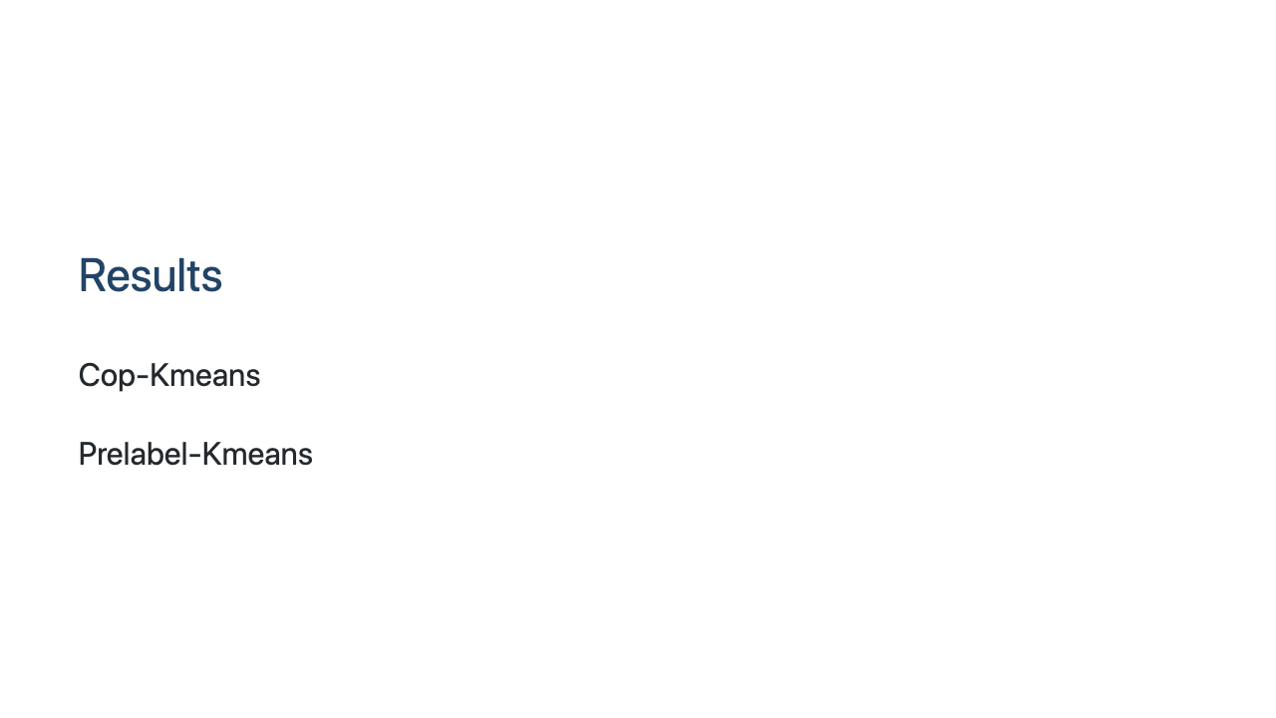

Slide 12
