Slide 1

API.AI – A Conversational UX Platform iGnite@EGS
Sudheen Bhatt
Krishna, Augustine
Oct 3rd 2016
© 2016 Wells Fargo Bank, N.A. All rights reserved. Internal use only.

Slide 2
API.AI
Agent is a virtual assistant that is created on api.ai platform trained on some specific skills based on the domain.
Entities represent concepts that are often specific to a domain as a way of mapping natural language phrases to canonical phrases that capture their meaning.
Intents represent a mapping between what a user says and what action should be taken by the application.
Actions correspond to the steps your application will take when specific intents are triggered by user inputs. An action may have parameters for specifying detailed information about it.
Contexts are strings that represent the current context of the user expression. Context preserves the previous phrases the user interacted with the system and when it needs more information as the previous phrases are vague.

Slide 3
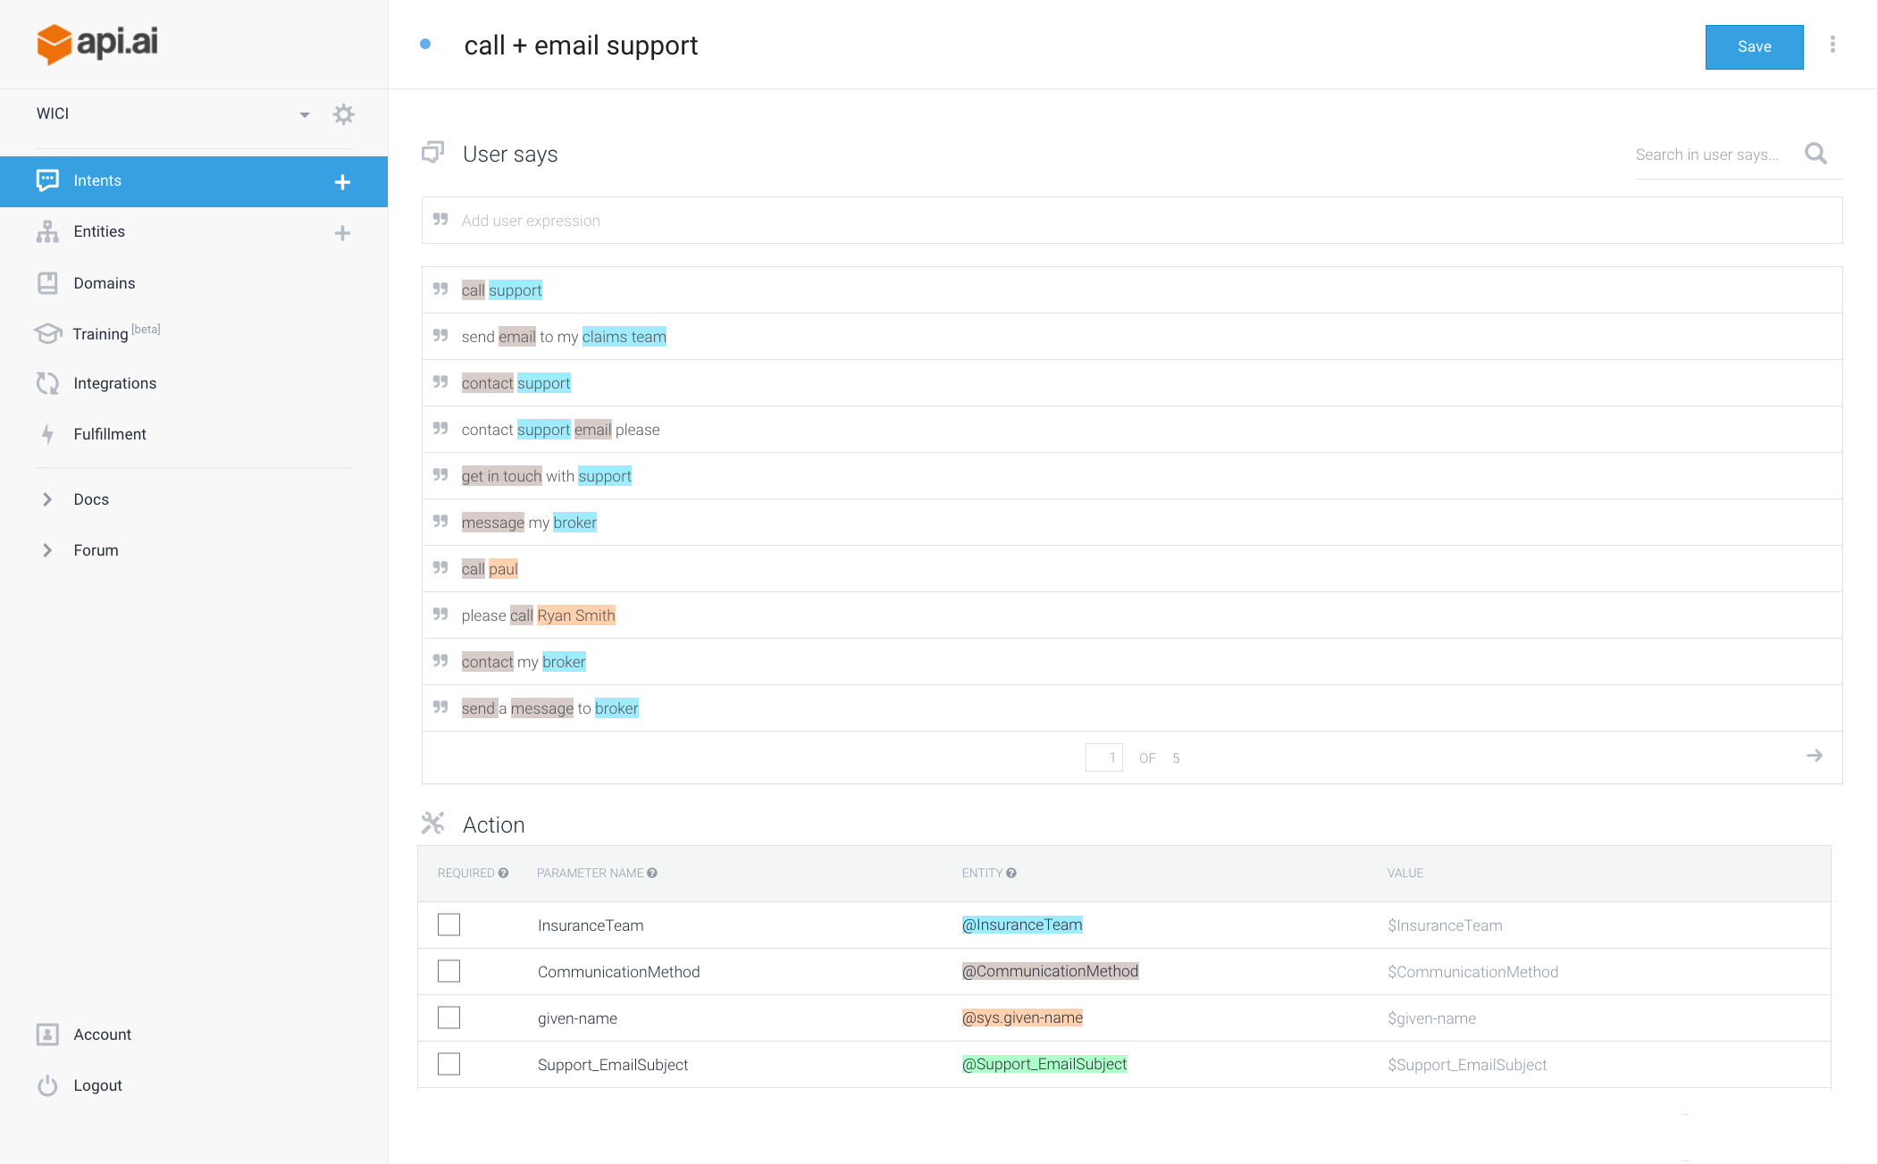

Slide 4
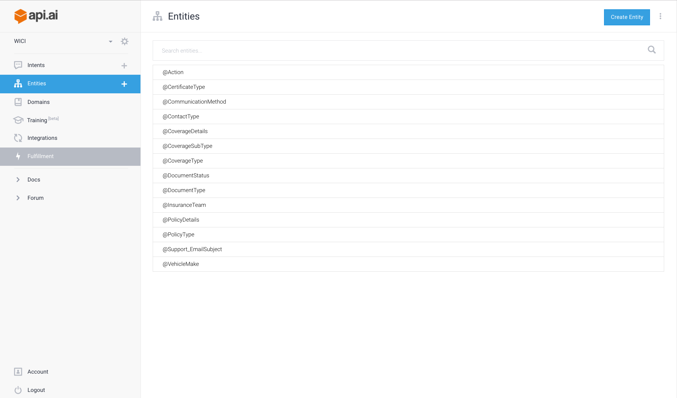

Slide 5
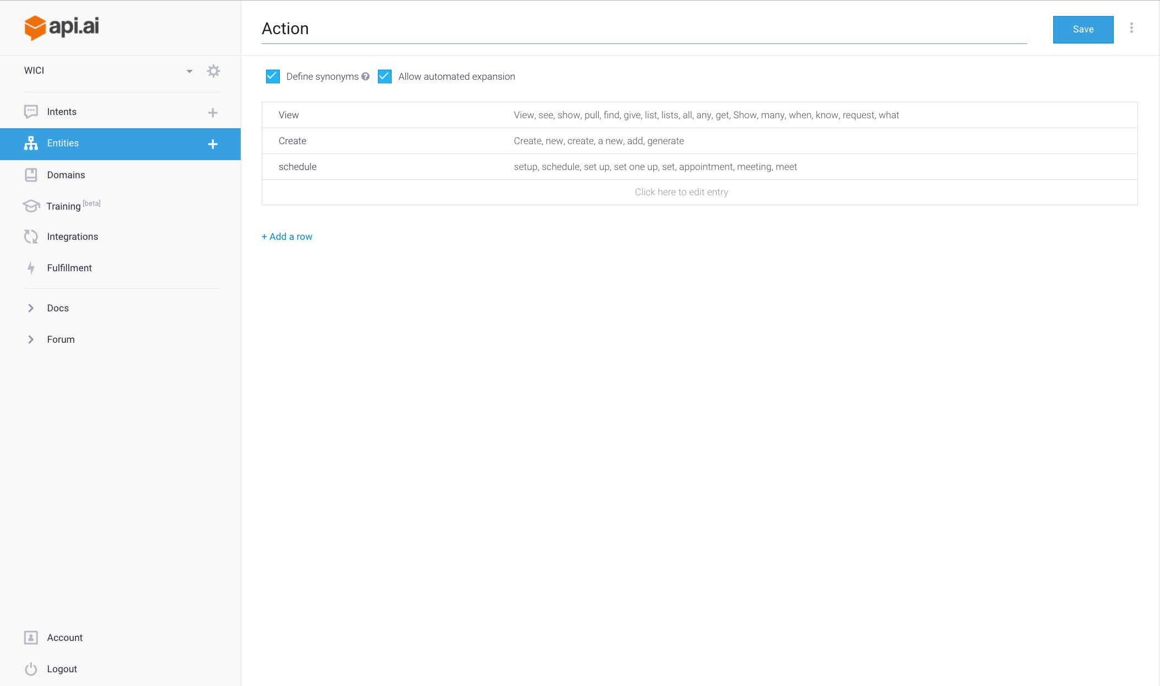

Slide 6
{
"id": "818c4e7e-c972-4684-b180-501ace861788",
"timestamp": "2016-10-04T05:26:06.519Z",
"result": {
"source": "agent",
"resolvedQuery": "create new certificate",
"actionIncomplete": false,
"parameters": {
"Action": "Create",
"CommunicationMethod": "",
"DocumentType": "Certificate",
"PolicyType": ""
},
"contexts": [],
"metadata": ……
"fulfillment": {
"speech": ""
},
},
"status": {
"code": 200,
"errorType": "success"
}
}
{
"id": "d5ce7b63-826f-4319-8b16-04986be337c9",
"timestamp": "2016-10-04T05:24:11.699Z",
"result": {
"source": "agent",
"resolvedQuery": "call my broker",
"actionIncomplete": false,
"parameters": {
"CommunicationMethod": "call",
"InsuranceTeam": "Support",
"Support_EmailSubject": "",
"given-name": ""
},
"contexts": [],
"metadata": {
"intentId": "7c42589d-1d61-4346-8f1e-89717544b0c5",
"webhookUsed": "false",
"intentName": "call + email support"
},
"fulfillment": {
"speech": ""
},
"score": 1
},
"status": {
"code": 200,
"errorType": "success"
}
}

Slide 7
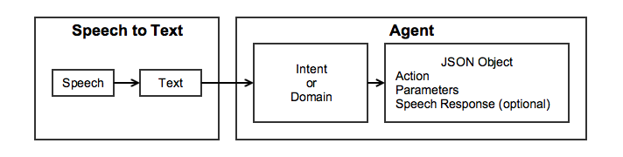
2-way conversation
Context is preserved on API.AI
Speech/Response is played back to the user
Action is analyzed

Slide 8
Traning API.AI
As the users can input any type of text or speech, it becomes important to have as many intents mapped to actions, so the system can work seamlessly.
WF team has worked with API.AI team to load various commonly used phrases to intents
The more the phrases that are mapped to, the better the voice assistant can recognize the phrase.

Slide 9
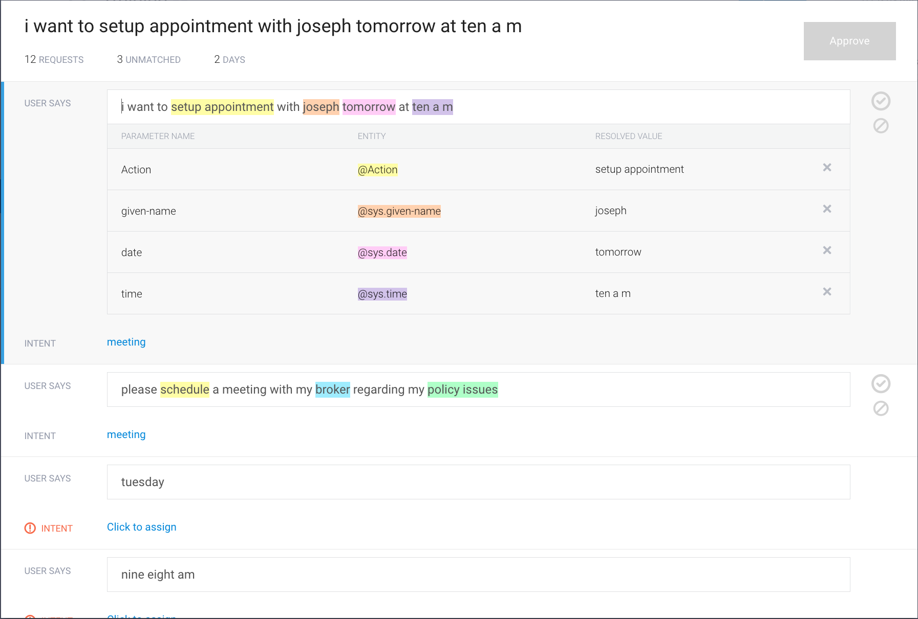

Slide 10
Thank You

