Slide 1

DocReach
Predict Physician Specialty from
Text Data for a Marketing Company
(Company and data confidential)

Slide 2
Business Problem
“A large social media marketing firm wants to target doctors / physicians based on their practice area. For example, A marketing campaign to target Cardiologists for heart related news feed.”

Slide 3
Scope
The marketing firm wants to predict physicians under medical specialties based upon procedures performed over the past year

Slide 4
Process followed
Week1: Goal MVP Binary Classifier to classify Cardiologists
Data Cleaning & Prep
EDA
Profit curve to choose the best model
Next Steps: Week2: Multiclass classifier
Document Results
Acquired Dataset

Slide 5
Data Source
Data has been provided in the form of csv files:
procedures.csv - contains a list of procedures doctors performed over the past year. The columns of this dataset are as follows:
physician_id unique physician identifier, joins to id in physicians.csv
procedure_code unique code representing a procedure
procedure description of the procedure performed (Text Column)
number_of_patients the number of patients the doctor performed that procedure on over the past year
physicians.csv - contains a list of doctors and their unique specialty. Specialty is listed as "Unknown" for the doctors need to be classified.
physician_id unique physician identifier, joins to id in physicians.csv
Specialty: String e.g. Cardiologist

Slide 6
EDA & Prep
Data Munging
Joined data files
Removed non-alpha & non-numeric characters
Stemming
Stop Words
Vectorization: Count Vector, TFIDF
Analysis of procedure column
Created binary target variable
EDA
Specializations: 69
Class Ratio:
47% Cardiologists
53% Non-Cardiologist
Total Instances: 406,690
cost benefit matrix (assumed for analysis)
cost_benefit = np.array([[100, -10], [0, 0]])
Classifiers:
Logistic Regression, Multinomia NaïveBayes, RandomForest, GradientBoosting, SVC

Slide 7
Program Structure
Data
train_model.py
best_model.pkl
predict.py
New Instances
Prediction

Slide 8
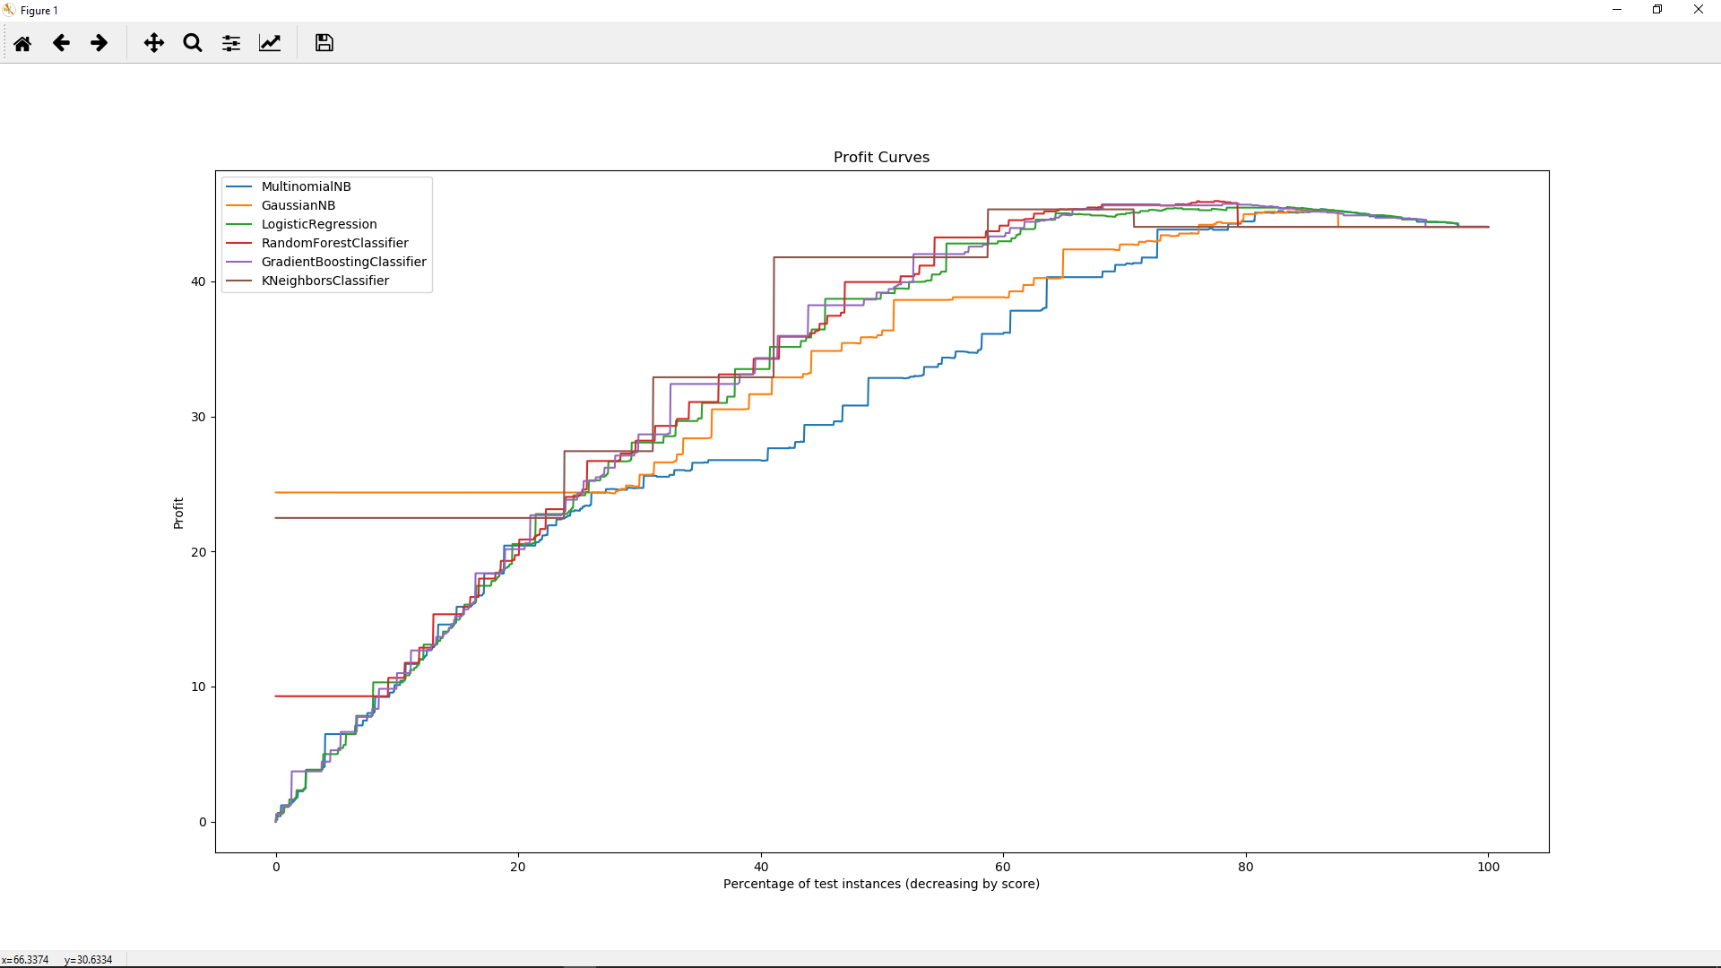
Results - Profit Curves

Slide 9
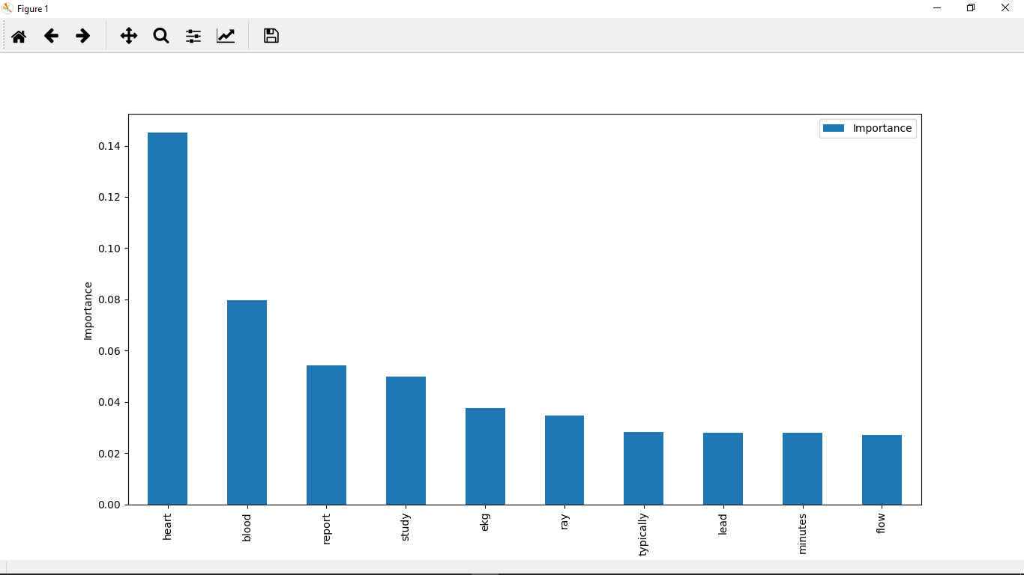
Feature Importance

Slide 10
Results – Best Model
Best model: RandomForestClassifier
Best threshold: 0.04
Resulting profit: $45.94
Proportion positives: 0.80
precision recall f1-score support
False 0.74 0.85 0.79 1272
True 0.82 0.68 0.75 1228
avg / total 0.78 0.77 0.77 2500
Accuracy Score Train: 0.7890666666666667
Accuracy Score Test: 0.7708

Slide 11
Next Steps – Goal for Week2
Build Multi-class classifier
Hyper parameter tuning
Predict .py
Flask App
Code Refactoring, doc strings
Update presentation

Slide 12
Thanks!

