Slide 1
IBM University Engagement Project Submission
“Exploring the Power of Agentic AI with IBM Granite and LangFlow”

Slide 2

Project Tile – CourseClarity AI
Domain of Project – Education
Student Name | Recent Passport Photo | Email ID | Mobile number [WhatsApp]
Krishna Tyagi |  | krishnatyagi824@gmail.com | 8959607620

Slide 3
Problem Statement – CourseClarity AI
The Challenge
Students often struggle to understand academic material because textbooks, lecture notes and study documents contain complex explanations, technical terminology and lengthy paragraphs.
Understanding large PDF and DOCX documents can be time-consuming. Students may also find it difficult to identify important concepts, understand unfamiliar terms and prepare effectively for examinations.
The Objective
To develop CourseClarity AI, an AI-powered course content simplification agent that transforms complex educational material into easy-to-understand learning resources using IBM Granite.
The solution aims to:
Content Simplification: Convert complex explanations into clear and simple language.
Smart Summarization: Generate concise summaries and key takeaways.
Quiz Generation: Create practice questions from supplied course material.
Glossary Generation: Explain important technical terms.
Translation: Make learning content accessible in different languages.

Slide 4
Proposed Solution -
CourseClarity AI: An AI-Powered Learning Assistant
CourseClarity AI is a web-based application developed using Python, Streamlit and IBM watsonx.ai. It helps students understand complex educational content by transforming it into simpler and more useful learning resources.
Users can paste text or upload PDF and DOCX documents. The application processes the supplied content and uses IBM Granite to generate the requested output.
Key Features
Simplification: Converts difficult academic explanations into understandable language.
Summary: Provides an overview and important takeaways.
Quiz: Generates practice questions to test understanding.
Glossary: Explains important terms in simple language.
Translation: Translates learning content into a selected language.The application provides a single interface for multiple learning-support tasks, helping students study and revise more effectively.

Slide 5
Technology Used
Python: Core programming language used to develop the application.
Streamlit: Creates the interactive web-based user interface.
IBM watsonx.ai: Provides access to IBM's AI models.
IBM Granite 4: Large language model used for understanding and simplifying content.
PyMuPDF: Extracts text from PDF documents.
python-docx: Extracts text from DOCX documents.
GitHub: Used for source code management and version control.
Streamlit Community Cloud: Used to host and deploy the application.

Slide 6
Core Components Used -
1) Streamlit User Interface – Allows users to enter text, upload documents, select tasks and view generated results.
2) Text Input Component – Accepts educational content directly from users.
3) PDF and DOCX File Processing – Extracts text from uploaded academic documents for further processing.
4) Task Selection – Allows users to choose simplification, summary, quiz, glossary or translation.
5) IBM watsonx.ai Integration – Connects the application to IBM Granite for AI-powered content generation.
6) IBM Granite Model – Processes the supplied content and generates the requested learning output.
7) Output and Download – Displays generated content and provides supported download options.
Note: This project uses a direct IBM Granite inference workflow. LangFlow components are not part of the current implementation.

Slide 7
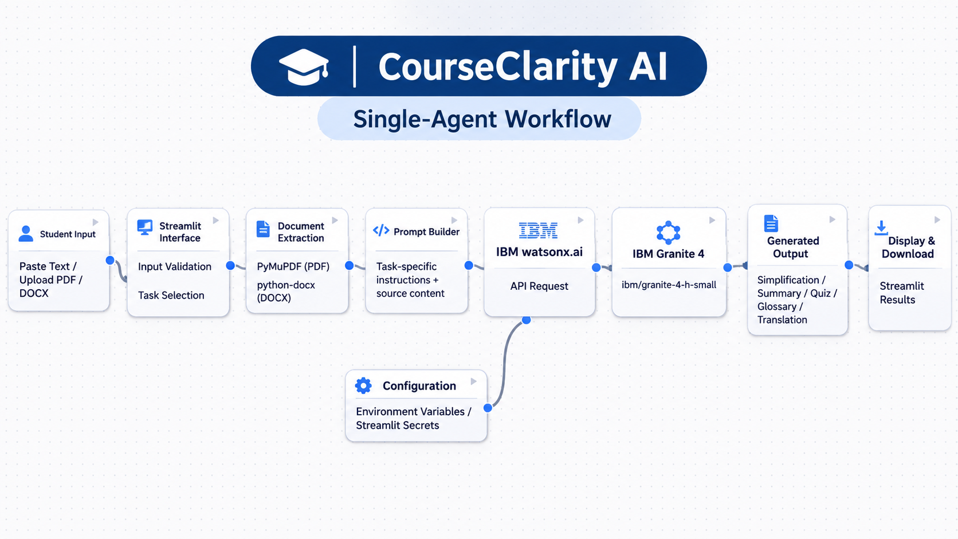
Application Workflow -

Slide 8
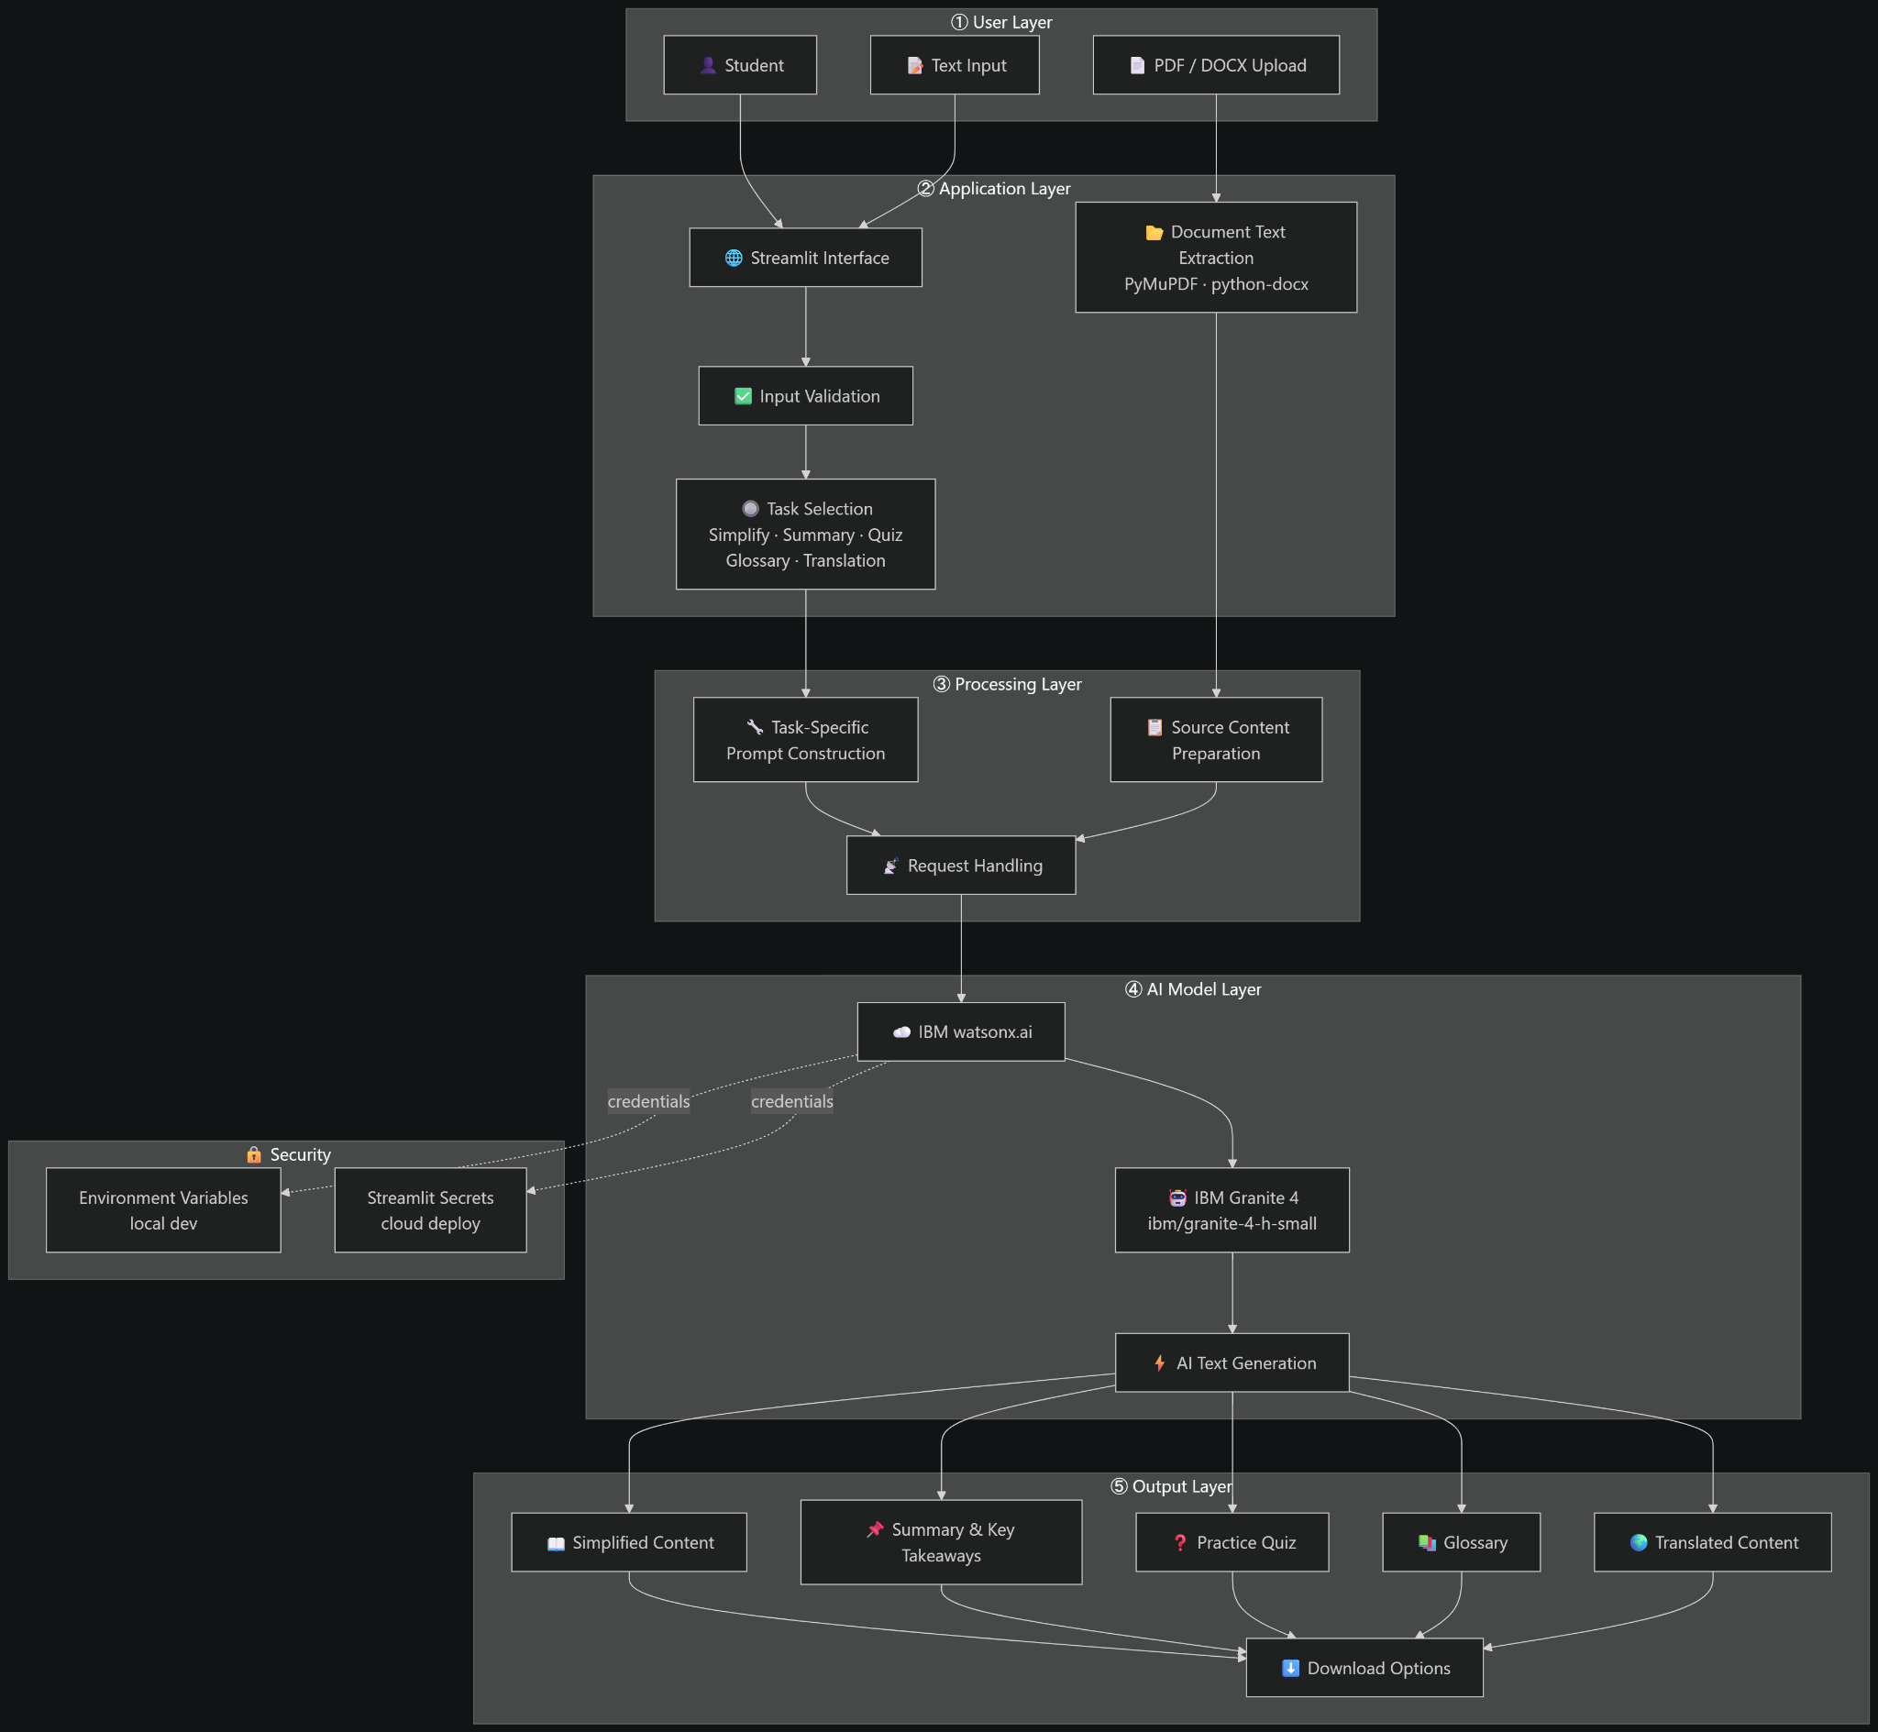
Architecture Blueprint -

Slide 9
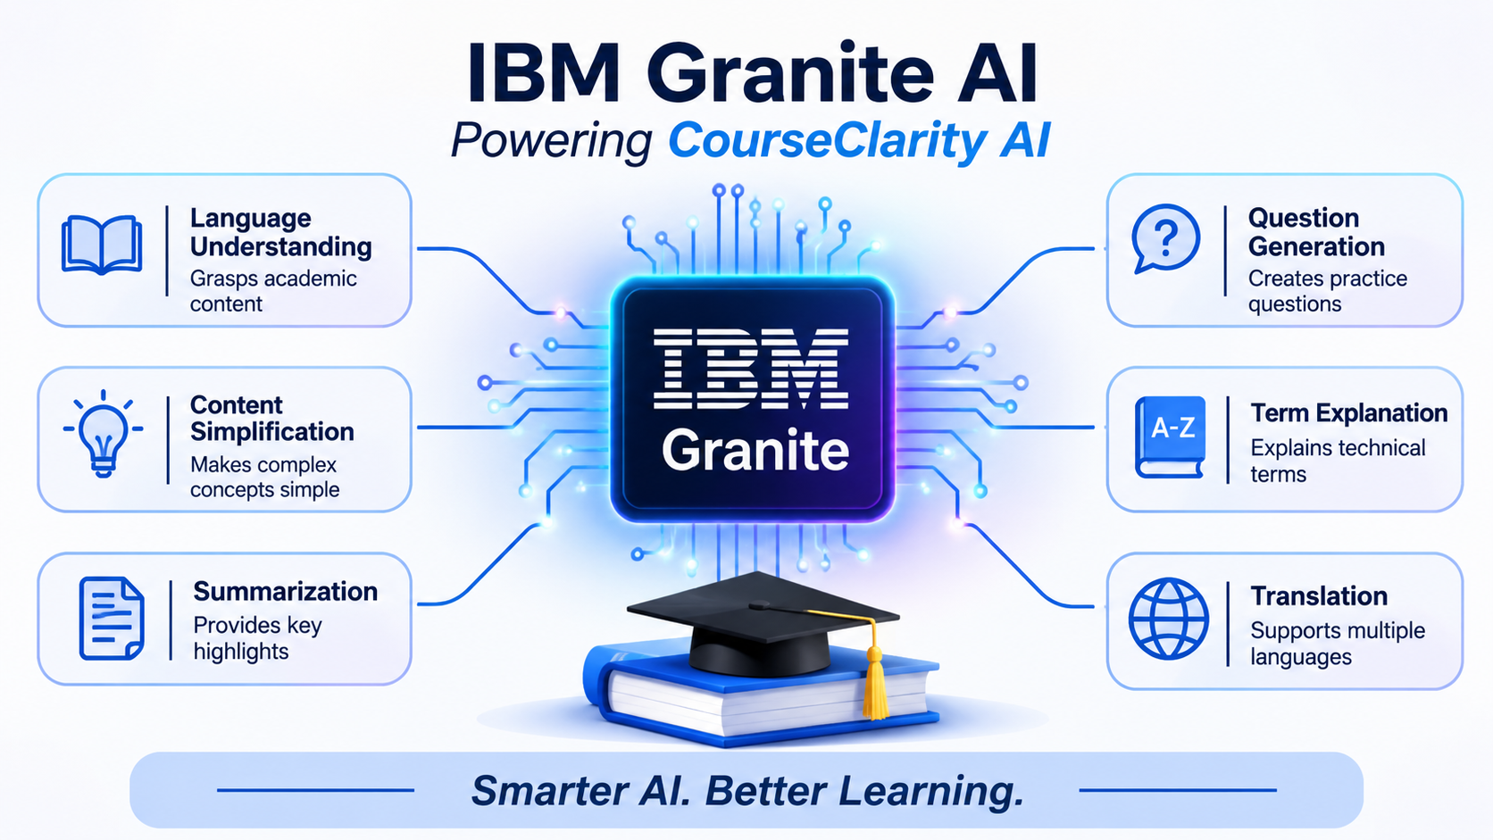
Role of IBM Granite AI in CourseClarity AI
Role of IBM Granite AI in CourseClarity AI
IBM Granite acts as the core language model behind CourseClarity AI. It processes the educational content supplied by users and generates outputs based on task-specific instructions. Its role includes:
Language Understanding: Processes academic text and identifies the context of the supplied content.
Content Simplification & Summarization: Rewrites complex explanations using easier language and produces concise overviews and important points.
Question Generation & Term Explanation: Creates practice questions and generates simple explanations of technical terminology.
Translation & Note: Helps make content available in different languages. The current implementation is a model-powered application with a defined workflow, rather than an autonomous multi-agent system.

Slide 10
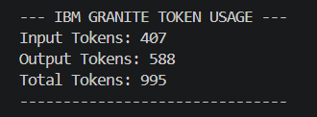
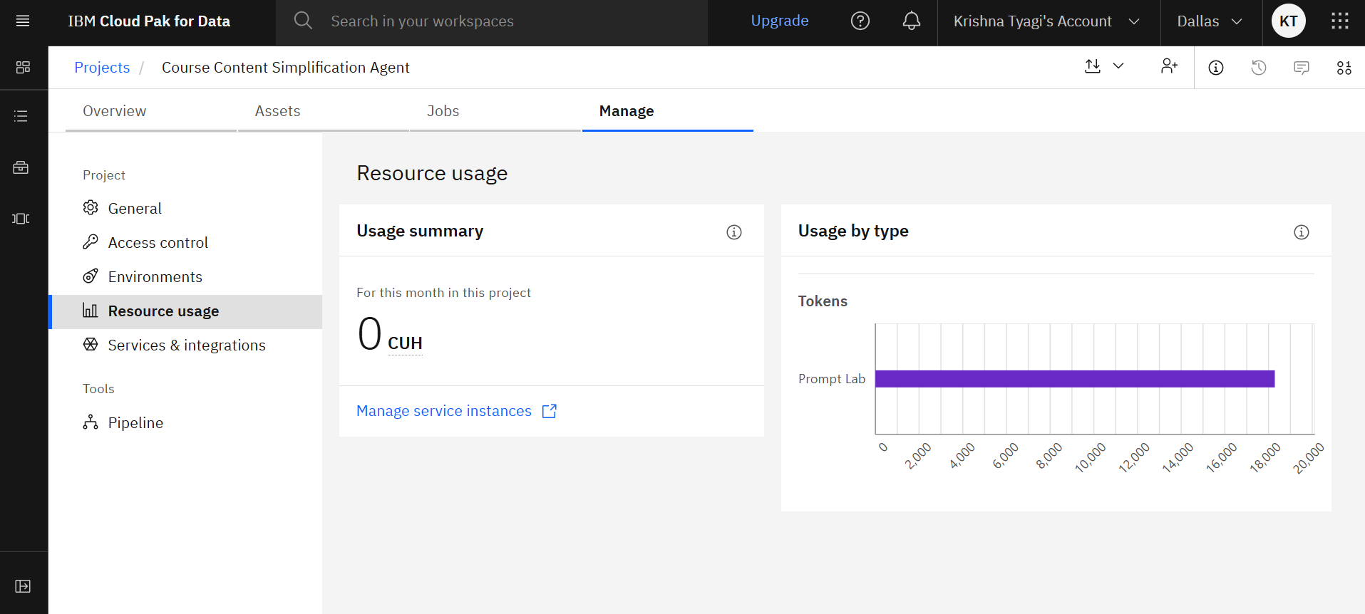
Token Usage Initially, token consumption was not directly visible in the IBM Cloud dashboard. To improve monitoring, token usage was extracted from the IBM Granite API response and displayed through the Python application.
Actual Usage During Testing:
Input Tokens: 407
Output Tokens: 588
Total Tokens: 995
Key Outcome: Implemented token-level monitoring to track AI input and output consumption, providing better visibility into model usage.

Slide 11
Novelty and Uniqueness
CourseClarity AI combines multiple AI-powered learning-support functions in a single, user-friendly application.
1. Multiple Learning Tools – Provides simplification, summarization, quiz generation, glossary creation and translation in one platform.
2. Learner-Level Adaptation – Supports General Audience, High School, Undergraduate and Postgraduate proficiency levels.
3. Document-Based Learning – Allows users to work with pasted text and uploaded PDF/DOCX documents.
4. Interactive Learning Support – Generates practice questions and explanations to support self-assessment.
5. IBM Granite Integration – Uses IBM's foundation model through watsonx.ai for language-based content generation.
6. Simple User Experience – Provides an accessible web interface through Streamlit.
The key value is the ability to transform complex academic content into several useful learning formats through one application.

Slide 12
Git Hub Link
Project Name: CourseClarity AI | Deployment Platform: Streamlit Community Cloud
GitHub Repository: https://github.com/krishnatyagi824-ship-it/CourseClarity-AI-Through-IBM-BOB
Repository Contents: Application source code, requirements.txt, README.md, app.json, Problem statement PDF, Project presentation. API keys and credentials are not included — maintained using secure configuration.
·
·
·

Slide 13
Future Scope
1. Retrieval-Augmented Generation (RAG) – Integrate approved educational resources for source-grounded answers.
2. Source-Based Question Answering – Allow students to ask questions about uploaded material with source-supported answers.
3. Improved Output Evaluation – Introduce testing methods to evaluate accuracy, readability, completeness and relevance.
4. Expanded Multilingual Support – Improve accessibility with additional languages and better translation options.
5. Learning Management System Integration – Explore integration with institutional learning platforms to support students and educators.
6. Personalized Learning Experience – Explore adaptive content generation based on learner preferences and progress.
(These are proposed enhancements and are not features of the current version.)
·
·
·

Slide 14
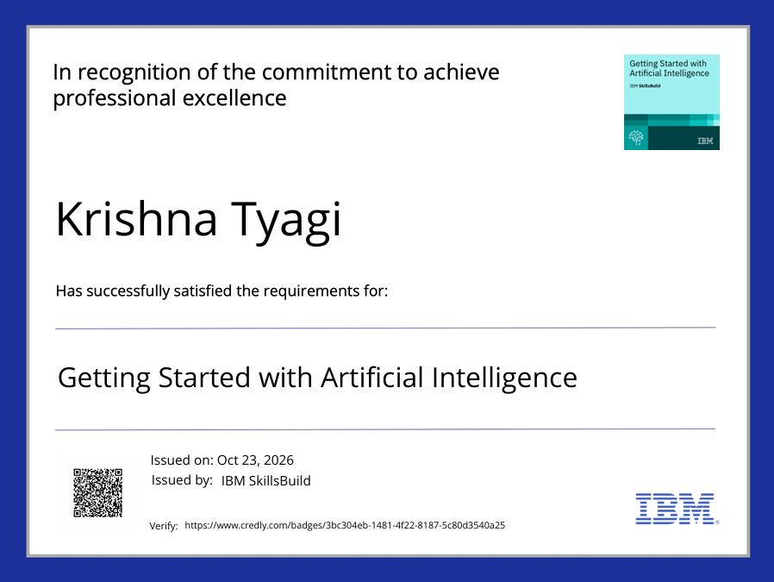
Certificates Earned:
Please add your credly certificate

Slide 15
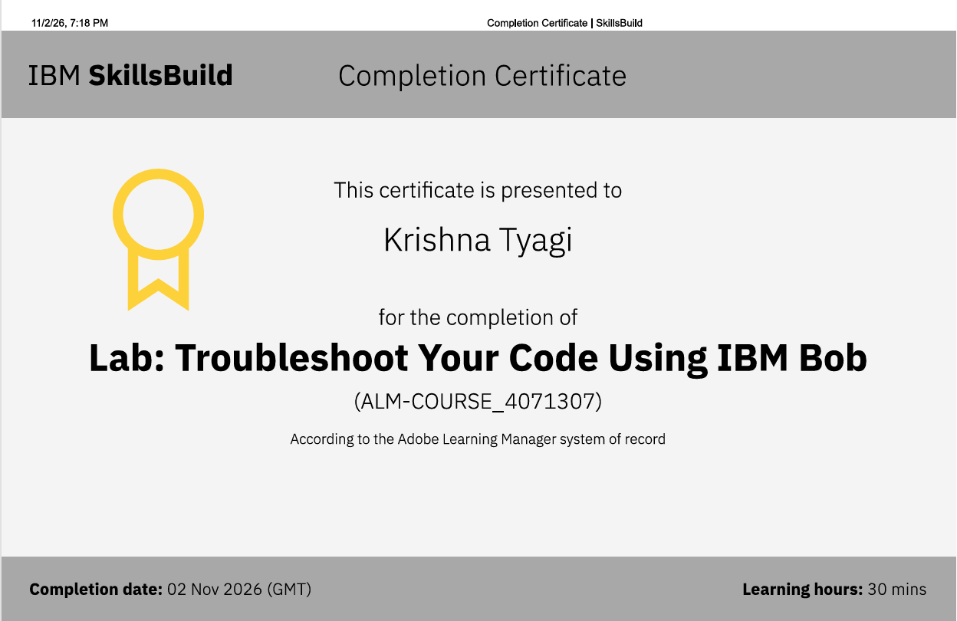
Certificates Earned:​
Add your IBM BOB Certificate

Slide 16


