Slide 1
POST-MERGER INTEGRATION
PMI Plan: Key Phases & Synergy Tracking
Asuccessful integration requires astructuredapproach,focusingonstabilization,systemsalignment,andcommercial
integration to unlock full synergy potential.
1
2
3
Month 1-2: Stabilize
Month 3-4: Systems
Month 5-6: Commercial Integration
Ensure business continuity, secure key talent, and establish immediate communication channels.
Integrate core operational systems, standardize processes, and align IT infrastructure.
Merge sales, marketing, and customer support functions to optimize market reach and client engagement.

Slide 2

Tracking Synergy Realization
Quantifiablemetricswilldriveaccountabilityandensurethatexpectedsynergies translate into tangible value post-acquisition.
Synergy Type
Target (12 Months)
Q1 Status
Q2 Status
Cost Savings
Revenue Growth Operational Efficiency Market Share
15% Reduction
10% Increase 20% Improvement 5% Expansion
3% Achieved
2% Achieved 5% Achieved 1% Achieved
8% Achieved
5% Achieved 12% Achieved 2.5% Achieved
Regular monitoring and reporting will highlight progress and allow for timely adjustments to integration strategies.

Slide 3

RISK ASSESSMENT
Key Risks & Mitigation Strategies
Addressingpotentialchallengesproactivelyiscriticalforsafeguardingtheinvestmentand ensuring a smooth transition.
Risk
Probability
Impact
Mitigation Strategy
Integration exceeds 6-month window
Founders exit
despite retention
clause Synergies don't
materialize in 12
months Key client
concentration at
target Overpayment /
Valuation risk
Medium
High
Dedicated PMI team, clear milestones, external integration consultants, agile project management.
Enhanced golden handcuffs, performance incentives,
structured handover process, strong internal succession
planning. Rigorous synergy tracking, cross-functional accountability,
regular review meetings, contingency plans for
underperforming areas. Diversification strategy post-acquisition, relationship
management overlap, contract review and renegotiation,
value proposition enhancement. Thorough due diligence, multiple valuation models, earn-
out structures linked to performance, expert third-party
review. Cost optimization initiatives, pricing strategy review,
operational efficiency improvements, economies of scale
leveraging.
Low
High
Medium
High
High
Medium
Low
High
Post-acquisition
margin dilution
Medium
Medium

Slide 4
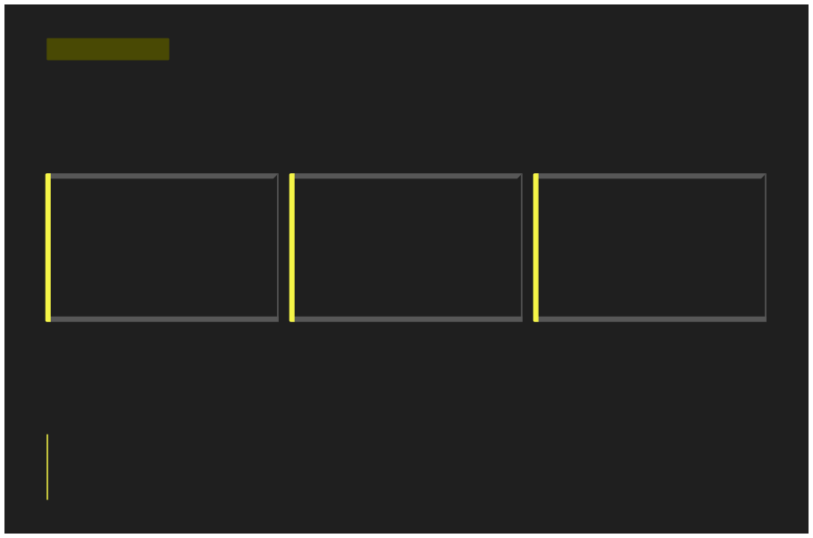
ACQUISITION OUTLOOK
Final Recommendation
Basedon comprehensiveduediligenceandstrategicalignment, the acquisition presents a compelling opportunity for market
expansion andvaluecreation.
Strategic Market Entry
Synergistic Value Proposition
Strengthened Talent & IP
The target provides immediate
access to a rapidly growing market
segment, accelerating our strategic
objectives.
Acquisition includes key human
capital and proprietary
technologies that will drive future
innovation.
Integration promises significant operational efficiencies and expanded customer offerings, enhancing competitive advantage.
ACQUIRE ✅
Approval is contingent upon successful negotiation of earn-out provisions, retention of key founders for a minimum of 3 years, and integration cost adherence within 10% of projected budget.

