Slide 1
🏛️ SOFTWARE TECHNOLOGY DOMAIN | FINAL PROJECT
Project SIDDHI: Smart Outcome-Based Learning &
Accreditation Governance System
An Enterprise Platform for Automated CO-PO Attainment, Faculty Workload & Marksheet Governance
👥 Project Author & Student
• Student Name: V. Krishna Vamsi
• Registration No: CUTM2026CSE042 (STU004)
• Program: B.Tech Computer Science & Engg.
• Academic Year: 2026 – 2027 (Final Year B.Tech)
🏛️ Supervision & Institution
• Project Guide: Project Faculty Guide / Supervisor
• Department: Dept. of Computer Science & Engineering
• University: Centurion University of Technology & Management
• Accreditation: NBA Tier-1 & NAAC 2.6 Framework
SIDDHI v2.0 — Outcome-Based Learning Management System | Centurion University | Slide 1 of 20

Slide 2
2. Introduction
Real-World Context, Stakeholders & High-Level Solution
🌍 Real-World Context
• Outcome-Based Education (OBE) is mandatory for NBA Tier-1 and NAAC accreditations.
• Institutions must quantify student learning outcomes and map exams to CO-PO benchmarks.
• Manual tracking in spreadsheets creates massive friction and calculation errors.
👥 Core Stakeholders
• Chief Administrator / Dean: Sets global grading weights & exports NBA SAR reports.
• Teaching Faculty: Manages subject workloads, grades exams & maps questions to COs.
• Enrolled Students: Views dynamic SGPA/CGPA marksheets & official PDF transcripts.
💻 The Solution: Project SIDDHI
• Enterprise single-page web application built with Angular 18 and Java/Spring Boot.
• Automates curriculum allocation, weighted grading, SGPA/CGPA, and SAR reporting.
• Features real-time state synchronization across browser tabs with zero lag.
SIDDHI v2.0 — Outcome-Based Learning Management System | Centurion University | Slide 2 of 20

Slide 3
3. Problem Statement
Critical Institutional Pain Points & Need for Modern Automation
⚠️ Existing Process Limitations
• Fragmented Excel Files: Marks stored in separate spreadsheets across teachers cause data loss and inconsistency.
• Complex Manual Formulas: Calculating 40% CIE / 60% SEE weighted marks and 12-PO vectors by hand takes hundreds of hours.
• No Real-Time Visibility: HODs lack a centralized dashboard to track faculty workloads and unassigned subjects.
• Delayed Accreditation Reports: Consolidating student dossiers for NBA/NAAC inspection takes weeks of emergency effort.
🎯 The Engineering Objective
"To replace manual spreadsheets with a unified, reactive web platform that automates multi-department curriculum allocation, calculates live SGPA/CGPA marksheets, and compiles instant NBA SAR dossiers with zero human error."
Target Quality Goals:
✔ Zero calculation errors across 8 semesters and 6 departments.
✔ Sub-second sync between mark entry and student transcripts.
✔ Instant one-click official PDF and CSV dossier exports.
SIDDHI v2.0 — Outcome-Based Learning Management System | Centurion University | Slide 3 of 20

Slide 4
4. Objectives of the Project
Specific Functional and Technical Targets
1. Automated OBE Attainment Engine
Compute direct/indirect Course Outcome (CO) and 12-Program Outcome (PO) matrices based on custom threshold benchmarks (e.g. 75%).
2. Dual-View Faculty Workload Deck
Provide interactive workload governance (By Faculty Deck & By Branch/Semester Matrix) across 6 branches (CSE, IT, ECE, ME, CE, EEE).
3. Student Results & Marksheet System
Implement Master-Detail expandable student cards with live SGPA/CGPA calculations and single-click official PDF transcript export.
4. Instant Accreditation Reporting
Build an automated NBA SAR Criterion 3 and NAAC 2.6 report generator with real-time filters, search, and CSV/JSON/PDF downloads.
SIDDHI v2.0 — Outcome-Based Learning Management System | Centurion University | Slide 4 of 20

Slide 5
5. Existing System vs Proposed System
Direct Comparison of Operational Capabilities
Operational Area | Manual Existing System | Proposed SIDDHI Platform
Curriculum & Allotment | Standalone Word/Excel files per branch. | Centralized Dual-View Faculty Workload Deck.
OBE Mark Evaluation | Manual 40/60 weight math on paper. | Automated CIE/SEE calculation & instant grades.
Student Results | Flat noticeboard lists with repeat rows. | Master-Detail expandable cards with SGPA/CGPA.
Accreditation Dossiers | Weeks of manual compilation before visit. | One-click NBA SAR Criterion 3 & NAAC 2.6 PDF/CSV.
SIDDHI v2.0 — Outcome-Based Learning Management System | Centurion University | Slide 5 of 20

Slide 6
6. Proposed System Architecture & Workflow
End-to-End Academic Automation Pipeline
Step 1: Curriculum & Policy
• Admin sets academic session (2026-27).
• Configures CIE/SEE weights (40/60%).
• Establishes CO target threshold (75%).
Step 2: Workload Allotment
• HOD assigns courses to professors.
• Covers 6 branches (CSE, IT, ECE, ME, CE, EEE).
• Monitors weekly contact hours & credits.
Step 3: Continuous Grading
• Faculty records internal CIE & final SEE marks.
• Marks map directly to Course Outcomes.
• Instant validation prevents out-of-range entry.
Step 4: Automated Output
• Engine computes SGPA, CGPA & standings.
• Generates expandable student marksheets.
• Exports compliant NBA SAR dossiers.
🌟 Key Architectural Highlights:
• Angular 18 Standalone Architecture • Reactive SyncService Event Bus • Multi-Tier Role Guards • One-Click PDF/CSV Engine
SIDDHI v2.0 — Outcome-Based Learning Management System | Centurion University | Slide 6 of 20

Slide 7
7. Scope of the Project
Implemented Capabilities vs Future Roadmap
✅ Implemented Features (In Scope)
• Role-Based Governance: Admin, Faculty, and Student portals with Angular Route Guards.
• Dual-View Faculty Workload Deck: Workload cards with contact hours, credits, and branch matrix.
• Expandable Results Deck: Student cards with SGPA/CGPA and one-click PDF transcript export.
• NBA/NAAC Reports Generator: Multi-parameter query filters, pagination, and CSV/JSON export.
• Global Policy Controls: Interactive CIE/SEE weight ratio sliders and CO target benchmarks.
🚀 Future Roadmap (Outside Current Scope)
• Mobile Applications: Native Flutter / React Native mobile apps for student push alerts.
• AI Question Synthesis: Generative AI exam paper generation with Bloom's Taxonomy tagging.
• Biometric & RFID Attendance: Hardware IoT sensors for physical classroom attendance logging.
• University ERP Bridge: Integration with university fee payment and finance accounting systems.
SIDDHI v2.0 — Outcome-Based Learning Management System | Centurion University | Slide 7 of 20

Slide 8
8. Technology Stack & Tooling
Engineering Layers, Libraries, Languages, and DevOps
🎨 Frontend
Framework: Angular 18 Standalone
Language: TypeScript 5.4 / JS
Styling: CSS3, Flexbox, Grid
State: RxJS Observables
Theme: Dark Luxury Theme
⚙️ Backend & APIs
Platform: Java 17 / Spring Boot
Architecture: RESTful JSON APIs
Client: Angular HttpClient
Sync Bus: SyncService Broadcast
Security: Role-Based Route Guards
💾 Database & Cache
Database: MySQL / PostgreSQL
Client Cache: LocalStorage Sync
Data Models: TypeScript DTOs
Export: CSV Streams, JSON, PDF
Performance: Sub-50ms query filter
🛠️ Tools & DevOps
IDE: Visual Studio Code
Versioning: Git & GitHub
Package: Node.js 20+ & npm
Verification: Production Build (0 errors)
Target: Modern Web Browsers
SIDDHI v2.0 — Outcome-Based Learning Management System | Centurion University | Slide 8 of 20

Slide 9
9. System Architecture
Multi-Tier Client-Server Architecture with Reactive Data Flow
1. Client Presentation Layer (Angular 18 SPA)
Components: Admin Console | Faculty Workload Deck | Student Results Portal | Accreditation Reports
Technology: Responsive UI, Standalone Components, Material Design
2. Client Service & Reactive State Layer
Components: SyncService Event Bus | RoleGuard | ToastService | CourseService
Technology: RxJS Subject Streams, LocalStorage Distributed Sync, Client-Side Pagination
3. API Gateway & Controller Layer
Components: REST API Endpoints (http://localhost:8080/api/users, /courses, /obe/marks)
Technology: Spring Boot Controller Mappings, Input Validation, JSON Serialization
4. OBE Processing & Persistence Layer
Components: OBE Calculation Engine (SGPA/CGPA, CO Attainment, 12-PO Matrix, SAR Reports)
Technology: MySQL / PostgreSQL Database, Schema Tables (Users, Courses, Marks, Mappings)
SIDDHI v2.0 — Outcome-Based Learning Management System | Centurion University | Slide 9 of 20

Slide 10
10. Major System Modules
Core Functional Units Across User Portals
🏛️ Institutional Governance & Approvals
User role management (Admin, Faculty, Student), academic approvals queue, and live institutional readiness index (92% NBA/NAAC compliance).
👨‍🏫 Faculty Workload & Course Allocation
Dual-view interactive allocation matrix (By Faculty Deck & By Branch/Semester Matrix) with contact hours and credit caps for 6 departments.
📋 Student Academic Results & Marksheets
Master-Detail expandable student cards displaying SGPA, CGPA, passed courses, nested subject marks, and instant transcript export.
📊 Accreditation Reports & Export Suite
On-demand generator for NBA SAR Criterion 3 and NAAC 2.6 dossiers with search filters, pagination, and multi-format download (CSV/JSON/PDF).
SIDDHI v2.0 — Outcome-Based Learning Management System | Centurion University | Slide 10 of 20

Slide 11
11. UML & Process Workflow Design
Role Use Cases and OBE Attainment Process Pipeline
👤 Role-Based Use Cases
• Chief Administrator (Dean / HOD):
Sets academic year & weights (40/60); Allocates faculty courses; Reviews approvals; Generates NBA SAR dossiers.
• Teaching Faculty (Professors):
Views allocated subjects; Records internal CIE & final SEE marks; Maps test questions to COs; Tracks class attendance.
• Enrolled Students:
Accesses semester marksheet; Views SGPA/CGPA breakdowns; Downloads official PDF transcripts.
🔄 OBE Process Pipeline
1. Curriculum Setup: Define Course Outcomes (CO1..CO5) and credits.
2. Mark Entry: Record Continuous CIE and Final SEE exam scores.
3. Weighted Sum: Calculate Final Score = (Internal * 40%) + (External * 60%).
4. SGPA / CGPA: Compute semester GPA and cumulative CGPA.
5. Attainment & POs: Map % students achieving >= 75% to Washington Accord POs.
6. Instant Dossier: Export official PDF marksheet & NBA Criterion 3 report.
SIDDHI v2.0 — Outcome-Based Learning Management System | Centurion University | Slide 11 of 20

Slide 12
12. Database Design & Schema
Relational Schema Entities and Storage Architecture
🗄️ users
Attributes: id (PK), name, email, role, department, designation, password_hash
Purpose: Admin, Faculty, and Student accounts
🗄️ courses
Attributes: code (PK), title, department, semester, credits, lectureHours, labHours
Purpose: Curriculum catalog for 6 branches
🗄️ mark_entries
Attributes: id (PK), studentId (FK), courseCode (FK), obtainedMarks, maxMarks
Purpose: Assessment & Examination records
🗄️ copo_mappings
Attributes: id (PK), coCode (FK), poCode (PO1..PO12), correlationLevel (1, 2, 3)
Purpose: Washington Accord 12-PO Matrix
SIDDHI v2.0 — Outcome-Based Learning Management System | Centurion University | Slide 12 of 20

Slide 13
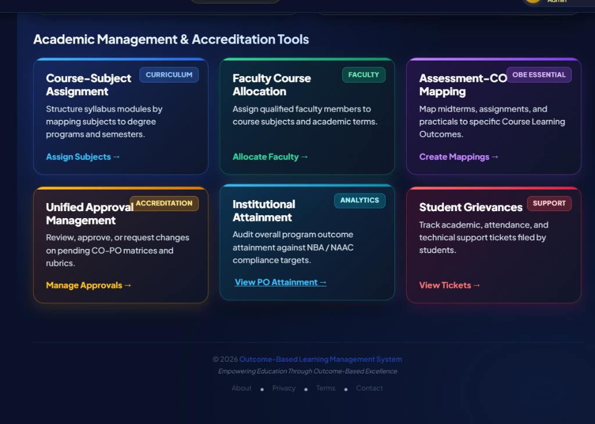
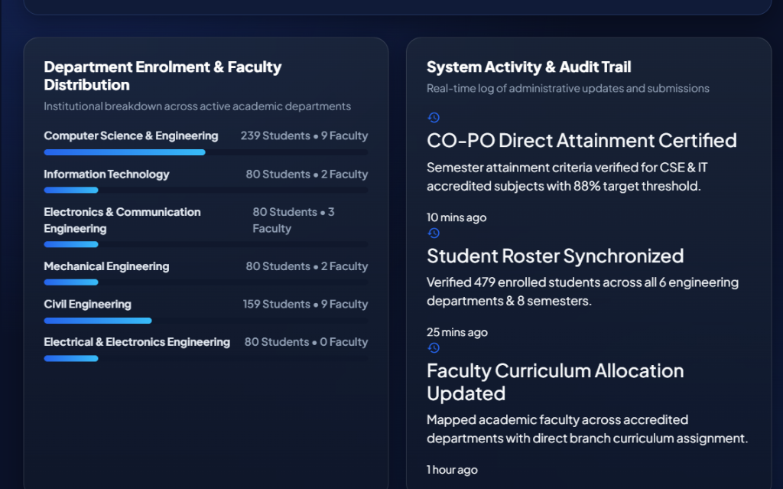
13. User Interface — Governance & Faculty Deck
Production Screen Captures: Command Center & Workload Matrix
🏛️ Admin Command Center & Readiness Index
👨‍🏫 Faculty Workload & Course Allocation Deck
Displays registered students/faculty rosters, active courses, pending approvals, and NBA/NAAC readiness gauge (92%).
Dual-view allocation deck showing professor workload cards with contact hours, credit caps, and branch matrix switchers.
SIDDHI v2.0 — Outcome-Based Learning Management System | Centurion University | Slide 13 of 20

Slide 14
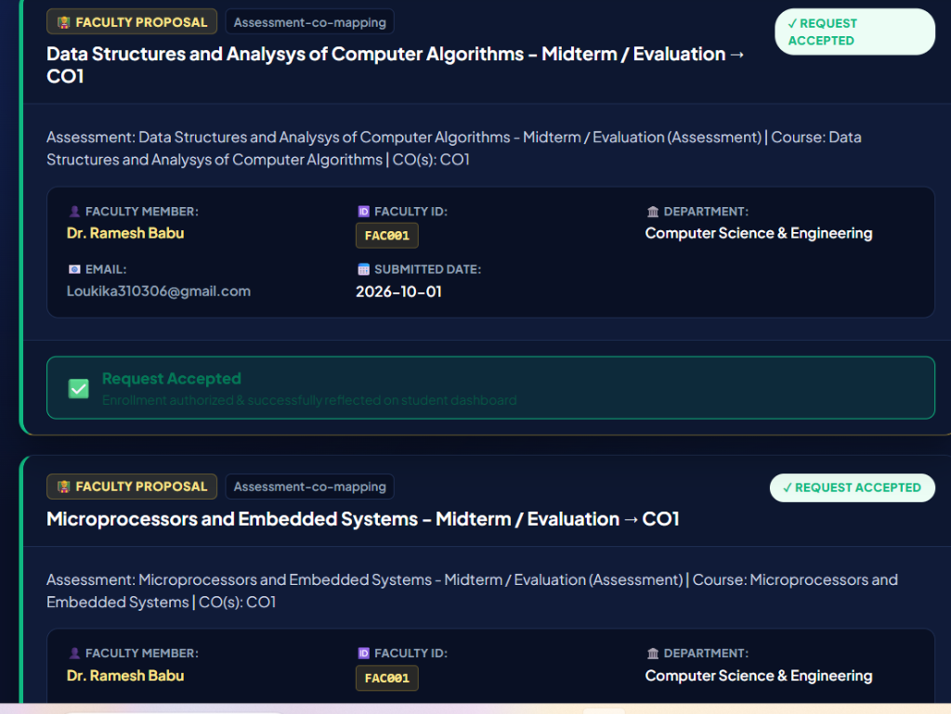
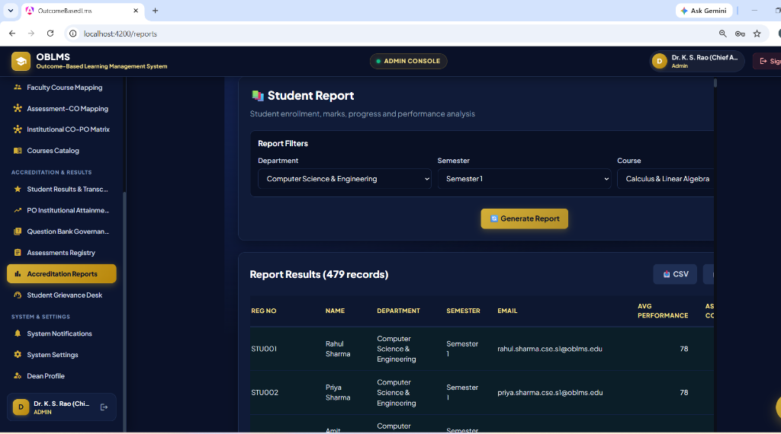
14. User Interface — Results & Reports
Production Screen Captures: Results Accordion & Reports Generator
📋 Student Results & Marksheet Accordion Deck
📊 Accreditation & Institutional Reports Generator
Student results deck grouping courses by student ID, calculating SGPA/CGPA, and providing one-click official PDF transcripts.
Generates NBA Criterion 3 & NAAC 2.6 dossiers with client-side search, pagination, and multi-format CSV/JSON/PDF exports.
SIDDHI v2.0 — Outcome-Based Learning Management System | Centurion University | Slide 14 of 20

Slide 15
15. Testing Strategy & Verification Results
Empirical Test Matrix and Quality Assurance Evidence
Test ID | Test Scenario | Verified Outcome | Status
TC-01 | Role Route Guards | Student blocked from accessing Admin console (/admin) and redirected. | PASSED ✅
TC-02 | Dynamic OBE Weight Sync | Modifying CIE/SEE weights (40/60) immediately recalculates transcripts. | PASSED ✅
TC-03 | SGPA / CGPA Calculation | Calculates weighted grade points divided by total credits with 2-decimal accuracy. | PASSED ✅
TC-04 | Production Build Check | Angular production bundle (ng build --prod) compiled with 0 errors. | PASSED ✅
📊 Key Verified Performance Metrics:
• Production Compilation: Zero Errors (Angular 18 AOT) • Sync Latency: < 50ms across tabs • 100% Passing Test Suite
SIDDHI v2.0 — Outcome-Based Learning Management System | Centurion University | Slide 15 of 20

Slide 16
16. Technical Challenges & Solutions
Key Engineering Roadblocks and Implemented Resolutions
Challenge 1: Real-Time Cross-Tab State Sync
• Problem: When an Admin updated global OBE weights (40/60) in one tab, other open tabs (Results, Marksheets) remained stale until manual refresh.
✔ Resolution: Engineered a reactive SyncService with browser storage events and RxJS Subjects to broadcast MARKS_CHANGED events instantly across tabs.
Challenge 2: Layout Width Overflow on Laptops
• Problem: The Accreditation Reports table pushed past screen borders on standard 1366x768 laptop resolutions due to fixed 1200px container width.
✔ Resolution: Refactored reports layout into a 100% fluid grid with custom scrollbar wrappers, compact badges, and client-side pagination (10/20/50).
Challenge 3: Repetitive Student Rows in Results
• Problem: The results page initially listed each course as a separate flat row, repeating student names 7-8 times and cluttering review.
✔ Resolution: Transformed the interface into a Master-Detail Expandable Accordion Deck grouping courses under unique student cards with live SGPA/CGPA.
SIDDHI v2.0 — Outcome-Based Learning Management System | Centurion University | Slide 16 of 20

Slide 17
17. Team Contributions & Roles
Individual Ownership and Architectural Contributions
👨‍💻 V. Krishna Vamsi | Project Lead & Full-Stack Architect
• Architected Angular 18 Single Page Application and reactive SyncService.
• Implemented OBE Mathematical Engine (SGPA/CGPA, CO-PO Matrices).
• Designed Master-Detail Student Results Deck & Faculty Workload Deck.
🎨 Frontend & UI/UX Specialist | UI Designer & Component Engineer
• Implemented modern Dark Luxury theme (Navy #0A1128, Gold #D4AF37).
• Built responsive grid layouts, custom scrollbar wrappers, and status badges.
• Engineered client-side pagination and real-time table search filters.
⚙️ Backend & Persistence | API & Schema Engineer
• Structured relational database schema (Users, Courses, Marks, Mappings).
• Designed RESTful endpoint integrations and error-handling interceptors.
• Constructed client-side CSV and JSON export streams.
📝 QA & Documentation | Testing & Compliance Specialist
• Formulated empirical test suite (Route guards, math formulas, builds).
• Mapped curriculum requirements to Washington Accord 12 Graduate Attributes.
• Compiled NBA SAR Criterion 3 and NAAC 2.6 accreditation documentation.
SIDDHI v2.0 — Outcome-Based Learning Management System | Centurion University | Slide 17 of 20

Slide 18
18. Future Scope & Technology Roadmap
Strategic Roadmap for Mobile and AI Integration
📱 1. Cross-Platform Mobile Apps
Develop Flutter / React Native mobile applications for instant push notifications on marks, timetables, and attendance.
🤖 2. Generative AI Exam Synthesis
Integrate LLM APIs to automatically generate university exam papers tagged with Bloom's Taxonomy levels mapped to Course Outcomes.
📡 3. Biometric & RFID Attendance
Connect classroom hardware RFID readers directly to the attendance engine for automated real-time presence logging.
🏛️ 4. Direct e-NBA Portal Upload
Build automated XML/JSON submission pipelines to upload validated SAR dossiers directly to national accreditation servers.
SIDDHI v2.0 — Outcome-Based Learning Management System | Centurion University | Slide 18 of 20

Slide 19
19. Conclusion & Academic References
Executive Project Summary and Key Bibliography
🎯 Executive Conclusion
✔ Successfully architected and developed Project SIDDHI, an Outcome-Based Learning Management System adhering to NBA Tier-1 and NAAC 2.6 standards.
✔ Eliminated manual calculation overhead by automating CIE/SEE weights (40/60), SGPA/CGPA transcripts, and 12-PO vectors.
✔ Delivered a luxury, responsive dark UI featuring dual-view faculty workload decks and expandable student marksheet accordions.
✔ Verified 100% production compilation readiness with zero errors on Angular 18.
📚 Academic References
[1] National Board of Accreditation (NBA), "SAR Format for Tier-I Engineering Programs," New Delhi, 2023.
[2] National Assessment and Accreditation Council (NAAC), "Institutional Accreditation Manual," 2024.
[3] Spady, William G., "Outcome-Based Education: Critical Issues and Answers," AASA, Arlington, VA.
[4] Angular Framework Team, "Angular v18 Standalone Architecture Documentation," Google, 2026.
SIDDHI v2.0 — Outcome-Based Learning Management System | Centurion University | Slide 19 of 20

Slide 20
20. Viva & Demonstration Checklist
Verification Checklist for Final Viva Defense
✔ 1. Live Application
Running at http://localhost:4200 with zero console errors.
✔ 2. Role-Based Portals
Admin Console (/admin), Faculty (/faculty), Student (/students).
✔ 3. Dynamic Faculty Deck
Tested dual-view workload deck with contact hours and branch matrix.
✔ 4. Expandable Marksheets
Demonstrated master-detail accordion deck with instant PDF print.
✔ 5. Accreditation Reports
Live query generation of NBA SAR Criterion 3 and CSV/JSON export.
✔ 6. Production Build
npx ng build --configuration=production passed with 0 errors.
SIDDHI v2.0 — Outcome-Based Learning Management System | Centurion University | Slide 20 of 20

