Slide 1
SIDDHI:Outcome-Based Learning Management &
Accreditation Governance System (OBLMS)
DOMAIN- SOFTWARE TECHNOLOGY
Malla Loukika-240101120034
Dandela Naga Krishna Vamsi-240101120041
Taddi Santosh Vardhan-240101120021
Guided By-
Prof. Manoj Kumar Padhy
Prof.Biswaranjan Routray
TEAM MEMBERS

Slide 2
2. Introduction
🌍 Real-World Context
• Outcome-Based Education (OBE) is mandatory for NBA Tier-1 and NAAC accreditations.
• Institutions must quantify student learning outcomes and map exams to CO-PO benchmarks.
• Manual tracking in spreadsheets creates massive friction and calculation errors.
👥 Core Stakeholders
• Chief Administrator / Dean: Sets global grading weights & exports NBA SAR reports.
• Teaching Faculty: Manages subject workloads, grades exams & maps questions to COs.
• Enrolled Students: Views dynamic SGPA/CGPA marksheets & official PDF transcripts.
💻 The Solution: OBLMS
• Enterprise single-page web application built with Angular 18 and Java/Spring Boot.
• Automates curriculum allocation, weighted grading, SGPA/CGPA, and SAR reporting.
• Features real-time state synchronization across browser tabs with zero lag.

Slide 3
3. Problem Statement
⚠️ Existing Process Limitations
• Fragmented Excel Files: Marks stored in separate spreadsheets across teachers cause data loss and inconsistency.
• Complex Manual Formulas: Calculating 40% CIE / 60% SEE weighted marks and 12-PO vectors by hand takes hundreds of hours.
• No Real-Time Visibility: HODs lack a centralized dashboard to track faculty workloads and unassigned subjects.
• Delayed Accreditation Reports: Consolidating student dossiers for NBA/NAAC inspection takes weeks of emergency effort.
🎯 The Engineering Objective
"To replace manual spreadsheets with a unified, reactive web platform that automates multi-department curriculum allocation, calculates live SGPA/CGPA marksheets, and compiles instant NBA SAR dossiers with zero human error."
Target Quality Goals:
✔ Zero calculation errors across 8 semesters and 6 departments.
✔ Sub-second sync between mark entry and student transcripts.
✔ Instant one-click official PDF and CSV dossier exports.

Slide 4
4. Objectives of the Project
1. Automated OBE Attainment Engine
Compute direct/indirect Course Outcome (CO) and 12-Program Outcome (PO) matrices based on custom threshold benchmarks (e.g. 75%).
2. Dual-View Faculty Workload Deck
Provide interactive workload governance (By Faculty Deck & By Branch/Semester Matrix) across 6 branches (CSE, IT, ECE, ME, CE, EEE).
3. Student Results & Marksheet System
Implement Master-Detail expandable student cards with live SGPA/CGPA calculations and single-click official PDF transcript export.
4. Instant Accreditation Reporting
Build an automated NBA SAR Criterion 3 and NAAC 2.6 report generator with real-time filters, search, and CSV/JSON/PDF downloads.

Slide 5
5. Existing System vs Proposed System
Operational Area | Manual Existing System | Proposed OBLMS Platform
Curriculum & Allotment | Standalone Word/Excel files per branch. | Centralized Dual-View Faculty Workload Deck.
OBE Mark Evaluation | Manual 40/60 weight math on paper. | Automated CIE/SEE calculation & instant grades.
Student Results | Flat noticeboard lists with repeat rows. | Master-Detail expandable cards with SGPA/CGPA.
Accreditation Dossiers | Weeks of manual compilation before visit. | One-click NBA SAR Criterion 3 & NAAC 2.6 PDF/CSV.

Slide 6
6. Proposed System Architecture & Workflow
Step 1: Curriculum & Policy
• Admin sets academic session (2026-27).
• Configures CIE/SEE weights (40/60%).
• Establishes CO target threshold (75%).
Step 2: Workload Allotment
• Admin allocates courses & subjects to respective faculty.
• Covers 6 engineering branches (CSE, IT, ECE, ME, CE, EEE).
• System automatically computes faculty weekly contact hours & credits.
Step 3: Continuous Grading
• Faculty records internal CIE & final SEE marks.
• Marks map directly to Course Outcomes.
• Instant validation prevents out-of-range entry.
Step 4: Automated Output
• Engine computes SGPA, CGPA & standings.
• Generates expandable student marksheets.
• Exports compliant NBA SAR dossiers.

Slide 7
7. Scope of the Project
✅ Implemented Features (In Scope)
• Role-Based Governance: Admin, Faculty, and Student portals with Angular Route Guards.
• Dual-View Faculty Workload Deck: Workload cards with contact hours, credits, and branch matrix.
• Expandable Results Deck: Student cards with SGPA/CGPA and one-click PDF transcript export.
• NBA/NAAC Reports Generator: Multi-parameter query filters, pagination, and CSV/JSON export.
• Global Policy Controls: Interactive CIE/SEE weight ratio sliders and CO target benchmarks.
🚀 Future Roadmap (Outside Current Scope)
• Mobile Applications: Native Flutter / React Native mobile apps for student push alerts.
• AI Question Synthesis: Generative AI exam paper generation with Bloom's Taxonomy tagging.
• Biometric & RFID Attendance: Hardware IoT sensors for physical classroom attendance logging.
• University ERP Bridge: Integration with university fee payment and finance accounting systems.

Slide 8
8. Technology Stack & Tooling
Engineering Layers, Libraries, Languages, and DevOps
🎨 Frontend
Framework: Angular 18 Standalone
Language: TypeScript 5.4 / JS
Theme: Dark Luxury Theme
⚙️ Backend & APIs
Platform: Java 17 / Spring Boot
Architecture: RESTful JSON APIs
Client: Angular HttpClient
Sync Bus: SyncService Broadcast
Security: Role-Based Route Guards
💾 Database & Cache
Database: MySQL
Client Cache: LocalStorage Sync
Data Models: TypeScript
Export: CSV Streams, JSON, PDF
🛠️ Tools & DevOps
IDE: Visual Studio Code
Versioning: Git & GitHub
Package: Node.js 20+ & npm
Verification: Production Build (0 errors)
Target: Modern Web Browsers

Slide 9
9. System Architecture
Layer 1: Presentation Layer (Angular 18 Single Page App)
Role-Based Portals: Admin Governance Console, Faculty Command Center, Student Marksheet & Timetable Hub.
Smart Modules: AI Assistant Chatbot (Gemini Integration), Real-Time Attendance & Question Bank.
Tech Stack: Standalone Components, Material Icons, Responsive Luxury Dark UI.
2. Client Service & Reactive State Layer
Core Services: SyncService (Cross-Tab State Broadcast), AuthService (Role Guards & Route Security), ExportService (Instant PDF/CSV).
OBE Client Engine: Dynamic CIE/SEE (40:60) Weightage, SGPA/CGPA live recalculation, 12-PO Matrix Radar computation.
Tech Stack: RxJS Observable Streams, LocalStorage State Persistence.
Layer 3: Backend API & Business Logic Layer (Java Spring Boot)
REST Controllers: /api/auth, /api/courses, /api/assessments, /api/timetable, /api/attendance.
Security & Processing: Multi-tier Role Validation, JSON Serialization, Attendance & Timetable Multi-Branch Dispatcher.
Tech Stack: Spring Boot 3.x, Spring Web, Maven, JPA / Hibernate.
Layer 4: Data Persistence & Storage Layer (MySQL / Database)
Relational Schemas: users, courses, faculty_allocations, assessments, co_po_mappings, timetable_slots.
Data Integrity: Foreign key constraints, automated cascades, seed records across 6 engineering branches.
Storage Engines: MySQL RDBMS with ACID transaction compliance.

Slide 10
10. Major System Modules
🏛️ Institutional Governance & Approvals
User role management (Admin, Faculty, Student), academic approvals queue, and live institutional readiness index (92% NBA/NAAC compliance).
👨‍🏫 Faculty Workload & Course Allocation
Dual-view interactive allocation matrix (By Faculty Deck & By Branch/Semester Matrix) with contact hours and credit caps for 6 departments.
📋 Student Academic Results & Marksheets
Master-Detail expandable student cards displaying SGPA, CGPA, passed courses, nested subject marks, and instant transcript export.
📊 Accreditation Reports & Export Suite
On-demand generator for NBA SAR Criterion 3 and NAAC 2.6 dossiers with search filters, pagination, and multi-format download (CSV/JSON/PDF).

Slide 11
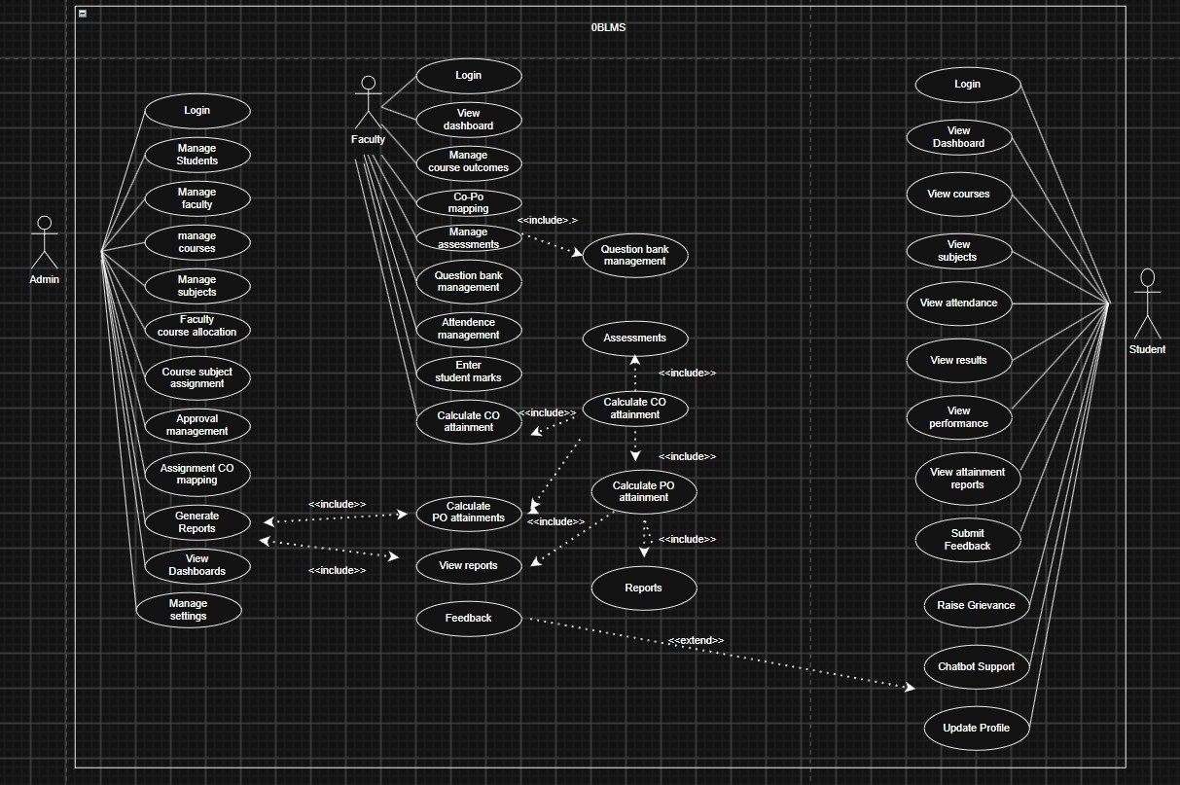
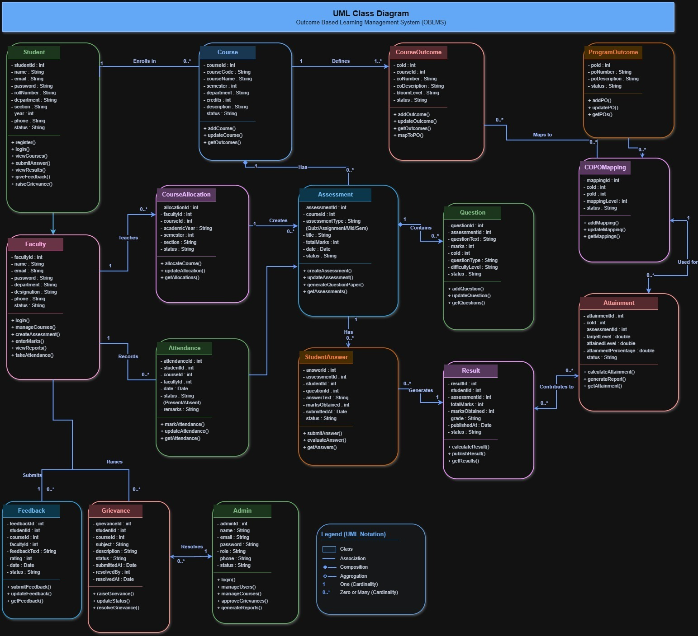
11. UML & Process Workflow Design
USE-CASE
UML-CLASS
LOGIN PAGE

Slide 12
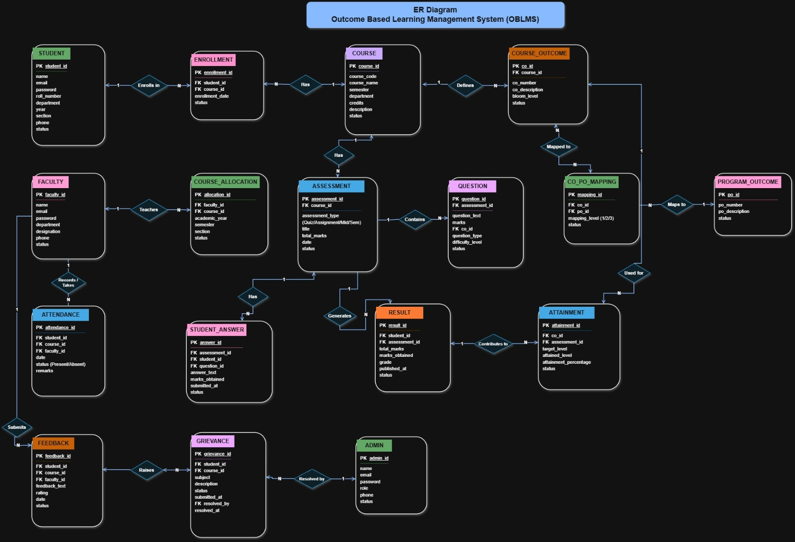
ENTITY RELATIONSHIP(ER DIAGRAM)

Slide 13
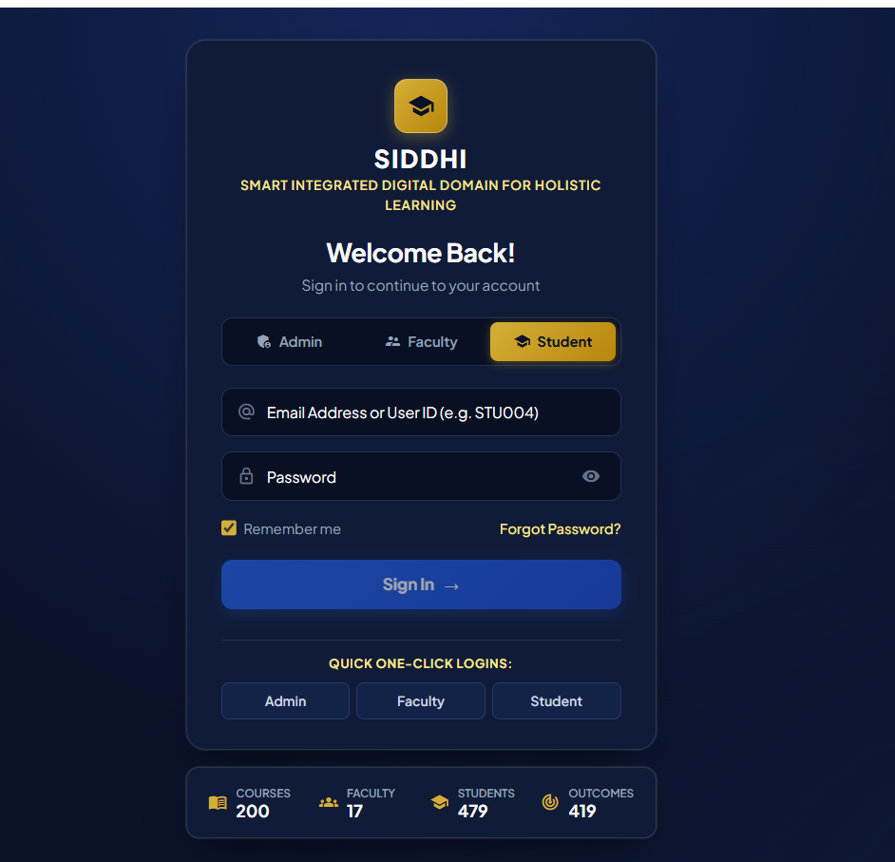
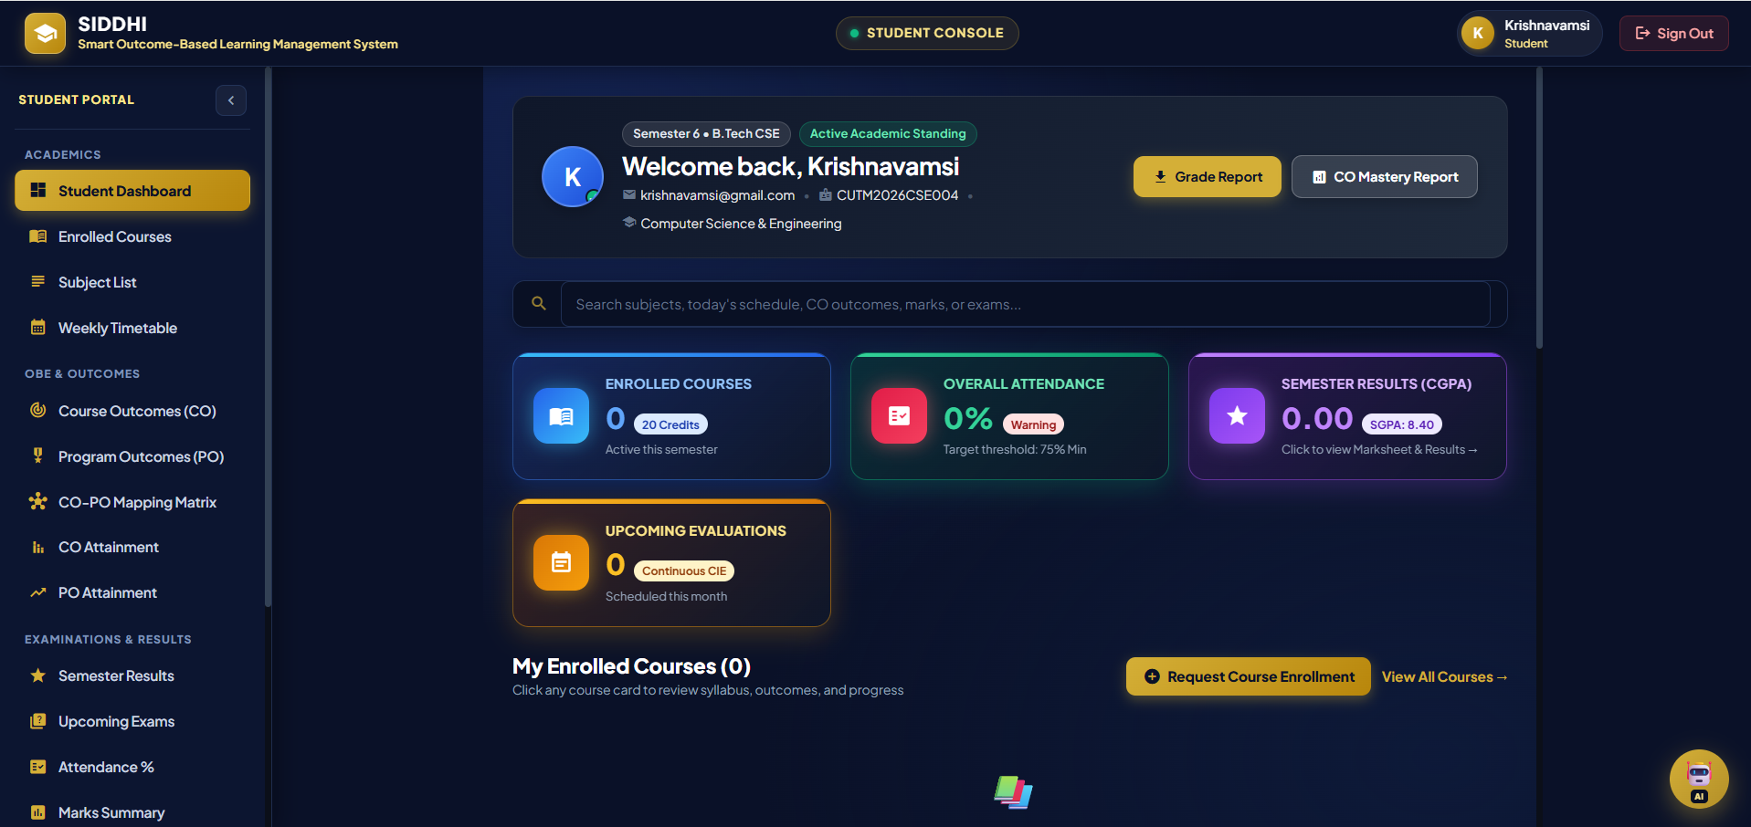
13. User Interface — LOGIN AND STUDENT
LOGIN PAGE

Slide 14
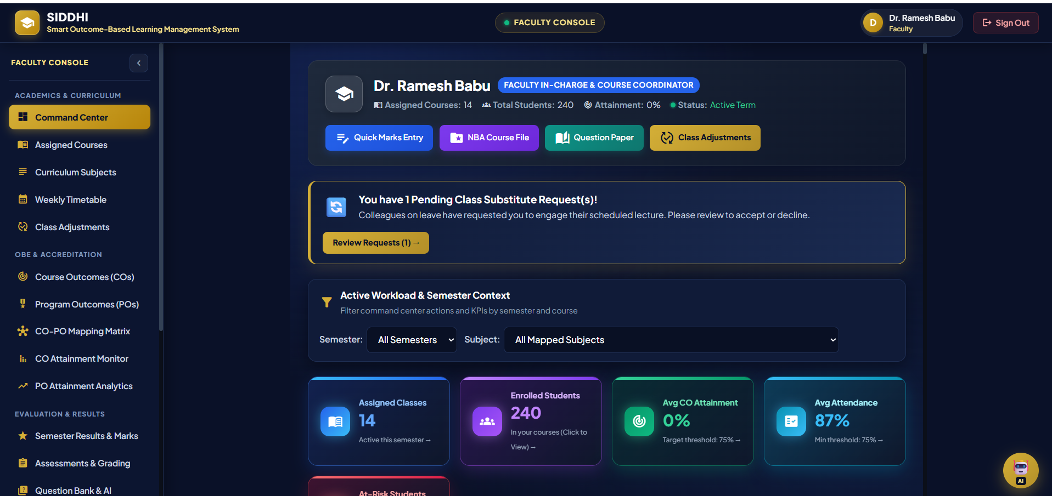
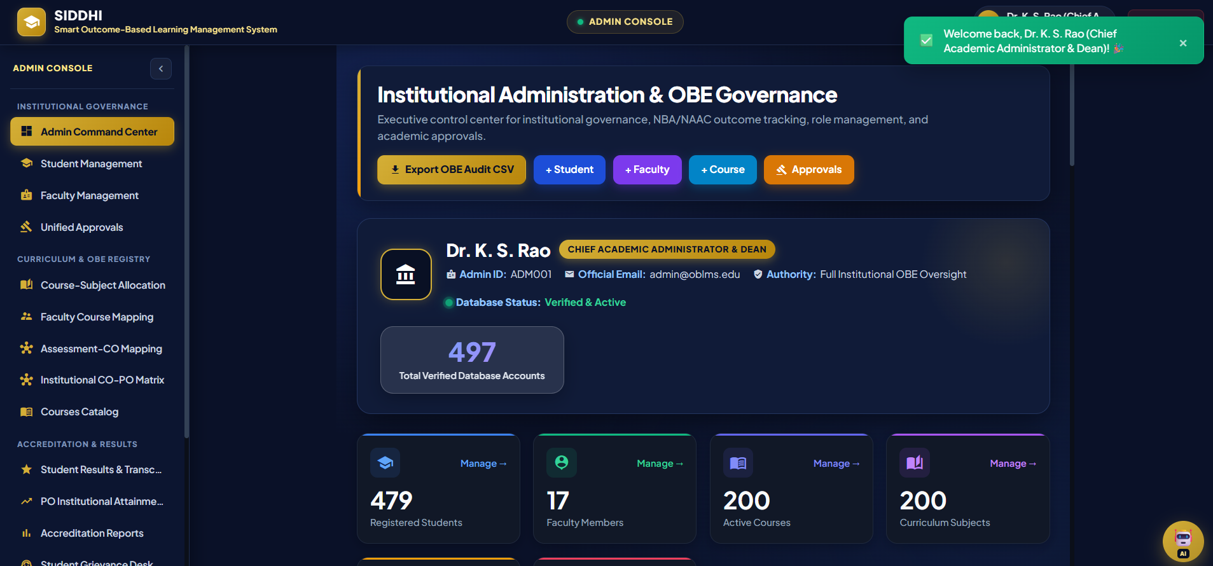
14. User Interface — FACULTY AND ADMIN

Slide 15
15. Testing Strategy & Verification Results
Test ID | Test Scenario | Verified Outcome | Status
TC-01 | Role Route Guards | Student blocked from accessing Admin console (/admin) and redirected. | PASSED ✅
TC-02 | Dynamic OBE Weight Sync | Modifying CIE/SEE weights (40/60) immediately recalculates transcripts. | PASSED ✅
TC-03 | SGPA / CGPA Calculation | Calculates weighted grade points divided by total credits with 2-decimal accuracy. | PASSED ✅
TC-04 | Production Build Check | Angular production bundle (ng build --prod) compiled with 0 errors. | PASSED ✅

Slide 16
16. Technical Challenges & Solutions
Challenge 1: Real-Time Cross-Tab State Sync
• Problem: When an Admin updated global OBE weights (40/60) in one tab, other open tabs (Results, Marksheets) remained stale until manual refresh.
✔ Resolution: Engineered a reactive SyncService with browser storage events and RxJS Subjects to broadcast MARKS_CHANGED events instantly across tabs.
Challenge 2: Layout Width Overflow on Laptops
• Problem: The Accreditation Reports table pushed past screen borders on standard 1366x768 laptop resolutions due to fixed 1200px container width.
✔ Resolution: Refactored reports layout into a 100% fluid grid with custom scrollbar wrappers, compact badges, and client-side pagination (10/20/50).
Challenge 3: Repetitive Student Rows in Results
• Problem: The results page initially listed each course as a separate flat row, repeating student names 7-8 times and cluttering review.
✔ Resolution: Transformed the interface into a Master-Detail Expandable Accordion Deck grouping courses under unique student cards with live SGPA/CGPA.

Slide 17
17. Team Contributions & Roles
👨‍💻 D. Krishna Vamsi
Admin & Governance Architecture Lead
Primary Module: Admin Console & Institution Governance
  Built Admin Dashboard for department-wise student/faculty allocation.
Engineering & Architecture Ownership:
  Database Schema Design: Relational database schema (users, courses, departments, enrollments).
  UML & System Modeling: Use Case Diagrams, Class Diagrams, and System Architecture Flowcharts.
  Security: Role-based routing guards & authentication tokens.
👨‍💻 T. Santosh Vardhan
Faculty Command Center & Attainment Lead
Primary Module: Faculty Command Center & CO-PO Attainment
  Built Faculty Course Workload deck (dual-view contact hours & weekly load).
  Implemented Continuous Internal Evaluation (CIE) and Semester End Exam (SEE) mark entry matrices.
Engineering & Architecture Ownership:
  Attendance & Timetable Engine: Multi-department timetable matrix and daily attendance logger.
  UML & Database: Entity-Relationship (ER) Diagrams, Activity Diagrams, and State Machine Diagrams.
👨‍💻 M.Loukika
Student Portal & AI Integration Lead
Primary Module: Student Results & Learning Hub
  Engineered Student Marksheet with expandable semester-wise grade accordions.
  Automated dynamic SGPA/CGPA calculation engine and instant PDF transcript generator.
  Built Student Timetable view.
Engineering & Architecture Ownership:
  AI Assistant Module: Integrated Google Gemini AI Chatbot (SIDDHI AI Assistant) for real-time academic queries.
  UML Diagrams: Sequence Diagrams & Data Flow Diagrams (DFD Level 0, 1, 2).
  Frontend Styling: Responsive Luxury Dark UI theme and Material Design styling.

Slide 18
18. Future Scope & Technology Roadmap
📱 1. Cross-Platform Mobile Apps
Develop Flutter / React Native mobile applications for instant push notifications on marks, timetables, and attendance.
🤖 2. Generative AI Exam Synthesis
Integrate LLM APIs to automatically generate university exam papers tagged with Bloom's Taxonomy levels mapped to Course Outcomes.
📡 3. Biometric & RFID Attendance
Connect classroom hardware RFID readers directly to the attendance engine for automated real-time presence logging.
🏛️ 4. Direct e-NBA Portal Upload
Build automated XML/JSON submission pipelines to upload validated SAR dossiers directly to national accreditation servers.

Slide 19
19. Conclusion & Academic References
🎯 Executive Conclusion
✔ Successfully built and deployed OBLMS, an Outcome-Based Learning Management System adhering to NBA Tier-1 and NAAC 2.6 standards.
✔ Eliminated manual calculation overhead by automating CIE/SEE weights (40/60), SGPA/CGPA transcripts, and 12-PO vectors.
✔ Delivered a luxury, responsive dark UI featuring dual-view faculty workload decks and expandable student marksheet accordions.
✔ Verified 100% production compilation readiness with zero errors on Angular 18.

Slide 20
Thanking You
~~~Have a good Day~~~

