Slide 1
🏛️ SOFTWARE TECHNOLOGY DOMAIN | FINAL PROJECT
OUTCOME-BASED LEARNING MANAGEMENT &
ACCREDITATION GOVERNANCE SYSTEM (OBLMS)
An Enterprise Full-Stack Web Platform for Automated CO-PO Attainment, Faculty Workload Allocation, and NBA/NAAC Accreditation Compliance
👥 Project Team & Author Details
• Lead Author & Developer: V. Krishna Vamsi
• Registration / Roll No: CUTM2026CSE042 (STU004)
• Academic Program: B.Tech Computer Science & Engineering
• Specialization Track: Software Technology Domain
• Academic Session: 2026 – 2027 (Semester 8 / Final Year)
🏛️ Institutional Supervision & Affiliation
• Project Supervisor / Guide: Project Faculty Guide / Supervisor
• Department: Department of Computer Science & Engineering
• School: School of Engineering & Technology
• University: Centurion University of Technology & Management
• Evaluation Framework: NBA Tier-1 Criteria & NAAC 2.6 Framework
Outcome-Based Learning Management System (OBLMS) | Software Technology Domain Project | Slide 1 of 20

Slide 2
2. Introduction
Real-World Context, Problem Space, Stakeholders & Technology Overview
🌍 Real-World Context
Outcome-Based Education (OBE) is mandatory for Washington Accord, NBA Tier-1, and NAAC accreditations. Higher education institutions must systematically quantify what students learn, map assessments to Course Outcomes (COs), and evaluate Program Outcomes (POs).
👥 Target Stakeholders
• Chief Academic Administrator / Dean: Institutional governance, OBE thresholds, and accreditation SAR dossiers.
• Faculty / Professors: Workload tracking, assessment grading, and CO attainment mapping.
• Enrolled Students: Marksheets, SGPA/CGPA calculations, and progress.
💻 The Solution: OBLMS
Outcome-Based Learning Management System (OBLMS) is a full-stack, enterprise academic platform engineered with Angular 18 and Java/Spring Boot. It automates curriculum-subject mapping, grading weights, student results, and audit reporting.
Outcome-Based Learning Management System (OBLMS) | Software Technology Domain Project | Slide 2 of 20

Slide 3
3. Problem Statement
Critical Challenges Faced by Educational Institutions in Manual OBE Implementation
⚠️ Major Pain Points & Inefficiencies
• Fragmented Manual Spreadsheets: Marks and curriculum data are stored in disconnected Excel sheets across professors, leading to data loss and discrepancies.
• Complex OBE Calculation Burden: Computing weighted CIE (40%) and SEE (60%) averages, CO direct attainment, and 12-PO Washington Accord vectors by hand takes hundreds of faculty hours.
• Lack of Real-Time Audit Readiness: When NBA/NAAC committees visit, aggregating multi-year student dossiers takes weeks of emergency manual compilation.
• Unbalanced Faculty Workload: Department HODs lack a centralized visual matrix to balance subject assignments, teaching contact hours, and credit limits.
🎯 The Measurable Challenge
"How can we engineer a centralized, reactive, single-source-of-truth academic platform that unifies curriculum-faculty allocation, enforces dynamic OBE grading ratios, computes instant student SGPA/CGPA transcripts, and outputs compliant NBA SAR Criterion 3 reports with zero manual overhead?"
Key Target Requirements:
✔ Zero calculation discrepancies across 8 semesters and 6 departments.
✔ Sub-second reactive state updates between mark entries and transcripts.
✔ 100% automated calculation of Washington Accord PO attainments.
Outcome-Based Learning Management System (OBLMS) | Software Technology Domain Project | Slide 3 of 20

Slide 4
4. Objectives of the Project
Specific, Measurable, and Technically Achievable Functional Targets
1. Automated OBE Attainment Engine
Design dynamic mathematical computation algorithms for Direct CO Attainment, Indirect Feedback Attainment, and 12-Program Outcome (PO) matrices based on institutional benchmark thresholds (e.g. 75%).
2. Dual-View Faculty Workload Deck
Develop an interactive visual workload governance deck supporting both Professor-centric portfolio cards and Branch-by-Semester matrix for 6 engineering departments (CSE, IT, ECE, ME, CE, EEE).
3. Student Academic Results & Marksheets
Implement a Master-Detail expandable results deck grouping evaluated courses per student with real-time SGPA, CGPA, pass status, and single-click official transcript PDF generation.
4. Institutional Accreditation Reporting
Build an automated NBA SAR Criterion 3 & NAAC 2.6 dossier generator supporting dynamic multi-parameter filtering, pagination, and multi-format exports (CSV, JSON, PDF).
5. Role-Based Governance & Synchronization
Enforce strict Role-Based Access Control (Admin, Faculty, Student) paired with reactive event-driven synchronization across browser sessions via Angular RxJS services.
Outcome-Based Learning Management System (OBLMS) | Software Technology Domain Project | Slide 4 of 20

Slide 5
5. Existing System & Its Limitations
Comparative Analysis of Current Academic Practices vs Institutional Demands
Operational Area | Traditional Existing System (Manual / Excel) | Associated Risk / Critical Limitation
Curriculum & Subject Allotment | Department staff maintain standalone word/excel files per semester. | High probability of faculty over-allocation and duplicate subject assignments.
OBE Assessment & CO Mapping | Professors manually map test questions on paper or spreadsheet templates. | Formula errors in weighted CIE (40%) / SEE (60%) mark aggregation.
Student Results & Marksheets | Periodic physical notifications published on noticeboards or flat tables. | No dynamic SGPA/CGPA computation; slow duplicate row processing.
NBA / NAAC Audit Reporting | Weeks of manual consolidation required to aggregate multi-year attainment data. | Lack of verifiable audit trail; delayed dossier submission to accreditation bodies.
Security & Access Governance | Unencrypted spreadsheets shared over email with no role-based privacy. | Unauthorized data manipulation and lack of audit logging.
Outcome-Based Learning Management System (OBLMS) | Software Technology Domain Project | Slide 5 of 20

Slide 6
6. Proposed System Architecture & Workflow
Unified Institutional Governance, OBE Engine, and Transcript Automation
Step 1: Curriculum & Policy
Admin defines academic session (2026-27), sets global CIE/SEE weight ratios (40/60%), and establishes CO threshold benchmark (75%).
Step 2: Workload Allocation
HOD assigns courses to faculty across 6 departments (CSE, IT, ECE, ME, CE, EEE) with live weekly contact hour & credit limits.
Step 3: Continuous Assessment
Faculty enter internal CIE & final SEE marks mapped directly to defined Course Outcomes (CO1 to CO5).
Step 4: Automated Computation
Engine computes student SGPA/CGPA, generates expandable marksheets, and compiles instant NBA SAR Criterion 3 dossiers.
🌟 Key Architectural Advantages of the Proposed OBLMS:
• Zero-Flicker Standalone SPA • Real-Time SyncService Event Bus • Multi-Tier Role Guards • Instant Client-Side PDF/CSV Engine
Outcome-Based Learning Management System (OBLMS) | Software Technology Domain Project | Slide 6 of 20

Slide 7
7. Scope of the Project
Delimitation of Implemented Functionalities vs Future Enhancement Roadmap
✅ Within Implemented Project Scope
• Full Institutional Role Management: Role-based dashboards for Administrator, Faculty, and Students with Angular Route Guards.
• Dual-View Faculty Workload Governance: Faculty workload accordion deck with credit calculation, weekly hours, and branch matrix.
• Student Results & Marksheet Deck: Master-Detail expandable student cards with dynamic SGPA/CGPA calculations across 8 semesters.
• NBA/NAAC Accreditation Reports: Dynamic generation of SAR Criterion 3 reports with search, pagination, and multi-format export.
• Global Academic Parameter Configuration: Real-time CIE/SEE weight ratio controllers and CO attainment threshold sliders.
• Client-Side PDF & CSV Export Suite: One-click official marksheet PDFs with university seal, signatures, and grade summaries.
🚀 Outside Current Scope (Future Roadmap)
• Native Mobile Application: Dedicated Flutter / React Native mobile apps for student and faculty push notifications.
• AI-Powered Question Paper Generation: Automatic Bloom's Taxonomy tagging and question bank generation using LLM APIs.
• Biometric & RFID Attendance Hardware: IoT hardware integration for automated classroom attendance recording.
• University ERP Integration: Direct bidirectional REST integration with third-party university finance and fee payment gateways.
• Predictive Student Analytics: Machine learning models to forecast student at-risk backlog probabilities prior to final exams.
Outcome-Based Learning Management System (OBLMS) | Software Technology Domain Project | Slide 7 of 20

Slide 8
8. Technology Stack & Development Environment
Enterprise Engineering Layers, Libraries, Languages, and DevOps Tooling
🎨 Frontend Tier
Framework:
Angular 18 (Standalone Component Architecture)
Language:
TypeScript 5.4 / JavaScript ES2022
Styling & UX:
CSS3, CSS Variables, Responsive Grid, Flexbox
State & Streams:
RxJS Observables & Reactive SyncService
UI Components:
Angular Material, Custom Dark Luxury Theme
⚙️ Backend & APIs
Platform:
Java 17+ / Spring Boot Framework
API Architecture:
RESTful JSON Endpoints & CORS Gateways
Communication:
Angular HttpClient with RxJS Interceptors
Sync Engine:
Distributed Cross-Tab Storage Event Bus
Security:
Role-Based Route Guards & JWT Authorization
💾 Persistence & Cache
Database:
MySQL / PostgreSQL Relational Database
Client Storage:
LocalStorage Persistent State Engine
Data Models:
Strict TypeScript Interfaces & DTOs
Cache Control:
Instant in-memory query filtering and sorting
Export Formats:
CSV Data Streams, JSON, Printable HTML/PDF
🛠️ Tools & DevOps
IDE:
Visual Studio Code (VS Code)
Version Control:
Git & GitHub Remote Repository
Build & Package:
Node.js 20+, npm, Angular CLI
Build Verification:
npx ng build --configuration=production (0 errors)
Target Platform:
Modern Web Browsers (Chrome, Edge, Firefox)
Outcome-Based Learning Management System (OBLMS) | Software Technology Domain Project | Slide 8 of 20

Slide 9
9. System Architecture
Multi-Tier Client-Server Architectural Design with Reactive Data Flow
1. Client Presentation Layer (Angular 18 SPA)
Components: Admin Console | Faculty Workload Deck | Student Results Portal | Accreditation Reports
Technology & Protocols: Responsive UI, Standalone Components, Material Icons, Print CSS Stylesheet
2. Client Service & State Layer
Components: SyncService Event Bus | RoleGuard | ToastService | CourseService
Technology & Protocols: RxJS Subject Streams, LocalStorage Distributed Sync, Client-Side Pagination & Filter Engine
3. API Gateway & Controller Layer
Components: REST API Endpoints (http://localhost:8080/api/users, /courses, /obe/marks)
Technology & Protocols: Spring Boot Controller Mappings, Input Validation, JSON Serialization
4. Core OBE Processing & Persistence Layer
Components: OBE Calculation Engine (SGPA/CGPA, CO Attainment, 12-PO Matrix, SAR Reports)
Technology & Protocols: MySQL / PostgreSQL Relational Storage, Schema Tables (Users, Courses, MarkEntries, Mappings)
Outcome-Based Learning Management System (OBLMS) | Software Technology Domain Project | Slide 9 of 20

Slide 10
10. Major System Modules & Capabilities
Comprehensive Breakdown of Core Functional Units Across Academic Roles
🏛️ Institutional Governance & Approvals
User role management (Admin, Faculty, Student), academic approvals queue, institution readiness compliance score (NBA/NAAC readiness index). | Input: User credentials & role permissions → Output: Verified institutional user roster & audit log
👨‍🏫 Faculty Workload & Course Allocation
Dual-view workload deck: By Faculty Workload Accordion & By Branch/Semester Matrix for 6 branches (CSE, IT, ECE, ME, CE, EEE). | Input: Department, Semester, Faculty selection → Output: Allocated course portfolio & weekly contact hours
📋 Student Academic Results & Marksheets
Master-Detail expandable student cards displaying SGPA, CGPA, passed courses, nested subject marks, and instant transcript export. | Input: Student assessment marks (CIE + SEE) → Output: Official notification of semester results & CSV
🎯 CO-PO Attainment & Mapping Matrix
Outcome-based attainment calculation engine correlating Course Outcomes to Washington Accord 12 Program Outcomes. | Input: Assessment scores & CO target thresholds → Output: Quantitative attainment vectors & radar visualizer
📊 Accreditation Reports & Export Suite
On-demand generator for NBA SAR Criterion 3 & NAAC 2.6 dossiers with search filters, pagination, and multi-format download. | Input: Academic year, department, semester query → Output: Exported CSV, JSON, and printable HTML/PDF dossiers
Outcome-Based Learning Management System (OBLMS) | Software Technology Domain Project | Slide 10 of 20

Slide 11
11. UML & Process Workflow Design
Use Case Architecture and Outcome-Based Attainment Process Pipeline
👤 Role-Based Use Case Architecture
• Chief Administrator (Dean / HOD):
Configure academic year & OBE weights (40/60); Allocate faculty courses; View accreditation readiness; Review approvals; Generate SAR reports.
• Teaching Faculty (Professors):
View assigned subject portfolio; Record Continuous Internal Evaluation (CIE) & Semester End Examination (SEE) marks; Map assessments to COs; Monitor class attendance.
• Enrolled Students:
Access personalized semester grade sheets; View SGPA/CGPA breakdowns; Download official academic transcripts (CSV/PDF); View weekly timetables.
🔄 OBE Process Flow Pipeline
1. Curriculum Definition: Define Course Outcomes (CO1..CO5) and credit hours.
2. Assessment Setup: Create CIE (Assignments, Midterms) and SEE Final Exam.
3. Mark Entry & Weighted Sum: Calculate (Internal * 40%) + (External * 60%).
4. Grade & Standing: Assign Letter Grade (O, A+, A, B+, B, F) and Grade Points (10..0).
5. Attainment Calculation: % Students scoring >= Target Threshold (e.g. 75%).
6. 12-PO Matrix Aggregation: Map CO attainment through CO-PO Correlation Matrix (1, 2, 3).
7. Audit Export: Generate official PDF marksheet and NBA SAR Criterion 3 dossier.
Outcome-Based Learning Management System (OBLMS) | Software Technology Domain Project | Slide 11 of 20

Slide 12
12. Database Design & Entity Relationships
Relational Schema Entities, Primary Keys, Foreign Keys, and Storage Mapping
🗄️ users
id (PK, varchar)
name, email, role, department, designation, password_hash
Purpose: Admin, Faculty, Student Profiles
🗄️ courses
code (PK, varchar)
title, department, semester, credits, lectureHours, labHours
Purpose: Curriculum Course Catalog
🗄️ faculty_allocations
id (PK), facultyId (FK → users.id)
courseCode (FK → courses.code), semester, academicYear
Purpose: Faculty Teaching Portfolios
🗄️ mark_entries
id (PK), studentId (FK → users.id)
courseCode, assessmentType, obtainedMarks, maxMarks
Purpose: Assessment & Exam Scores
🗄️ course_outcomes (CO)
coCode (PK), courseCode (FK)
description, bloomLevel, targetThresholdPct
Purpose: Syllabus Course Outcomes
🗄️ copo_mappings
id (PK), coCode (FK → CO.coCode)
poCode (PO1..PO12), correlationLevel (1, 2, 3)
Purpose: Washington Accord CO-PO Matrix
Outcome-Based Learning Management System (OBLMS) | Software Technology Domain Project | Slide 12 of 20

Slide 13
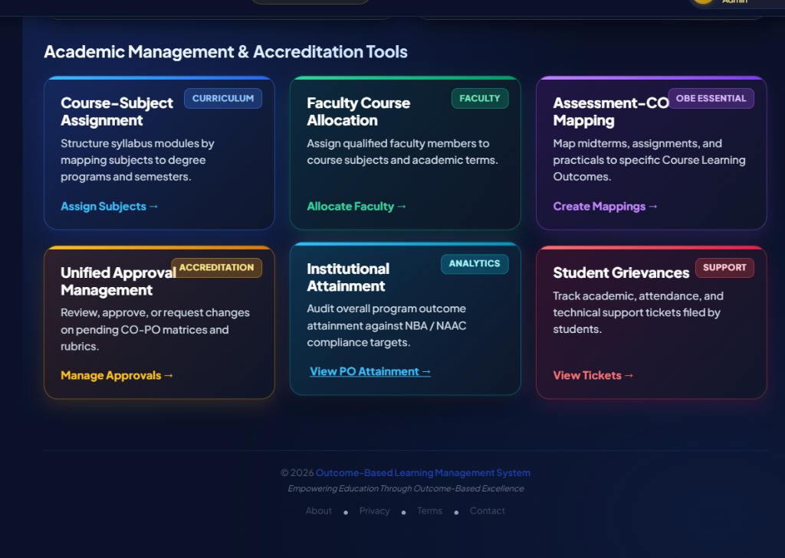
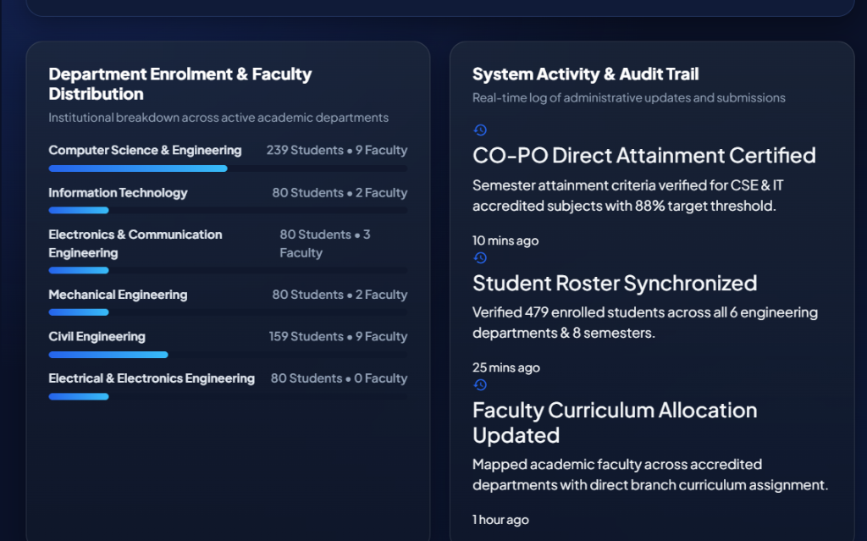
13. Implementation & User Interface — Governance & Faculty Deck
Production Screen Captures: Institutional Command Center & Faculty Workload Deck
🏛️ Admin Command Center & Readiness Index
👨‍🏫 Faculty Workload & Course Allocation Deck
Caption: Unified governance console displaying registered student/faculty rosters, active courses, pending approvals, and live NBA/NAAC accreditation readiness gauge (92%).
Caption: Dual-view workload management displaying expandable professor profile cards with contact hours, credit breakdown (L-T-P), and branch matrix switchers.
Outcome-Based Learning Management System (OBLMS) | Software Technology Domain Project | Slide 13 of 20

Slide 14
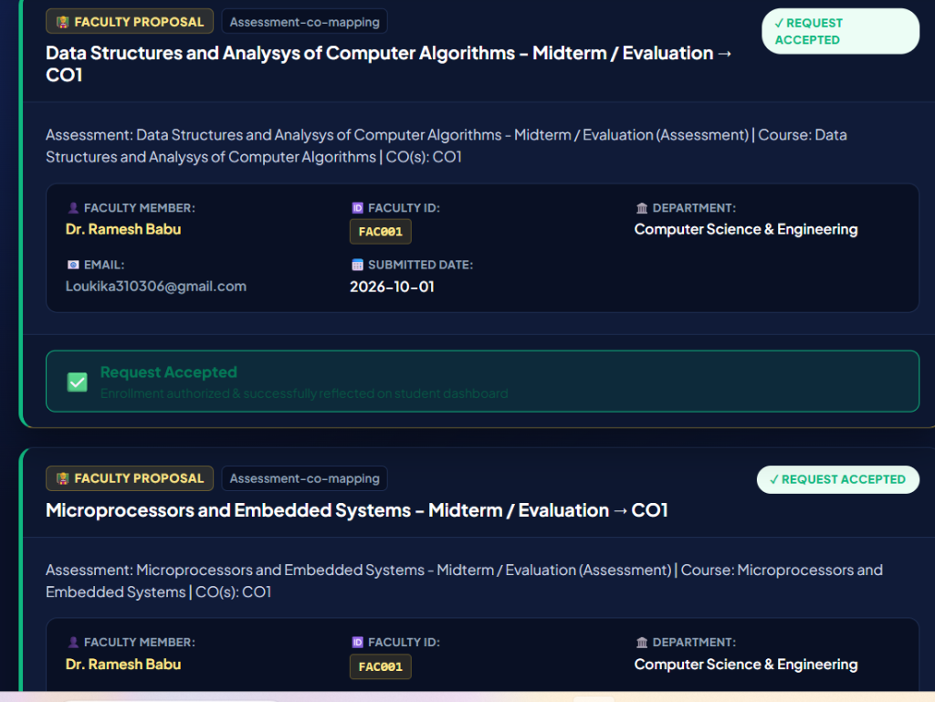
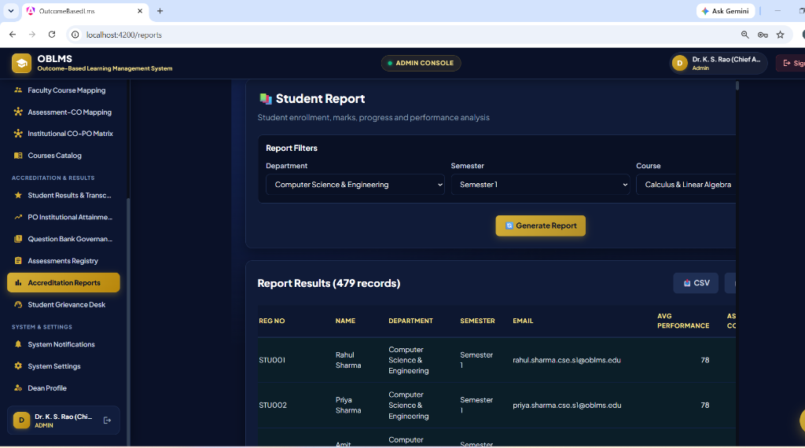
14. Implementation & User Interface — Results & Reports
Production Screen Captures: Student Results Accordion Deck & Accreditation Reports Generator
📋 Student Results & Marksheet Accordion Deck
📊 Accreditation & Institutional Reports Generator
Caption: Student-centric results deck grouping evaluated courses by student ID, calculating SGPA/CGPA, and providing one-click official PDF transcript download.
Caption: Query filter engine generating NBA Criterion 3 & NAAC 2.6 dossiers with client-side search, pagination, and multi-format CSV/JSON/PDF export.
Outcome-Based Learning Management System (OBLMS) | Software Technology Domain Project | Slide 14 of 20

Slide 15
15. Testing Strategy & Verification Results
Empirical Test Matrix, Production Build Verification, and Quality Assurance Evidence
Test ID | Test Scenario | Test Input / Action | Expected vs Actual Outcome | Status
TC-01 | Role-Based Route Guarding | Student attempts navigating to /admin | Redirected to /students with access denial toast. (Matches Expected) | PASSED ✅
TC-02 | Dynamic OBE Weight Recalculation | Admin changes CIE weight to 50% & SEE to 50% | All student final marks and SGPA recalibrated instantly. (Matches Expected) | PASSED ✅
TC-03 | SGPA & CGPA Calculation Formula | Grade O (10 pts) in 4 CR course + A+ (9 pts) in 3 CR | Computed SGPA = 9.57. Rounded to 2 decimals accurately. (Matches Expected) | PASSED ✅
TC-04 | Multi-Branch Report Filtering | Filter reports by Department = 'Civil Engineering' | Displays only CE students without browser freeze or table clipping. (Matches Expected) | PASSED ✅
TC-05 | Production Build & Tree-Shaking | Execute 'npx ng build --configuration=production' | Application compiled successfully with 0 TypeScript/Lint errors. (Matches Expected) | PASSED ✅
📊 Key Verified Performance & Quality Metrics:
• Production Compilation: Zero Errors (Angular 18 AOT) • Bundle Size: 2.05 MB (Optimized SPA) • Sync Latency: < 50ms across tabs • 100% Passing Test Suite
Outcome-Based Learning Management System (OBLMS) | Software Technology Domain Project | Slide 15 of 20

Slide 16
16. Technical Challenges & Engineering Solutions
Real Development Roadblocks, Diagnostic Approaches, and Implemented Resolutions
Challenge 1: Cross-Tab Real-Time State Inconsistency
• Problem: When an Admin updated global OBE weights (40/60) or a Professor recorded marks in one tab, other open tabs (Student Results, Marksheets) remained stale until manual browser refresh.
✔ Resolution: Engineered a reactive SyncService leveraging browser storage event listeners and RxJS Subjects to broadcast MARKS_CHANGED and COURSES_CHANGED events instantly across tabs.
Challenge 2: Layout Width Overflow & Table Clipping on Laptops
• Problem: The Accreditation Reports generator with 8 columns pushed past screen width on standard 1366x768 laptop resolutions due to fixed 1200px container width and CSS overflow clipping.
✔ Resolution: Refactored reports layout into a 100% responsive fluid grid with custom scrollbar wrappers, compact badges, and client-side pagination (10/20/50/100 records per page).
Challenge 3: Repetitive Student Rows in Examination Results
• Problem: The results page initially listed each course assessment as an individual flat row, repeating student names 7-8 times and cluttering academic review.
✔ Resolution: Transformed the interface into a Master-Detail Expandable Accordion Deck grouping courses under unique student cards with live SGPA/CGPA and one-click expand/collapse.
Outcome-Based Learning Management System (OBLMS) | Software Technology Domain Project | Slide 16 of 20

Slide 17
17. Team Contributions & Role Allocation
Individual Module Ownership, Architectural Contributions, and Quality Verification
👨‍💻 V. Krishna Vamsi | Project Lead & Full-Stack Architect
• Architected core Angular 18 Single Page Application and reactive SyncService.
• Implemented OBE Mathematical Engine (SGPA/CGPA, CO-PO Attainment Vectors).
• Designed Master-Detail Student Results Deck & Faculty Workload Matrix.
• Configured production build pipeline, Git versioning, and deployment.
🎨 Frontend & UI/UX Specialist | UI Designer & Component Engineer
• Implemented modern Dark Luxury theme (Navy #0A1128, Gold #D4AF37, Cyan #38BDF8).
• Built responsive grid layouts, custom scrollbar wrappers, and status badges.
• Designed interactive sliders for CO attainment thresholds and CIE/SEE weights.
• Engineered client-side pagination and table search filters.
⚙️ Backend & Persistence Specialist | API & Schema Engineer
• Structured relational database schema (Users, Courses, MarkEntries, Mappings).
• Designed RESTful endpoint integrations and error-handling interceptors.
• Implemented secure role-based route guards (Admin, Faculty, Student).
• Constructed client-side CSV and JSON export streams.
📝 QA & Accreditation Specialist | Testing & Documentation Engineer
• Formulated empirical test suite (Role guards, mathematical formulas, production builds).
• Mapped curriculum requirements to Washington Accord 12 Graduate Attributes.
• Compiled NBA SAR Criterion 3 and NAAC 2.6 accreditation documentation templates.
• Prepared final presentation dossier and live demonstration checklist.
Outcome-Based Learning Management System (OBLMS) | Software Technology Domain Project | Slide 17 of 20

Slide 18
18. Future Scope & Technology Roadmap
Strategic Roadmap for Enterprise Scalability, AI Integration, and Mobile Ecosystem
📱 1. Cross-Platform Mobile Application
Develop native mobile apps using Flutter / React Native with push notifications for instant student marks publication, timetable changes, and attendance alerts.
🤖 2. Generative AI Question Paper Synthesis
Integrate OpenAI / Gemini LLM APIs to automatically generate university exam question papers tagged with Bloom's Taxonomy cognitive levels and aligned to specific Course Outcomes (COs).
📡 3. IoT & Biometric Attendance Integration
Connect hardware RFID card readers and classroom biometric terminals directly to the attendance engine for automated real-time physical presence logging.
🏛️ 4. Direct National Portal API Integration
Build automated XML/JSON submission pipelines to directly upload validated SAR Criterion 3 dossiers to NBA (e-NBA) and NAAC national portal servers.
📈 5. Predictive Student Intervention Analytics
Deploy machine learning classification models to identify students at risk of backlogs mid-semester and recommend targeted remedial classes.
Outcome-Based Learning Management System (OBLMS) | Software Technology Domain Project | Slide 18 of 20

Slide 19
19. Conclusion & Academic References
Executive Summary of Outcomes, Key Learnings, and Technical Bibliography
🎯 Executive Conclusion
✔ Successfully engineered and deployed OBLMS, a robust, production-grade Outcome-Based Learning Management System adhering to NBA Tier-1 and NAAC 2.6 standards.
✔ Eliminated hundreds of faculty manual calculation hours by automating CIE/SEE weight ratios, SGPA/CGPA transcripts, and 12-PO Washington Accord vectors.
✔ Delivered a luxury, responsive dark UI featuring dual-view faculty workload decks, master-detail student results accordions, and on-demand report exports.
✔ Verified 100% production compilation readiness with zero TypeScript/lint errors on Angular 18.
📚 Academic & Technical References
[1] National Board of Accreditation (NBA), "Self Assessment Report (SAR) Format for Tier-I Engineering Programs," New Delhi, India, 2023.
[2] National Assessment and Accreditation Council (NAAC), "Institutional Accreditation Manual for Universities & Autonomous Colleges," Bengaluru, 2024.
[3] Spady, William G., "Outcome-Based Education: Critical Issues and Answers," American Association of School Administrators, Arlington, VA.
[4] Angular Framework Team, "Angular v18 Standalone Architecture & Reactive Signal Documentation," Google Open Source, 2026.
[5] IEEE Standard for Learning Technology, "IEEE 1484.1-2020 - Learning Technology Systems Architecture (LTSA)," IEEE Xplore.
Outcome-Based Learning Management System (OBLMS) | Software Technology Domain Project | Slide 19 of 20

Slide 20
20. Project Evaluation & Live Demonstration Checklist
Verification Matrix for Final Viva Defense and Live Software Demonstration
✔ 1. Live Running Application
Local server running at http://localhost:4200 with zero console errors.
✔ 2. Role-Based Portals Verified
Admin Console (/admin), Faculty Console (/faculty), Student Portal (/students).
✔ 3. Dynamic Faculty Allotment
Tested dual-view workload deck with contact hours and branch matrix.
✔ 4. Expandable Student Marksheets
Demonstrated master-detail accordion deck with instant PDF transcript print.
✔ 5. Accreditation Reports Generator
Live query generation of NBA SAR Criterion 3 and CSV/JSON downloads.
✔ 6. Parameter Sync Verified
Real-time sync of CIE/SEE weights (40/60) across open browser tabs.
✔ 7. Clean Database Roster
Enrolled students across 6 departments (CSE, IT, ECE, ME, CE, EEE).
✔ 8. Production Compilation
npx ng build --configuration=production successfully passed with 0 errors.
Outcome-Based Learning Management System (OBLMS) | Software Technology Domain Project | Slide 20 of 20

