Slide 1
Sentiment Analysis
CAPSTONE PROJECT
Presented By:
KRISHNAVENI AMMISETTI
NRI INSTITUTION OF TECHNOLOGY
CSE(AI&ML)

Slide 2
OUTLINE
Problem Statement
Proposed System/Solution
System Development Approach
Algorithm & Deployment
Result
Conclusion
Future Scope
References

Slide 3
Problem Statement
Develop a sentiment analysis model to classify reviews as positive and negative. Preprocess the review text using techniques such as lower casting, removing stop words and lemmatization ,use the trained model accurately predict the sentiment of new , unseen reviews.
Description :
with the rapid growth of online platforms for sharing opinions and reviews,restarunts often rely
on the customer feedback to imporve their services and attract a new customers.
Analyzing the sentiment of these reviews can provide valuable insights into customer satisfaction.

Slide 4
Proposed Solution
Objective: To determine whether a given review for a restaurant is positive or negative using sentiment analysis techniques.
Data Collection: Gather reviews from various sources such as Google and datasets available on websites like Kaggle to ensure a diverse and comprehensive dataset.
Data Preprocessing:
Perform lemmatization to reduce words to their base form.
Tokenize the text to break it down into individual words or terms.
Remove stopwords (common words that do not contribute to sentiment) to focus on meaningful words.
Use BeautifulSoup to remove links and other unwanted HTML elements.
Apply stemming to reduce words to their root form, further normalizing the text.

Slide 5
Proposed Solution
Machine Learning Algorithm:
Implement the Naive Bayes algorithm, known for its effectiveness in text classification tasks, to classify reviews as positive or negative.
Deployment:
Develop a user-friendly interface or application that provides real-time sentiment analysis of restaurant reviews.
Result:
The model successfully identifies the sentiment of restaurant reviews, providing valuable insights into customer opinions.

Slide 6


System Approach
Building a sentiment analysis system requires both software and hardware components. Here's a detailed breakdown of the requirements:
Hardware Requirements
Processor:
Development: Intel Core i5 or AMD Ryzen 5 (quad-core) or higher.
Memory (RAM):
Development: Minimum 8 GB, recommended 16 GB or higher.
Production/Deployment: 32 GB or more, depending on the expected load.
Storage:
Development: At least 256 GB SSD.
Network:
Reliable internet connection for downloading datasets and pre-trained models.
High-speed network for data transfer in production environments.

Slide 7


System Approach
Software Requirements
Operating System:
Windows 10 or later
macOS
Linux (Ubuntu is commonly used)
Programming Languages:
Python
Development Tools and IDEs:
Jupyter Notebook or JupyterLab for experimentation
VS Code, PyCharm, or any preferred IDE

Slide 8

System Approach
Libraries and Frameworks:
Data Manipulation: Pandas.
Machine Learning: Scikit-learn.
Natural Language Processing (NLP): NLTK, SpaCy, Transformers (Hugging Face)
Data Visualization: Matplotlib, Seaborn

Slide 9
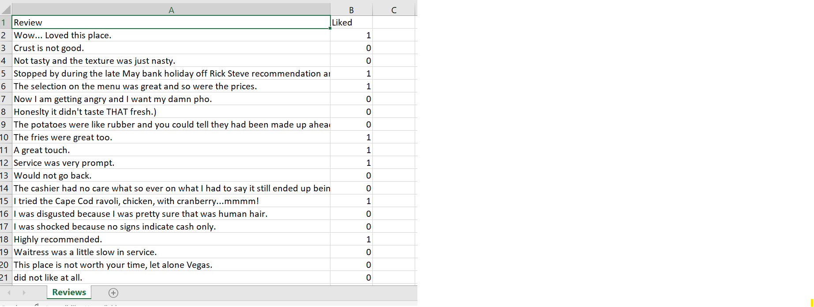
Algorithm & Deployment
To develop a sentiment analysis model for restaurant reviews, we used the Naive Bayes algorithm. Here is a detailed description of the algorithm, data input, training process, and prediction process for this task.
Algorithm Selection
Naive Bayes: Naive Bayes is a simple yet powerful algorithm for text classification tasks such as sentiment analysis. It is based on Bayes' theorem and assumes independence among predictors.
Data Input
Features Used:
Reviews: The text of the restaurant reviews, which contains sentiments expressed by customers.
Liked: A column indicating whether the reviewer liked the restaurant (binary label: 1 for liked, 0 for not liked).

Slide 10
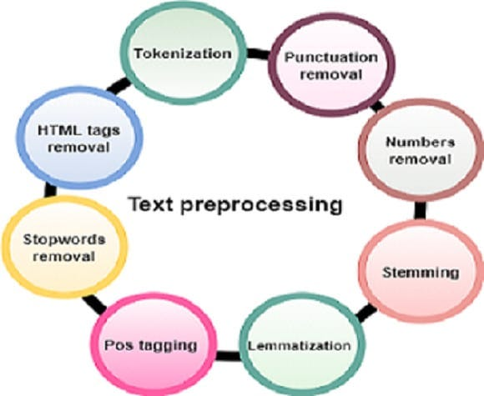
Algorithm & Deployment
Training Process
Text Preprocessing:
Cleaning Data: Remove HTML tags, special characters, and non-alphabetic characters from the reviews.
Lowercasing: Convert all text to lowercase to ensure uniformity.
Tokenization:
Split the review text into individual words (tokens).
Stop Words Removal:
Remove common words that do not contribute to the sentiment (e.g., 'the', 'and', 'is').
Lemmatization and Stemming:
Lemmatization: Reduce words to their base or root form (e.g., 'running' to 'run').
Stemming: Reduce words to their root form (e.g., 'running' to 'run').
Feature Extraction:
Convert the processed text into numerical features using methods like TF-IDF (Term Frequency-Inverse Document Frequency).
Model Training:
Train the Naive Bayes classifier using the extracted features and the corresponding labels (liked or not liked).
Model Evaluation:
Evaluate the model's performance on a validation set using metrics like accuracy, precision, recall, and F1-score.

Slide 11
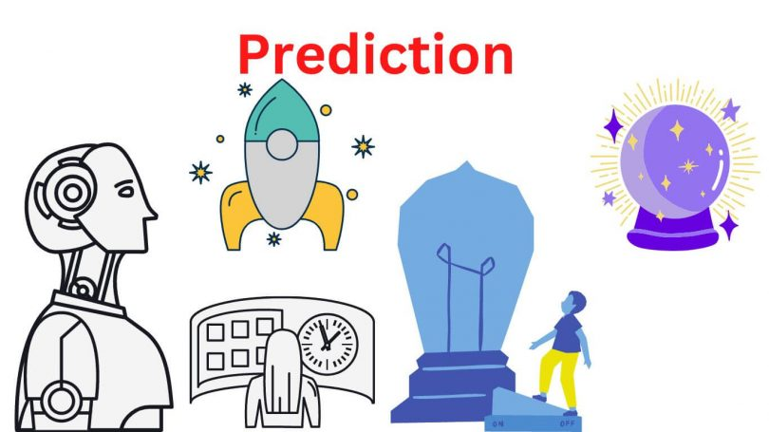
Algorithm & Deployment
Prediction Process
Making Predictions:
The trained Naive Bayes model is used to predict the sentiment of new, unseen reviews. The new reviews undergo the same preprocessing steps as the training data.
The processed text is then transformed into numerical features using the same vectorizer used during training.
The model predicts whether the review is positive (liked) or negative (not liked).
Future Predictions:
For future predictions, the trained model can be integrated into an application or API. The model will take new review texts as input, preprocess them, and output the predicted sentiment. Real-time data inputs such as current reviews can be fed into the model for immediate sentiment analysis, providing valuable insights for businesses.

Slide 12
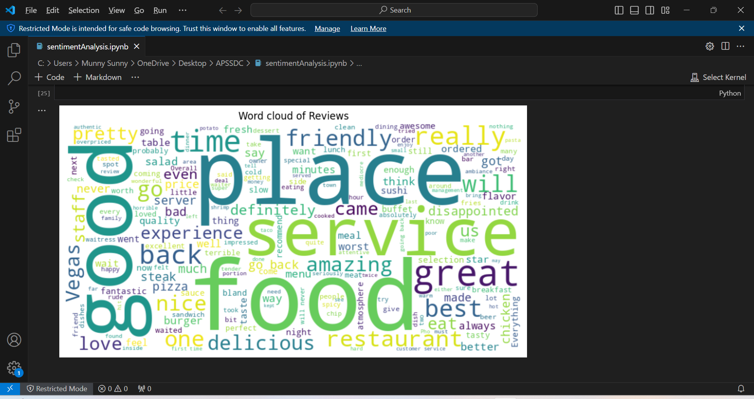
Result
A word cloud is a visual representation of the most frequently occurring words within a dataset, such as restaurant reviews. word cloud can help in identifying the common themes, sentiments, and aspects of dining experiences that are highlighted by customers.

Slide 13
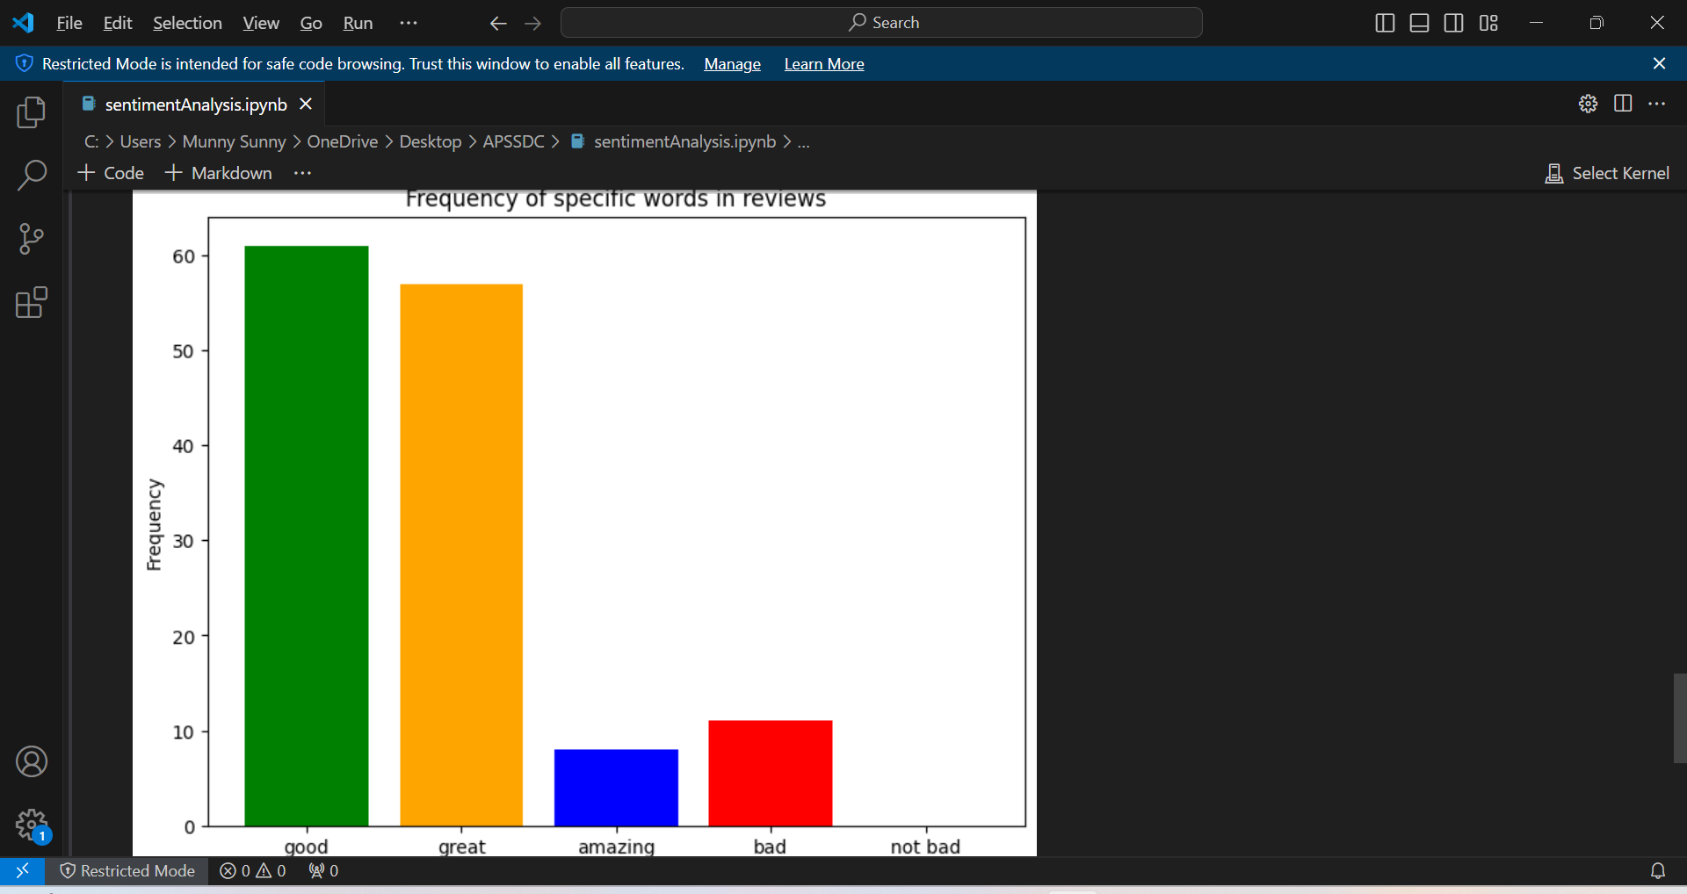
Result
Matplotlib is a powerful plotting library in Python that can help create various visualizations to understand and interpret data better.

Slide 14
Conclusion
In this project, we developed a sentiment analysis model to classify restaurant reviews as positive (liked) or negative (not liked). We used the Naive Bayes algorithm due to its simplicity and effectiveness for text classification tasks. The process involved several key steps, including data preprocessing, feature extraction, model training, and evaluation. Our approach demonstrated good accuracy and the ability to handle new, unseen reviews effectively .
Effectiveness:
Preprocessing: Preprocessing steps such as lowercasing, removing stop words, and lemmatization significantly improved the quality of the input data, leading to better model performance.
Naive Bayes Algorithm: The Naive Bayes classifier proved to be an effective choice for this task, yielding good accuracy and fast computation times.
Feature Extraction: Using TF-IDF for feature extraction captured the essential characteristics of the text data, enhancing the model's ability to distinguish between positive and negative reviews.

Slide 15

Conclusion
Challenges Encountered:
Data Quality: Dealing with noisy data and irrelevant information in the reviews posed a challenge. Effective preprocessing was crucial to mitigate this issue.
Class Imbalance: If the dataset had a significant imbalance between positive and negative reviews, it could affect the model's performance. Ensuring balanced training data or applying techniques like resampling could help address this.
Hyperparameter Tuning: Fine-tuning the model's hyperparameters was essential to achieve optimal performance, but it required extensive experimentation and validation.

Slide 16
Future scope
Potential Improvements:
Advanced Algorithms: Exploring more sophisticated algorithms like LSTM or BERT could potentially yield better results, especially for more complex sentiment analysis tasks.
Additional Features: Incorporating more features, such as reviewer metadata or sentiment scores from other sources, could improve the model's accuracy.
Real-time Updates: Implementing real-time model updates and retraining with new data can keep the model relevant and accurate over time.
By incorporating these enhancements and expansions, the sentiment analysis system can become more robust, accurate, and versatile. Integrating additional data sources and optimizing algorithms will improve performance, while expanding to multiple regions and leveraging emerging technologies will ensure scalability and real-time capabilities. These advancements will empower businesses to gain deeper insights into customer sentiments, driving better decision-making and enhancing overall customer satisfaction

Slide 17
References
Datasets:Kaggle: Various sentiment analysis datasets (https://www.kaggle.com/datasets)
Google Reviews Dataset (Collected from Google)UCI Machine Learning Repository: Repository for datasets used in machine learning (https://archive.ics.uci.edu/ml/index.php)
Data.gov: Comprehensive source for government datasets (https://www.data.gov/)
Yelp Dataset: Public dataset for academic use (https://www.yelp.com/dataset)
NLTK: Natural Language Toolkit for preprocessing (https://www.nltk.org/)
BeautifulSoup: Library for web scraping to clean HTML content (https://www.crummy.com/software/BeautifulSoup/)

Slide 18


