Slide 1
TRANSFORMER BASED ESTIMATION OF SPOKEN SENTENCES USING ELECTROCORTICOGRAPHY
BY
KRISHNAVENI KATTA

Slide 2
OUTLINE
Methodology
Conclusion
References
Background
Introduction
Results
Discussions

Slide 3
OVERVIEW
This presentation discusses about the measurement of the invasive electrocorticogram(ECoG) signals from seven participating epilepsy(brain disorder) patients as they spoke a sentence.
A Transformer encoder was incorporated into a "sequence-to-sequence" model to decode spoken sentences from the ECoG. The proposed model with the Transformer achieved significantly better decoding accuracy than a conventional long short-term memory model.

Slide 4
Introduction
What is Brain machine interfacing (BMI) ?
Brain-machine interfaces (BMIs) are devices that bridge human brain and an external device. They can read human brain activity and communicate that information directly to a computer system. BMIs could help a patient control a robotic prosthesis or enable the user to type into a word processor using only their thoughts.
BMIs can either be invasive or non-invasive. Invasive brain mapping includes surgically implanting electrodes under the scalp to more accurately transmit brain impulses. On the other hand, non-invasive BMIs do not require surgery and are positioned over the head to monitor brain activity.
Several decoding techniques are available to achieve BMI. One such technique is Electrocorticography (Ecog).

Slide 5
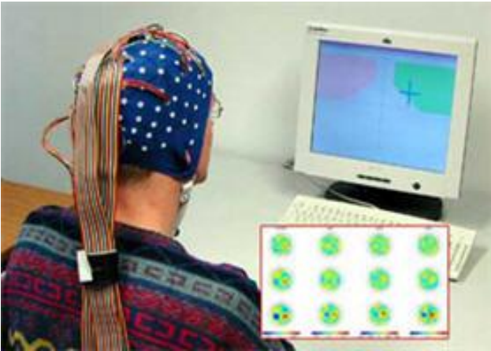
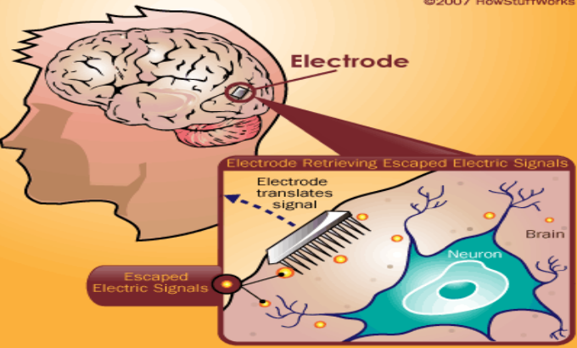
Invasive vs Noninvasive BMI
invasive
non-invasive
Electrocorticography (ECoG) is invasive bmi
Electroencephalograph (EEG) is non invasive.

Slide 6
Introduction
What is Electrocorticography(Ecog) ?
Electrocorticography is the process of recording electrical activity in the brain by placing electrodes in direct contact with the cerebral cortex or surface of the brain.
Signals received are invasive in nature and they have excellent spatial and spectral resolution compared with EEG(Electroencephalography).
ECoG has been used to study a range of speech decoding methods, ranging from phoneme-based decoding to sentence-based decoding and for speaking, listening, and imagining brain activities.

Slide 7
Background
Pei et al used a naive Bayes classifier for speaking and imagining tasks.
Martin et al. used a support vector machine for speaking, listening, and imagining tasks To enable sentence-based speech decoding.
Herff et al. used Viterbi decoding with a hidden Markov model for a speaking task, while Moses et al. used it for a listening job, to allow sentence-based speech decoding.
Deep-learning techniques also applied to decoding speech from ECoG signals. Sun et al. employed a mix of a long short-term memory (LSTM) RNN model and a connectionist temporal classification decoder for speaking and envisioning tasks.
Makin et al. successfully utilized a "sequence-to-sequence" model with bidirectional LSTM (BLSTM) for speaking tasks. Sun et al. and Makin et al. used mutually synchronized ECoG signals as inputs and Mel frequency cepstral coefficients (MFCCs) as outputs to train LSTM layers in a sequence-to-sequence encoder.

Slide 8
Background
LSTM has limitations when it comes to learning longer-term relationships between input and output sequences. As a result, a model known as the Transformer model has been effectively employed in natural language processing (NLP) and automated speech recognition (ASR).
The Transformer decodes spoken phrases from the ECoG effectively. This paper is the first to describe an invasive BMI that decodes speech from ECoG signals utilizing a Transformer inserted in the encoder stage of a sequence-to-sequence model.

Slide 9
Methodology
There were seven people that participated in this study. Four males: js1, js5, js6, and js8; and three females: js3, js4, and js7. These people were undergoing epilepsy treatment.
Epilepsy is a central nervous system (neurological) disorder in which brain activity becomes aberrant, resulting in seizures or episodes of odd behavior, feelings, and occasionally loss of awareness.
ECoG arrays were surgically installed on each participant's cortical surface (left hemisphere) to locate seizure foci. The participants' ECoGs were recorded during the speaking task, in which they read phrases presented on a monitor aloud. Each sentence was in Japanese and consisted of three phrases. Eight patterns of sentences were generated and repeated the same for 10 times and collected 80 sentences.
ECoG signals were recorded using biosignal amplifiers . In addition to Ecog signals, acoustic signals, speech signals were also recorded and excessive noise were removed. Then, Ecog and acoustic signals were trimmed. These trimmed ECoG signals were anti-aliased and down sampled. Then, ECoG preprocessed signals were obtained.

Slide 10
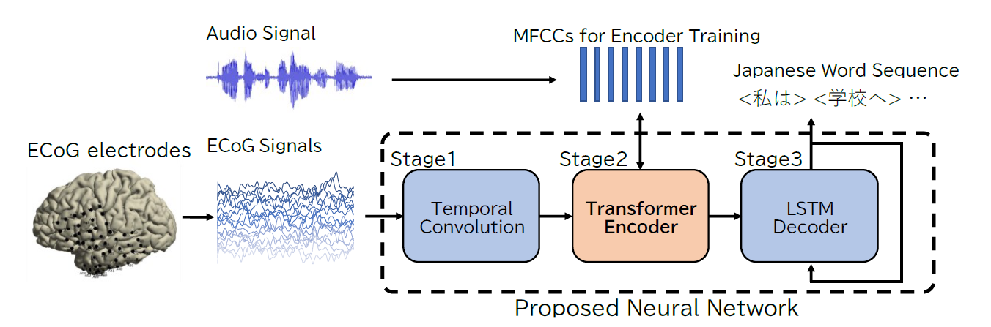
Model Architecture
This is the model architecture and decoding pipeline. The details of the Transformer encoder in the proposed neural network, which is the most unique characteristic of this network.

Slide 11
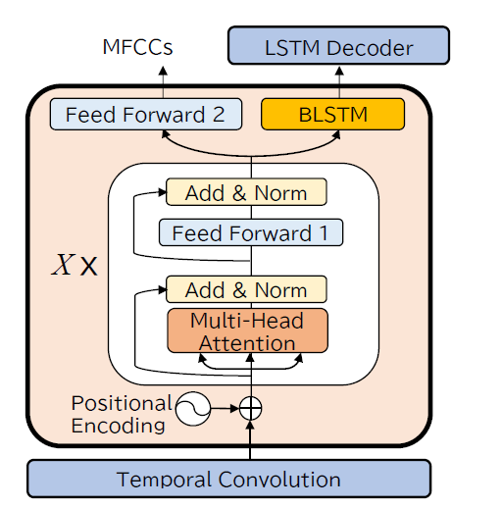
Neural Network Architecture
The diagram depicts the architecture of a sequence-to-sequence artificial neural network. A temporal convolution network, an encoder network, and a decoder network are used to process the sequences.
In the encoder layer, a Transformer encoder is employed, the outputs of which are trained to be MFCCs(Mel Frequency Cepstral Coefficients). If BLSTM layers are utilized in the encoder stage, then it corresponds to Makin's model. Although a Transformer decoder might be used at the decoder stage, the LSTM decoder was chosen for reasons of sufficiency for decoding simple sentences.
The temporal convolution (CNN)layer effectively downsamples the ECoG preprocessed signals.
Sequence to sequence neural network architecture

Slide 12
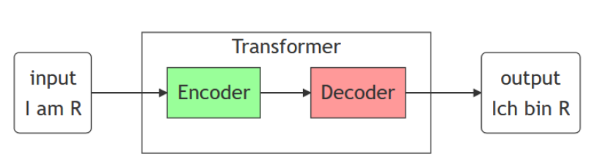
Transformer Model
Transformer is a type of machine learning model designed for processing the sequences. This is mainly focused on Natural Language tasks.
The transformer is a new architecture which is based on attention mechanisms which improves translation quality. The Transformer is unique in that it uses attention based approach for almost everything.
The Transformer expands its idea by repeatedly paying attention to an input and relying on traditional feed forward neural networks to transform that input into something useful. Transformers continue to use traditional neural networks, though their significance has diminished.
The Transformer high level architecture

Slide 13
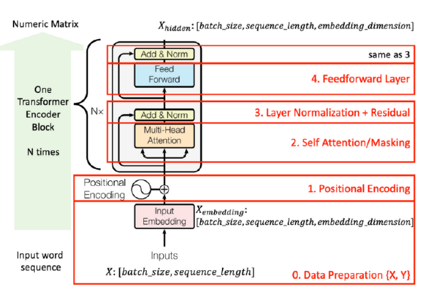
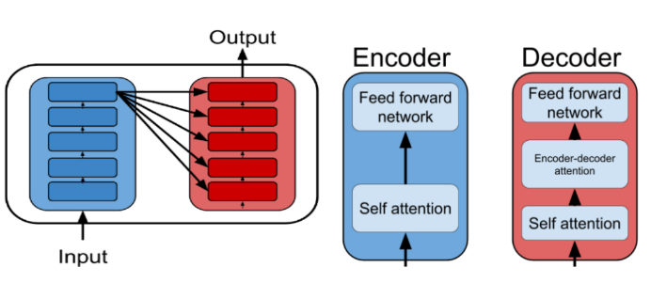
Transformer Model
In encoder-decoder mechanism, we use two different networks where one is encoder and other is decoder.
In Transformer, we have a stack of encoders and decoders with self-attention and feed forward network. Input is fed to lower stack of encoder which moves up and after reaching the top stack it is fed to decoder with some information provided to each decoder stack. Then we go through decoder stacks by using the information from encoder.
The Transformer encoder

Slide 14
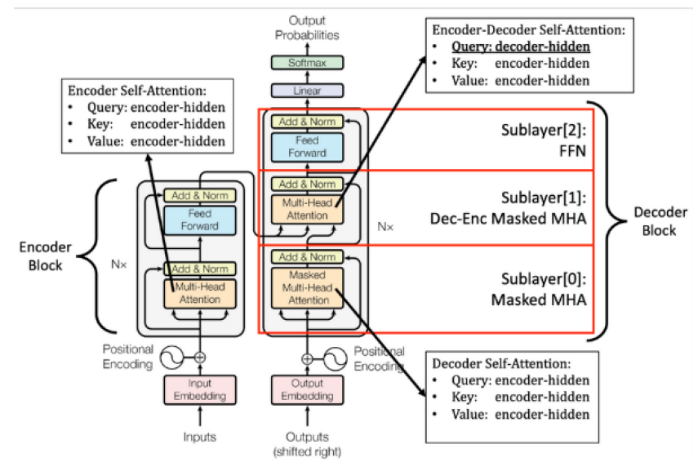
Transformer Model
An encoder has two sub-components Feedback forward network and self attention.
Decoder is similar to encoder except with one extra component Encoder-decoder attention.
The Transformer adheres to this general design by employing stacked self-attention and pointwise, completely linked layers for both the encoder and decoder, as seen in the left and right sides of figure.
The Transformer Encoder -decoder

Slide 15
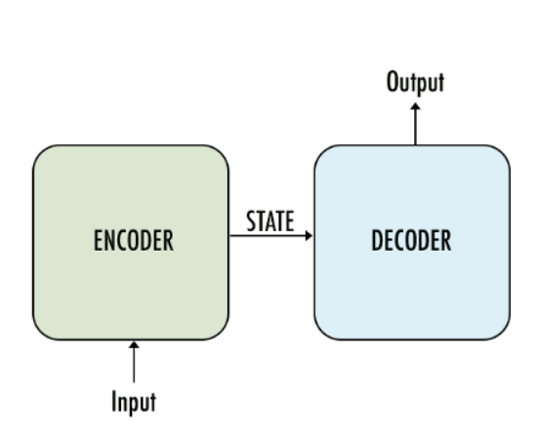
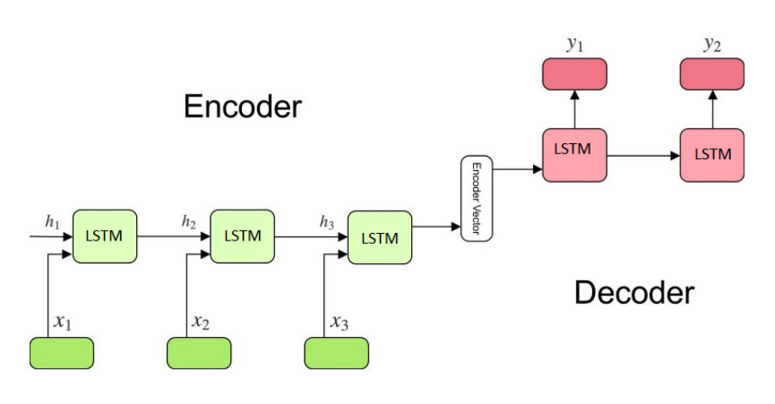
Long short-term memory (LSTM)
Encoder reads the input sequence and summarizes the information in internal state vectors. We discard the outputs of the encoder and only preserve the internal states.
The encoder summarizes the input sequence into state vectors, which are then fed to the decoder which starts generating the output sequence given the Thought vectors. The decoder is just a language model conditioned on the initial states.
The decoder behaves a bit differently during the training and inference procedure. During the training, we use a technique call teacher forcing which helps to train the decoder faster. During inference, the input to the decoder at each time step is the output from the previous time step.
Encoder – Decoder architecture

Slide 16
Methods
The Transformer encoder receives the temporal convolution layer's outputs and is composed of a stack of identical layers with two sub-layers each.
The multi head self-attention mechanism is the first, and a fully connected feed-forward network is the second. A residual connection around each of the two sub-layers is used, followed by layer normalization.
The outputs of the stack of X identical layers are input to two different layers; one is BLSTM, whose last hidden and cell states are input to the next stage, and the other is the feed-forward network called “feed-forward 2” to represent the sequence of MFCCs(Mel Frequency Cepstral Coefficients ).

Slide 17
Method and Analysis
The “feed-forward 2” layer plays an important role in regularizing the outputs of the Transformer encoder.
The third stage is the decoder network layer with an LSTM layer whose initial hidden and cell states are equal to the last ones of the BLSTM in the second stage.
Mel Frequency Cepstral Coefficients (MFCCs) are a feature widely used in automatic speech and speaker recognition.
The proposed structure of the Transformer encoder with a feed-forward layer, which outputs speech-latent variables (MFCCs) and a BLSTM layer connected to the decoder

Slide 18
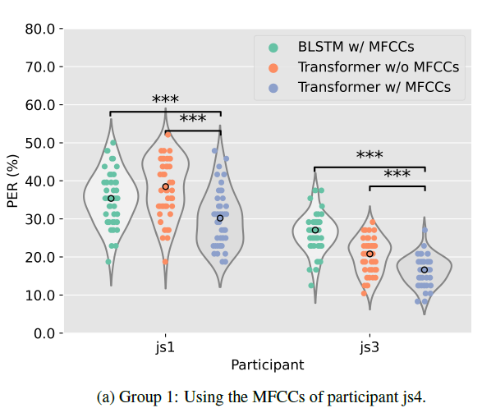
Method and Analysis
Three models below are evaluated in this paper:
• BLSTM with MFCCs
• Transformer without MFCCs
• Transformer with MFCCs
The vertical axis shows the phrase error rate (PER); the horizontal axis shows the participants.
The “o” marks for participants and models indicate medians. The asterisks indicate the significance between the two models.
Group 1 figure shows the models using MFCCs
derived from the speech of participant js4

Slide 19
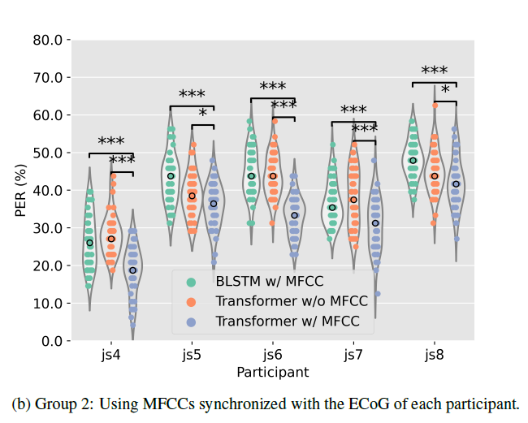
Method and Analysis
Group 2 figure shows the models with MFCCs derived from the participant’s speech, as synchronized with ECoG.
A comparison of the BLSTM-with-MFCCs and Transformer with MFCCs models shows the effectiveness of using a Transformer. The comparison of the Transformer models with and without MFCCs shows the contribution of the MFCCs to the training of the encoder.
For evaluation test set was evaluated in terms of a phrase error rate (PER).
To mitigate the problem of non-repeatability of the model training due to the randomness of the initial weights of the model and calculation by GPUs, the series of processes from training to evaluation was repeated ten times.

Slide 20
Results
The average PERs for each subject according to the Transformer with- MFCCs model with standard deviations were 29.9± 7.3% for js1, and 16.4±3.7% for js3 in Group 1, and 18.7± 6.3% for js4, 35.8 ± 5.7% for js5, 33.1 ± 5.0% for js6, 30.9 ± 7.0% for js7, and 41.9 C 6.5% for js8 in Group 2.
The decoding test revealed that the use of the Transformer model achieved a minimum phrase error rate (PER) of 16.4%, and the median ( standard deviation) across seven participants was 31.3% (± 10.0%).

Slide 21
Discussions
The First, the proposed model achieved an average PER below 20% for js3 and js4.
PER could be improved by using the Transformer model, even with a lower density electrode array.
Second, for all seven participants, the Transformer encoder outperformed the BLSTM in terms of accuracy, suggesting that the longer-range relationships that are stated to be acquired by the Transformer encoder may be helpful for decoding speech from ECoG signals.
Finally, using MFCCs contributed to the training of the Transformer encoder.
The models for the participants js1 and js3 with the MFCCs from js4 achieved better accuracy than those without MFCCs. This implies that MFCCs used in the training phase is not necessarily calculated from the speech of the same person. This finding suggests that it is possible to train imagining tasks where we cannot use MFCCs calculated from synchronized speech signals.

Slide 22
Conclusion
This paper found the importance of the ECoG’s longer-range dependencies. Also explained the importance of Transformer architecture and LSTM architectures.
Future work will include a detailed analysis based on looking at the output of the intermediate layers, such as attention layers, and clarifying which part of the cortex and which time points are important for speech decoding.
Finally, using MFCCs contributed to the training of the Transformer encoder. This implies that MFCCs used in the training phase is not necessarily calculated from the speech of the same person. This finding suggests that it is possible to train imagining tasks where we cannot use MFCCs calculated from synchronized speech signals.

Slide 23
References
[1] J. R. Wolpaw, N. Birbaumer, D. J. McFarland, G. Pfurtscheller, and T. M. Vaughan, “Brain–computer interfaces for communi- cation and control,” Clinical Neurophysiology, vol. 113, no. 6, pp. 767–791, 2002.
[2] N. E. Crone, D. L. Miglioretti, B. Gordon, and R. P. Lesser, “Functional mapping of human sensorimotor cortex with elec- trocorticographic spectral analysis. II. Event-related synchro- nization in the gamma band,” Brain: A Journal of Neurology, vol. 121, no. 12, pp. 2301–2315, 1998.
[3] X. Pei, E. C. Leuthardt, C. M. Gaona, P. Brunner, J. R. Wol- paw, and G. Schalk, “Spatiotemporal dynamics of electrocor- ticographic high gamma activity during overt and covert word repetition,” Neuroimage, vol. 54, no. 4, pp. 2960–2972, 2011.
[4] S. Martin, P. Brunner, I. Iturrate, J. d. R. Milla´n, G. Schalk,
R. T. Knight, and B. N. Pasley, “Word pair classification dur- ing imagined speech using direct brain recordings,” Scientific Reports, vol. 6, no. 1, pp. 1–12, 2016.

