Slide 1
Weekly Business Report
Auto-generated on 11 Jul 2026

Slide 2
Summary
Total Collection
Target Achievement
Total Orders
Avg Order Value
₹1,377,100
94.5%
573
₹2,403
Profit
Period-on-Period Growth
₹526,500
▼ 5.1%

Slide 3
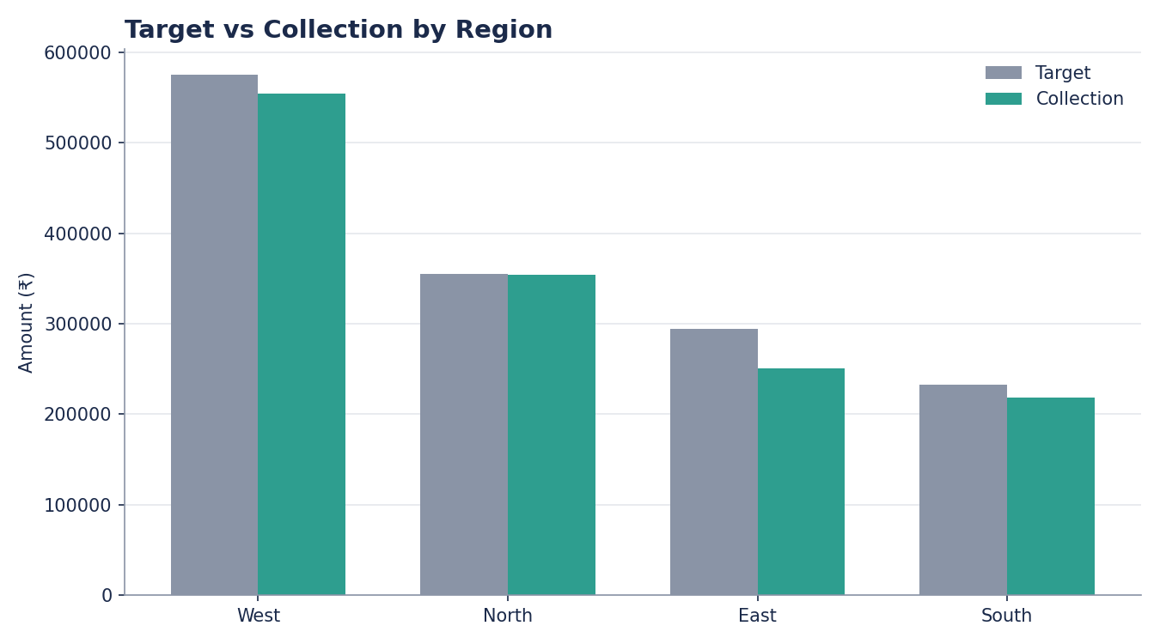
Regional Performance

Slide 4
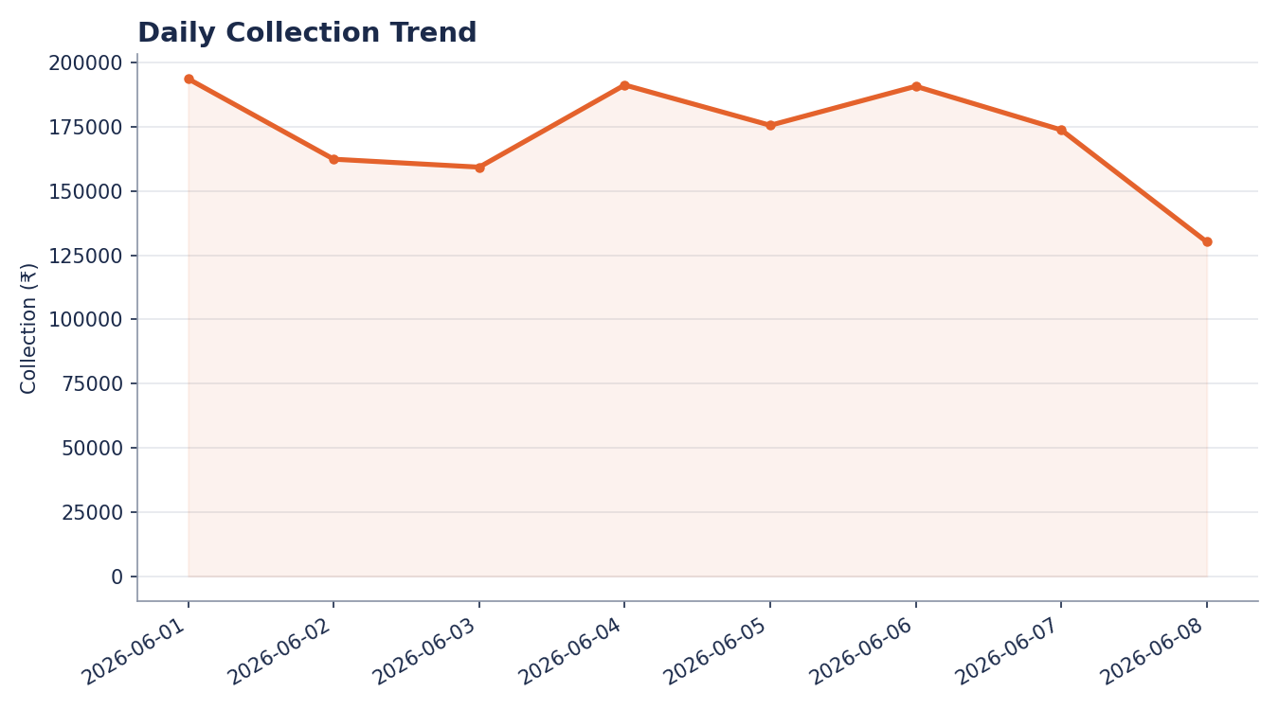
Collection Trend

Slide 5
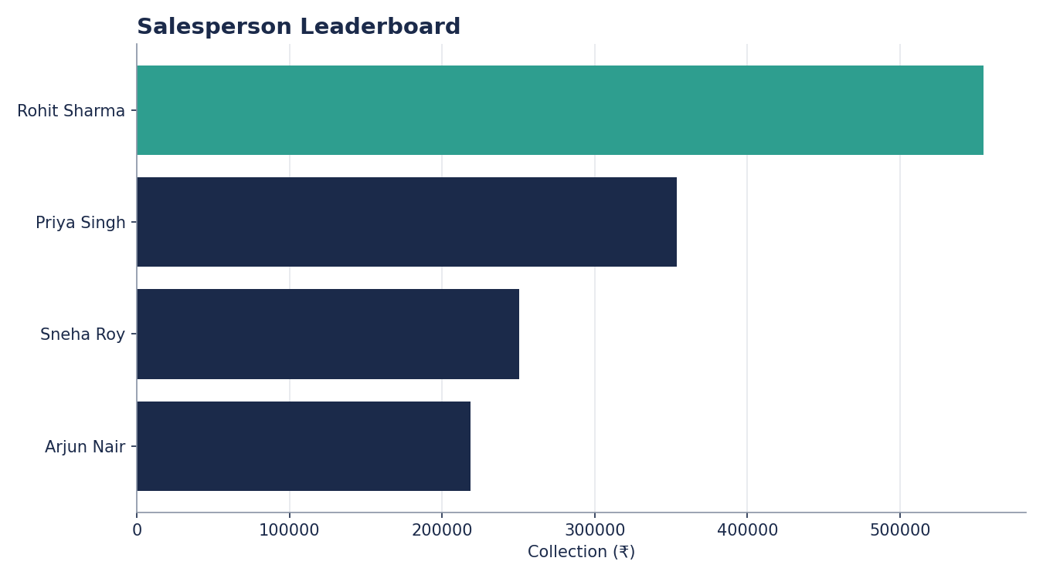
Salesperson Leaderboard

