Slide 1
SQL PROJECT | MySQL
PIZZA SALES
ANALYSIS
13 business questions answered with SQL: from simple counts to revenue share and running totals
Presented by: Your Name

Slide 2
About the Project
In this project I worked with the sales data of a pizza restaurant and used MySQL to find out what sells, when customers order and where the revenue comes from.
I started with simple counts and totals, moved on to joins and grouping, and finished with subqueries and window functions.
Tools and Skills
MySQL Workbench
Database: PIZZA_SALES
Joins across 4 tables
Aggregations and GROUP BY
Subqueries
Window functions (RANK, SUM OVER)

Slide 3
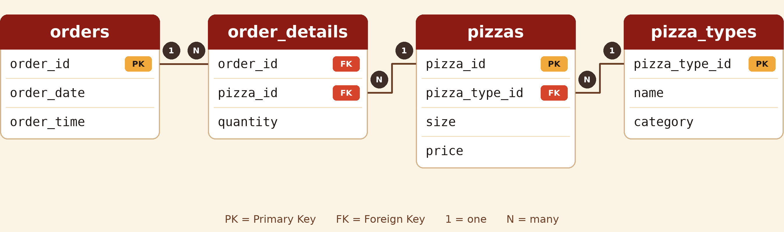
Database Schema
One order has many order lines (order_details). Each line refers to one pizza (pizzas), and each pizza belongs to one pizza type (pizza_types).
Only the columns used in this project are shown.

Slide 4
Questions I Answered
1
Total orders placed
8
Category-wise distribution of pizzas
2
Total revenue from pizza sales
9
Average pizzas ordered per day
3
Highest-priced pizza
10
Top 3 pizza types by revenue
4
Most common pizza size ordered
11
Revenue contribution of each pizza type
5
Top 5 most ordered pizza types
12
Cumulative revenue over time
6
Quantity ordered per pizza category
13
Top 3 pizza types by revenue in each category
7
Orders by hour of the day

Slide 5
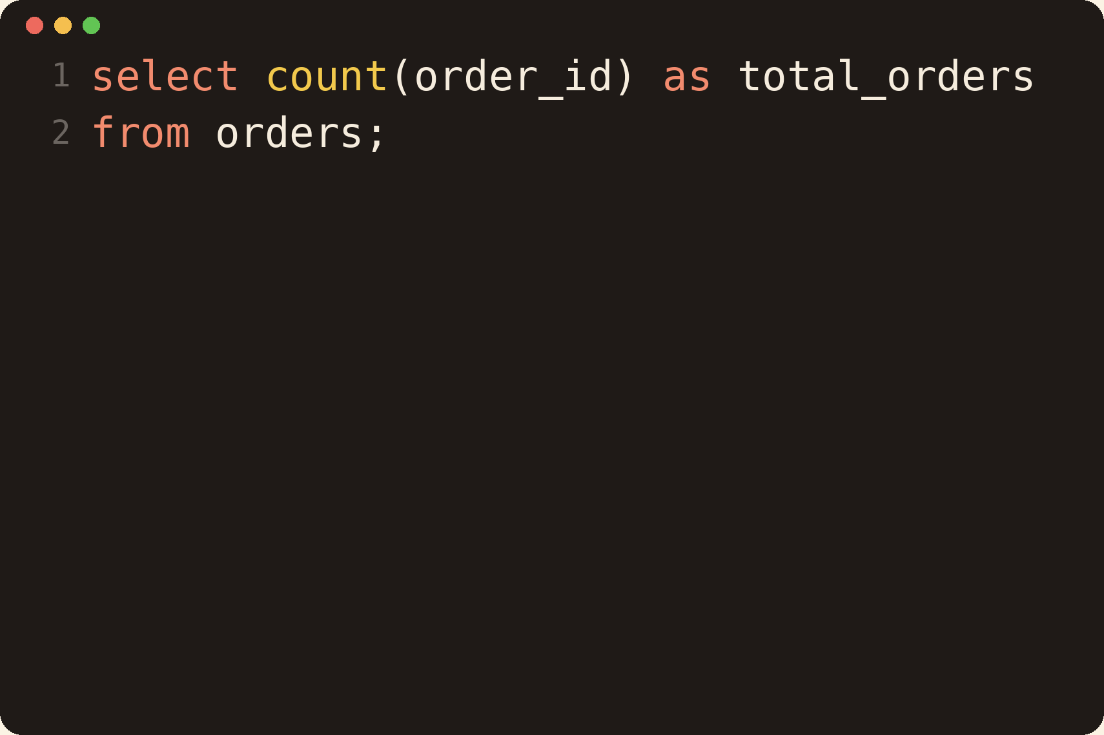
Q1: Total Orders Placed
Retrieve the total number of orders placed.
How it works
Counts every order_id in the orders table. This is the base number every other metric is compared with.
Concepts used
COUNT, Alias
Notes:
How to explain: Counts every order_id in the orders table. This is the base number every other metric is compared with. Then mention which business question it answers.

Slide 6
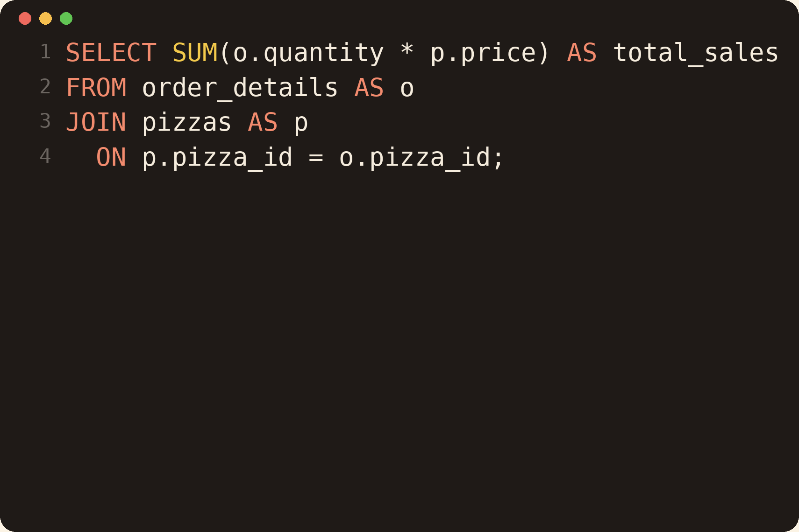
Q2: Total Revenue from Pizza Sales
Calculate the total revenue generated from pizza sales.
How it works
order_details has the quantity and pizzas has the price, so I join them and add up quantity x price for every row.
Concepts used
JOIN, SUM, Alias
Notes:
How to explain: order_details has the quantity and pizzas has the price, so I join them and add up quantity x price for every row. Then mention which business question it answers.

Slide 7
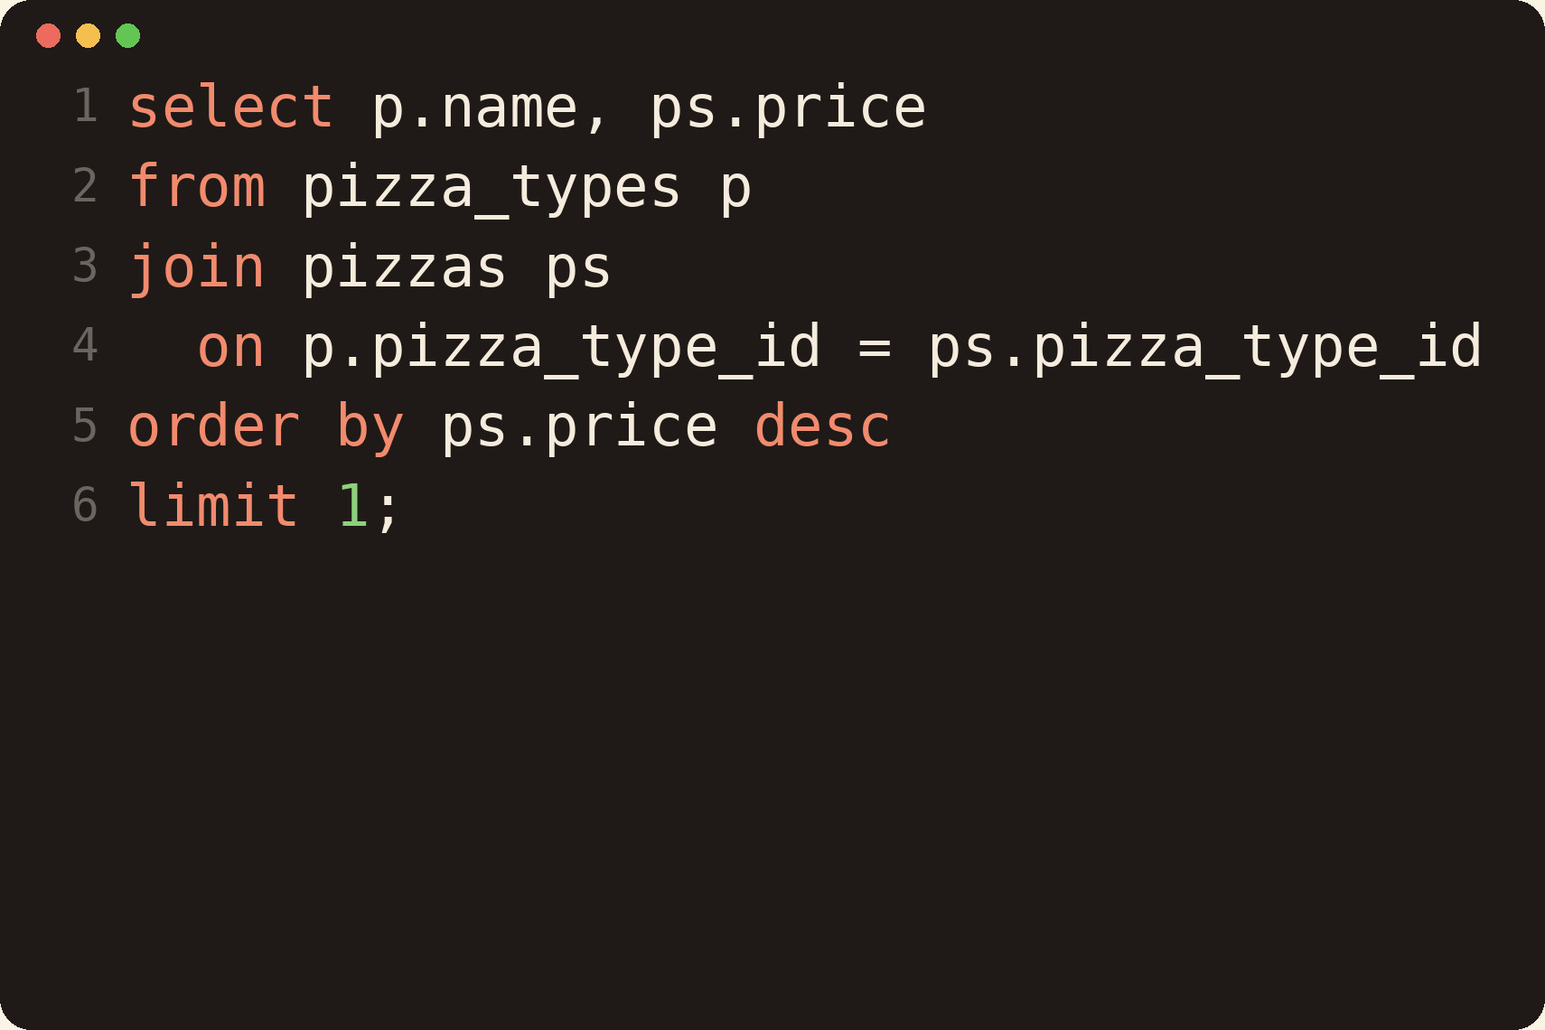
Q3: Highest-Priced Pizza
Identify the highest-priced pizza.
How it works
Joins pizza names with their prices, sorts the price from high to low and keeps only the first row.
Concepts used
JOIN, ORDER BY, LIMIT
Notes:
How to explain: Joins pizza names with their prices, sorts the price from high to low and keeps only the first row. Then mention which business question it answers.

Slide 8
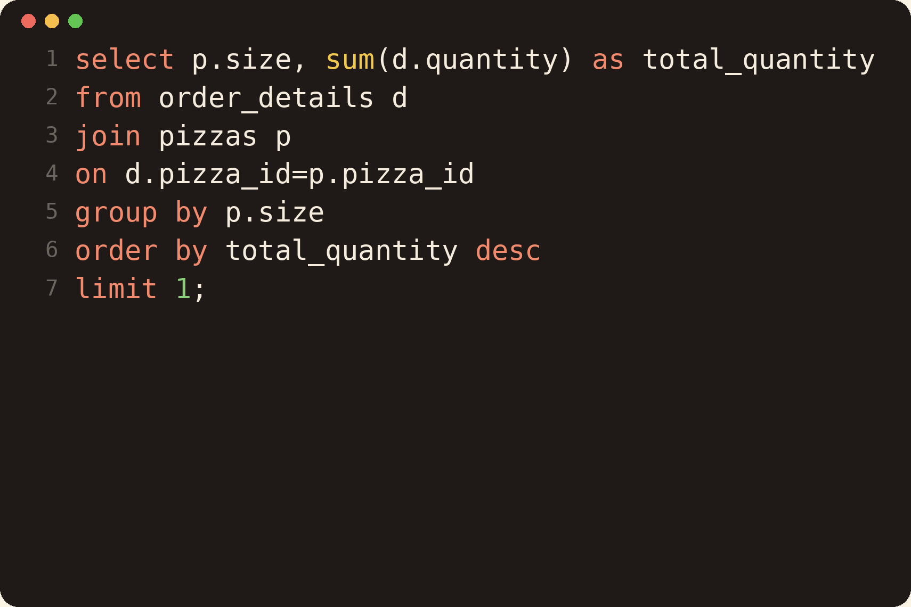
Q4: Most Common Pizza Size
Identify the most common pizza size ordered.
How it works
Adds up the quantity ordered for each size and shows the size with the highest total.
Concepts used
JOIN, GROUP BY, SUM, LIMIT
Notes:
How to explain: Adds up the quantity ordered for each size and shows the size with the highest total. Then mention which business question it answers.

Slide 9
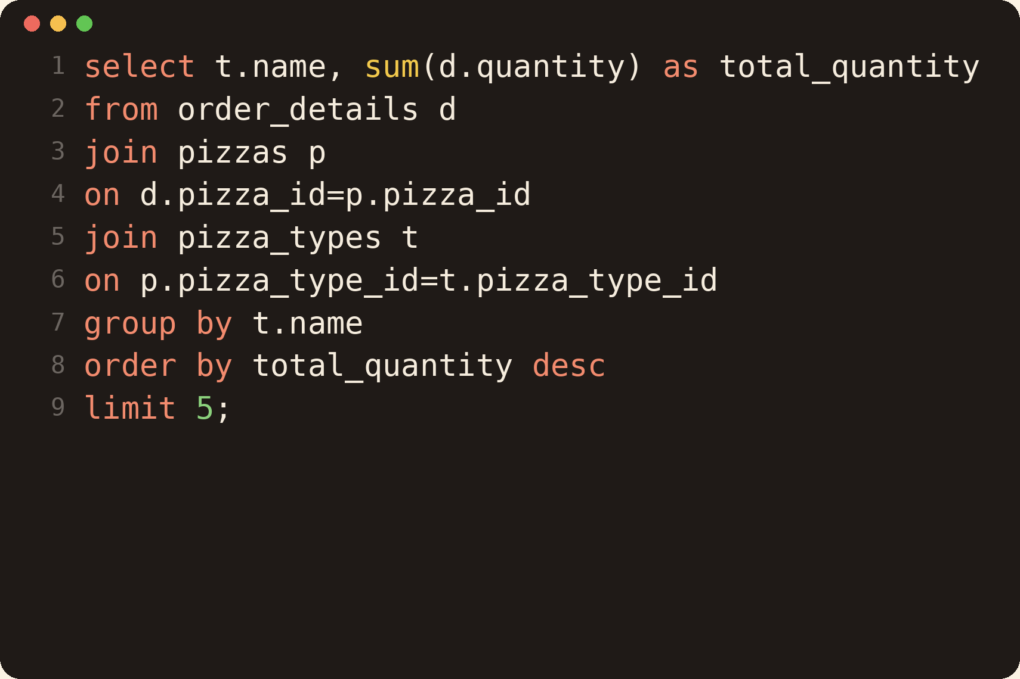
Q5: Top 5 Most Ordered Pizza Types
List the top 5 most ordered pizza types along with their quantities.
How it works
Three tables are joined to reach the pizza name. Quantity is summed per name and the top 5 are kept.
Concepts used
3-table JOIN, GROUP BY, LIMIT
Notes:
How to explain: Three tables are joined to reach the pizza name. Quantity is summed per name and the top 5 are kept. Then mention which business question it answers.

Slide 10
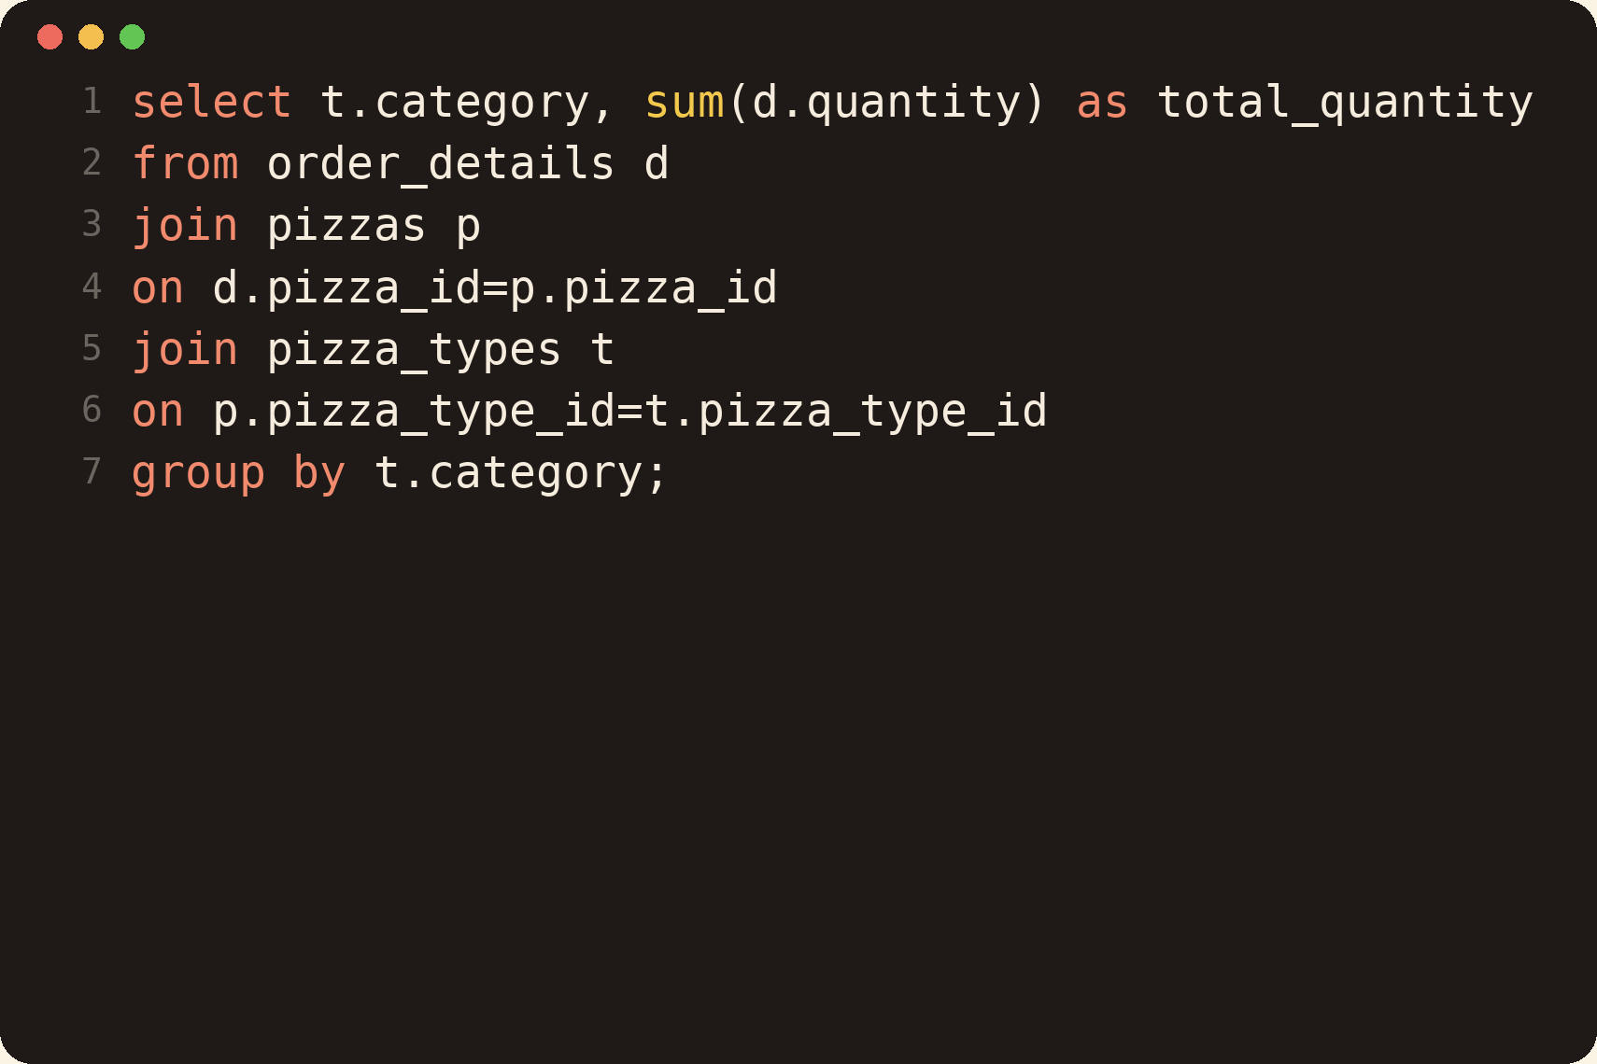
Q6: Quantity Ordered by Category
Join the necessary tables to find the total quantity of each pizza category ordered.
How it works
Same join path as the previous query, but grouped by category to compare demand between categories.
Concepts used
JOIN, GROUP BY, SUM
Notes:
How to explain: Same join path as the previous query, but grouped by category to compare demand between categories. Then mention which business question it answers.

Slide 11
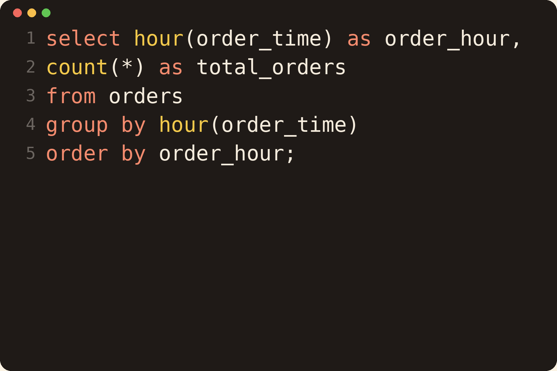
Q7: Orders by Hour of the Day
Determine the distribution of orders by hour of the day.
How it works
HOUR() pulls the hour out of order_time, so the orders can be counted for each hour. Useful to find peak hours.
Concepts used
HOUR(), GROUP BY, COUNT
Notes:
How to explain: HOUR() pulls the hour out of order_time, so the orders can be counted for each hour. Useful to find peak hours. Then mention which business question it answers.

Slide 12
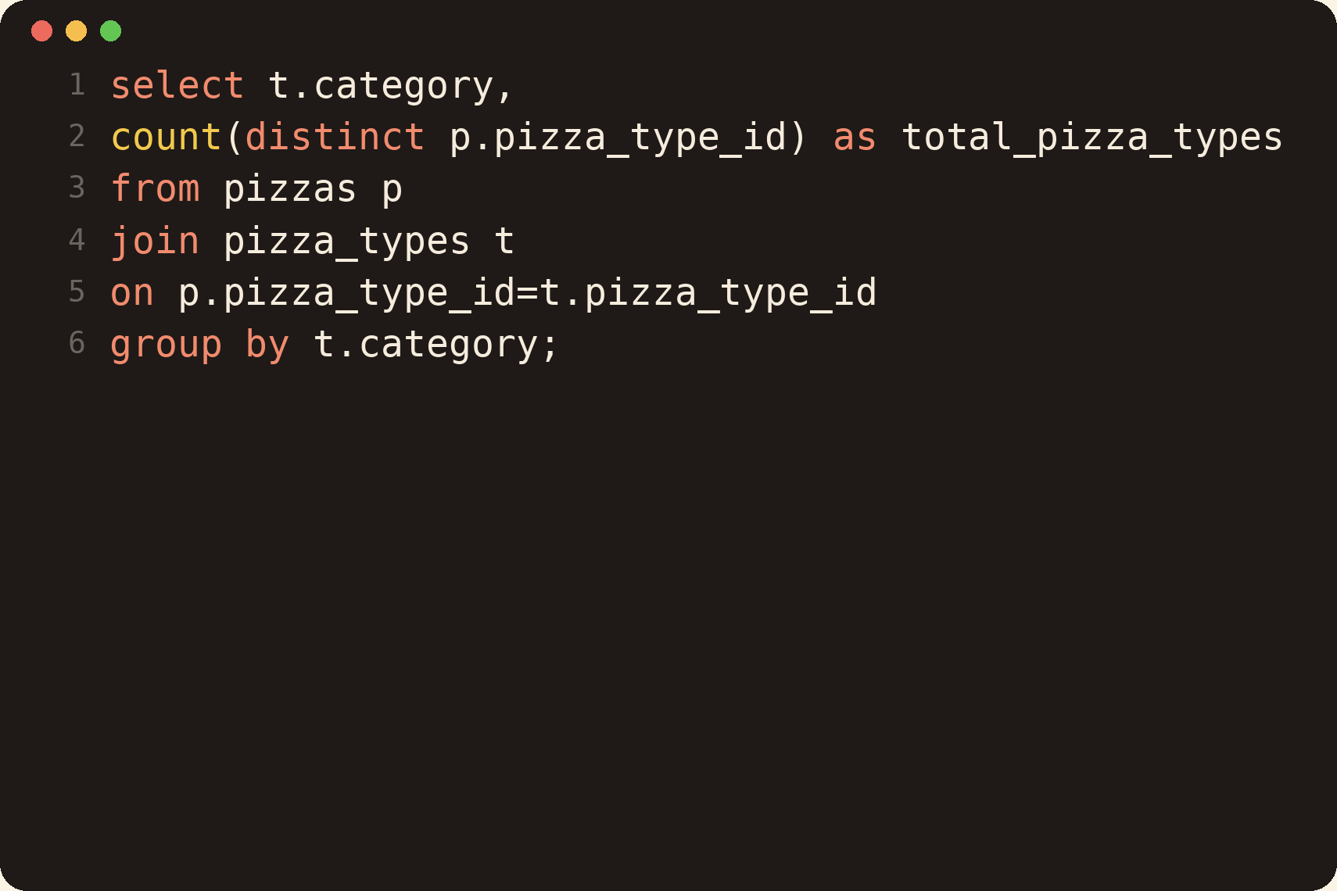
Q8: Category-wise Distribution of Pizzas
Join relevant tables to find the category-wise distribution of pizzas.
How it works
Counts how many different pizza types each category has on the menu. DISTINCT avoids counting the same type for every size.
Concepts used
JOIN, COUNT DISTINCT
Notes:
How to explain: Counts how many different pizza types each category has on the menu. DISTINCT avoids counting the same type for every size. Then mention which business question it answers.

Slide 13
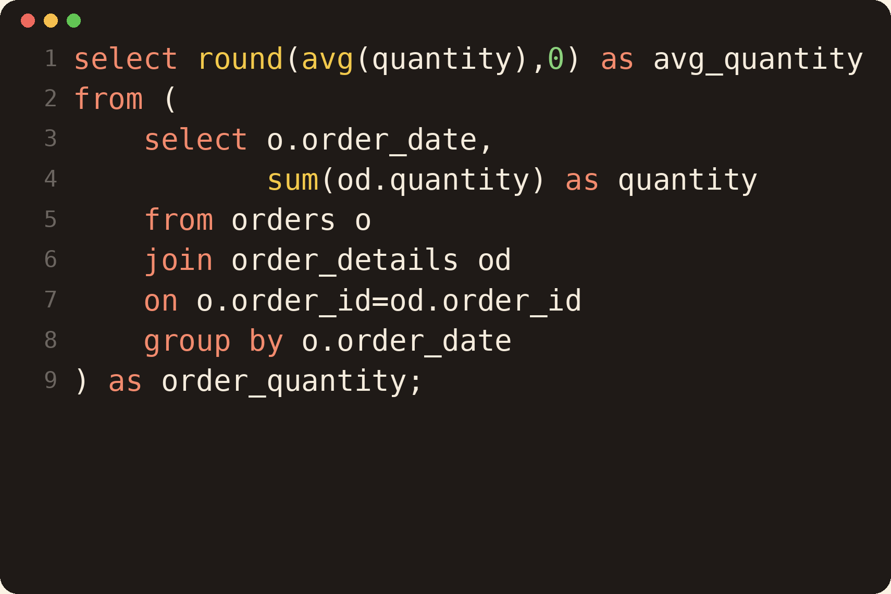
Q9: Average Pizzas Ordered per Day
Group the orders by date and calculate the average number of pizzas ordered per day.
How it works
The inner query gives the total pizzas for each date. The outer query takes the average of those daily totals.
Concepts used
Subquery, AVG, ROUND
Notes:
How to explain: The inner query gives the total pizzas for each date. The outer query takes the average of those daily totals. Then mention which business question it answers.

Slide 14
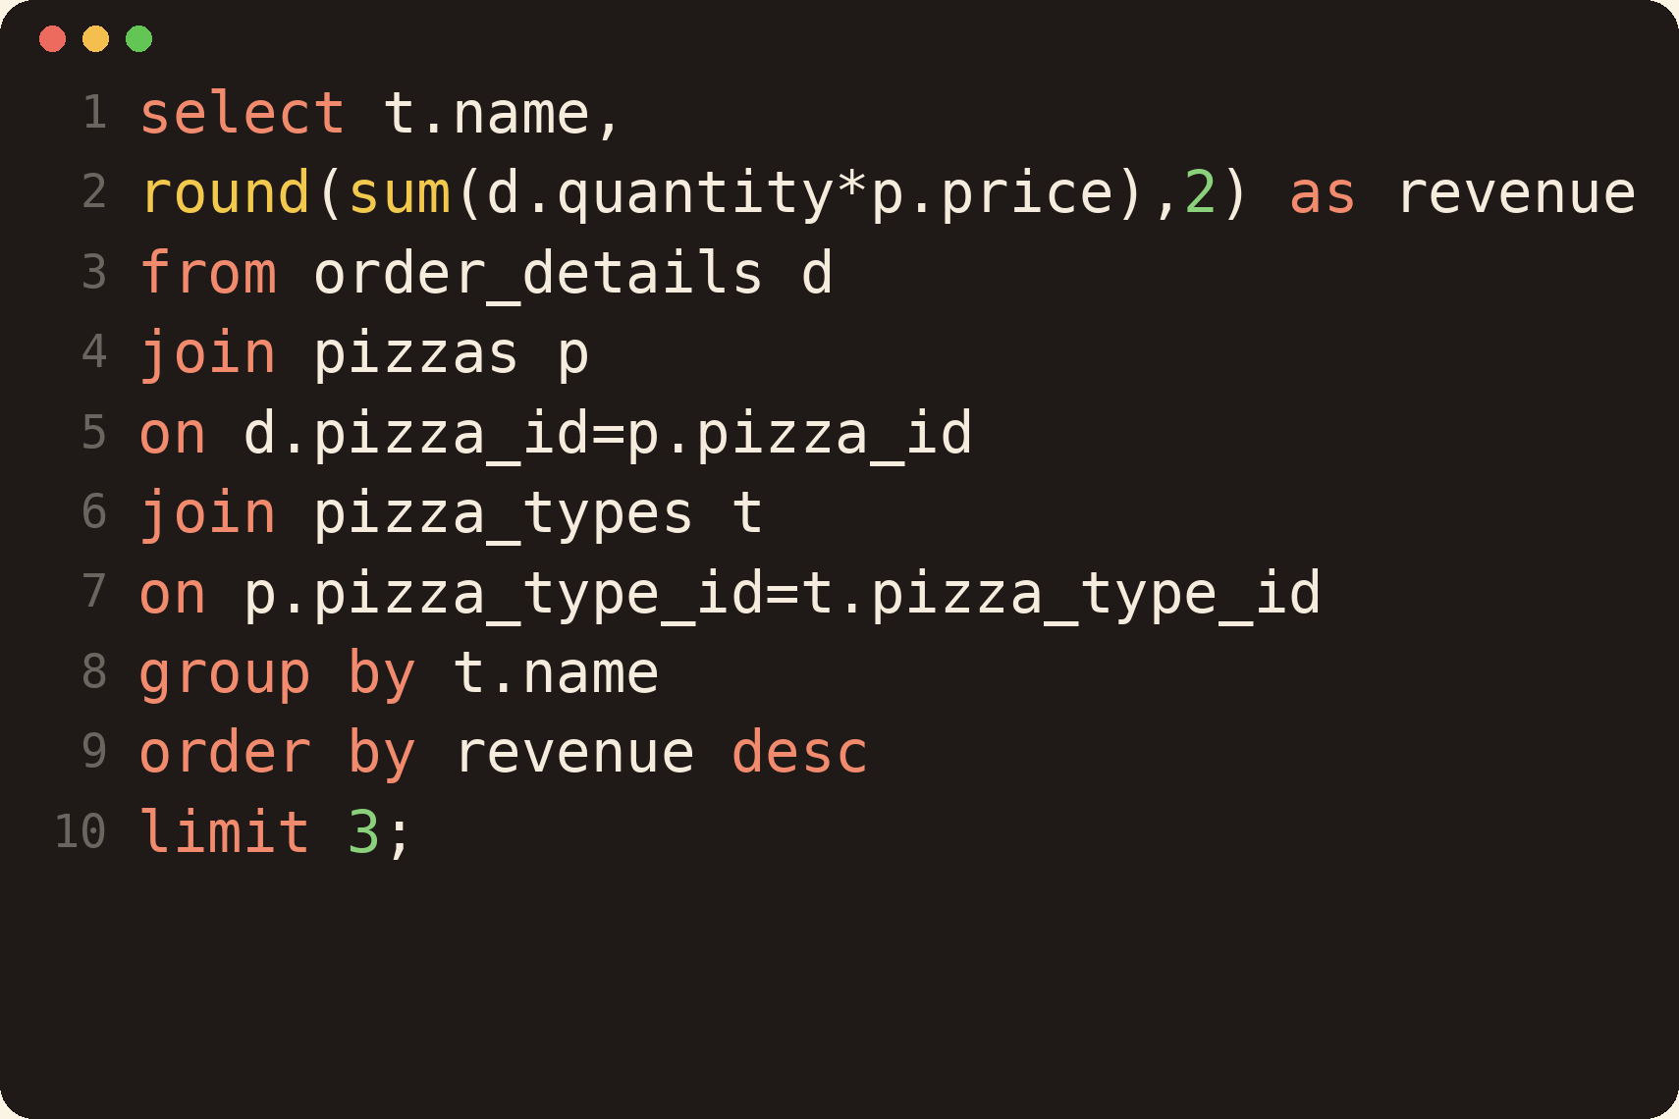
Q10: Top 3 Pizza Types by Revenue
Determine the top 3 most ordered pizza types based on revenue.
How it works
Revenue is quantity x price, summed for every pizza name. Sorting by revenue and limiting to 3 gives the top earners.
Concepts used
JOIN, SUM, ORDER BY, LIMIT
Notes:
How to explain: Revenue is quantity x price, summed for every pizza name. Sorting by revenue and limiting to 3 gives the top earners. Then mention which business question it answers.

Slide 15
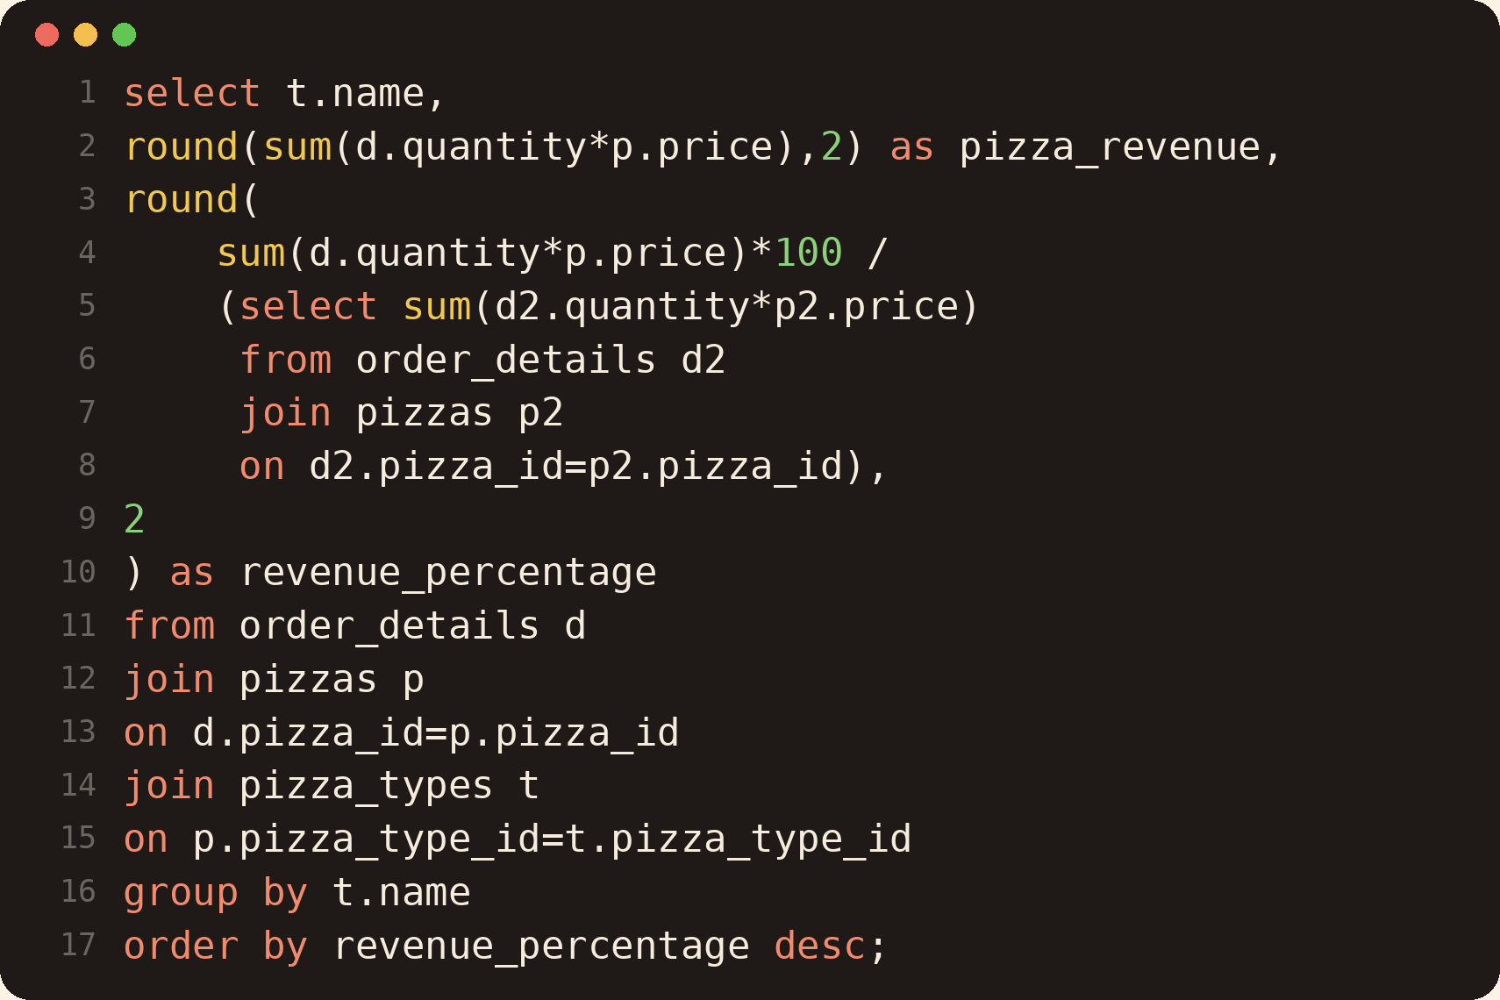
Q11: Revenue Contribution of Each Pizza Type
Calculate the percentage contribution of each pizza type to total revenue.
How it works
The subquery calculates total revenue once. Each pizza's revenue x 100 divided by that total is its percentage share.
Concepts used
Subquery, ROUND, JOIN
Notes:
How to explain: The subquery calculates total revenue once. Each pizza's revenue x 100 divided by that total is its percentage share. Then mention which business question it answers.

Slide 16
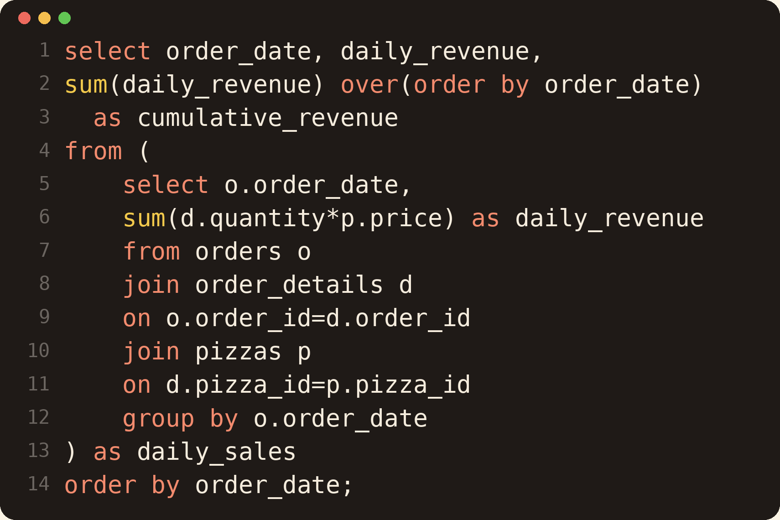
Q12: Cumulative Revenue Over Time
Analyze the cumulative revenue generated over time.
How it works
First I calculate revenue for each day. Then SUM() OVER (ORDER BY order_date) keeps adding the days to give a running total.
Concepts used
Window function, Subquery
Notes:
How to explain: First I calculate revenue for each day. Then SUM() OVER (ORDER BY order_date) keeps adding the days to give a running total. Then mention which business question it answers.

Slide 17
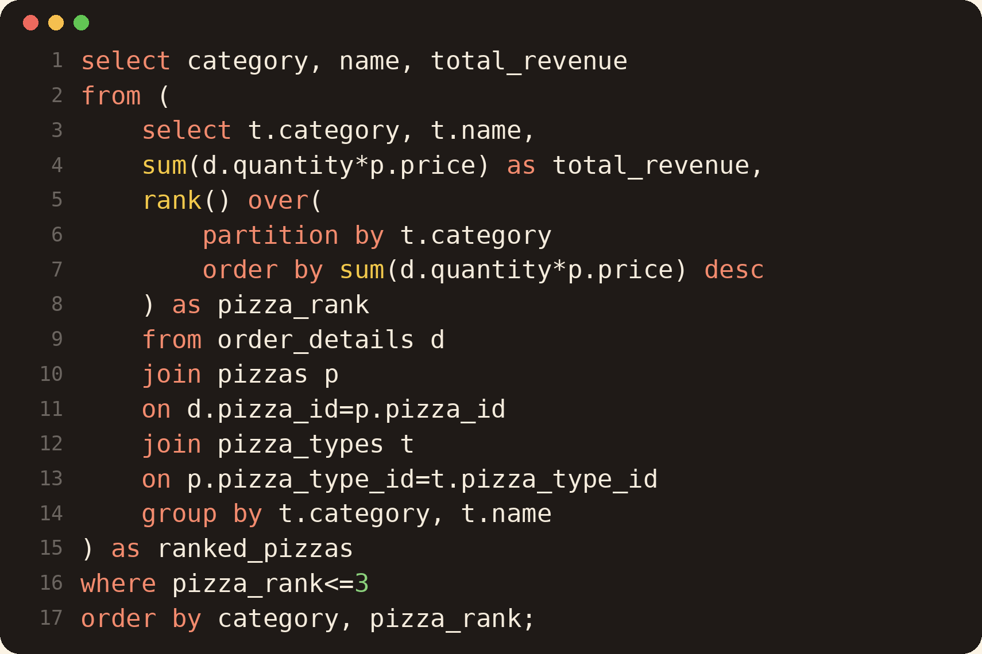
Q13: Top 3 by Revenue in Each Category
Determine the top 3 most ordered pizza types based on revenue for each pizza category.
How it works
RANK() restarts for every category (PARTITION BY). The outer query keeps only the pizzas ranked 1 to 3 in each category.
Concepts used
RANK, PARTITION BY, Subquery
Notes:
How to explain: RANK() restarts for every category (PARTITION BY). The outer query keeps only the pizzas ranked 1 to 3 in each category. Then mention which business question it answers.

Slide 18
Key Learnings
Joins
Aggregation
Combining up to 3 tables to reach pizza names and prices
SUM, COUNT, AVG and GROUP BY for business totals
Subqueries
Window functions
Inner queries for daily totals and overall revenue
RANK and SUM OVER for rankings and running totals
Date and time
Business thinking
HOUR() and grouping by date for trends
Finding best sellers, peak hours and revenue share
Next step: build a Power BI dashboard on these results.

Slide 19
THANK YOU
Any questions?

