Slide 1
Beginner Python Code for Snake Game
This presentation provides an introduction to Python code for a snake game.

Slide 2
Introduction
Python code for a snake game
Learn the basics of game development
Suitable for beginners
Fun and interactive

Slide 3
Setting Up the Environment
Import necessary modules
Install Python
Create the game window
Choose a code editor

Slide 4

Creating the Snake
Define the snake class
Initialize snake attributes
Implement snake movement
Handle collisions and boundaries

Slide 5
Adding Game Over Functionality
Reset the game
Detect collisions with the snake's body
Display game over message
Allow the player to play again

Slide 6
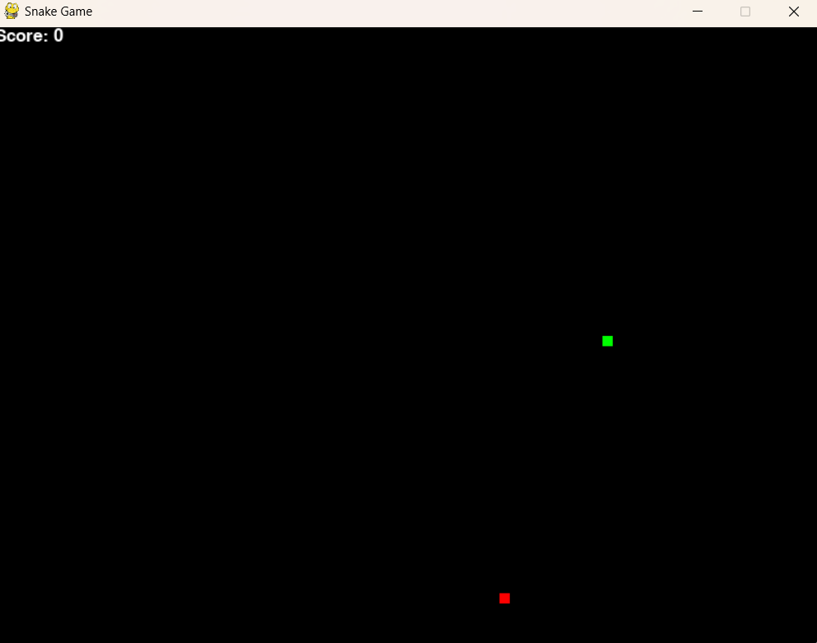
code

Slide 7
Thank you for your time 😊

