Slide 1
Park Recreation Management
Made by Group 6:
Jaynil Jaiswal (17114040)
Peddi Krishna Yeswanth (17114055)
Balwant Singh (17114018)
Akhilesh Kumar (17114007)
Ajay Dayma (17114006)

Slide 2
Problem Statement and Dataset
Data mining on Recreational Park Management. This includes different management related details like Expenditure, Revenue, Events, Ratings ... etc.
We are using three different types of data sets.
These data are collected from official website of New York City Department of Parks and Recreation (NYC park management), portal of Las Vegas.
These data includes Events that are conducted, Budget for different departments from which we extracted data related to park recreations and User Satisfaction for different events.

Slide 3
Events Dataset
Borough: This describes about the Borough in which the event was held
Event Name: Name of the event
Event Type: Type of the event that is being held
Category: Type of activity performed at the event
Classification: Further describes about the event based on category
Audience: Type of population participating in the event
Attendance: Number of participants who attended the event

Slide 4
Budget Dataset
id: Primary key of data
Fiscal_year
Department: Parks and Recreation
Type: General Category of expenditure
Type_Detail: Detailed Category of expenditure
Approved_amount: Amount of money
ExpenseType: Expenditure or Revenue
ObjectId: Foreign key to Original Dataset

Slide 5
Ratings Dataset
ResponseID
EndDate
Satisfaction_Level : 'Poor':0, 'Very Dissatisfied':1, 'Dissatisfied':2, 'Neutral':3, 'Fair':4, 'Satisfied':5, 'Very Satisfied':6, 'Good':7
Program: Event Type
FY: Fiscal Year

Slide 6
Data Preprocessing:-
Events Dataset:-
Firstly, we analyzed the data to remove redundant columns like Unit, Group Name, Date and Time. Then we used the combination of (Event Name, Event Type, Category) to categorize the classes and the events in different classes related to these. After pre-processing, the data contains Borough, Class of Event(extracted from above combination of event information), Audience and Attendance.
Budget Dataset:-
The only preprocessing required was:
To get department “parks and recreation”
Convert dataframe to multiindex dataframe for plotting
Ratings Dataset:-
Converting Satisfaction Level to ordered data(0-7 stars).

Slide 7
Results

Slide 8
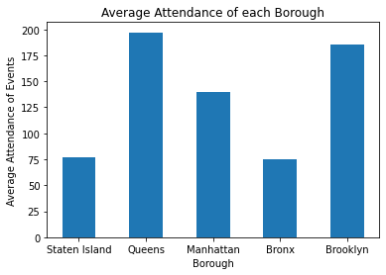
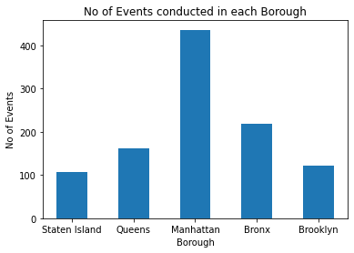
Attendance & Events per Borough

Slide 9
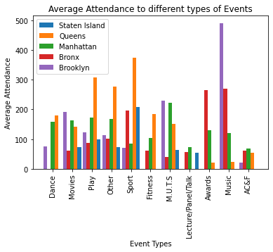
Average Attendance vs Type of Events

Slide 10
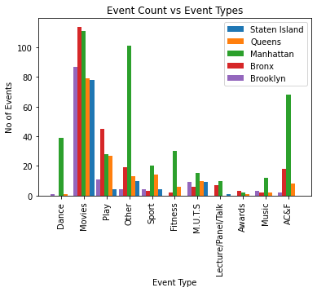
No of Events vs Type of Events

Slide 11
Rule Mining
We are calculating frequent itemsets with candidate items as the type of events and the type of Audience participating in these events to get the idea of which type of event attracts what age group of people, so that we estimate Audience during the next event. These itemsets can be used to generate association rules, which gives us a better understanding of what type of event attracts which age group, which age group of people appear in pairs/ groups.
But the frequency of most of the event types are less than 100, most prevailing events are Movies, Others, Play. We are considering a minimum support count of 100, to calculate the frequent item sets. We are generating rules with a minimum confidence level of 0.3 (so as to allow event types to occur, as the no of Audience far exceed event types).

Slide 12
Non-trivial rules
Trivial rules
('Play',): (('Children',), 0.9217391304347826)
('Children', 'Other'): (('Teens',), 0.9)
('Other', 'Tot'): (('Children',), 0.9807692307692307),
('Adults', 'Other', 'Seniors'): (('Teens',), 0.9532710280373832)
('Adults', 'Other', 'Young Adult'): (('Teens',), 0.9716981132075472)
('Other', 'Seniors', 'Young Adult'): (('Adults',), 0.9901960784313726)
('Adults', 'Other', 'Teens'): (('Children',), 0.9433962264150944)
('Other', 'Seniors', 'Teens'): (('Adults',), 1.0)
('Children', 'Other', 'Teens'): (('Adults',), 0.9259259259259259)
('Children', 'Other', 'Young Adult'): (('Adults', 'Teens'),0.9523809523809523)
('Adults', 'Movies', 'Tot', 'Young Adult'): (('Children', 'Seniors', 'Teens'),1.0),
('Movies', 'Seniors', 'Tot', 'Young Adult'): (('Adults', 'Children', 'Teens'),1.0),
('Adults', 'Movies', 'Teens', 'Tot'): (('Seniors',), 1.0),
('Adults', 'Movies', 'Teens', 'Young Adult'): (('Children', 'Seniors', 'Tot'),1.0),
('Movies', 'Teens', 'Tot', 'Young Adult'): (('Adults', 'Children', 'Seniors'),1.0),
('Movies', 'Seniors', 'Teens', 'Young Adult'): (('Adults', 'Children', 'Tot'),1.0),
('Movies', 'Seniors', 'Teens', 'Tot'): (('Adults',), 1.0),
('Adults', 'Movies', 'Seniors', 'Teens', 'Tot'): (('Children', 'Young Adult'),1.0)

Slide 13
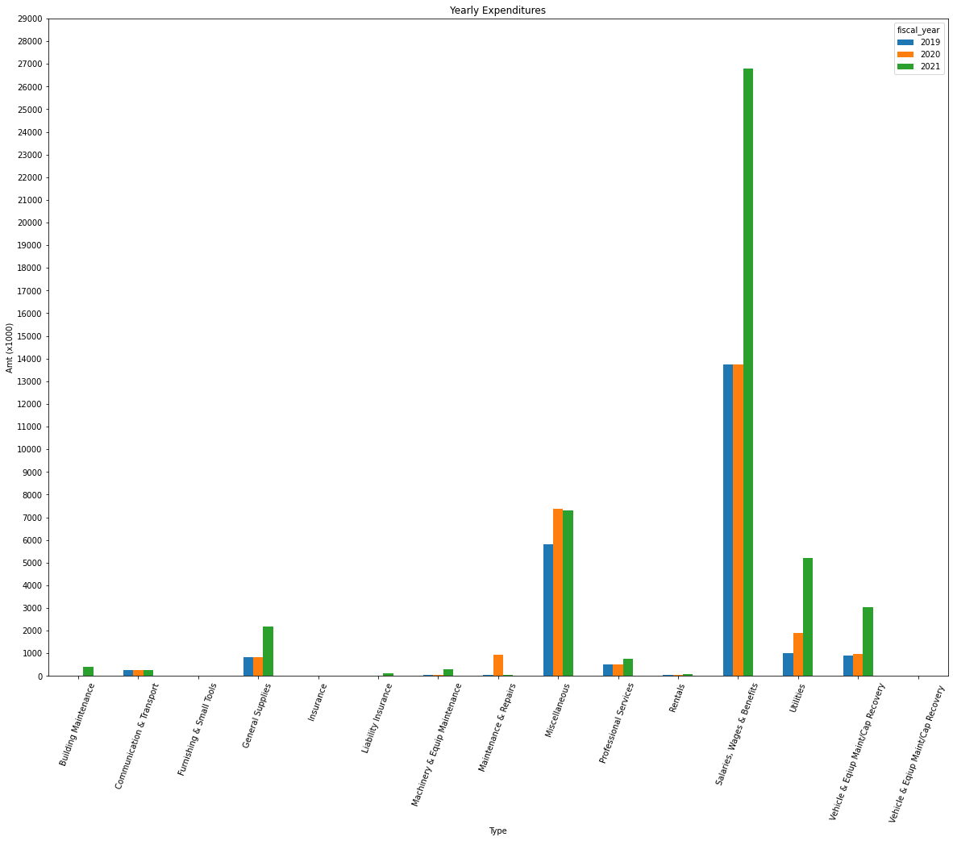
Annual Expenditure Review

Slide 14
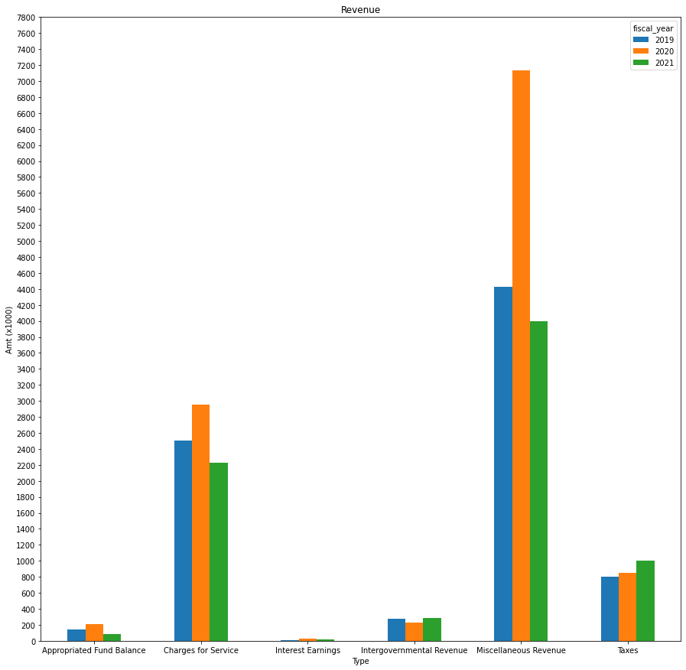
Annual Revenue Review

Slide 15
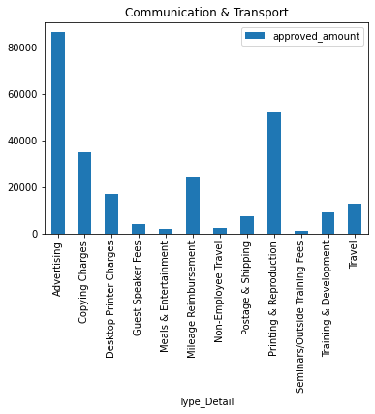
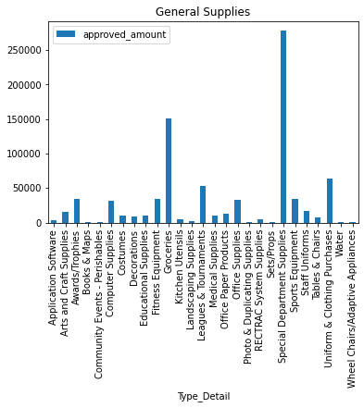
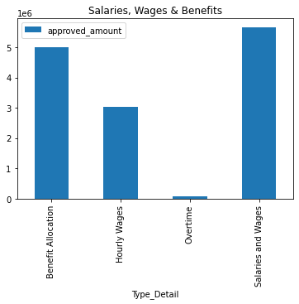
Expenditure Detailed Types

Slide 16
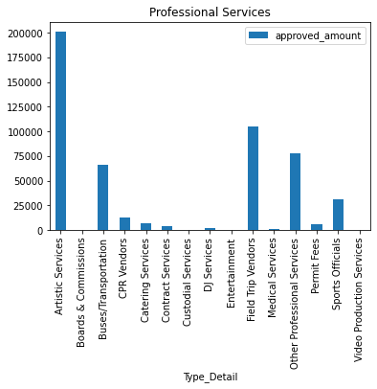
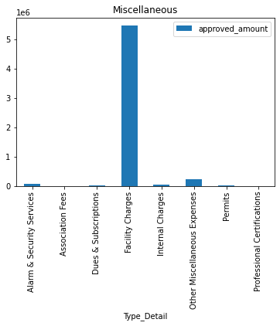

Slide 17
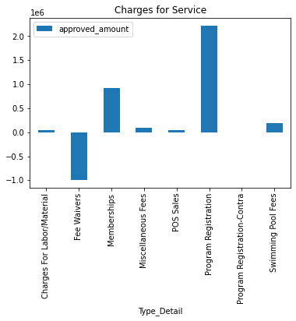
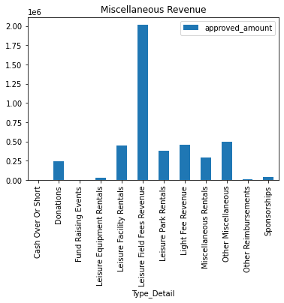
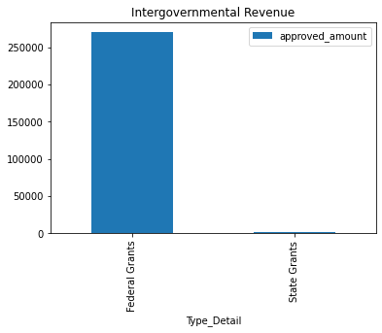
Revenue Detailed Types

Slide 18
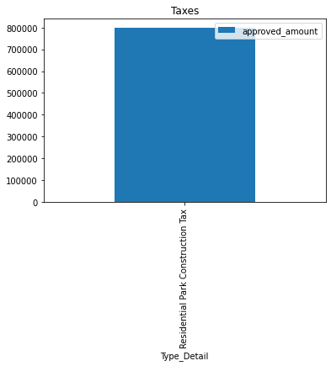
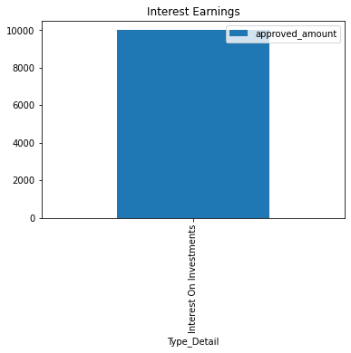
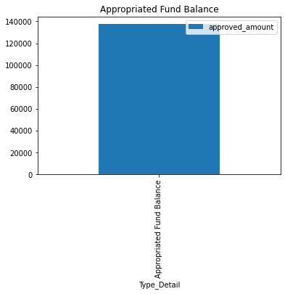

Slide 19
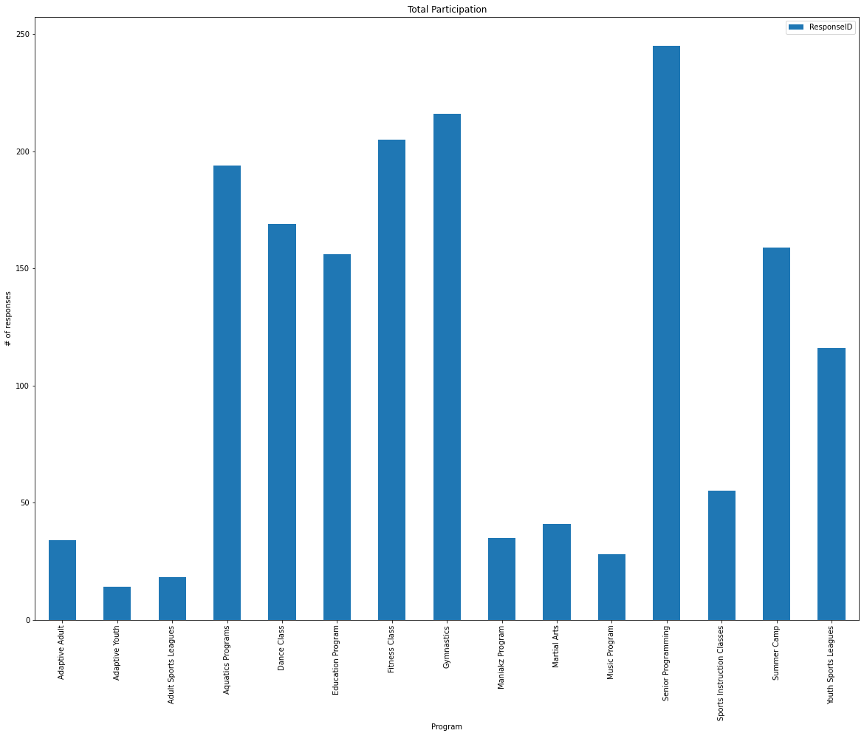
Total participation

Slide 20
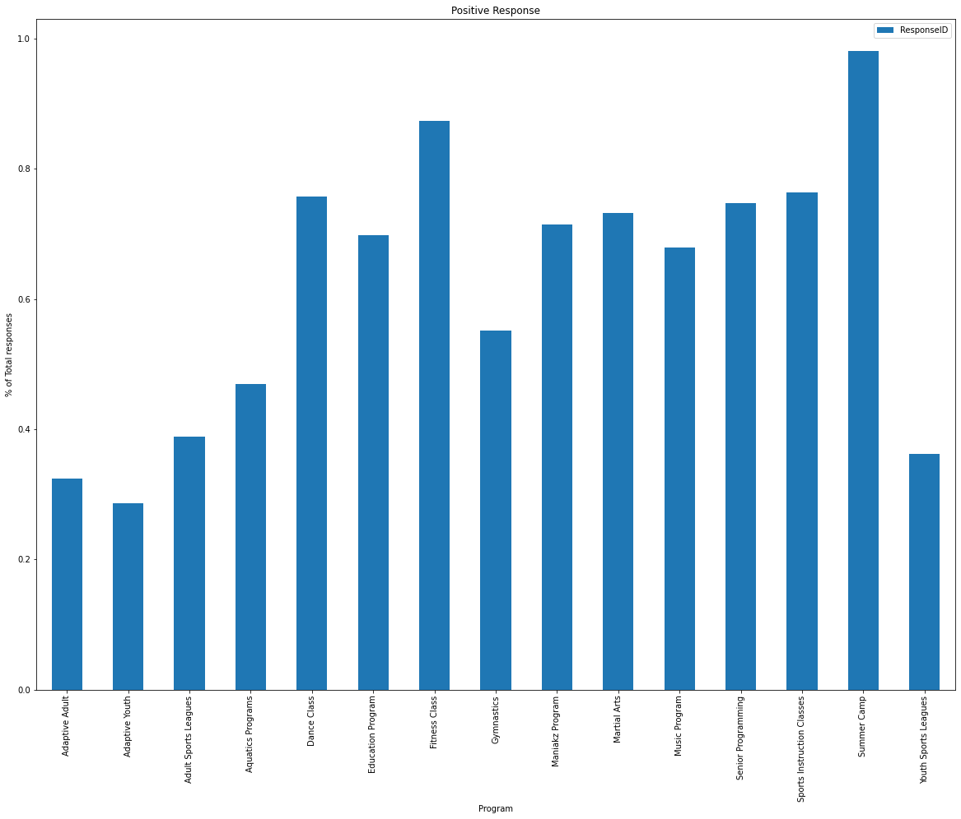
Popular Events

Slide 21
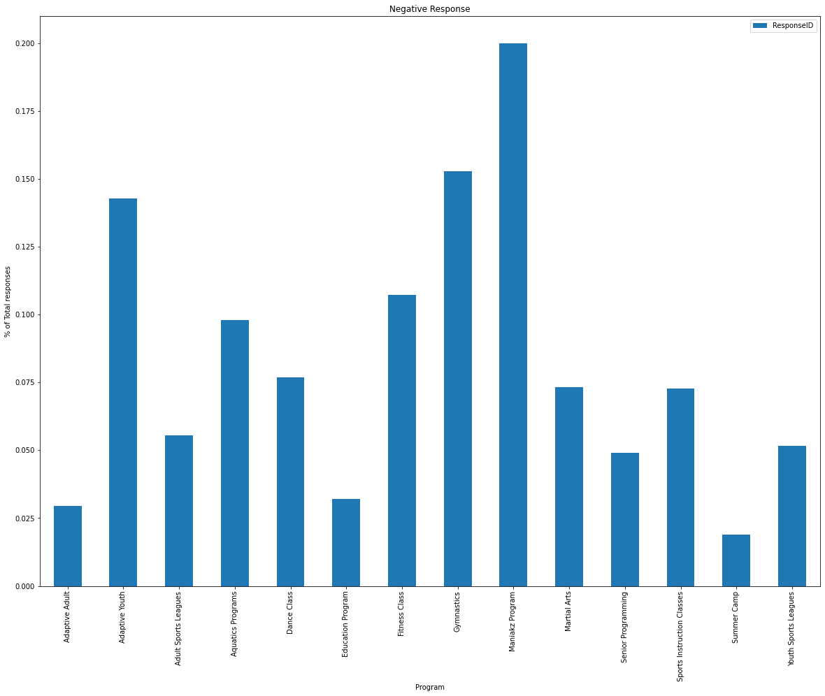
Unpopular Events

Slide 22
Thank You

