Slide 1

SalonSync: Innovative appointment booking system
Presented By :
Rushikesh Jamodkar B191054251
Krishna Poplayat B191054265
Sahil Agrawal B191054203
Krishna Zawar B191054367
Under Guidance of : Prof. Priti Warungse.
NBN Sinhgad Technical Institute Campus
2023-2024 Sem VII

Slide 2
Index
Introduction
Problem Statement and Objectives
Summary of Literature Survey
Methodology Proposed
Algorithms
Advantages and Disadvantages
Result and Discussion
Conclusion
References
NBN Sinhgad Technical Institute Campus
2023-2024Sem VII
Group 3

Slide 3
Introduction
Today is the era of digital technology and the development of technology. The rise of the INTERNET gives a boost in the digital field and India is also accepting it and runs many movements like digital India, UPI money transfer, and many more.
The growth of internet users is increasing day by day and we are well aware of the advantage of the internet. At present, many people run their businesses without any physical setup of their business like digital marketing agency, digital marketing, and many more. There are various types of online websites available, ranging from online E-commerce websites (AMAZON), online trip booking websites (MAKE MY TRIP), online food delivery systems (ZOMATO).
On the other hand, the grooming and beauty business are experiencing growth in the coming year. A beauty salon is an establishment dealing with cosmetic treatments for men and women. Other variations of this type of business include hair salons and spas. Using this platform user can view all the salons which are partner with our salon management system and also view their services.

Slide 4
Problem Statement
The existing manual or outdated systems used by salons are not efficient and user-friendly. Salon staff often struggle with managing appointments, keeping track of customer preferences, and ensuring timely service delivery. Customers also face challenges in booking appointments conveniently, rescheduling, or canceling them.

Slide 5
Objective
To create an engaging and seamless user experience, to provide features such as real-time availability of salon services, personalized recommendations, and easy online payment options.
To enhance customer convenience, increase salon efficiency, and ultimately boost customer satisfaction and loyalty.
To provide a user-friendly platform for customers to easily book appointments, view available services, and manage their salon appointments..
To create a decentralized and secure platform for managing and protecting personal identity information.

Slide 6
Literature Survey
Sr. No | Paper Name | Author Name | Description
1. | BOOKAZOR - an Online Appointment Booking System | Akshay V and Anish Kumar S | Bookazor is an appointment booking and scheduling web-based application which is used for booking appointments in the streams of parlor, hospitals and architects within a defined geographic area. This application is streamlined in an ionic basis. It is an open source SDK for hybrid mobile application development. It provides functionalities like analytics, database, messaging, and crash reporting which helps in focusing the users.
2 | Prototype Development For Online Reservation System in Barbershop and Salon Industry | Hendro Nindito,Maryani | The aim of this research is to analyze and design an online Barbershop and Salon reservation system that suits the needs of its users, Owners and Customers. On the other hand this system can reduce waiting time for each barbershop and salon. The methodology used to analyze system requirements is to compile a list of questions and disseminate with online Google docs and analyze using partial correlation.The data obtained is then processed to get an overview of the need for this system to be developed. As a result of this research, the Online Reservation System is suitable for use to reduce customer waiting time.
Group 3
NBN Sinhgad Technical Institute Campus
2023-2024 Sem VII

Slide 7
Literature Survey
Sr. No | Paper Name | Author Name | Description
3. | Salon Management System | Adarsh Kumar Gulshan, Amir Khan, | A saloon management system is a website that manages the appointment scheduling functionality. This system connects users and Salon in an online platform where user can browse salon and their services. Users can also write and read reviews of the salon and its management. Salon management system helps the industry to fill this void in such a way that is on-demand, easy to use, and effective. The final product will be a functioning web application that can handleuse cases like user account registration, login/logout, appointment scheduling, writing, and reading review for specific salon.
4. | QVID: AI based Salon Booking Application | Asha S,Vaibhav Nair and Neeraj Sagar | The current pandemic is restricting the scope of human crowding at places which otherwise seemed to be normal. Safety of the highest order being followed, a common man now has to think twice before proceeding for the most basic of chores, like getting a haircut. The appointment booking system is a custom which has always existed in the community, butseldom used, except for the time-conscious individuals.
NBN Sinhgad Technical Institute Campus
2023-2024 Sem VII
Group 3

Slide 8
Methodology
Gather detailed requirements from stakeholders, including salon owners, staff, and potential users. Gather feedback from stakeholders to refine the design, ensuring intuitive navigation and user-friendly interactions. Choose appropriate technologies and development tools for Android application development. Adopt an agile development methodology, breaking the project into smaller prints with specific tasks and goals. Foster collaboration among developers, designers, and stakeholders to ensure alignment between technical implementation and user expectations. Implement automated testing procedures to validate the application’s functionality, performance, and security.

Slide 9
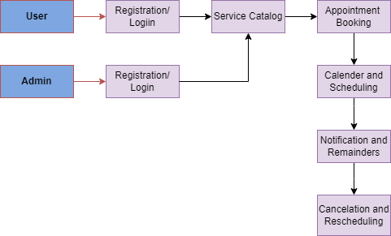
Flowchart

Slide 10
1. User Registration and Profiles:
User registration and login functionality to create and manage individual profiles for salon customers and staff.
Allow users to edit their profiles and add relevant information such as contact details, preferred services, and stylist preferences.
2. Service Catalog:
Display a comprehensive catalog of salon services, including haircuts, styling, coloring, manicures, pedicures, facials, etc.
Each service should have a detailed description, price, duration, and availability.
3. Appointment Booking:
A user-friendly interface that allows customers to easily browse available time slots for services and book appointments.
Real-time availability updates to prevent double bookings and conflicts.
Option to select preferred stylist or technician for specific services.
4. Calendar and Scheduling:
An interactive calendar to view booked and available time slots for each stylist or technician.
Allow users to schedule appointments for a future date and time.
5. Notifications and Reminders:
Push notifications and reminders to remind users of upcoming appointments.
Option to enable email or SMS notifications for added convenience.
6. Cancelation and Rescheduling:
Allow users to cancel or reschedule appointments with a straightforward process.
Set policies for cancelations and handling of any associated fees.

Slide 11
Algorithms
1.Scheduling Algorithm:
Greedy Algorithm: Assigns appointments to available staff in a way that maximizes the utilization of resources without considering future bookings. For example, selecting the earliest available time slot for each booking.
2.Search and Recommendation Algorithm:
TF-IDF (Term Frequency-Inverse Document Frequency): Used for keyword-based search. It calculates the relevance of a service or stylist based on the frequency of keywords in their description compared to the overall frequency in the database.
3.Notification Algorithm:
Push Notification Service: Utilizes algorithms to deliver notifications to users based on factors like time zone, user preferences, and relevance of the notification. Queuing Algorithms (e.g., FIFO): Ensures that notifications are sent in the order they are scheduled, maintaining fairness and timely delivery.
4.Feedback and Rating Algorithm:
Sentiment Analysis: Analyzes feedback text to determine the sentiment (positive, negative, neutral) and extract key insights.
Collaborative Filtering with Matrix Factorization: Updates service or stylist ratings based on feedback from users, adjusting recommendations accordingly.
5.Resource Allocation Algorithm:
Max-Flow Min-Cut Algorithm: Models the allocation of resources as a flow network problem, optimizing the allocation of staff time and service slots.

Slide 12
Advantages
Seamless Scheduling: Salon Sync ensures efficient and error-free appointment management, minimizing scheduling conflicts.
24/7 Accessibility: Clients can book appointments anytime, enhancing convenience and reducing reliance on traditional phone-based booking.
Integrated POS: Seamlessly integrates with point-of-sale systems for efficient invoicing and consolidated tracking of sales and appointments.
Automated Reminders: The system sends timely reminders, reducing no-shows and fostering a consistent revenue stream for the salon.
Resource Optimization: Salon owners can optimize staff schedules based on booking trends, maximizing operational efficiency.

Slide 13
Disadvantages
Technical Glitches: Potential system errors or downtime could disrupt the booking process, leading to customer frustration.
Dependency on Technology: Reliance on digital platforms may exclude clients uncomfortable with technology, limiting the customer base.
Data Security Concerns: Storing sensitive client information online poses a risk of data breaches, compromising privacy and trust.
Training Overhead: Staff may require additional training to adapt to the new system, causing a temporary decrease in efficiency.
Internet Reliance: The system's effectiveness depends on a stable internet connection, making it susceptible to disruptions in areas with poor connectivity.
Customization Challenges: Meeting diverse salon needs might be challenging, as the app's features may not align perfectly with every business model.

Slide 14
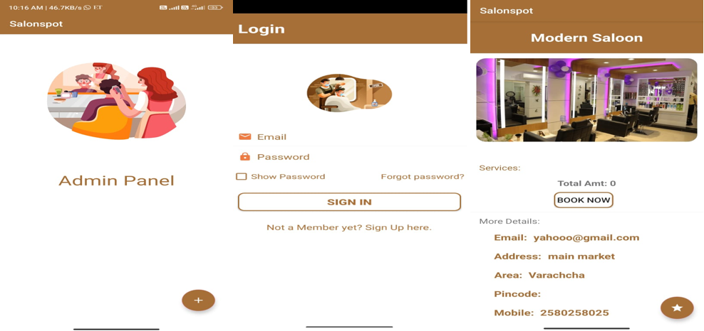
Result and Discussion

Slide 15
Future Scope
The future scope for Salon Sync, an innovative appointment booking system project, can be vast and promising. Here are several potential areas for future development and expansion:
Feature Enhancements:
Continuously improve and add new features to enhance the user experience for both salon owners and clients. This could include features like virtual consultations, personalized recommendations, and loyalty programs.
Mobile App Development:
Develop mobile applications for both Android and iOS platforms to make the booking process even more accessible for users on the go. Ensure that the app is user-friendly and provides a seamless experience.
Integration with Emerging Technologies:
Explore integration with emerging technologies such as augmented reality (AR) for virtual hairstyling consultations or virtual reality (VR) to create a unique and immersive experience for clients.
AI and Machine Learning Integration:
Implement AI and machine learning algorithms to analyze customer preferences, suggest personalized services, and optimize appointment schedules based on historical data and trends.
Blockchain for Security:
Consider integrating blockchain technology to enhance security and transparency in transactions and data management. This can build trust among salon owners and clients by ensuring the integrity of the booking system.

Slide 16
Conclusion
Based on the survey of Android-based salon appointment booking applications, the conclusion is that users highly value features such as easy appointment scheduling, real-time availability, a variety of salon options, user reviews and ratings, and secure payment options. Additionally, a user-friendly interface and seamless navigation are essential for a positive user experience.
Incorporating these features will likely attract more users and enhance the overall usability of the application. The current system addresses the limitations of the existing system by providing a more comprehensive and user-centric experience. Users now have more choices, simplified appointment booking, real-time availability updates, access to reviews and ratings, and convenient payment options. The interface and navigation have been improved for a smoother user journey. Overall, the current system offers enhanced functionality and a more satisfying user experience.
NBN Sinhgad Technical Institute Campus
2023-2024 Sem VII
Group 3

Slide 17
References
[1] Gunther Eysenbach “Web-Based Medical Appointment Systems”, J Med Internet Res. 2020.
[2] Arthur Hylton III and Suresh Sankaranarayanan “Application of Intelligent Agents in Hospital Appointment Scheduling System”, International Journal of Computer Theory and Engineering, Vol. 4, No. 4, August 2020.
[3] S. Sri Gowthem, K.P. Kaliyamurthie “Smart Appointment Reservation System”, International Journal of Innovative Research in Science, Engineering and Technology Vol. 4, Issue 6, June 2020.
[4] Shelar Pooja, Hande Nilima, Dhamak Prajakta, Hingane Nisha, Jadhav Vinayak “SMART APPOINTMENT GENERATION FOR PATIENT”,International Journal of Advance Engineering and Research Development, Technophilia-2019.
[5] Chutisant Kerdvibulvech , Nwe ni win ,2021,the dentist online reservation system design and implementation web based application and database management system project international conference on education technology and computer (icetc2021) IPCSIT VOL.43 (2021) IACSIT press, Singapore.

Slide 18
Thank You

